Slide 1
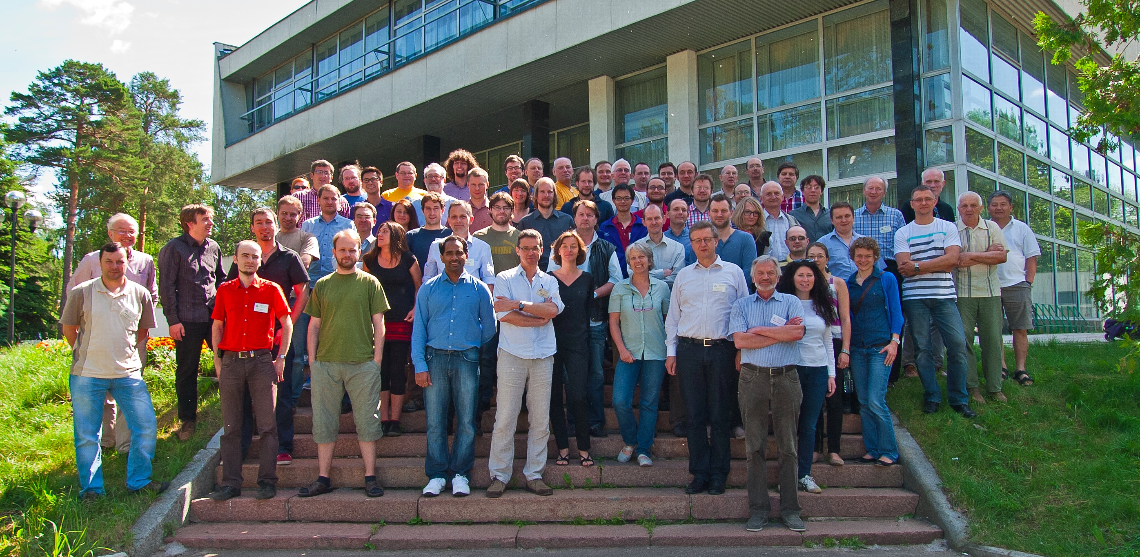
GERDA Collaboration: the first results on neutrinoless double beta decay of 76Ge from Phase I
Kornoukhov Vasily (ITEP&INR RAS)
for the GERDA collaboration
International Session-Conference of Nuclear Physics section RAS
November 6th, 2013

Slide 2
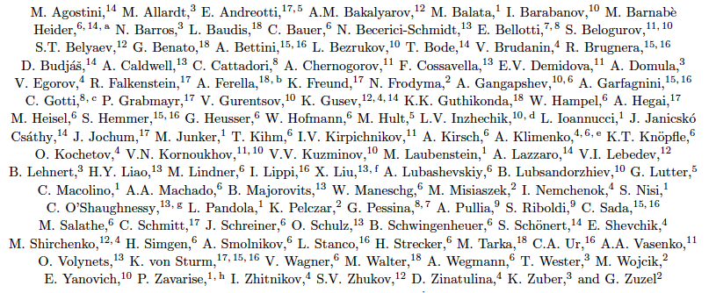
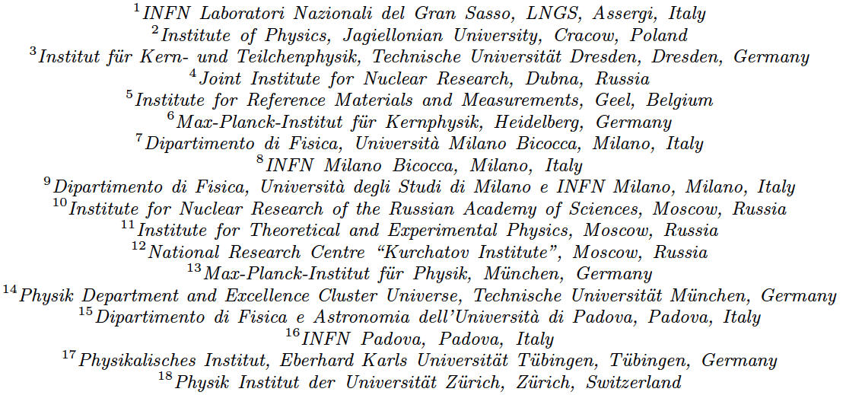
The GERDA collaboration
~ 100 members
18 institutions
6 countries

Slide 3
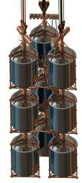
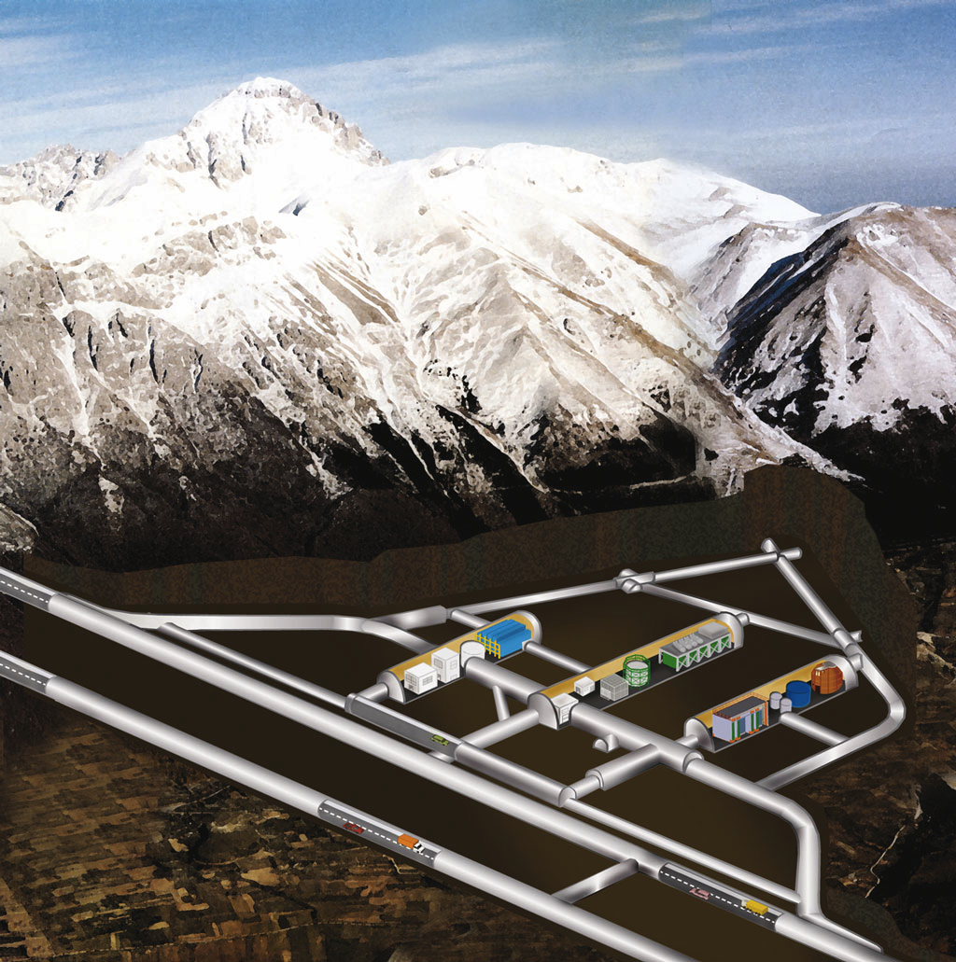
The GERDA searches for 0νββ-decay ⁷⁶Ge → ⁷⁶Se + 2 e⁻
- idea Gerd Heusser 1995
- GERDA proposal 2004
- construction 2006-2010
- commissioning 2010-11
- physics data Phase I 2011-13
GERDA @ LNGS
‘Bare’ ^{enr}Ge array in liquid argon
Shield: high-purity liquid Argon / H₂O
Phase I: 18 kg (HdM/IGEX)
Phase II: add ~20 kg new enriched detectors

Slide 4
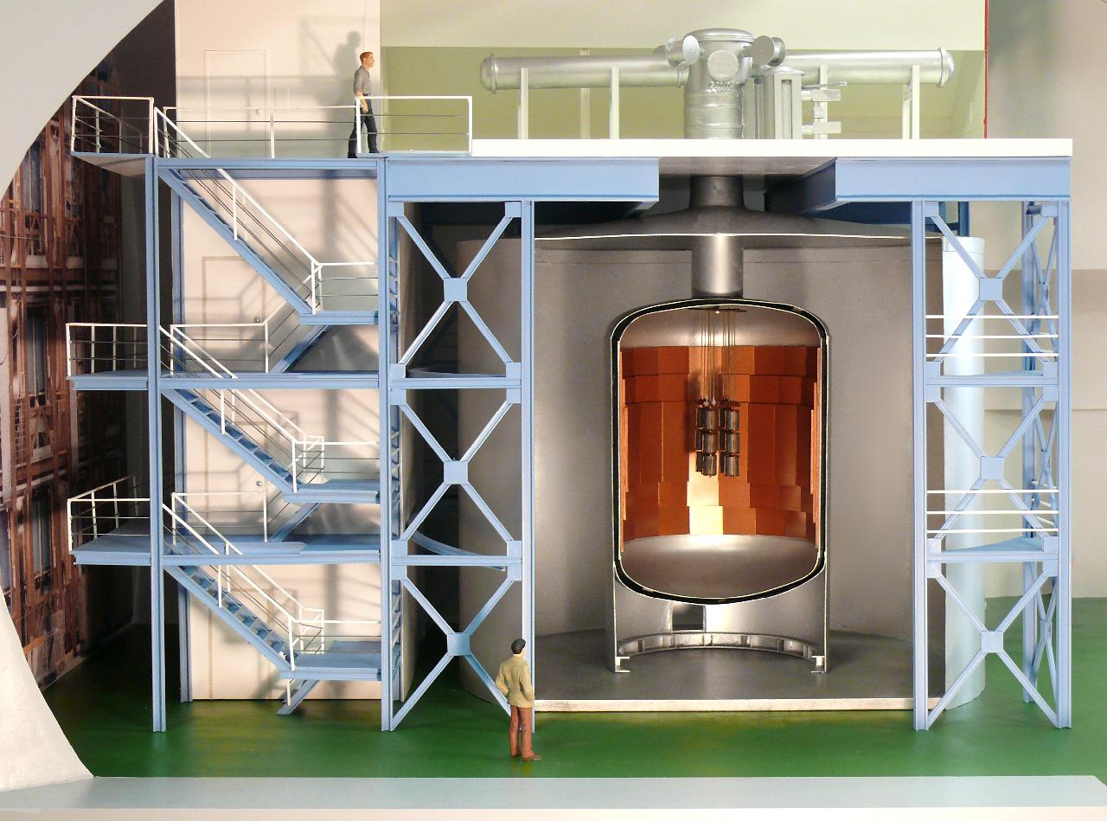
Artists view of the GERDA detector
plastic μ-veto
Eur. Phys. J. C (2013) 73:2330
clean room with lock and glove box for detector handling
muon & cryogenic
infrastructure
cryostat, Ø4m,
with internal
Cu shield
64 PMT
Cherenkov veto
control rooms
Ge-detector array
(enriched in ⁷⁶Ge)
water plant &
radon monitor
LAr: 64 m³
water tank, Ø10m,
part of muon-veto detector

Slide 5
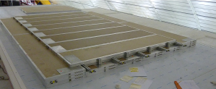
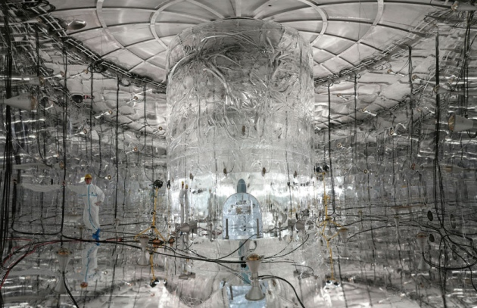
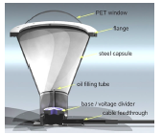
Water Cherenkov detector and plastic scintillator muon veto
Eur. Phys. J. C (2013) 73:2330
arXiv:1212.4067
64 PMT
Overall muon
reject efficiency
ε = 0,991

Slide 6
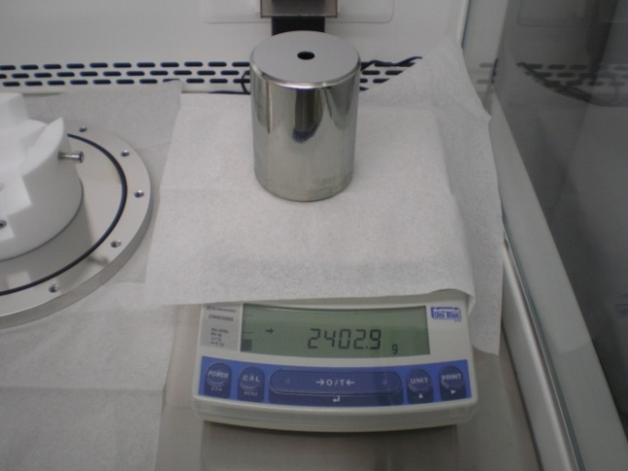
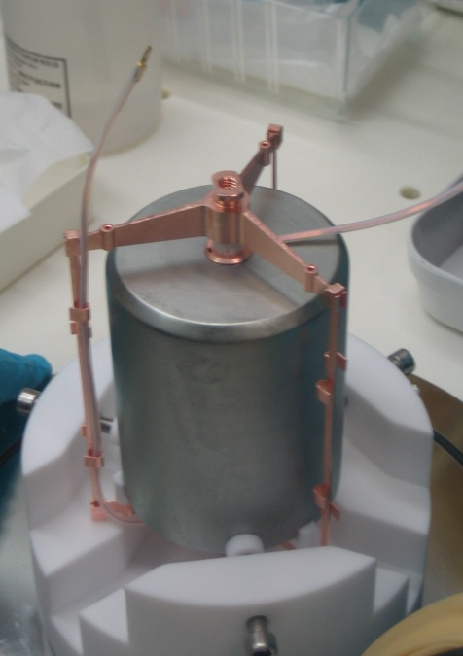
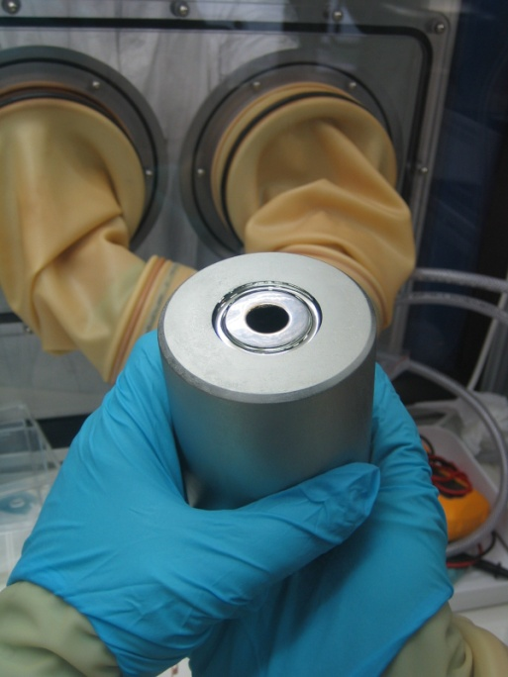
Phase I detectors: semi-coaxial detectors
Eur. Phys. J. C (2013) 73:2330
arXiv:1212.4067
8 diodes (from HdM, IGEX):
Enriched 86% in ⁷⁶Ge
Total mass 17.66 kg
HdM & IGEX diodes reprocessed at Canberra, Olen
Long term stability
in LAr w/o passivation layer
Energy resolution in LAr:
~2.5 keV (FWHM) @1.3 MeV
  6 diodes from Genius-TF:
  ^{nat}Ge
  Total mass: 15.60 kg

Slide 7
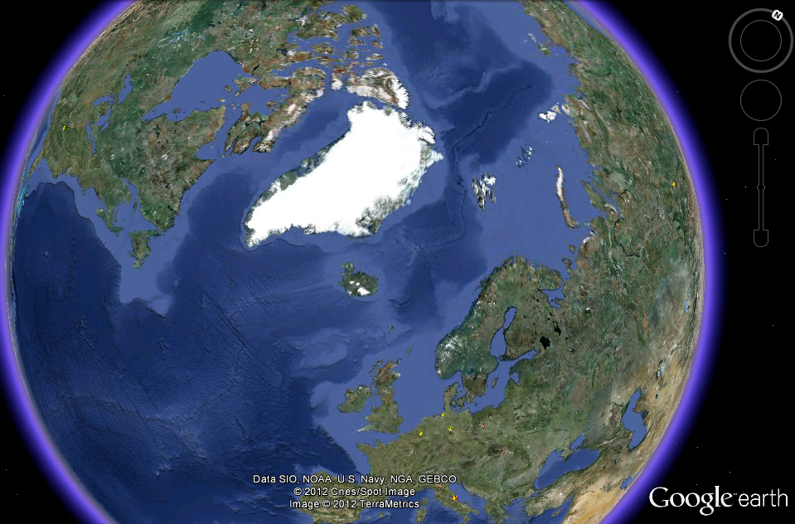
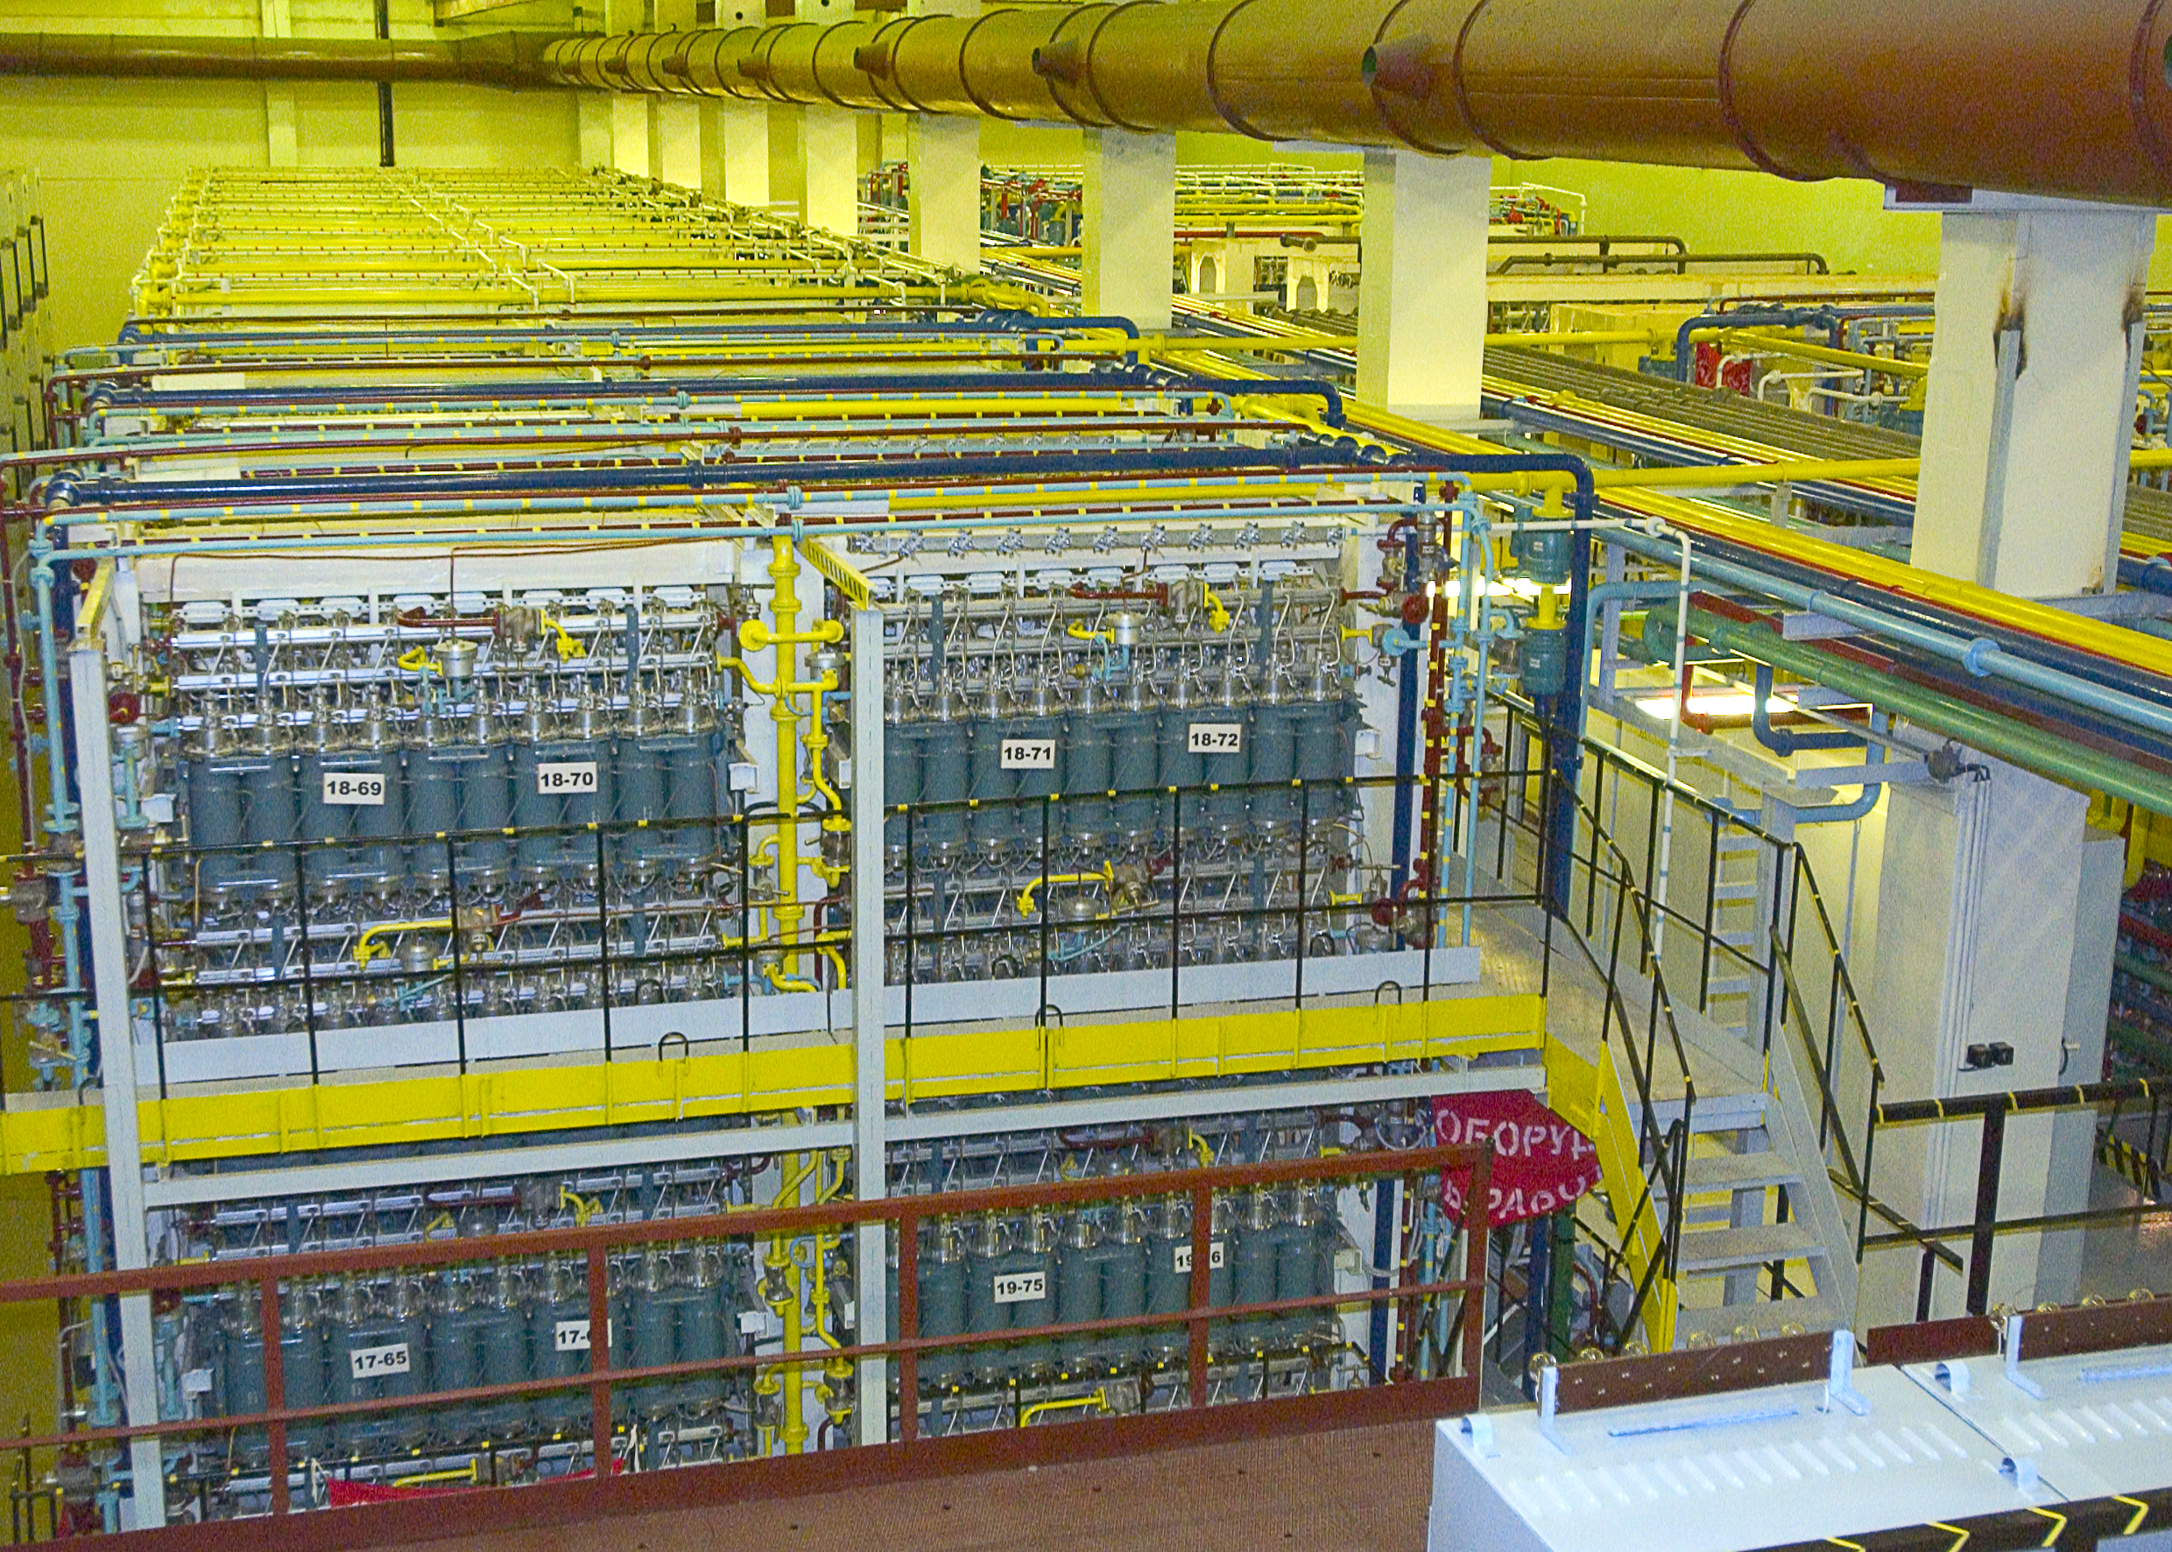
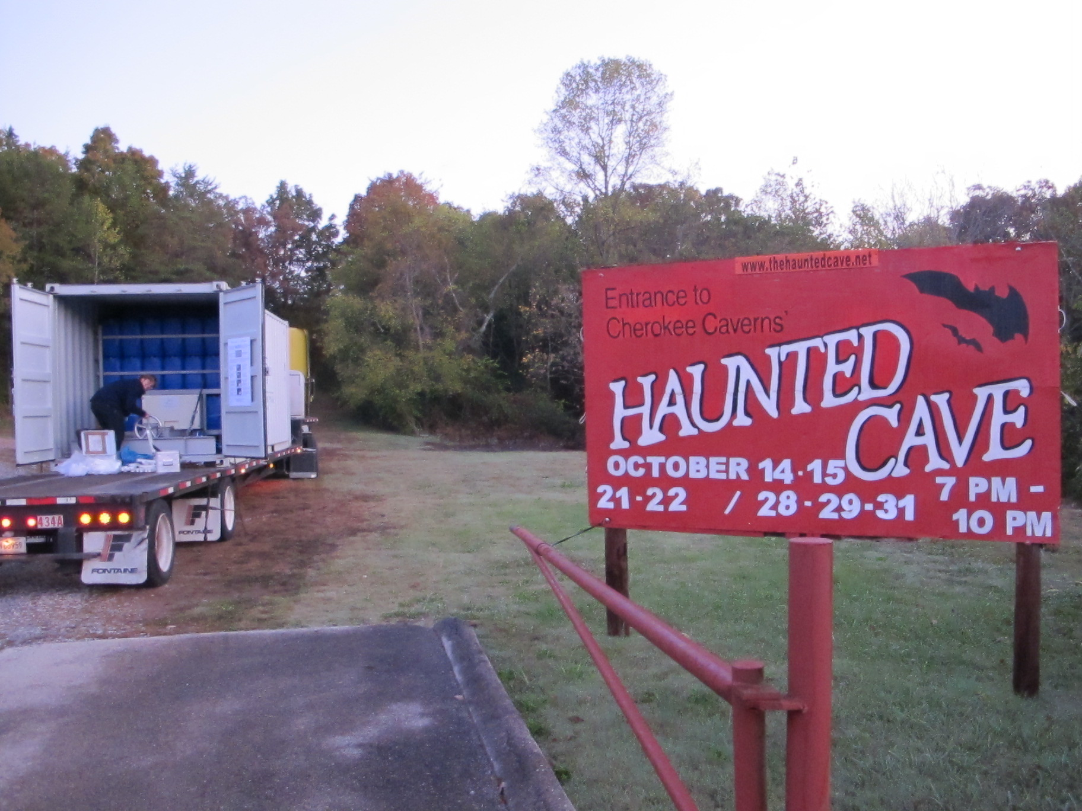
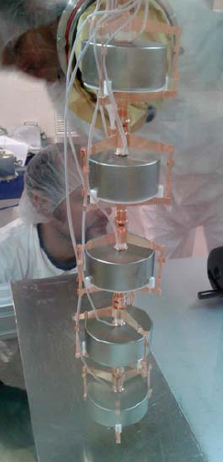
Production of ^{enr}Ge Phase II detectors
Canberra, Oak Ridge
ECP
Transports in shielded container, storage underground
PPM Pure Metals
Canberra,
Olen
→ 5 working HP^{enr}Ge detectors mounted in GERDA, LNGS

Slide 8
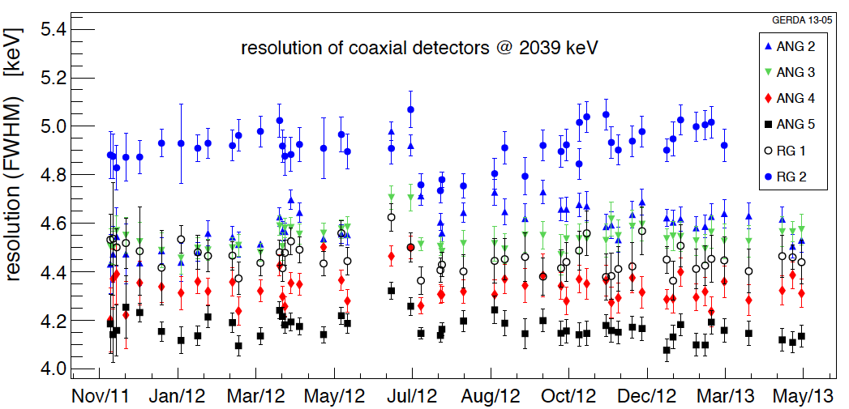
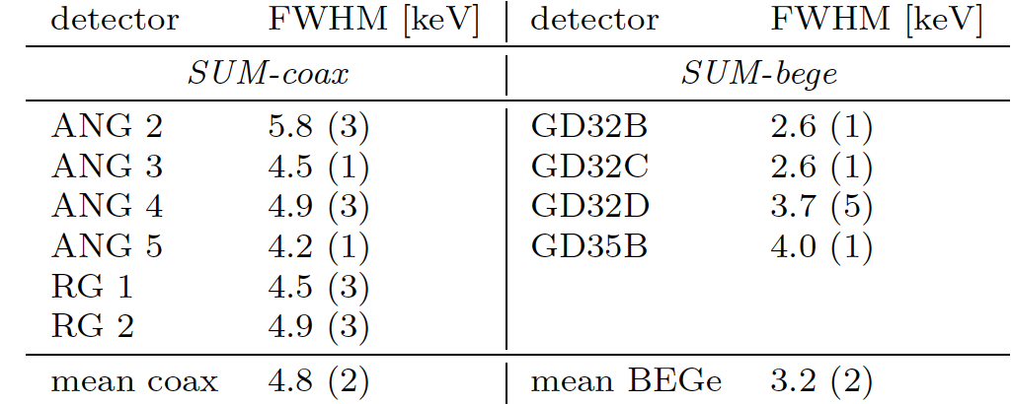
Energy calibration & data processing of HPGe detectors
weekly calibrated spectra with 228Th sources and pulser with 0.05 Hz frequency
data useful for monitoring of resolution and stability over time
FWHM at Q_{ββ} is about 4.8 keV for Coaxials (0.23%) and 3.2 keV (0.16%) for BEGes
arXiv 1212.4067
Summing all runs:
Peak position stability of 2614.5 keV calibration line: coax: 1.5 keV / BEGe: 1.0 keV (FWHM)
arXiv:1306.5084
Energy resolution of coax detectors at 2039 keV
Data processing: diode → amplifier → FADC → digital filter → energy, pulse shape,...
Data selection: anti coincidence + quality cuts + pulse shape discrimination
(total fraction of accepted events = 65%)

Slide 9
Measurement of T^{2ν}_{1/2} (⁷⁶Ge)
(with 5.04 kg yr exposure)
T^{2ν}_{1/2}(⁷⁶Ge) = (1.84^{+0.14}_{-0.10}) ∙ 10²¹ yr
LAB Talk of J. Phys. G Feb. 2013 issue:
http://iopscience.iop.org/0954-3899/labtalk-article/52398

Slide 10
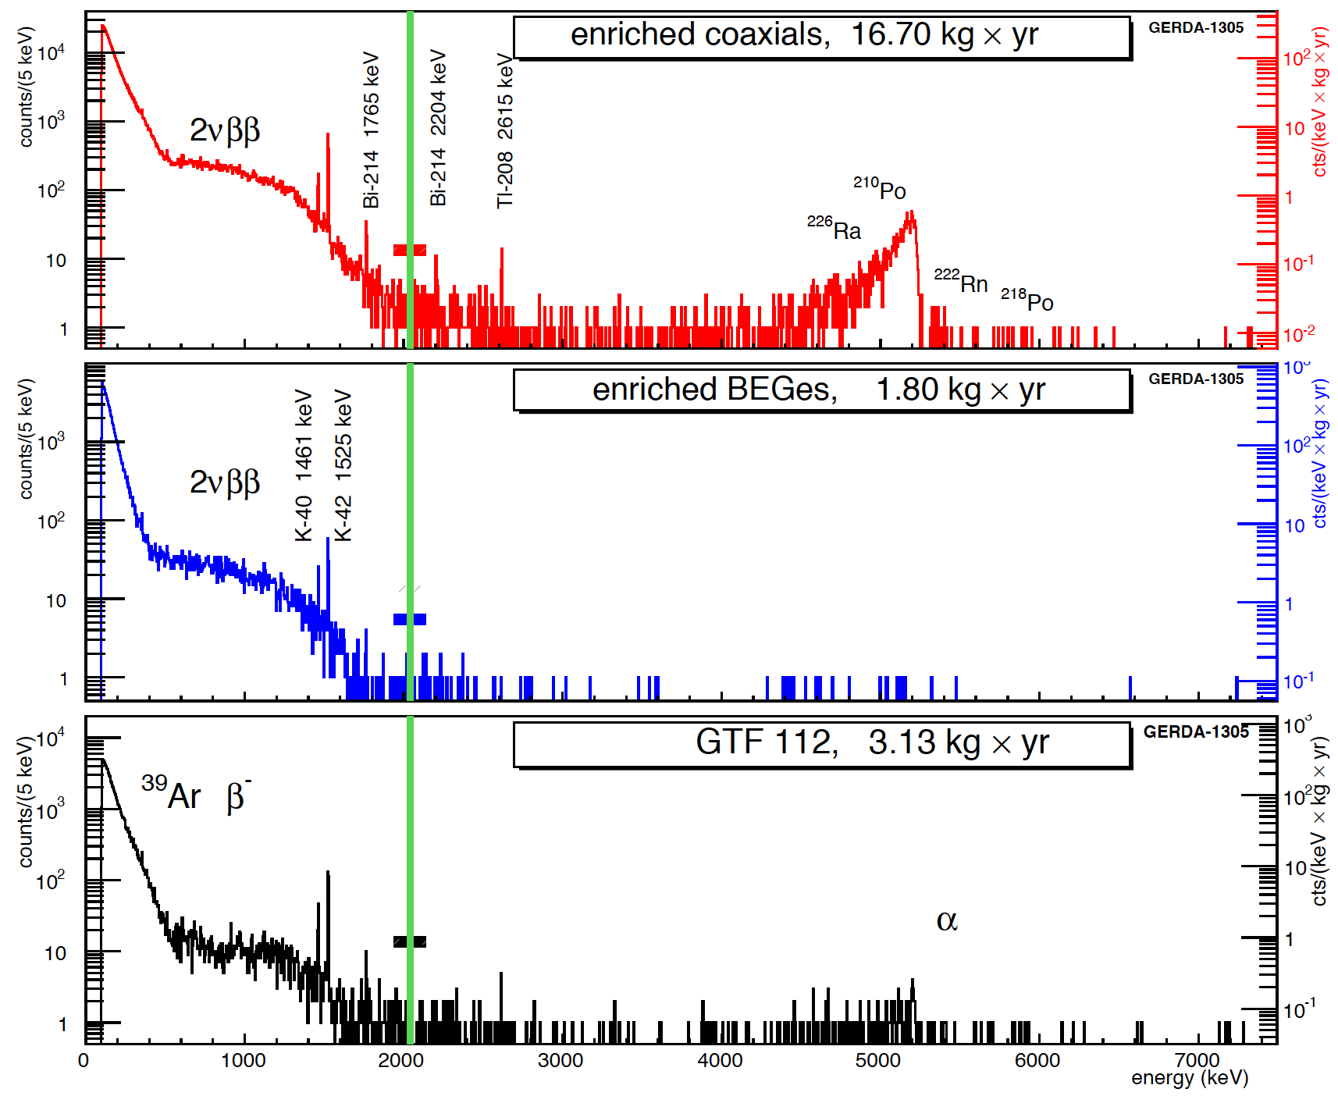
Physics energy spectra
arXiv:1306.5084
Phase I data split into 3 sets
- “golden coax” = 17.9 kg yr
all semi-coax data but 4 weeks
- “silver coax” = 1.3 kg yr
4 weeks when BEGe inserted
- “BEGe” = 2.4 kg yr
background level:
 | GERDA | HdM
2615 keV [cts/(kg yr)] | 1,1+/-0,3
1764 keV [cts/(kg yr)] | 3,3+/-0,5
avg@Q_{ββ} [cts/(kev kg yr)] | 0,018+/-0,002¹ | 0,17+/-0,05²
natural
1 “golden coax” in 1930 – 2190 keV
2 1995-2003 data, 2000 – 2100 keV
Blinding window
Q_{ββ}+/-20 keV

Slide 11
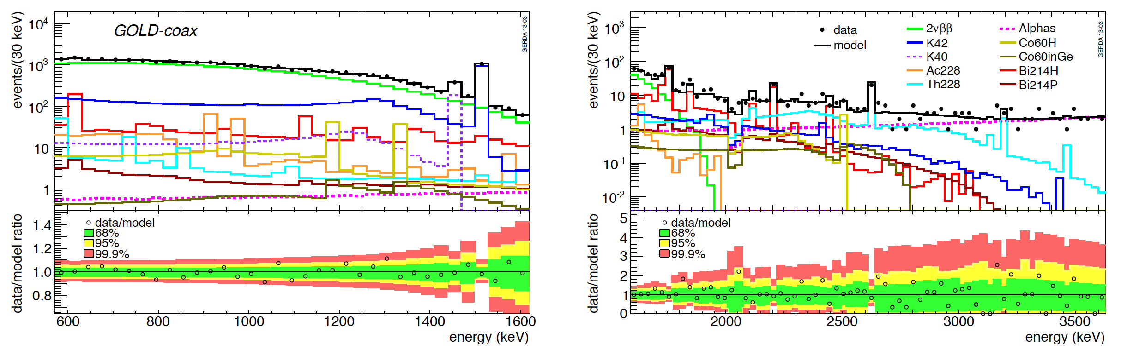
Background model
arXiv:1306.5084
- simulate known & observed backgrounds
- fit combination of MC spectra to data
in interval 570 keV – 7500 keV
→ relative contribution of backgrounds
- no unique determination
“Close” background sources dominate:
⁴²Ar, ²²⁸Th & ²²⁶Ra in holder,
α on detector surface.

Slide 12
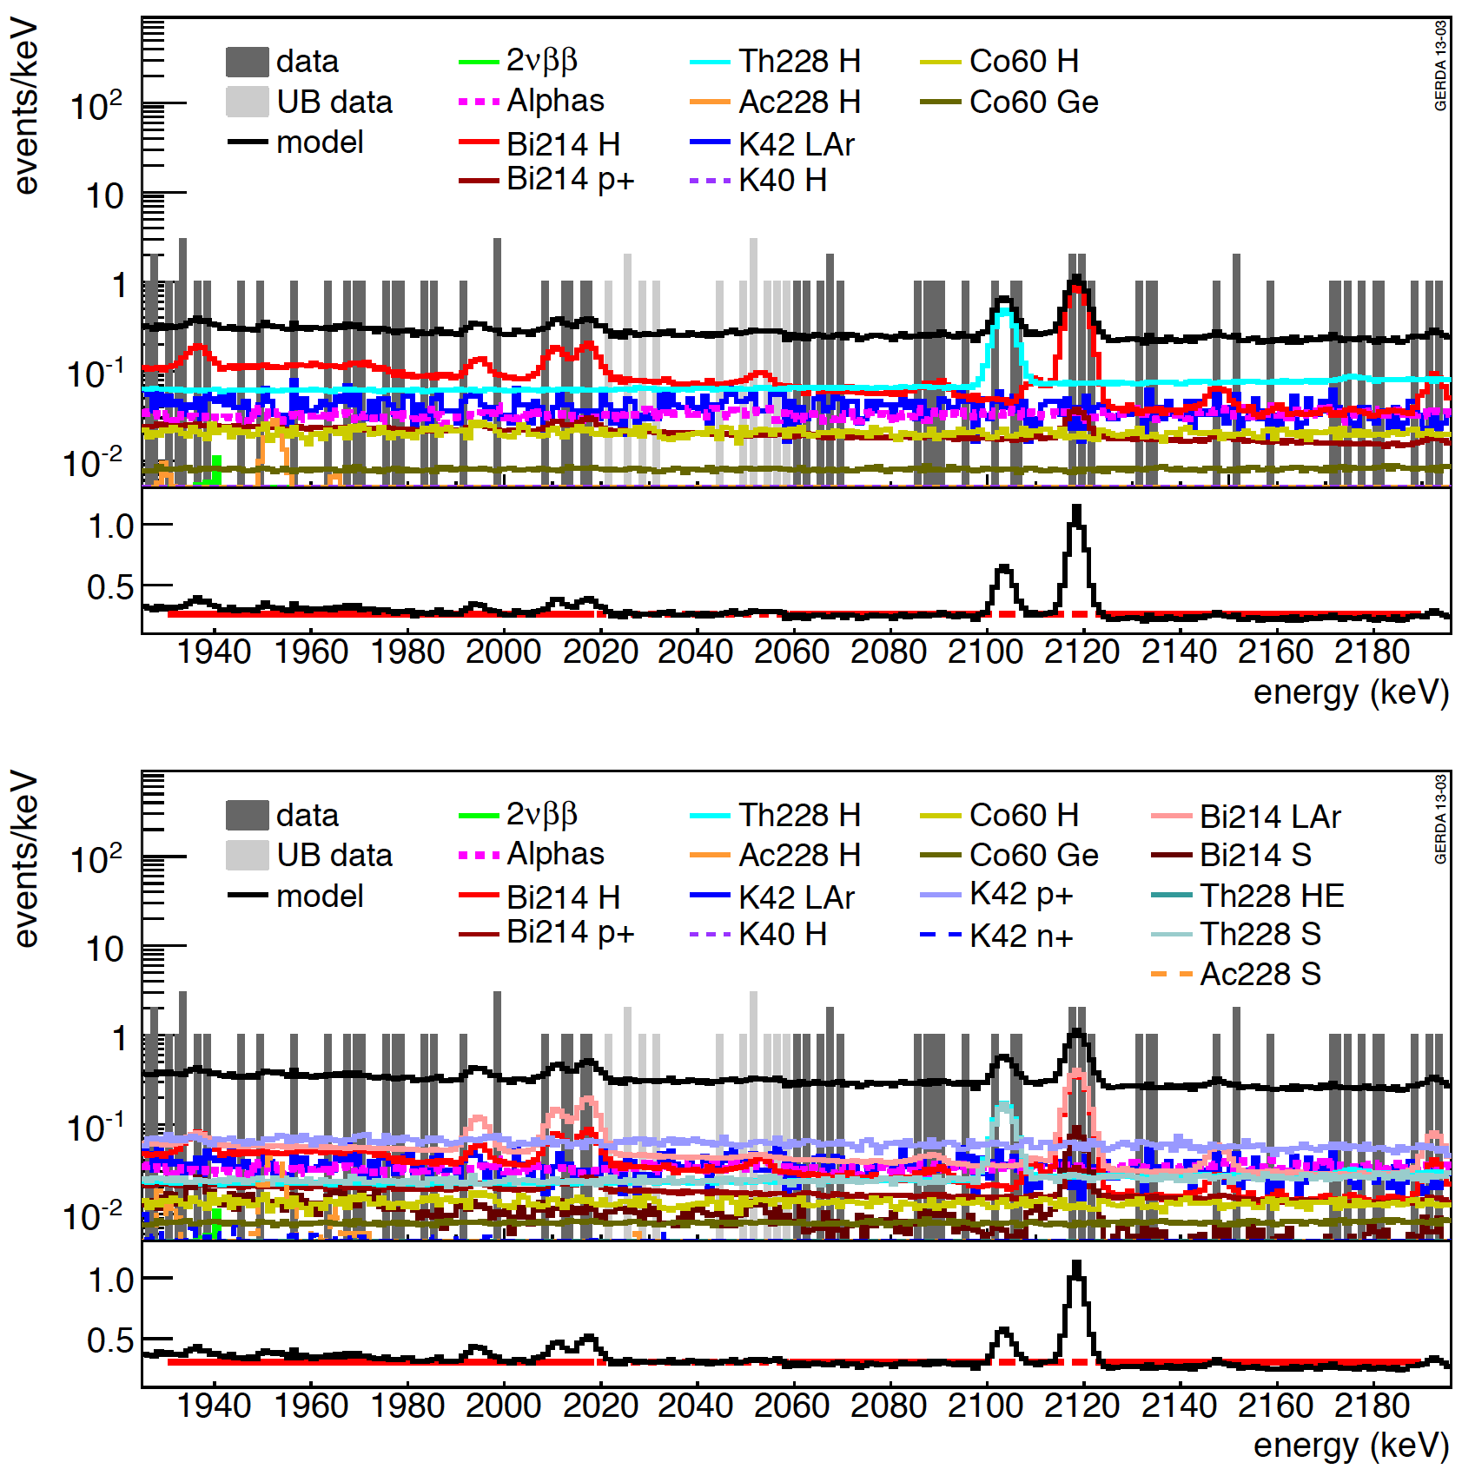
Physics run: background model and prediction of BI at Q_{ββ}
Minimal model
arXiv:1306.5084
Background model:
No background peak expected around Q_{ββ}
Spectrum can be modeled with flat background (red line) in 1930-2190 keV excluding known peaks at 2104 and 2119 keV
Background index (BI) at Q_{ββ} (17.6-23.8) 10⁻³ cts/(keV kg yr) depending on assumptions for location of sources
Statistical uncertainty of BI from interpolation coincides numerically with systematic uncertainty from model
Prediction for 30 keV BW:
Min./Max Mod: 8.2-9.1 / 9.7-11.1 observed.: 13
linear fit with flat background 1930-2190 keV excluding peaks
blinded
Maximum model
blinded

Slide 13
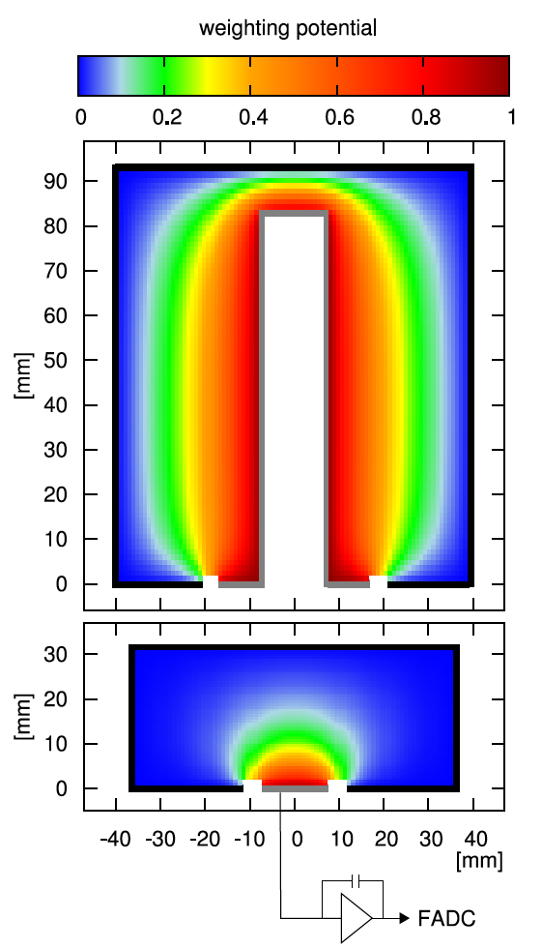
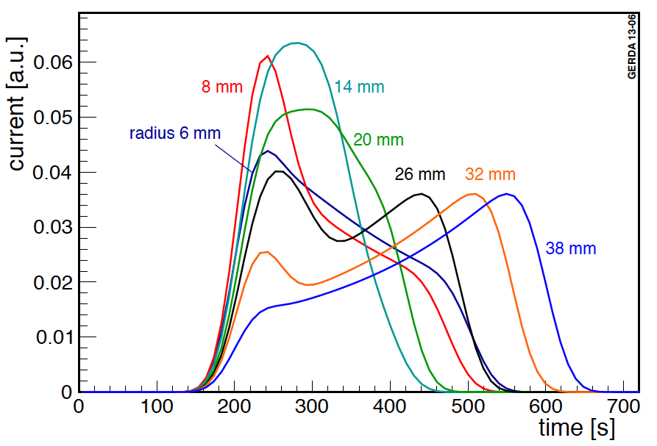
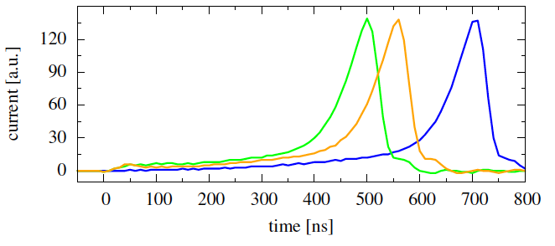
Pulse shape discrimination
EPJC 73 (2013) 2583
Classification of (0νββ) signal-like (SSE) or background-like (MSE, p+) events
Weighting potential for coax and BEGe detectors are different
Current pulses of simulated SSE signals
Coax
arXiv:1012.4300
BEGe

Slide 14
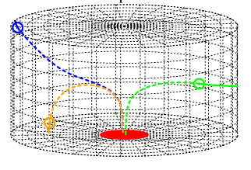
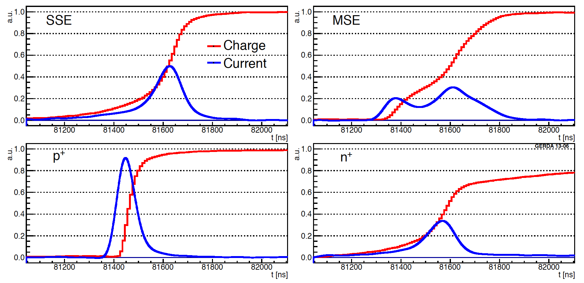
Pulse shape discrimination: BEGe
n+
EPJC 73 (2013) 2583
PSD discrimination parameter: A/E
p+
E
Signal-like
bgd-like (MSE γ’s)
A
bgd-like
(p+ surface α, β)
bgd-like
(n+ surface β, ⁴²K)

Slide 15
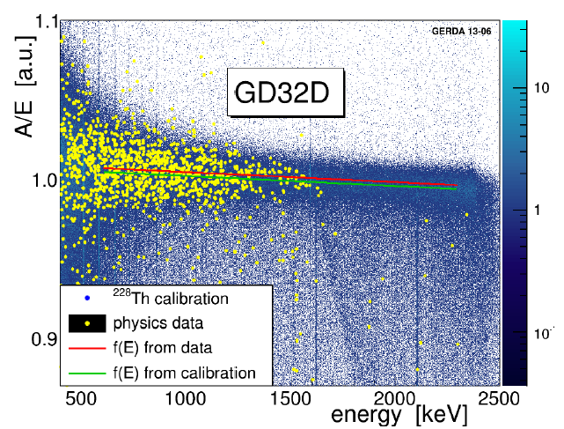
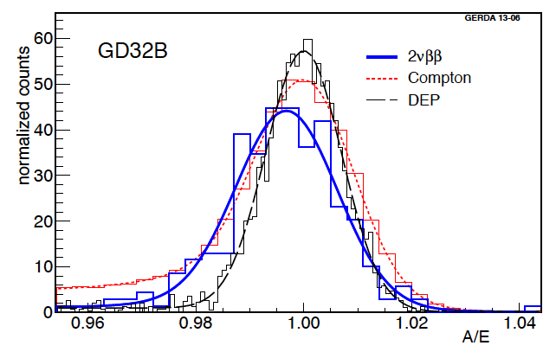
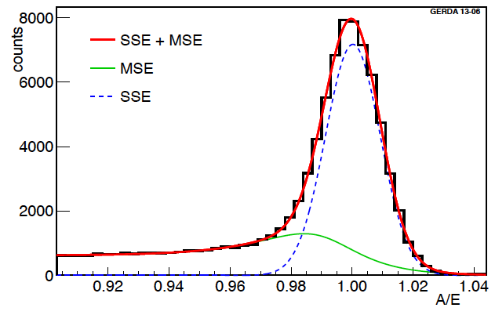
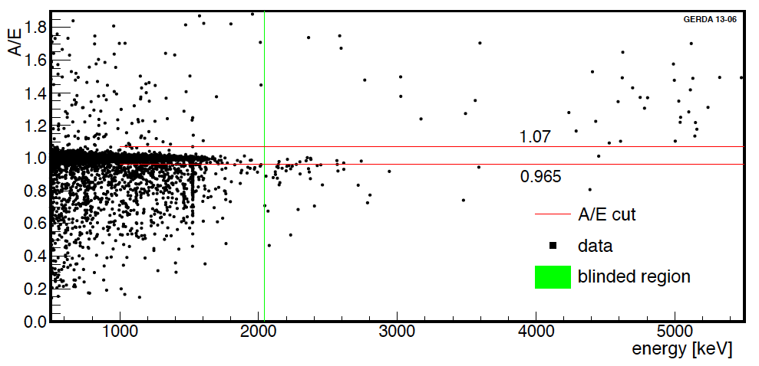
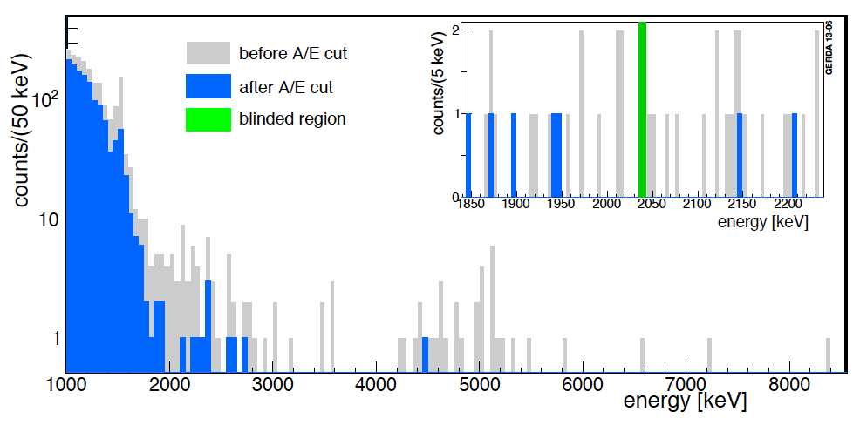
Pulse shape discrimination: BEGe
EPJC 73 (2013) 2583
A/E of Compton continuum from calibration
Energy dependence of A/E
A/E for 2νββ, Compton (1-1.4 MeV), DEP (1592 keV)
rejected
rejected
⁴²K-β n+ surface dominated
2νββ acceptance: 0.91±0.05
Rejects > 80% of bkg-like events & 0νββ acceptance: 92±2 %

Slide 16
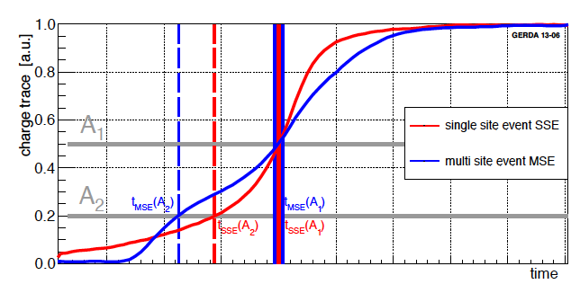
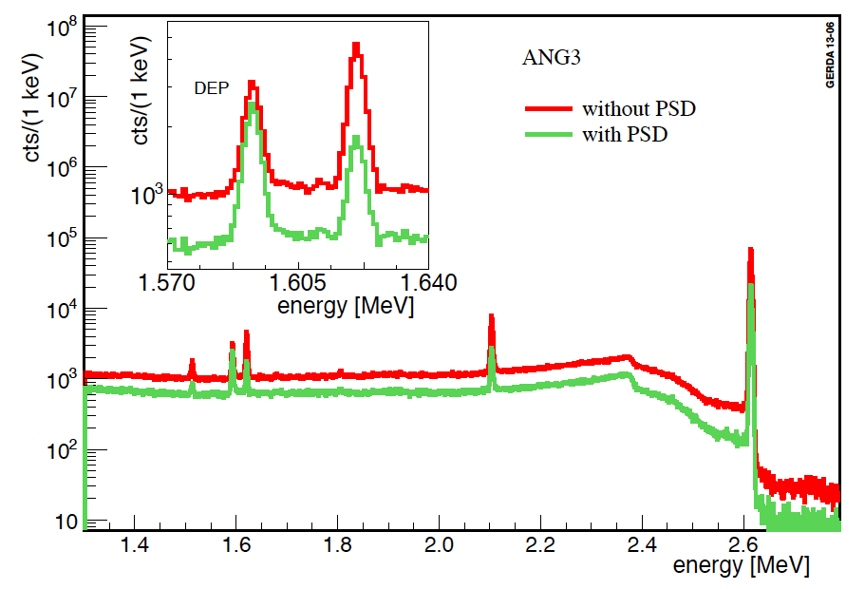
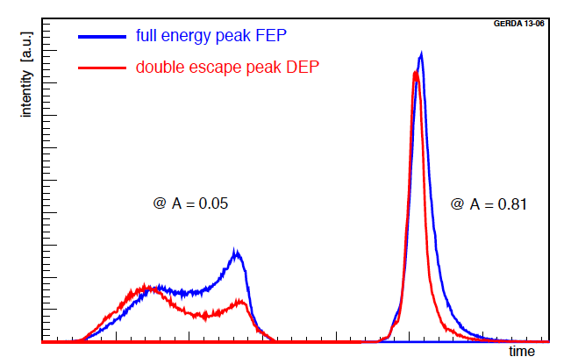
Pulse shape discrimination: Coax
EPJC 73 (2013) 2583
Artificial Neural Network analysis of 50 rise time info (1,3,5,…99%) with TMVA / TMlpANN
Calibration data are used for training:
SSE training with signal-like ²⁰⁸Tl DEP events (1592 keV)
MSE training with background-like ²¹²Bi FEP (1621 keV)
²²⁸Th calibration spectrum
FEP
DEP
select ANN cut position @ DEP survival = 90%
cross checks:
2νββ eff. = 85±5 %, Compton edge eff. = 85-94%,
⁵⁶Co DEP (1576 keV) eff. = 83%-95%
⁵⁶Co DEP (2231 keV) eff. = 83%-93%
ANN rejects 45% of background events
0νββ efficiency = 90% +5%/-9%

Slide 17
Unblinding: full data set
(21.6 kg yr & 7 event in blinded window & 3 event survive PSD cut
No peak in spectrum at Q_{ββ} +/- 5 keV,
event count consistent with bkg
⇒ GERDA sets a limit

Slide 18
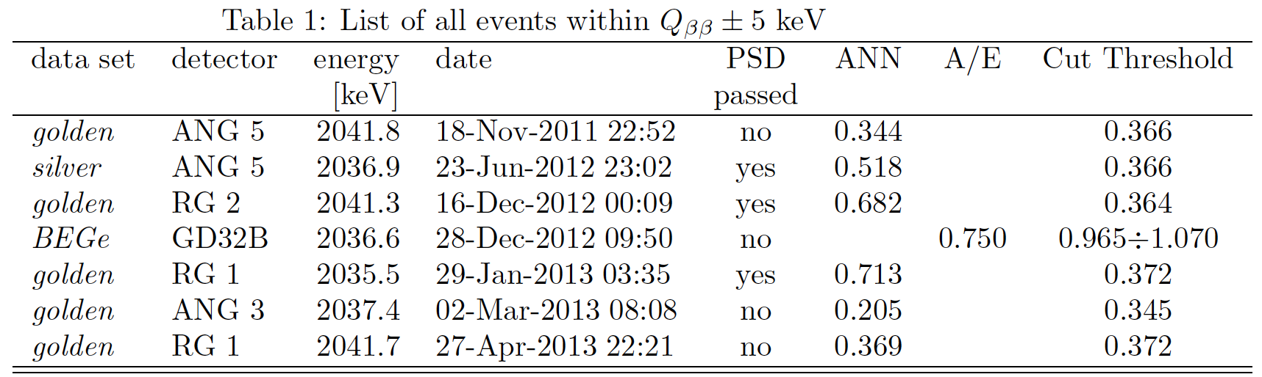
List of events in blinded window

Slide 19
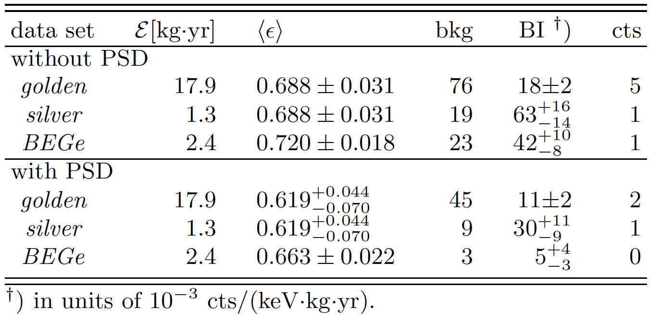
Parameters of three data sets and counts in blinded window
(in 230 keV)
Counts
in blinded window (BW)
Total counts in BW | Expected (bgd only) | Observed
without PSD | 5.1 | 7
with PSD | 2.5 | 3

Slide 20
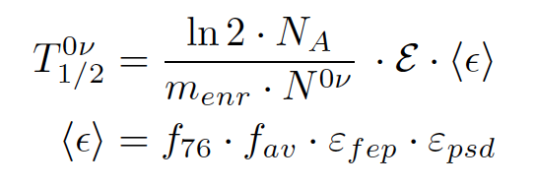
From counts to half-life
N_{A}: Avogadro number
E: exposure
ε: exposure averaged efficiency
m_{enr}: molar mass of enriched Ge
N ^{0ν}: signal counts / limit
f₇₆: enrichment fraction
f_{av}: fraction of active detector volume
ε_{fep}: full energy peak efficiency for 0νββ
ε_{psd}: signal acceptance
Data set | Exposure (kg yr)
Golden-coax | 17.9
Silver-coax | 1.3
BEGe | 2.4
 | <f₇₆> | <f_{av}> | <ε_{fep}> | <ε_{psd}> | <ε>
Coax | 0.86 | 0.87 | 0.92 | 0.90 +0.05/ -0.09 | 0.619 +0.044/-0.070
BEGe | 0.88 | 0.92 | 0.90 | 0.92 ±0.02 | 0.663 ±0.022

Slide 21
Half-life limit
Fit three data sets in 1930-2190 keV interval: Constant (for bkg) + gauss (for signal)
Four parameters: 3 x bkg level & 1/T^{0ν}
Fix gaussian µ = (2039,06+/-0,2) keV
σ=(2,0+/-0,1)/(1,4+/-0,1) keV for coax/BEGe
Systematic uncertainties on f, ε, µ, σ: Monte Carlo sampling & averaging
Profile likelihood fit ⇒ best fit N^{0ν}=0, T_{1/2}^{0ν} > 2.1×10²⁵ yr (90% C.L.)
(sensitivity = 2.4×10²⁵ yr)
Bayes: flat 1/T^{0ν} prior 0 - 10²⁴ yr ⇒ best fit N^{0ν}=0, T_{1/2}^{0ν} > 1.9×10²⁵ yr (90% C.L.)
(sensitivity = 2.0×10²⁵ yr)
Adding HdM¹ & IGEX² spectra to profile likelihood fit ⇒ T_{1/2}^{0ν} > 3.0×10²⁵ yr (90% C.L.)
Assuming the claimed signal³ GERDA should see 5,9+/-1,4 0νββ events in +/-2σ interval
above bkg = 2,0+/-0,3, HdM & IGEX spectra to profile likelihood fit ⇒ T_{1/2}^{0ν} > 3.0×10²⁵ yr (90% C.L.)
⇒ Probability to observe GEDA spectrum (best fit profile likelihood N^{0ν}=0) is 1 %
1 Euro Phys J A12 (2001) 147. 2 Phys Rev D65 (2002) 092007. 3 T_{1/2}0ν (Ge76) = 1.19×1025 yr, Phys Lett B586 (2004) 198

Slide 22
Summary
GERDA Phase I design goals reached:
  Background index after PSD: 0.01 cts / (keV kg yr)
  Exposure 21.6 kg yr
Observe 3 events in Q_{ββ} = ±5 keV with expected bkg of 2.5±0.3
⇒ no signal
No 0νββ-signal observed at Q_{ββ} = 2039 keV; best fit: N^{0ν}=0
  Background-only hypothesis H₀ strongly favored
  Claim strongly disfavored (independent of NME and of leading term)
Profile likelihood fit: T_{1/2}^{0ν} > 2.1×10²⁵ yr (90% C.L.)
Limit on half-life:
GERDA+IGEX+HdM: T_{1/2}^{0ν} > 3.0×10²⁵ yr (90% C.L.) (<m_{ee}> < 0.2-0.4 eV)
The claimed signal (without PSD) is ruled out by GERDA at 99% without any model dependence
T_{1/2}^{0ν} (central value & error) of the KK analysis with PSD is wrong

Slide 23
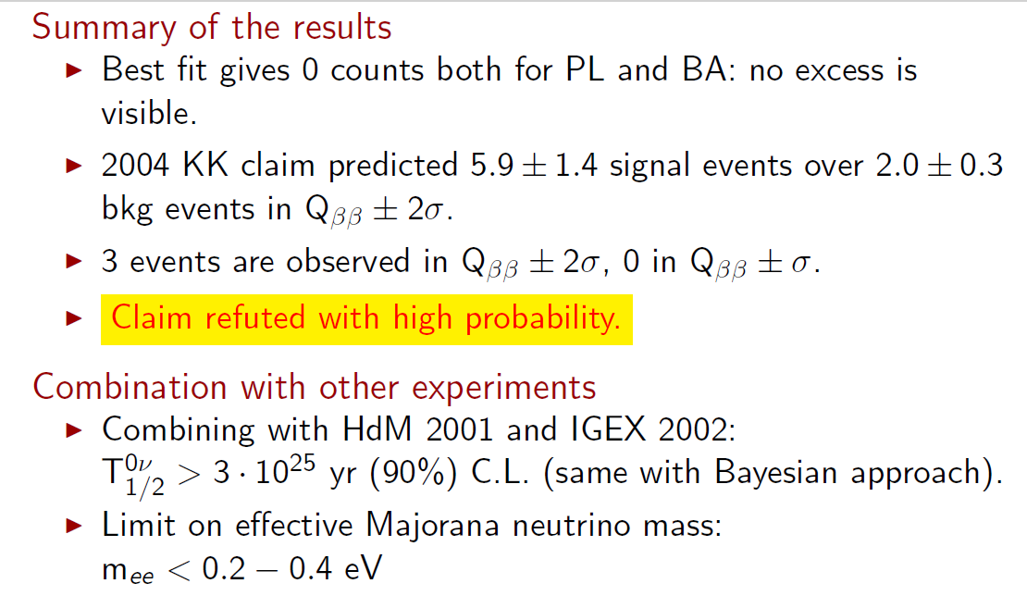

Slide 24
Thank you !

Slide 25
Back up slides

Slide 26
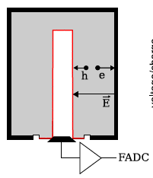
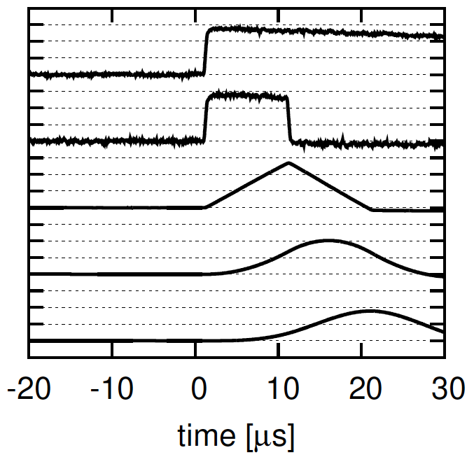
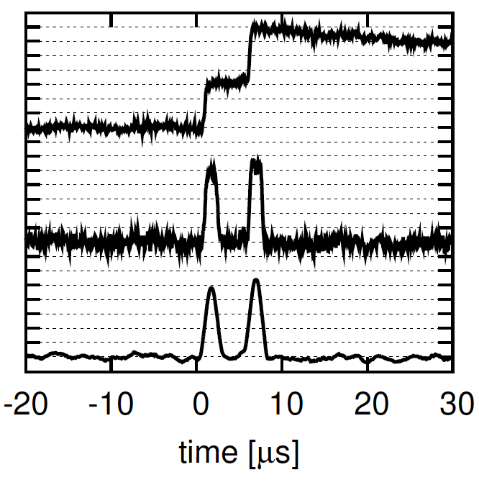
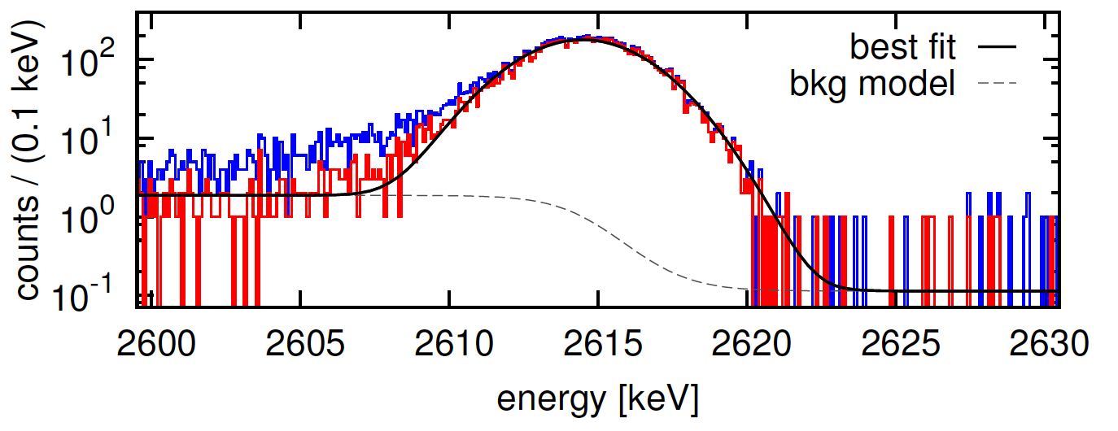
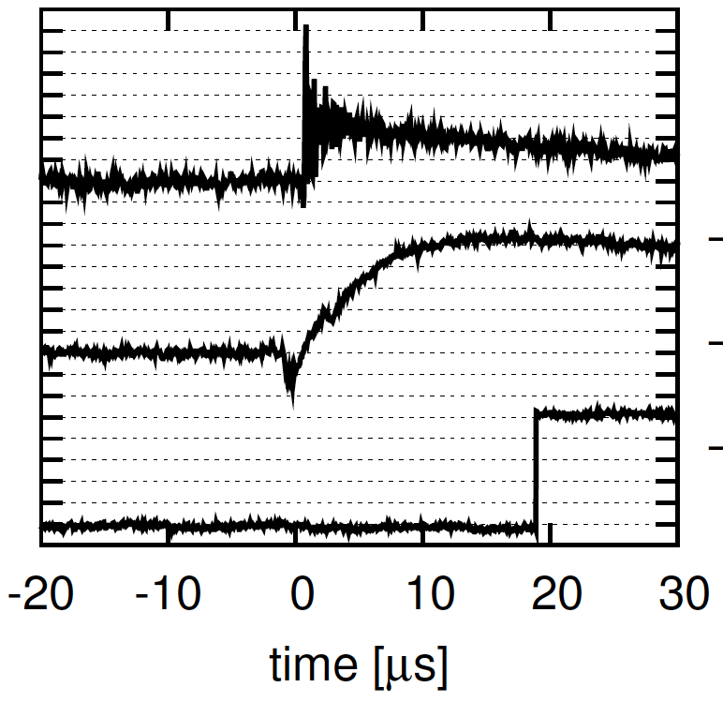
Data processing and selection
Eur. Phys. J. C (2013) 73:2330
arXiv:1212.4067
Read-out and signal structure
Digital signal processing to extract amplitude, rise time, etc.
Data selection and quality monitoring
Calibration of energy scale (²²⁸Th)
Examples of non-physical events
Data processing frame work ‘Gelatio’
2nd independent data processing software for cross check

Slide 27
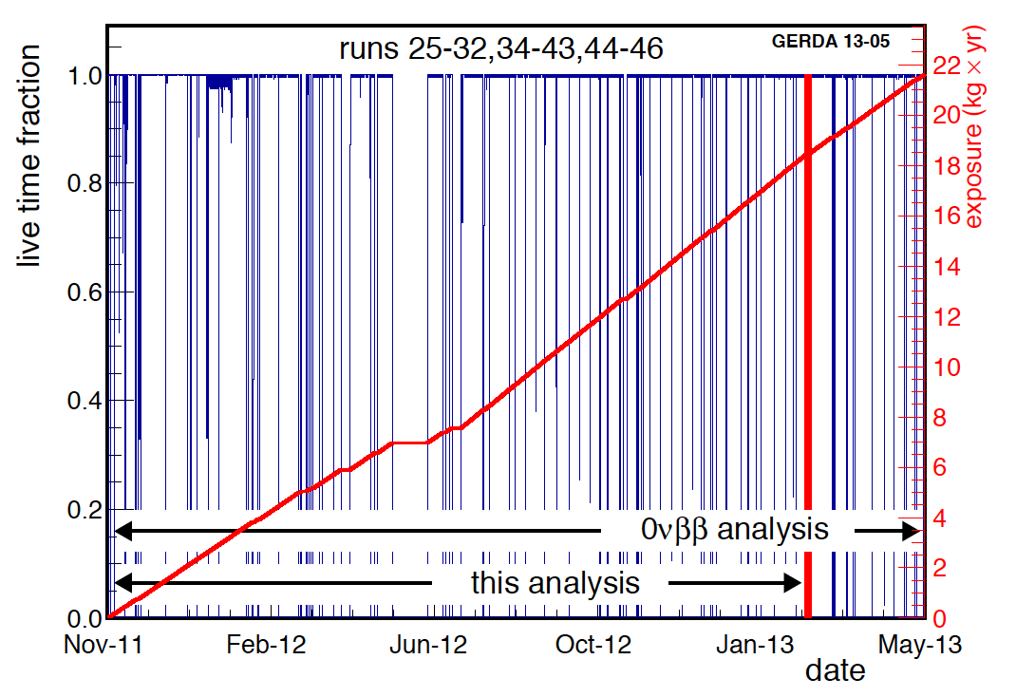
Data taking
Eur. Phys. J. C (2013) 73:2330
arXiv:1212.4067
Total exposure for 0νββ analysis: 21.6 kg yr
(bi-)weekly calibration runs (‘spikes’)
Data blinding:
All events in Q_{ββ}±20 keV removed in Tier 1
2 copies of raw data kept for processing after unblinding
0νββ
background paper
Insertion of 5 Phase II ^{enr}BEGe
1st physics: 2νββ analysis (5.04 kg yr)

Slide 28
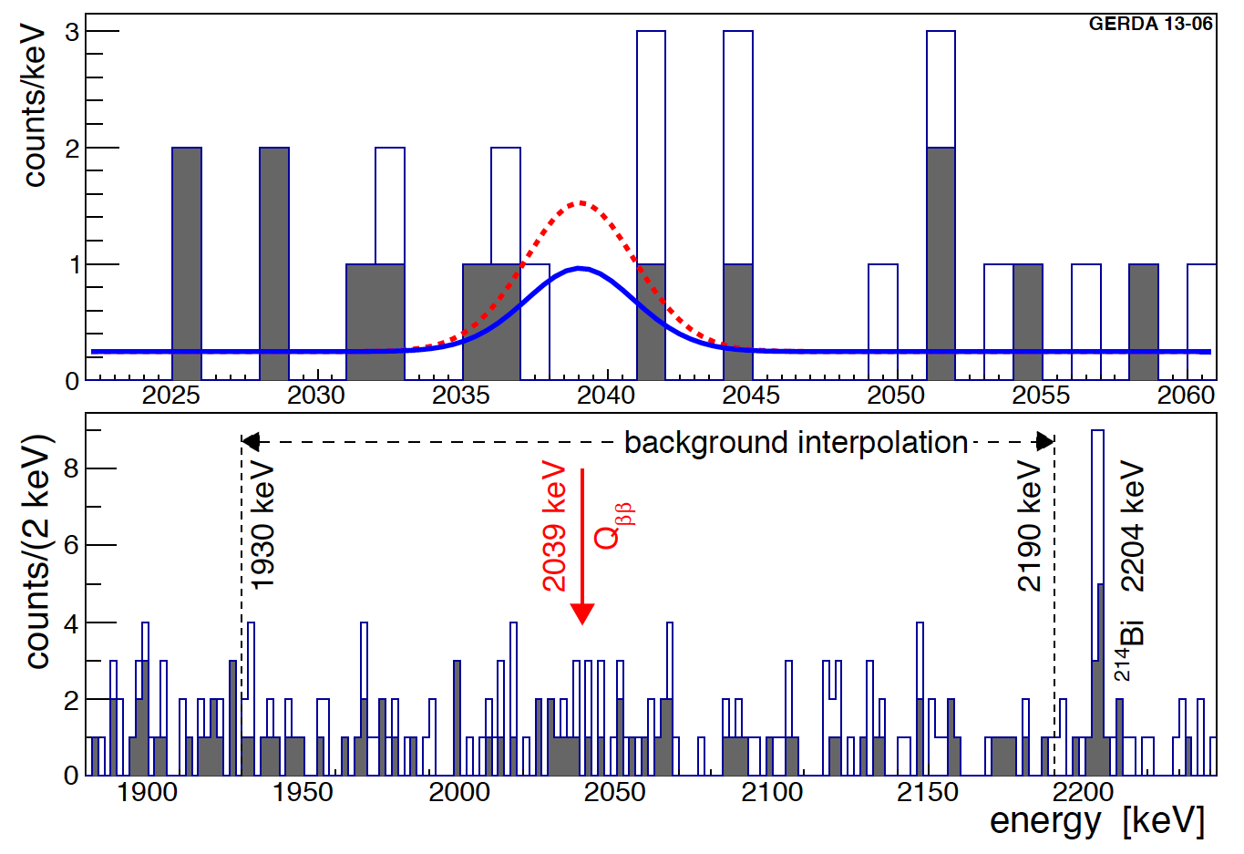
Comparison with Phys. Lett. B 586 198 (2004) claim
Expectation for claimed T_{1/2}^{0ν} =1.19×10²⁵ yr (Phys. Lett. B 586 198 (2004)):
5.9±1.4 signal over 2.0±0.3 bgd in ±2σ energy window to be compared with 3 cts (0 in ±1σ)
H1: claimed signal: 5.9±1.4
H0: background only
Bayes factor: P(H1)/P(H0 )=0. 024
p-value from profile likelihood
P(N=0 = 0|H1 ) = 0. 01 (0.006 if 1/T unconstrained)
➔Claim refuted with high probability

Slide 29


Frequentist and Bayesian limits & median sensitivities
90% lower limit (T_{1/2}^{0ν} )
Frequentist limit:
90% lower limit derived from profile likelihood fit to 3 data sets (constraint to physical 1/T range; excluding known γ-lines from bgd model at 2104±5 and 2119±5 keV)
Best fit: N^{0ν}=0
No excess of signal counts above the background
90% C.L. lower limit:
Limit on half-life corresponds to N^{0ν}<3.5 cts
Median sensitivity (90% C.L.): >2.4×10²⁵ yr
Bayesian:
Flat prior for 1/T
Posterior distribution for T_{1/2}^{0ν}
Best fit: N^{0ν}=0
90% credibile interval:
Median sensitivity: (90% C.I.): >2.0×10²⁵ yr
Systematics:
Parameter | Det./Set | Value | Uncertainty
<ε> w/o PSD | Coax | 0.688 | 0.031
 | BEGe | 0.720 | 0.018
Energy res. | Golden | 4.83 keV | 0.19 keV
 | Silver | 4.63 keV | 0.14 keV
 | BEGe | 3.24 keV | 0.14 keV
Energy scale (keV) |  | N.A. | 0.2 keV
ε_{PSD} | Coax | 0.90 | 0.10
 | BEGe | 0.92 | 0.02
Systematics folded: limit weakened by 1.5%

Slide 30
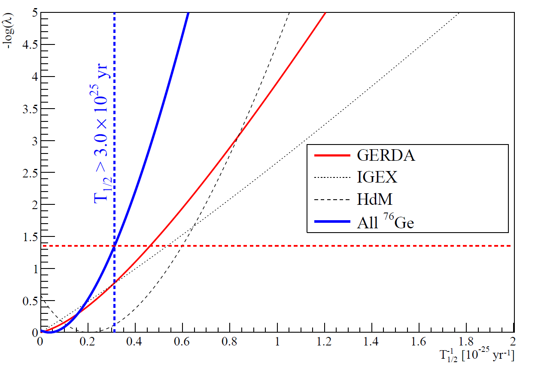

Combined analysis with HdM and IGEX experiments
HdM: Eur. Phys. J. A 12, 147 (2001)
IGEX: Phys. Rev. D 65, 092007 (2002),
Phys. Rev. D 70 078302 (2004)
Identical limits with
Frequentists & Bayesian analysis
Bayes Factor: P(H1)/P(H0 )=2×10⁻⁴ strongly disfavors claim
Comparison is independent of NME and of physical mechanism which generates 0νββ

