Slide 1
Particle multiplicity in jets at CMS
V.Konoplyanikov, S.Shulga
JINR (Dubna), GSU (Gomel)
November 5 – 8, 2013, Protvino
International Conference-Session of the Section
of Nuclear Physics of the Physical Sciences Devision
of Russian Academy of Sciences

Slide 2
Content
Multiplicity in jet (JM): what new to expect?
JM and Underlying Event.
JM and ISR & FSR.
JM and multiplicity in event.
Separation Quark and Gluon jets using semi-leptonic $t\overline{t}$-events.
JM and PileUp.
“Strange” tracks in JM.
Conclusion.

Slide 3
Multiplicity in jet (JM): what new to expect?
Particle correlations – the main subject of the dynamics in content of multiplicity measurement. Local conservation of quantum numbers in the hadronization process leads to short range correlations in rapidity.
For the final hadrons the widths of the multiplicity distribution in pp-collisions are larger than Poisson distribution and it indicates positive correlation between charged particles.
The nature of the particle correlation in jet compared to the event reflects clearer the fundamental laws.
But these correlations are partially hidden by Underlying Event (UE), by Initial and Final State Radiations (ISR and FSR). Particle correlations depend on type of parton produced the jet. From experimental point of view the main source of uncertainty is PileUp.

Slide 4
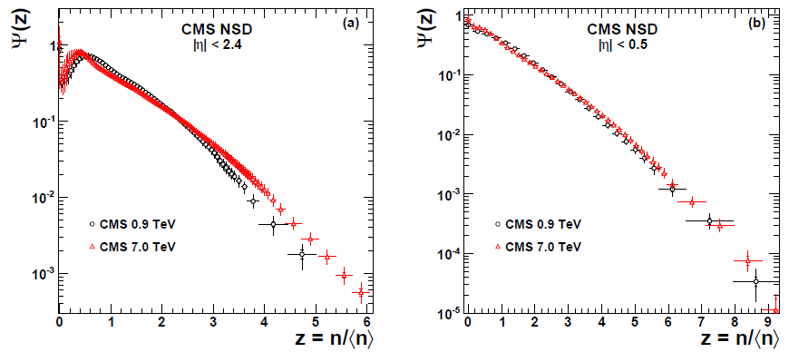
KNO-violation
[1]
[1]
$$Ψ\left(z\right)=\left\langle n\right\rangle P_{n}$$
$$Ψ\left(z\right)=\left\langle n\right\rangle P_{n}$$
KNO-scaling is true for events with a small $\left|η\right|<0.5.$
KNO-scaling is violated for $\left|η\right|<2.4$
Does the KNO scaling holds in jets?
This observation allow us to expect to have unexpected results on the subject the multiplicity in jet.
[1] Charged particle multiplicities in pp interactions at $\sqrt{s}=0.9, 2.36$ and 7 TeV.
CMS collaboration, JHEP01 (2011)079

Slide 5
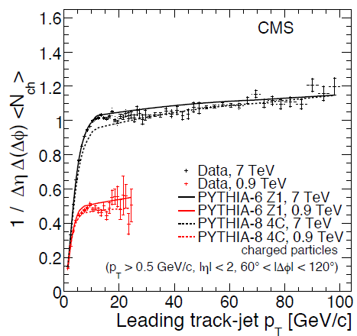
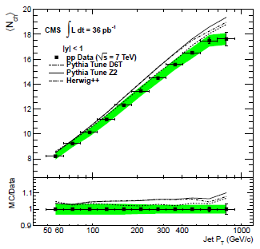
UE charge multiplicity in jets
JHEP 1109 (2011) 109
JHEP 1206 (2012) 160
$$\left|Δφ\right|∈\left[\frac{π}{3},\frac{2π}{3}\right] \left|η\right|<2 {P_{T}}^{ch}>0.5 GeV$$
“Underlying Event” = products of Beam Remnants + Multiple Parton Interactions.
Jet tracks = signal + UE
Energy rate of UE is match lower in Jet region than in full event
due to kinematics and “by construction” of jet as a group of collimated tracks.

Slide 6
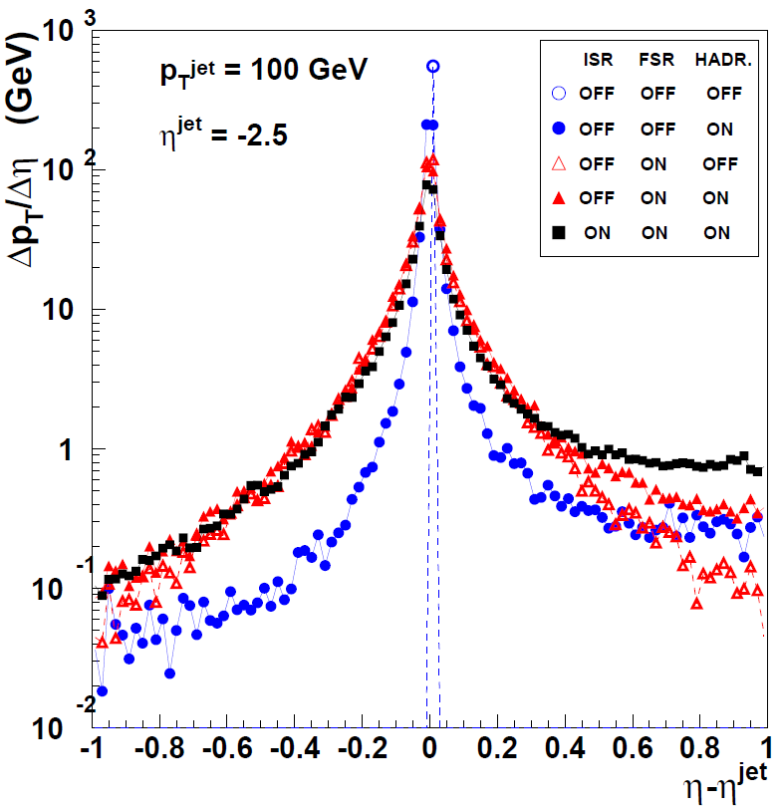
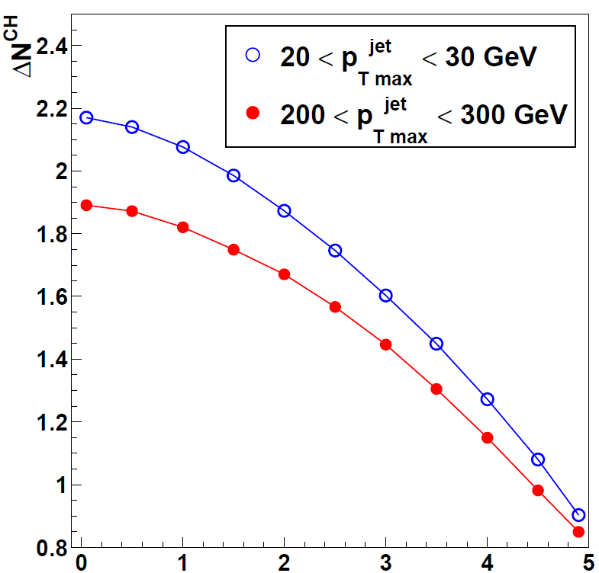
UE, ISR and FSR in jets
UE multiplicity in jet
q + ISR+FSR + Hadr
q + FSR + Hadr
q + FSR
q + Hadr
- q
Pythia6, $γ+jet$
Light quark jet
${P_{T}}^{jet}≈100 GeV$
$η≈−2.5$
$$\sum{{P_{T}}^{ch}/Δ\left(Δη\right)}, GeV/c$$
$$\left\langle {N^{ch} }_{UE in Jet} \right\rangle$$
UE
$$η^{jet}$$
$$Δη= η^{ch}−η^{jet}$$
Mean UE energy per Jet ($Δη<0.5$)
$≈$0.5 - 1 GeV
ISR and FSR reduce the effect of final particle correlations
because ISR and FSR does not correlate to the parton - origin of jet.
UE, ISR and FSR are inseparable parts of jet.

Slide 7
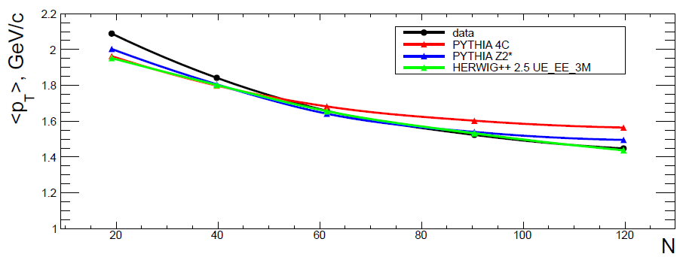
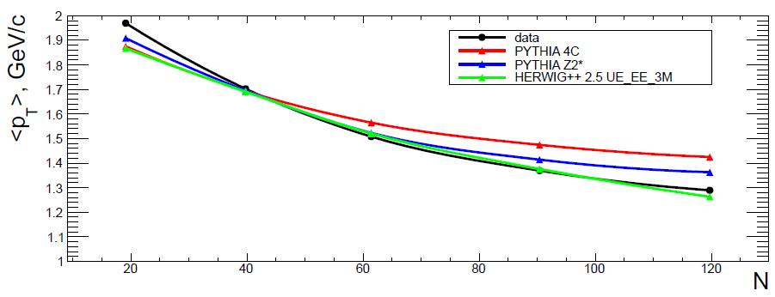
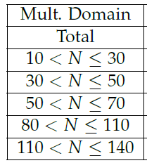
Jet properties vs multiplicity in event
$$CMS \sqrt{s}=7 TeV$$
$$CMS \sqrt{s}=7 TeV$$
$$\left\langle {P_{T}}^{ch}\right\rangle , GeV/c$$
$$\left\langle {P_{T}}^{ch}\right\rangle , GeV/c$$
${P_{T}}^{ch}$>0.25GeV/c
${P_{T}}^{ch}$>0.4GeV/c
Mean transverse momentum of charged tracks in jet
with $\left|η\right|$<2.4 vs multiplicity $N$ in event.
AN 12-240, JHEP(2013)
This dependence can be associated mainly to ISR and FSR
which increase with increasing multiplicity N in event.

Slide 8
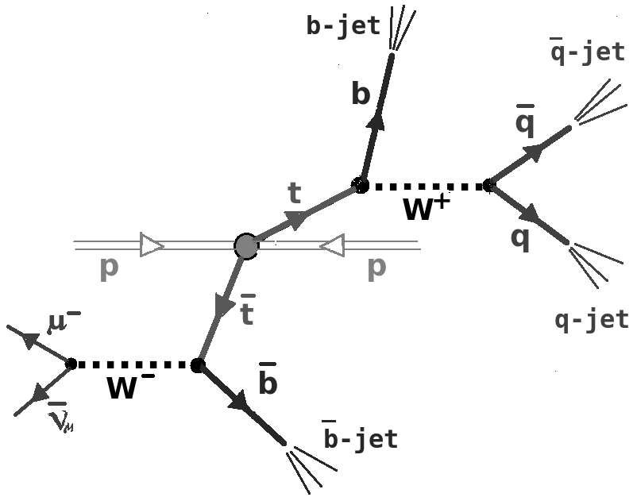
Three type of jets in Semi-leptonic $t\overline{t}−$ channel
Two identified b-jets
Two light quark jets identified as product of W
N gluon jets
In the task of Multiplicity in Jets (JM) semi-leptonic $t\overline{t}−$ channel is useful due to
Background is about 18%;
Equivalence to the 2-jets $e^{+}e^{−}$-channel $: e^{+}e^{−}→\frac{Z_{0}}{γ}→q\overline{q}$ ;
Separation the Light Quark Jets with 95% purity (see next slide).
For the task of JM it is not possible to discriminate quark and gluon jets by using inner jet constituent parameters (used in Q-G-discriminators) due to its correlations with JM.

Slide 9
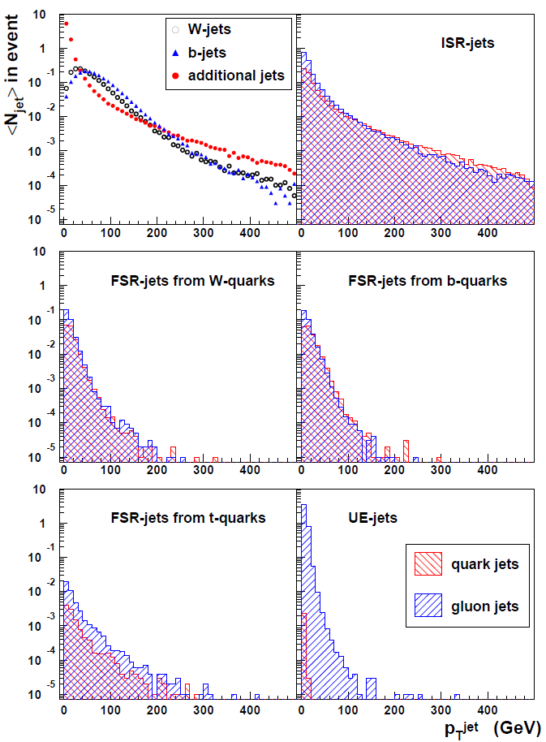
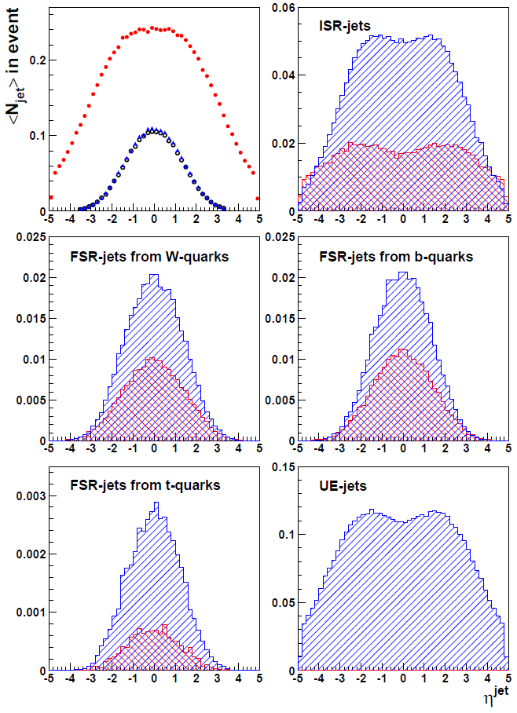
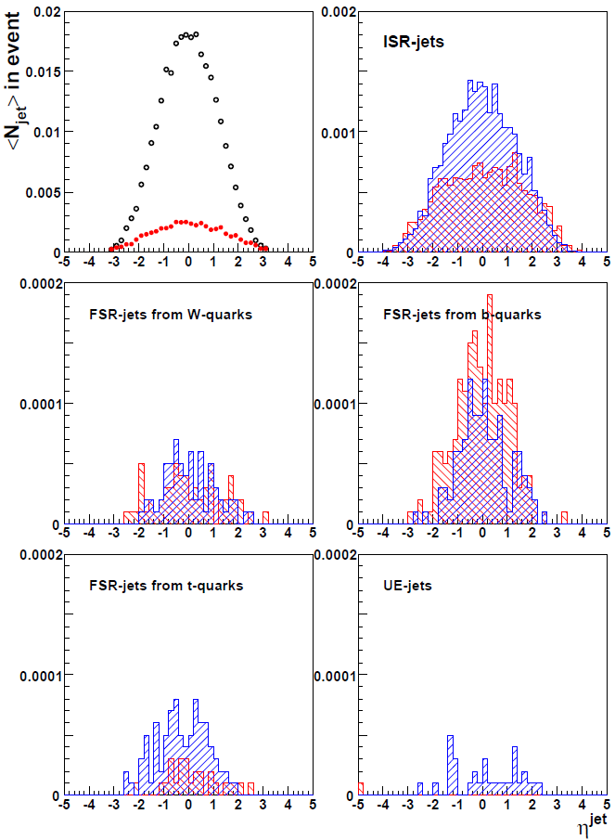
Separation the Light Quark Jets
in Semi-leptonic $t\overline{t}−$ channel (Pythia6)
Fig.3.1
Fig.1.
Fig.2.
Fig.3.
In Semi-leptonic $t\overline{t}−$ channel we have separation the Light Quark Jets with 95% purity (Fig.3.1) by using kinematics constraints:
invariant mass of light quark jets $\left|M_{j_{1}j_{2}} −M_{W}\right|<10 GeV$
rapidity-distance $\left|η_{j_{1}} −η_{j_{2}}\right|<1.5$and maximum ${P_{T}}^{j_{1,2}}$.

Slide 10
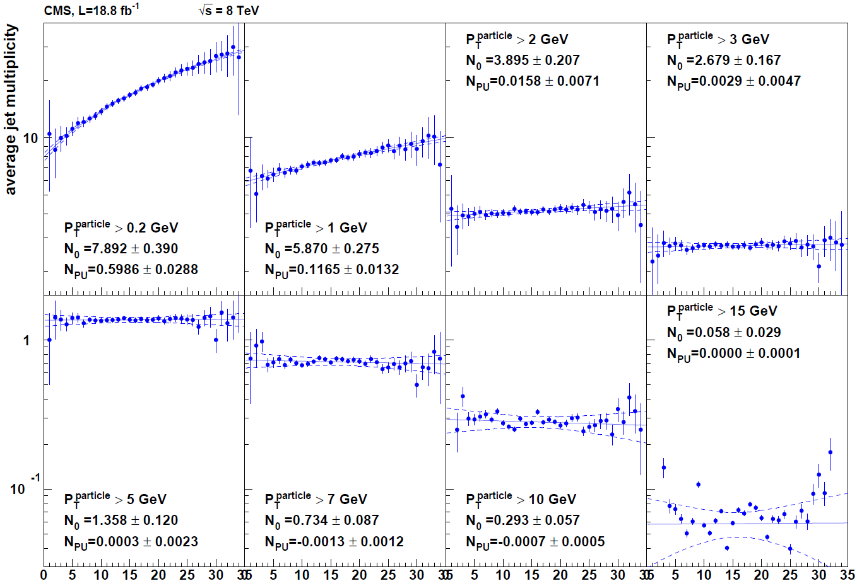
PU subtraction: extrapolation to 1 PV
Data
b-jets
$$\left\langle {N_{ch}}^{jet}\right\rangle$$
$${P_{T}}^{bjet} ∈\left[15, 50\right]GeV$$
$$N_{PV} −1$$
$$N_{PV} −1$$
0
0
0
After extrapolation to 1 PV mean values include “strange” tracks from the decays of signal strange particles + background (material interactions, magnetic field)

Slide 11
PU subtraction: Track-PV matching
3D-distance method
IP method
$$min⁡(d)<3∗err\left(d\right) and d<0.4 cm$$
$${min⁡(d}_{z})<3∗err\left(d_{z}\right) and{ d}_{z}<0.4 cm$$
$${min⁡(d}_{0})<3∗err\left(d_{0}\right) and{ d}_{0}<0.2 cm$$
 | Data | MC
3D or IP | 78.7% | 78.8%
Not 3D and not IP | 21.3% | 21.2%
All | 148637 | 793768
Signal + PU tracks
“Strange” tracks
 | Data/MC, %
3D and not IP | 0.6/1.4
3D and IP | 94/93.6
not 3D and IP | 5.5/5.0
3D or IP | 100/100
3D-method selection is harder, then IP-method
3D-conditions includes IP-conditions:
3D and not IP: 0.6%($d<0.4 cm$), 0.16%($d<0.2 cm$)

Slide 12
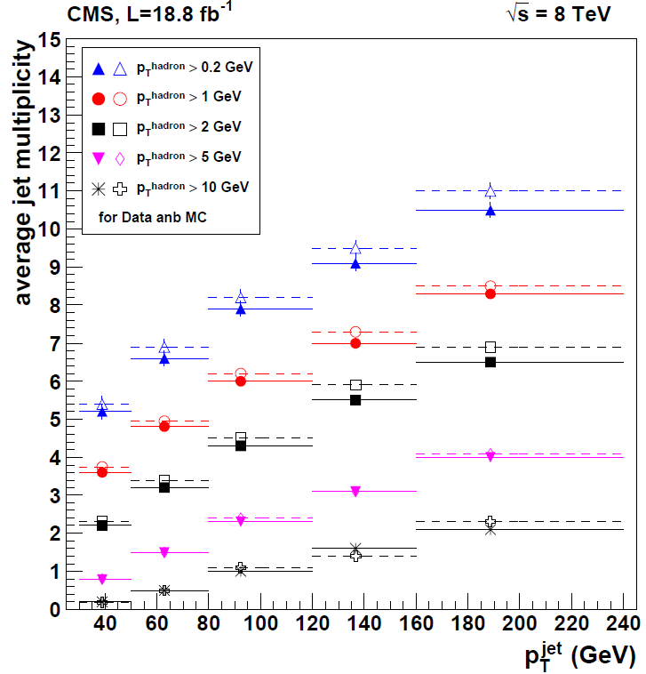
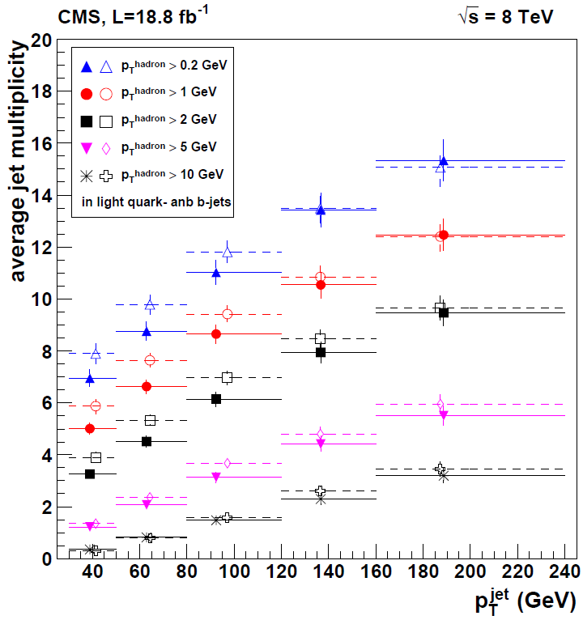
Mean track multiplicity in PF-jet vs. ${p_{T,min}}^{track}$ and ${P_{T}}^{jet}$
Data
MC
Light quark jet
b-jet
$\left\langle N^{CH}\right\rangle$
$\left\langle N^{CH}\right\rangle$
Track-PV matching
Extrapolation to 1 PV
MC and Data points are drawn by the same colors. MC a bit to the left than the data.
Systematic excess MC over the data is observed for small ${{ P}_{T, min}}^{track}$

Slide 13
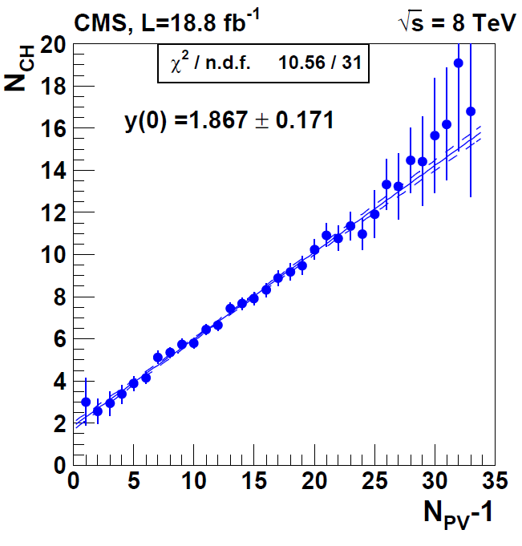
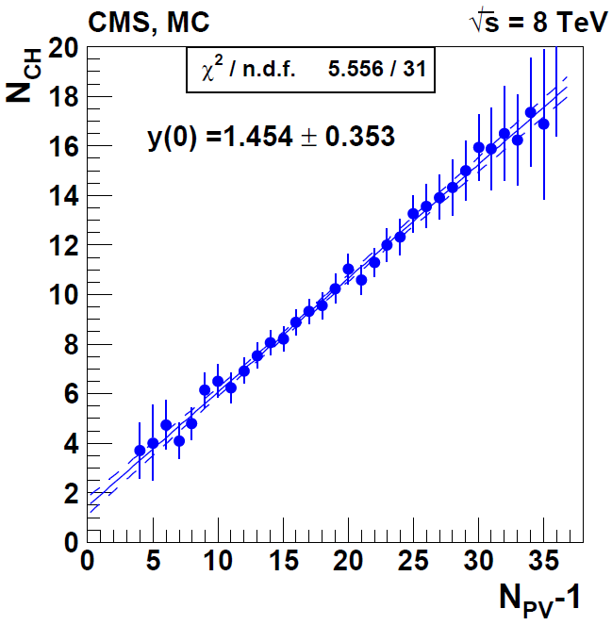
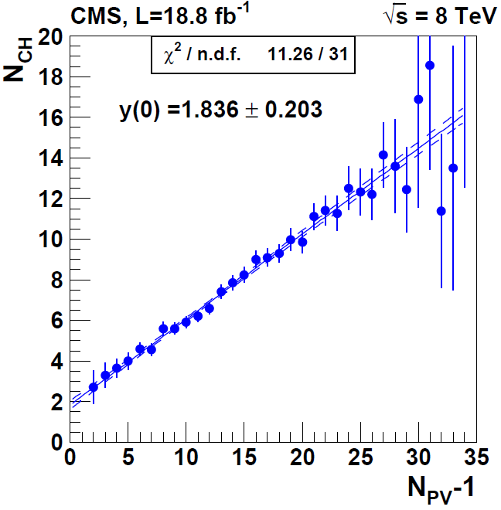
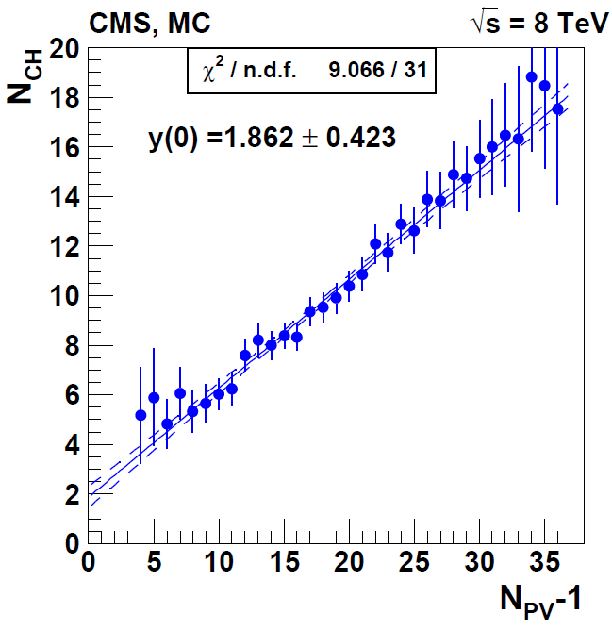
“Strange” jet content (tracks w/o PV)
Tracks from strange particle decays
Signal tracks w/o PV
(fake track-PV matching)
Interactions with material.
$${P_{T}}^{jet} ∈\left[30,50\right]GeV$$
$${P_{T}}^{jet} ∈\left[50,80\right]GeV$$

Slide 14
Conclusion
Multiplicity in jet (JM) will allow us to get an important information about particle correlations.
UE, ISR and FSR are inseparable parts of each jet. This is the background that hides some of particle correlations in jet.
For the task of JM one need to take into account the dependence of the JM on the multiplicity in event.
Using semi-leptonic $t\overline{t}−$ channel it is possible to separate light quark from W-decay with 95% purity to study JM in pure quark jets.
The measurement of strange mesons and baryons yields in jet is possible with CMS by fully exploiting the low-momentum track reconstruction capabilities of CMS.

