Slide 1
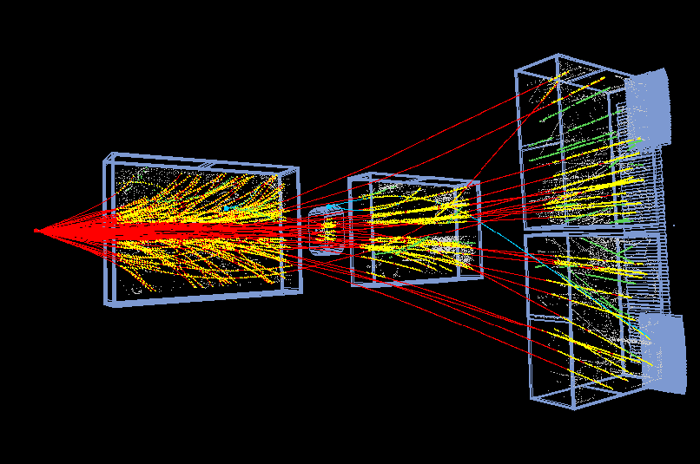




О нарушение изотопической симметрии
в столкновениях Ar+Sc при энергии √s_{NN}=11.9 ГэВ
в эксперименте NA61/SHINE на SPS
Г.А.Феофилов, М.Жаров (СПбГУ)
2 июн. 2026 г., 10:10, 25m https://indico.ihep.su/event/922/program
Работа выполнена при поддержке СПбГУ, шифр проекта ID: 153212394

Slide 2
Talk Layout
NA61/SHINE Experiment at CERN
Charged particle identification
Isotopic Symmetry Breaking in Ar+Sc Collisions
Some sources of the detected Isospin Symmetry Breaking
Predictions? Possible additional experimental studies.

Slide 3
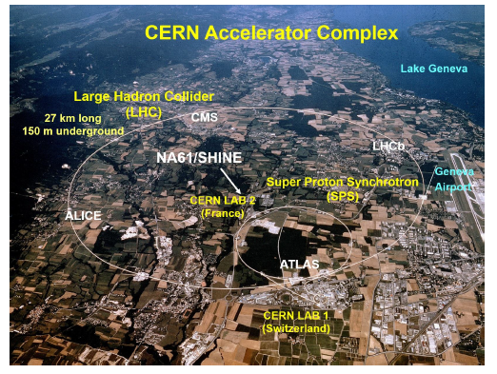
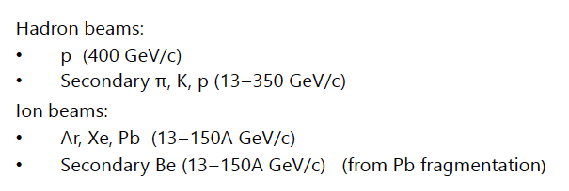
.
Strong interaction
The onset of deconfinement
Search for the critical point
Measurement for open charm
Measurements for neutrino
programs (J-park and Fermilab)
Cosmic ray physics
Isospin symmetry violation
Beams for NA61/SHINE Experiment:
[1] NA61/SHINEdetector overview,
https://indico.cern.ch/event/1174830/contributions/5174346/attachments/2567605/4426948/na61_det.pdf

Slide 4
National Nuclear Research Center, Azerbaijan
Faculty of Physics, University of Sofia, Bulgaria
Ruder Boskovic Institute, Croatia
LPNHE, University of Paris VI and VII, France
Karlsruhe Institute of Technology, Germany
Fachhochschule Frankfurt, Germany
Institut für Kernphysik, Goethe-Universität, Germany
Nuclear and Particle Physics Division, University of Athens, Greece
Wigner RCP, Hungary
Institute for Particle and Nuclear Studies (KEK), Japan
University of Bergen, Norway
Institute of Physics, Jan Kochanowski University, Poland
National Center for Nuclear Research, Poland
Institute of Physics, Jagiellonian University, Poland
Institute of Physics, University of Silesia, Poland
Faculty of Physics, University of Warsaw, Poland
Department of Physics and Astronomy, University of Wroclaw, Poland
Faculty of Physics, Warsaw University of Technology, Poland
Institute for Nuclear Research, Russia
Joint Institute for Nuclear Research, Russia
St. Petersburg State University, Russia
National Research Nuclear University MEPhI (Moscow Engineering Physics Institute), Russia
University of Belgrade, Serbia
ETH Zürich, Switzerland
University of Bern, Switzerland
University of Geneva, Switzerland
University of Colorado Boulder, USA
Los Alamos National Laboratory, USA
Department of Physics and Astronomy, University of Pittsburgh, USA
Fermilab, Neutrino Division, USA

Slide 5
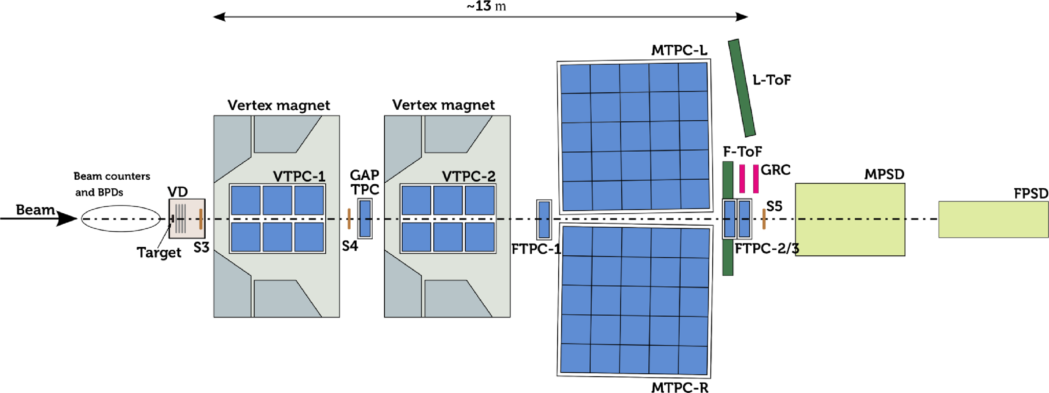
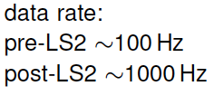
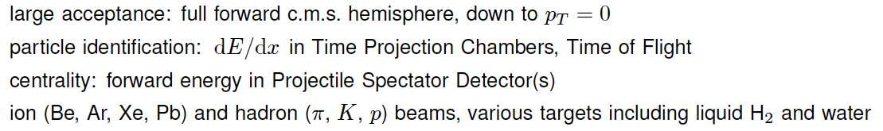
Fixed target experiment in the North area of SPS at CERN:
tracking efficiency: > 95%
Vertex Detector for open charm measurements
Double-wall He beam-pipe inside the VTPC1 and VTPC2
[1] NA61/SHINEdetector overview,
https://indico.cern.ch/event/1174830/contributions/5174346/attachments/2567605/4426948/na61_det.pdf
Notes:
GRC - Geometry Reference Chamber
Calibrate TPC y-drift coordinate
Two GRCs chambers are installed
GRC - Geometry Reference Chamber
• Calibrate TPC y-drift coordinate
• Two GRCs chambers are installed
• (40 x 120 cm MWPC)

Slide 6

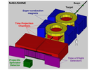
Example of St.Petersburg State University technologies for NA61(SHINE)
Left: Extra-thin double-wall He beam pipe installed in 2012 in the gas volume between two field cages in the VTPC-1 of NA61(SHINE). The same in VTPC-2
This He beam pipe reduces the background interactions in the VTPCs by about a factor of 10.
NA61/SHINE facility at the CERN SPS: beams and detector system, 2014 JINST 9 P06005, doi:10.1088/1748-0221/9/06/P06005

Slide 7
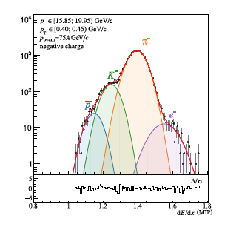
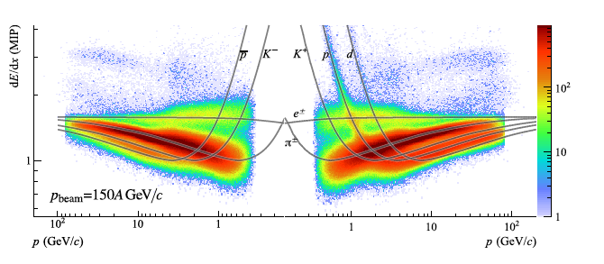
Charged particle identification by energy loss measurement in set of TPCs[1] cc/c
.
The dE/dx distributions for negatively
charged particles in a selected pT
bin produced in central Ar+Sc collisions
at 75AGeV/c. Solid line -- fits by a sum of
Contributions from different particle types.
Distribution of charged particles in dE/dx -- p plane
[1] NA61/SHINE Collaboration, Measurements of π±, K±,p and anti-p spectra in 40Ar+45Sc collisions at 13A to 150A GeV/c, Eur. Phys. J. C 84, 416 (2024).
https://doi.org/10.1140/epjc/s10052-024-12602-2
Notes:
arXiv:2308.16683v4 [nucl-ex] 23 Apr 2024
Measurements of .±, K±,
p
and
p
spectra in
40Ar+45Sc collisions at 13A to 150A GeV/
/c

Slide 8
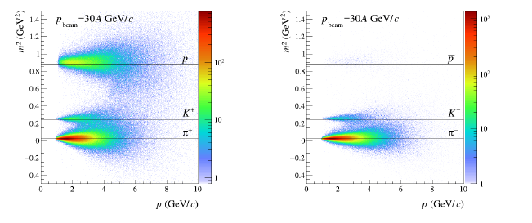


Charged particle identification by ToF measurements [1]
L – length of trajectory
.
p[GeV/c]
p[GeV/c]
[1] NA61/SHINE Collaboration, Measurements of π±, K±,p and anti-p spectra in 40Ar+45Sc
collisions at 13A to 150A GeV/c, Eur. Phys. J. C 84, 416 (2024).
https://doi.org/10.1140/epjc/s10052-024-12602-2

Slide 9
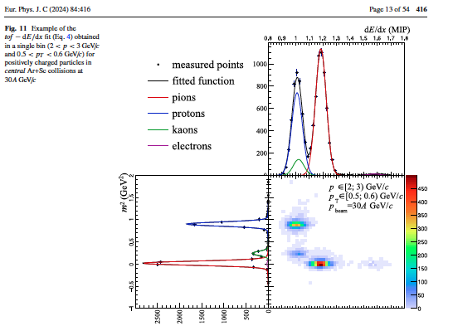
Charged particle identification by ToF – dE/dx measurements [1]
.
[1] NA61/SHINE Collaboration, Measurements of π±, K±,p and anti-p spectra in 40Ar+45Sc collisions at 13A to 150A GeV/c, Eur. Phys. J. C 84, 416 (2024).
https://doi.org/10.1140/epjc/s10052-024-12602-2

Slide 10
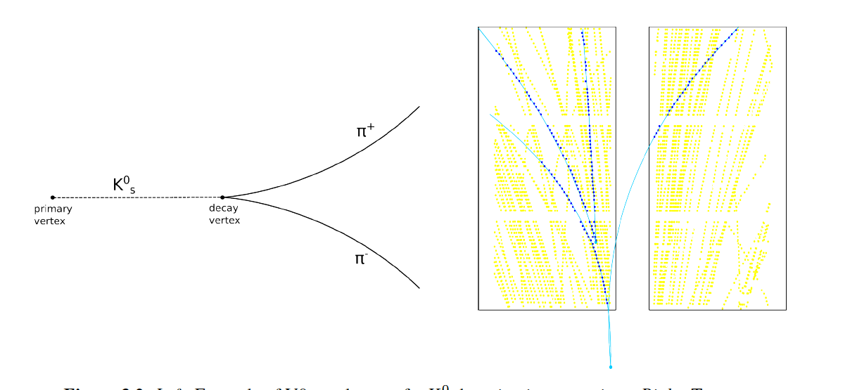
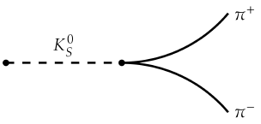
Identification of weakly decaying neutral particles by V0 topology and energy loss measurement in set of TPCs[1]
.
Decay topology for K⁰_{s} decay :
Left: Example of V0 topology as for K⁰_{S} decaying into two pions.
Right: Two reconstructed V0 decays in NA61/SHINE spectrometer.
Yellow points are TPC clusters and blue lines represent two reconstructed V0 decays.
TPC clusters belonging to V0 daughter tracks are marked as blue point
Wojciech Bryliński Thesis, Study of K⁰_{S} meson production in central Ar+Sc
collisions at SPS energies, Warsaw University of Technology, PhD, Submitted: 2023, Defended: 2023-07-12 https://repository.cern/records/5fv5z-ez421
Notes:
GRC - Geometry Reference Chamber
Calibrate TPC y-drift coordinate
Two GRCs chambers are installed
GRC - Geometry Reference Chamber
• Calibrate TPC y-drift coordinate
• Two GRCs chambers are installed
• (40 x 120 cm MWPC)

Slide 11
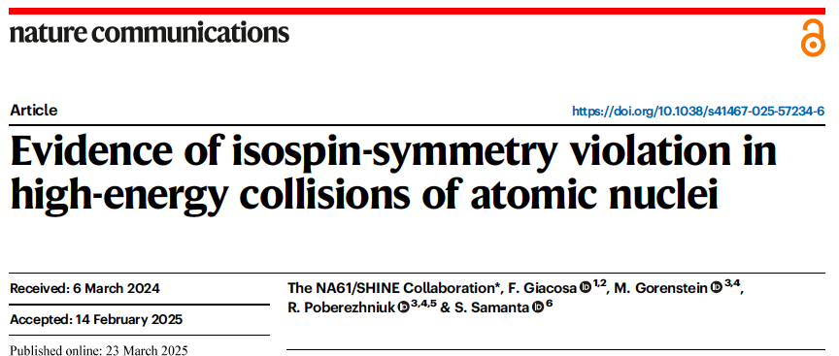
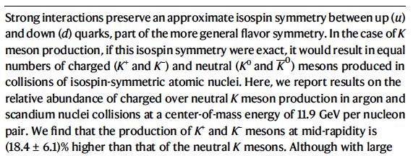
.
.
….
….The significance of the flavor-symmetry violation beyond the known effects is 4.7σ when the compilation of world data with uncertainties quoted by the experiments is used.
…
Notes:
Изотопи́ческий спин (изоспи́н) — одна из внутренних характеристик (квантовое число), определяющая число зарядовых состояний адронов.
Понятие изотопического спина было введено Гейзенбергом в 1932 г.[

Slide 12
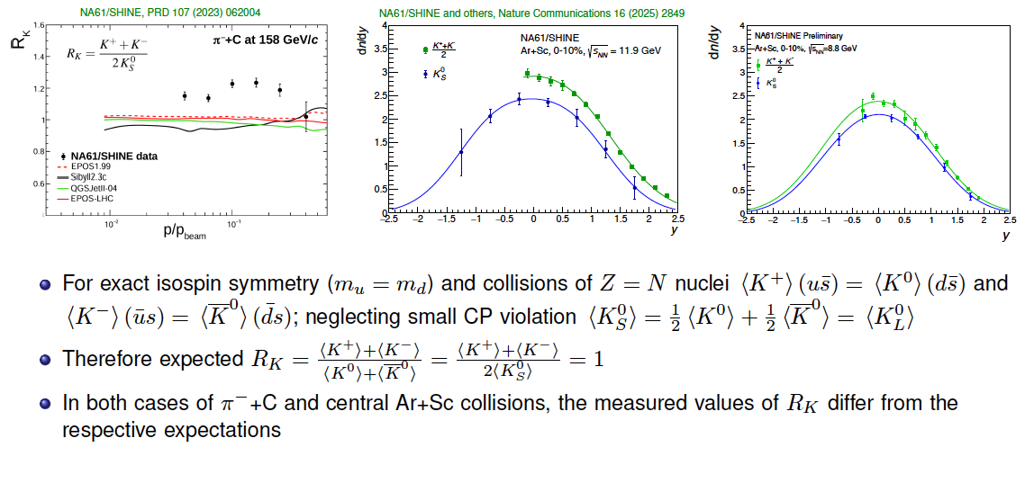
Evidence of isospin-symmetry violation in kaon production: new data by NA61/SHINE[1]
.
[1] Antoni Marcinek (for NA61/SHINE Collaboration), Strange and Non-Strange Particle Production in Small, Intermediate-Size, and Heavy-Ion Systems at SPS Energies, report at the 18th Workshop on Particle Correlations and Femtoscopy, 19 May 2026, Budapest, Hungary
https://indico.cern.ch/event/1679596/contributions/
Notes:
GRC - Geometry Reference Chamber
Calibrate TPC y-drift coordinate
Two GRCs chambers are installed
GRC - Geometry Reference Chamber
• Calibrate TPC y-drift coordinate
• Two GRCs chambers are installed
• (40 x 120 cm MWPC)

Slide 13
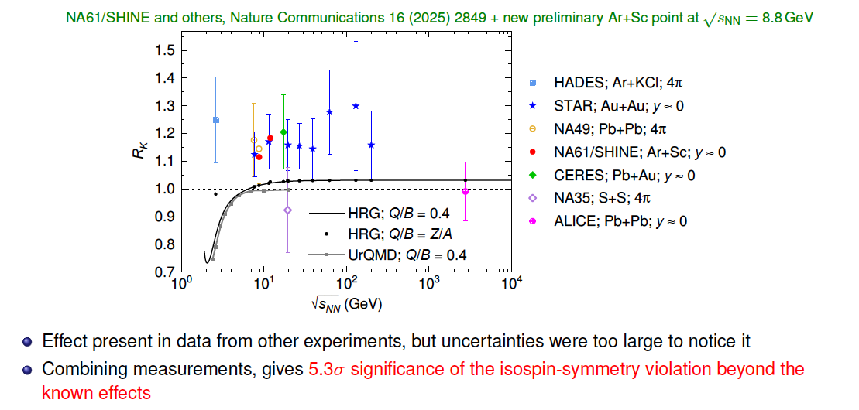

Evidence of isospin-symmetry violation in kaon production: world and new data by NA61/SHINE
for Ar+Sc at √sNN-8.8 GeV[1]
.
[1] Antoni Marcinek (for NA61/SHINE Collaboration), Strange and Non-Strange Particle Production in Small, Intermediate-Size, and Heavy-Ion Systems at SPS Energies, report at the 18th Workshop on Particle Correlations a nd Femtoscopy, 19 May 2026, Budapest, Hungary
https://indico.cern.ch/event/1679596/contributions/
Notes:
GRC - Geometry Reference Chamber
Calibrate TPC y-drift coordinate
Two GRCs chambers are installed
GRC - Geometry Reference Chamber
• Calibrate TPC y-drift coordinate
• Two GRCs chambers are installed
• (40 x 120 cm MWPC)

Slide 14
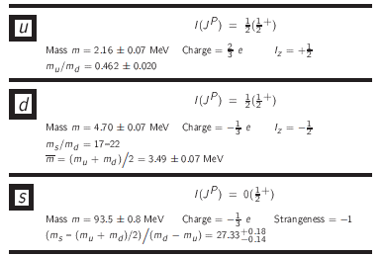
Violation of charge-symmetry invariance by known effects. Running quark masses [1]
These are the values of the "running” quark masses defined in the MS (Modified Minimal Subtraction) scheme at renormalization scale 𝜇=2GeV[1].
The masses of up and down quarks, m_{u} = 2.16 ± 0.07 MeV and m_{d} = 4.70 ± 0.07 MeV[1] are much smaller than the QCD scale, Λ_{QCD}
The different quark masses lead to different masses of charged and neutral kaons.
.
[1] Navas, S. et al. Review of particle physics. Phys. Rev. D 110, 030001 (2024).
Notes:
The MS-bar (Modified Minimal Subtraction) scheme is a mathematically rigorous method used to remove these infinities.

Slide 15
Effects of different masses of charged and neutral kaons?
The difference in the masses of the d and u quarks: Δ=4.7-2.16=2.54 MeV,
Accordingly, the relative magnitude of the differences in the masses of kaons is small: mK⁺=mK⁻ = 493.7 MeV, mK⁰=mK⁰=497.6 MeV→ the difference leads to an increase of R_{K} resulting from direct kaon production by about 0.02.
The influence of this mass difference on R_{K} was quantified using the statistical HRG model --by removing resonances from the particle list of HRG. It was numerically verified that HRG for Q/B = 1/2 and with exact isospin symmetry gives R_{K} = 1, as expected[1]
Role of resonances: ϕ(1020) meson decays about 1.45 more frequently into charged kaons than neutral ones (This large difference is because the ϕ(1020) mass is just above the kaon-kaon thresholds). Including the kaon production from resonance decay increases R_{K} by about 0.03 [1].
Role of decay of resonances a₀(980) and f₀(980)--one gets an increase of R_{K} by about 0.5%. The account of electromagnetic interaction between K⁺ and K⁻ in this decay leads to the increase of R_{K} by at most 3% at the highest collision energy[1]. See the next slide →
..
[1] The NA61/SHINE Collaboration., Giacosa, F., Gorenstein, M. et al.
Evidence of isospin-symmetry violation in high-energy collisions of atomic nuclei. Nat Commun 16, 2849 (2025). https://doi.org/10.1038/s41467-025-57234-6

Slide 16
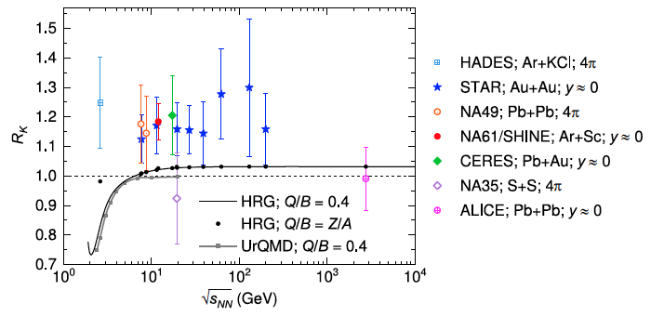
Effects of different quark masses in HRG and in UrQMD[1]
.
Fig. 3: The charged-to-neutral kaon ratio R_{K}
as a function of collision energy.
[1]The NA61/SHINE Collaboration., Giacosa, F., Gorenstein, M. et al.
Evidence of isospin-symmetry violation in high-energy collisions of atomic nuclei.
Nat Commun 16, 2849 (2025). https://doi.org/10.1038/s41467-025-57234-6
Notes:
The symbols show the experimental world data with total uncertainties; see Methods' “World data” subsection for details. The black line shows the HRG predictions for Q/B = 0.4. The black dots indicate the HRG predictions for Q/B values corresponding to the ones in the experiments. For different nuclei, Q/B corresponds to the electric charge over the baryon number of the whole system. The gray squares show UrQMD predictions. See Methods' “Models” subsection for details on models.
At energies larger than 10 GeV, the mass difference between charged and neutral kaons, leading to isospin-symmetry breaking (mostly via ϕ-meson decays), increases the R_{K} ratio by about 0.03.

Slide 17
Violation of charge-symmetry invariance by known effects
Electromagnetic interaction between K⁺ and K⁻ slightly increases the mass of K⁺ (both constituents u and s have positive charge), but slightly decreases the mass of K⁰ (the constituents d and s have opposite charges).[1]
The uu and dd pairs creation in strong processes may be affected by electromagnetic interactions due to different electric charges of up and down quarks. This leads to a different phase space for their production, favoring uu pairs and thus the charged kaons [1].
A model of the space-time evolution of the pair creation is needed
to quantify the effect.
[1] The NA61/SHINE Collaboration., Giacosa, F., Gorenstein, M. et al. Evidence of isospin-symmetry violation in high-energy collisions of atomic nuclei. Nat Commun 16, 2849 (2025). https://doi.org/10.1038/s41467-025-57234-6

Slide 18
Violation of charge-symmetry invariance
– novel explanation[1]:
Quite recently, the UrQMD approach has been modified by including violation of isospin symmetry [1] by the parametrized string breaking:
it brings as three times more probable to produce uu pair than a dd one;
Remarkably, in this way, the ratio R_{K} is also corretly described for data on kaon productions in e+e− and pp scattering[1].
See the next slide →
[1] Tom Reichert, Jan Steinheimer, and Marcus Bleicher. Explanation of the observed violation of isospin symmetry in relativistic nucleus-nucleus reactions. Phys. Lett. B , 873:140170, 2026.

Slide 19
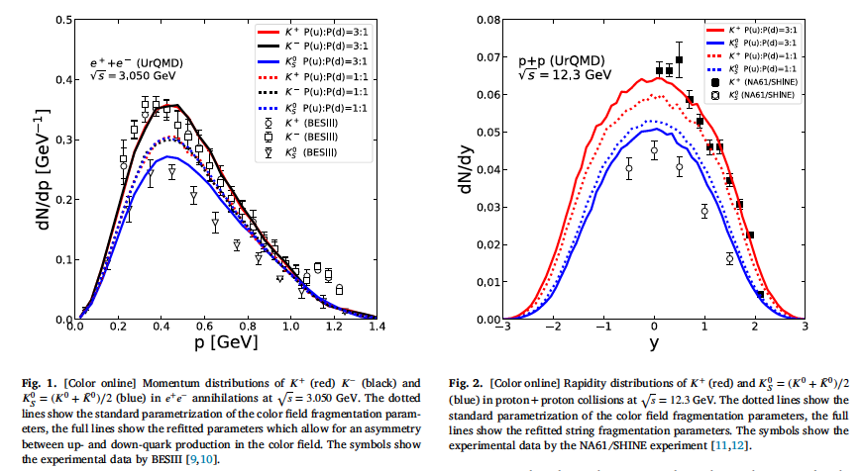
Violation of charge-symmetry invariance
– novel explanation [1]:
[1] Tom Reichert, Jan Steinheimer, and Marcus Bleicher. Explanation of the observed violation of isospin symmetry in relativistic nucleus-nucleus reactions. Phys. Lett. B , 873:140170, 2026
Notes:
Quite recently, the UrQMD approach has been modified by including violation of isospin symmetry [1] by the parameterized string breaking: it brings as three times more probable to produce uu pair than a dd one;
Remarkably, in this way, the ratio R_{K} is also correctly describing data on kaon productions in e⁺e⁻ and p+p scattering[1].

Slide 20
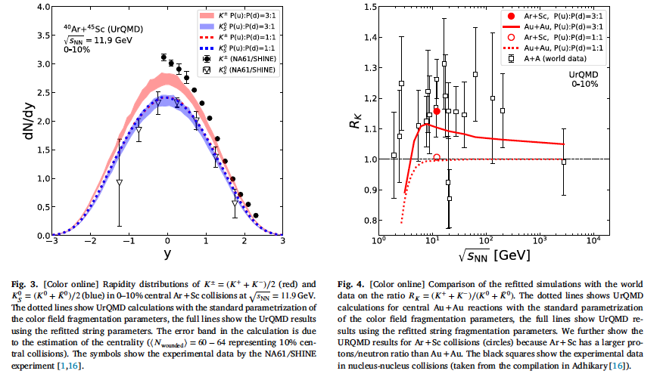
Violation of charge-symmetry invariance
– novel explanation [1]:
[1] Tom Reichert, Jan Steinheimer, and Marcus Bleicher. Explanation of the observed violation of isospin symmetry in relativistic nucleus-nucleus reactions. Phys. Lett. B , 873:140170, 2026

Slide 21
Our results on modification of the UrQMD code
“Modified UrQMD(3:1)” following the ideas of [1] on 3:1 probalities to produce uu pair vs. dd one
[1] Tom Reichert, Jan Steinheimer, and Marcus Bleicher. Explanation of the observed violation of isospin symmetry in relativistic nucleus-nucleus reactions. Phys. Lett. B , 873:140170, 2026

Slide 22
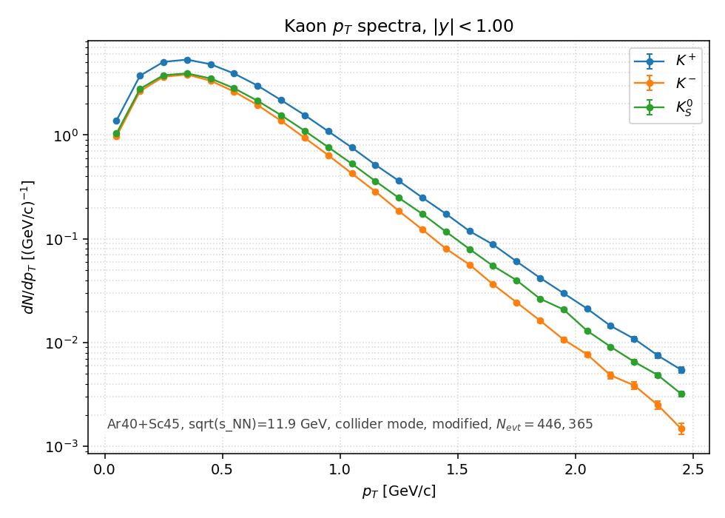
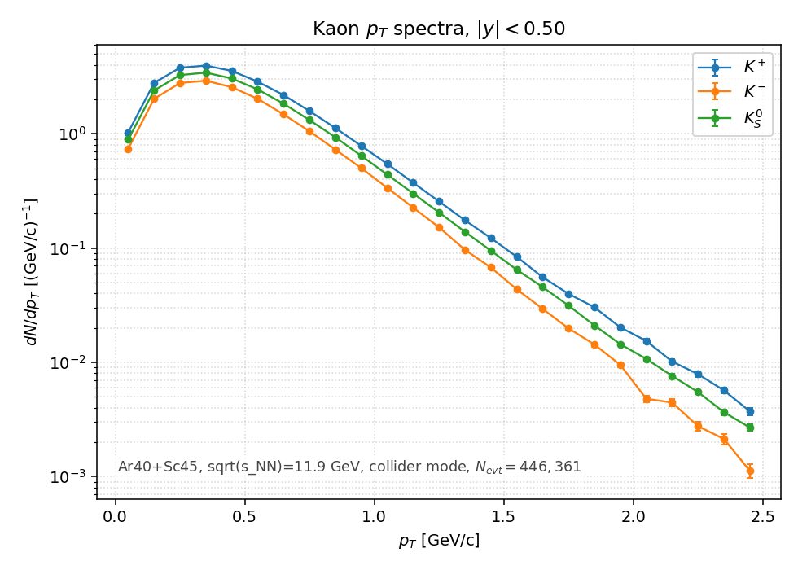
Default and our Modified UrQMD results for Ar+Sc √s_{NN}=11.9 GeV: pT spectra
Our UrQMD (default) results for Ar+Sc
Our modified UrQMD results for Ar+Sc
P(u):P(d)=3:1 (Preliminary)
“Soft” part (< 2 GeVc) of pT spectra of kaons appears to be different as calculated by the modified UrQMD in case of P(u):P(d)=3:1

Slide 23
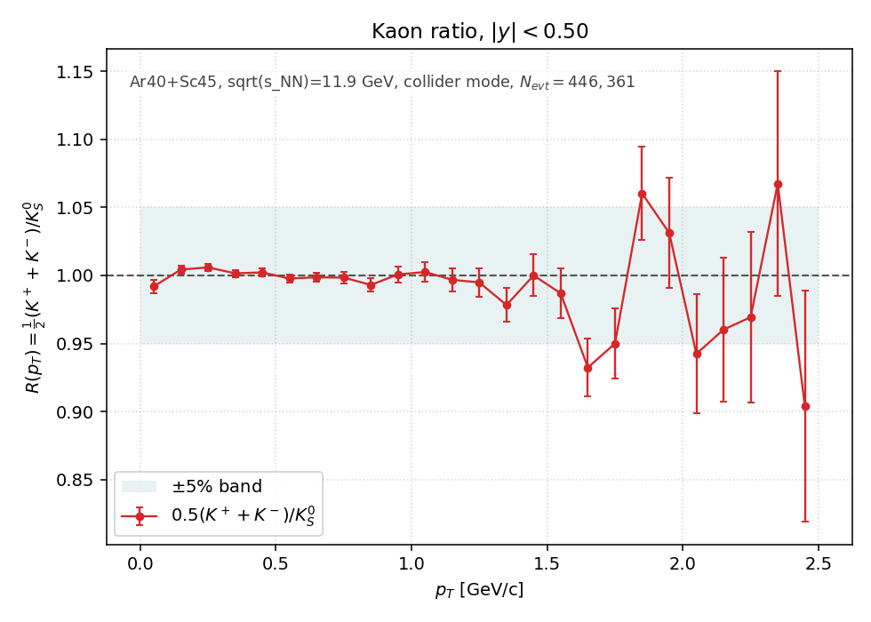
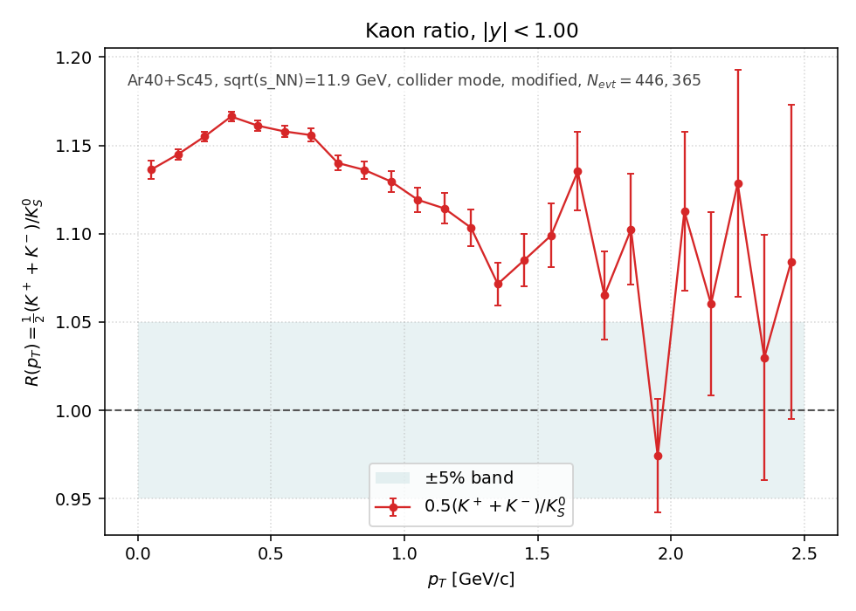
Default and our Modified UrQMD results for Ar+Sc √s_{NN}=11.9 GeV:
R_{k} (pT)
Our UrQMD (default) results foe Rk(pT)
In Ar+Sc at √s_{NN}=11.9 GeV
Our “Modified UrQMD(3:1)” results
for Ar+Sc with P(u):P(d)=3:1 (Preliminary)
Considerable effect of Isotopic Symmetry breaking is observed in R_{k} in pT spectra ratious predicted by the modified UrQMD in case of P(u):P(d)=3:1 in the “soft” part (< 1.5 GeVc) of spectra

Slide 24
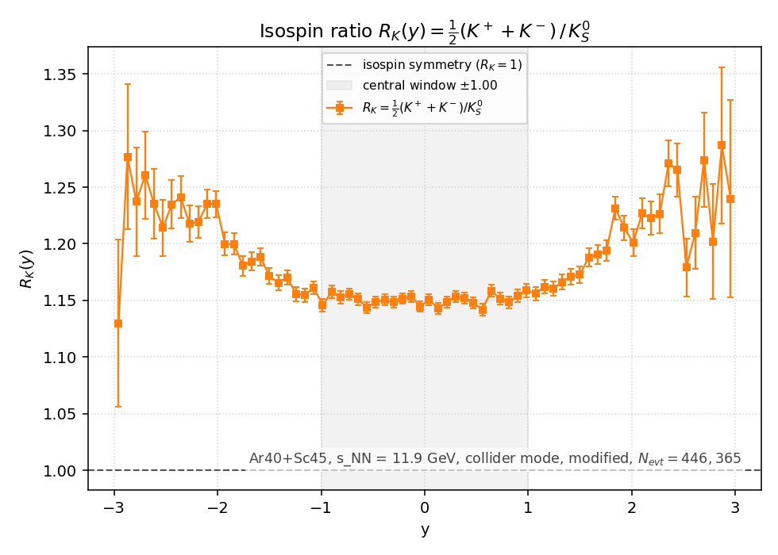
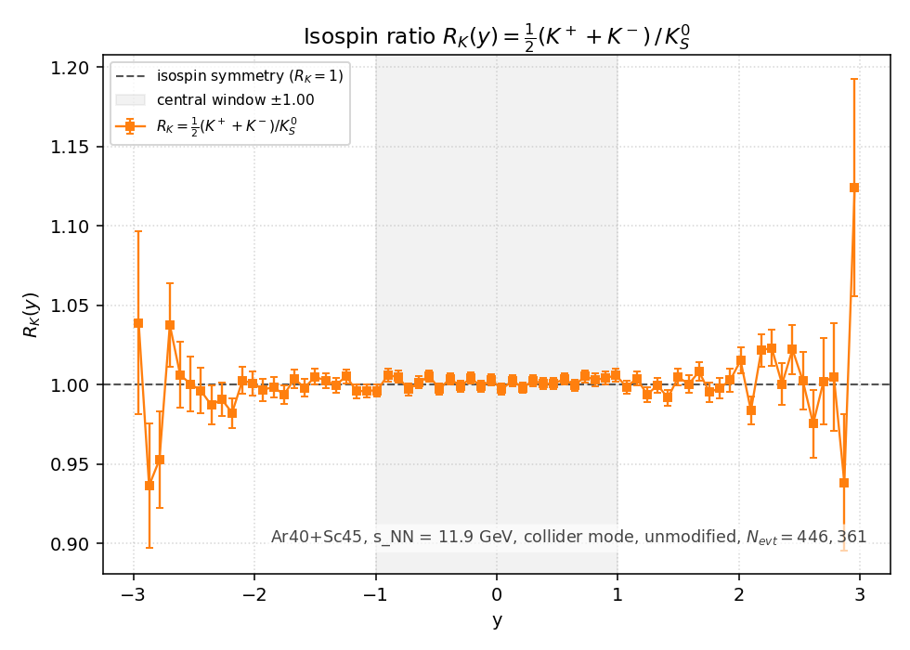
Default and our Modified UrQMD results for Ar+Sc at √s_{NN}=11.9 GeV
Ratios of rapidity distributions
Our modified UrQMD results for Ar+Sc
P(u):P(d)=3:1. (Preliminary)
Our UrQMD (default) results for Ar+Sc
The shape of “Modified UrQMD(3:1)” rapidity distribution appears to be different from the default UrQMD

Slide 25
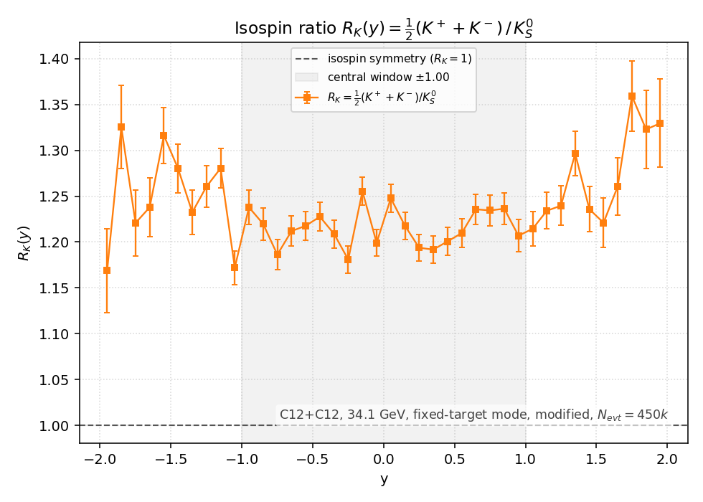
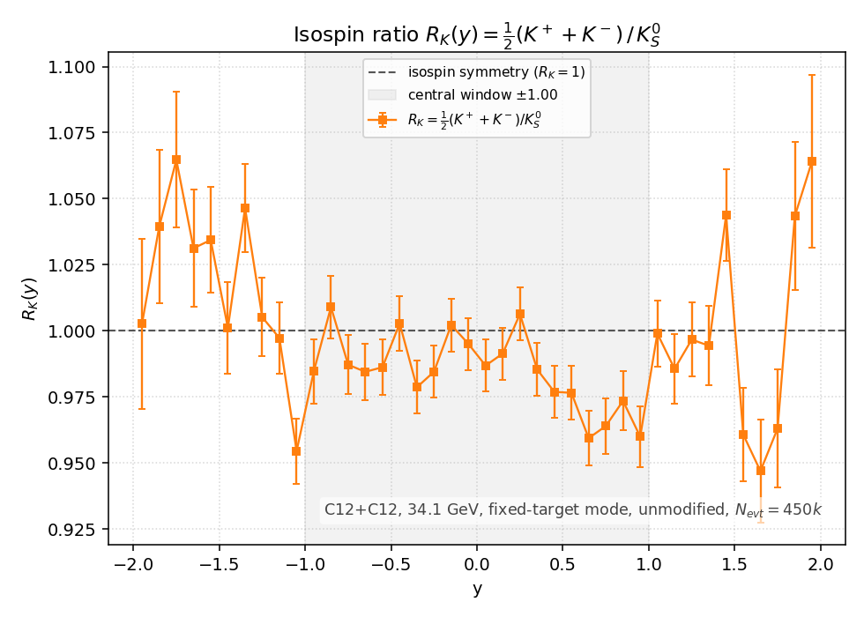
Default and our Modified UrQMD results for symmetric (Q/B=1/2) 12C+12C collisions,
-- an example at √s_{NN}=34 GeV:
Ratios of rapidity distributions
Our modified UrQMD results for 12+12C
P(u):P(d)=3:1
Our UrQMD (default) results
Considerable effect of Isotopic Symmetry Breaking is predicted by the “Modified UrQMD (3:1)” in ratious of rapidity distributions for the case of 12+12 C collisions at √s_{NN}=34 GeV
Figure is preliminary, statistics here is to be improved

Slide 26
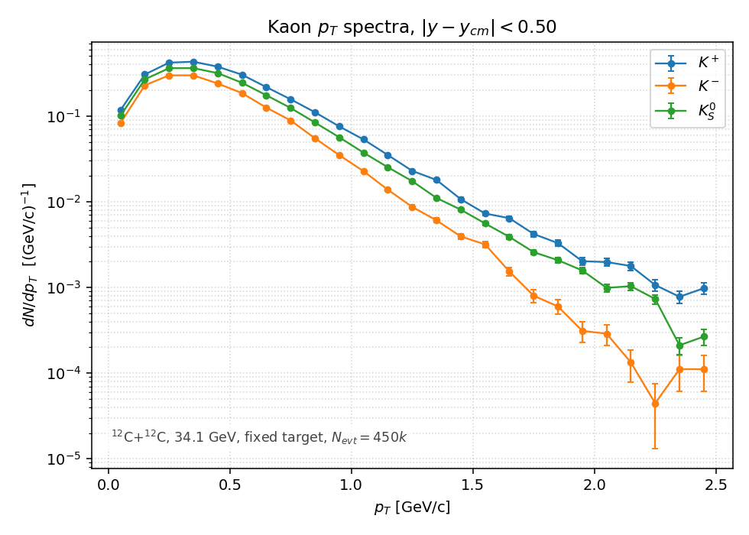
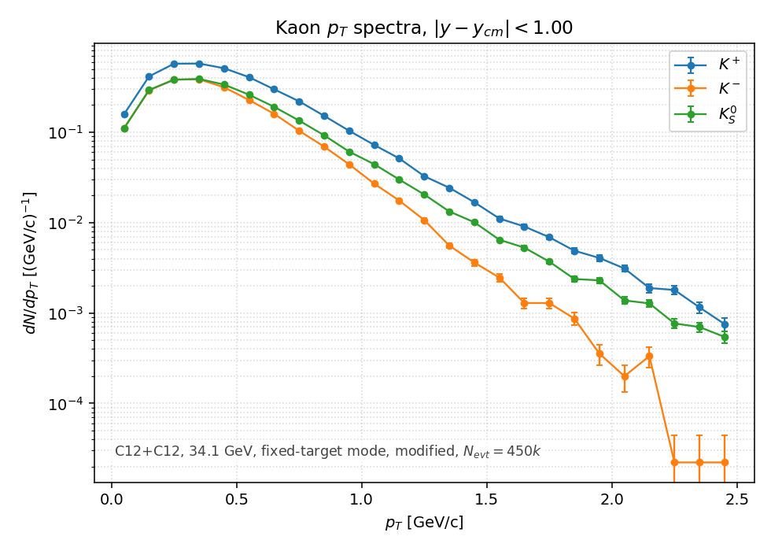
Default and our Modified UrQMD results for 12C+12C -- an example at √s_{NN}=34 GeV: pT spectra
Our modified UrQMD results for 12+12C
P(u):P(d)=3:1 (Preliminary)
Our UrQMD (default) results
“Soft” part (<1/5 GeVc) of pT spectra of kaons in two versions of the UrQMD is different

Slide 27
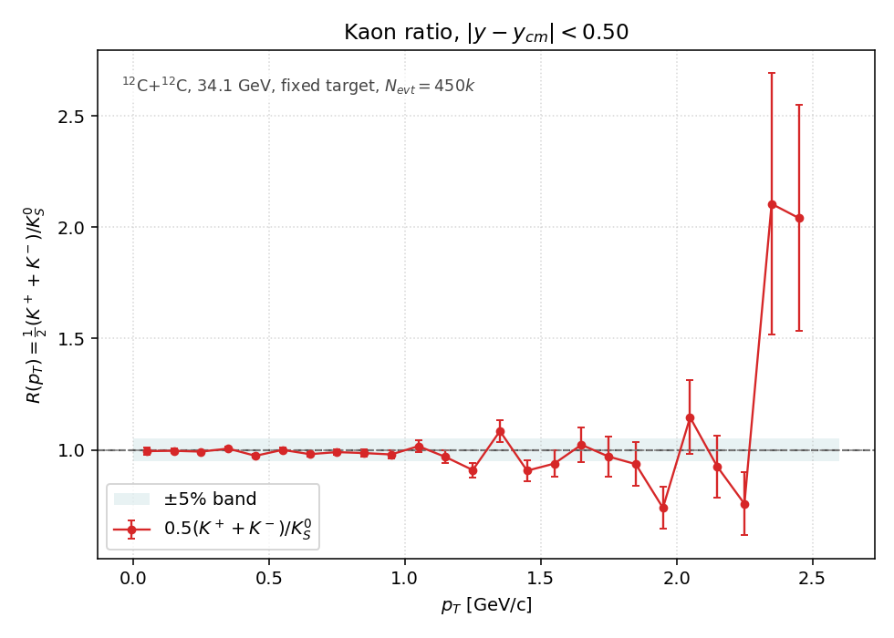
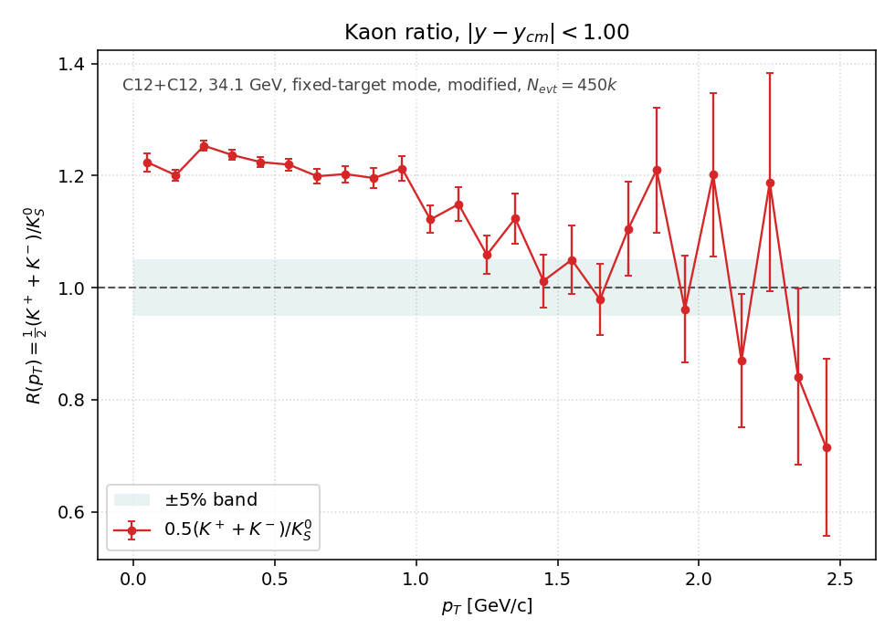
Default and our Modified UrQMD results for 12C+12C -- an example at √s_{NN}=34 GeV:
R_{k} (pT)
Our “Modified UrQMD(3:1)” results
for 12+12C with P(u):P(d)=3:1
Our UrQMD (default) results
Considerable effect of Isotopic Symmetry Breaking is predictedby the modified UrQMD in case of P(u):P(d)=3:1 for 12+12 C collisions at √s_{NN}=34 GeV in the “soft” part (<1/5 GeVc) of pT spectra of kaons

Slide 28
Summary
Unexpected excess of charged-over-neutral kaon production in π−+C and Ar+Sc collisions was observed by NA61/SHINE at SPS thus confirming the earlier world data
This indicates, in Ar+Sc reactions, the violation of isospin symmetry at the level of significance 5.3σ beyond the known effects
Explanation of the observed violation on the base of different probabilities of uu and dd quark pairs production (3:1) in the color field, proposed in [Phys. Lett. B , 873:140170, 2026], requires additional checks and theoretical efforts for the fundamental understanding
Our Modified UrQMD(3:1) results for Ar+Sc and for symmetric 12C+12C collisions show also, in both cases, that the level of violation of isospin symmetry could be different:
(i) for “soft” and”hard “ parts of pT spectra and
(ii) for rapidity distributions of R_{k} values at midrapiidity and large rapidity regions.
New experimental tests are required both for symmetric (Q/B=1/2)
and non-symmetric (Q/B<1/2) nucleus-nucleus collisions

Slide 29
Back-up slides
.

Slide 30
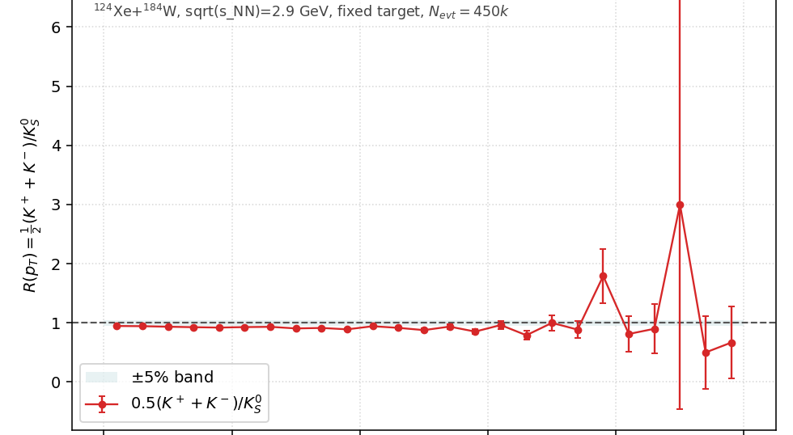
R_{k} (pT) <1 in UrQMD in case of non-symmetric collisions (Q/B<1/2): an example for Xe+W 0-10% central collisions

