Slide 1
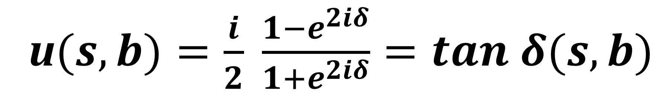
u$(s,b)=\frac{i}{2} \frac{1−e^{2iδ}}{1+e^{2iδ}}=tan δ(s,b)$

Slide 2

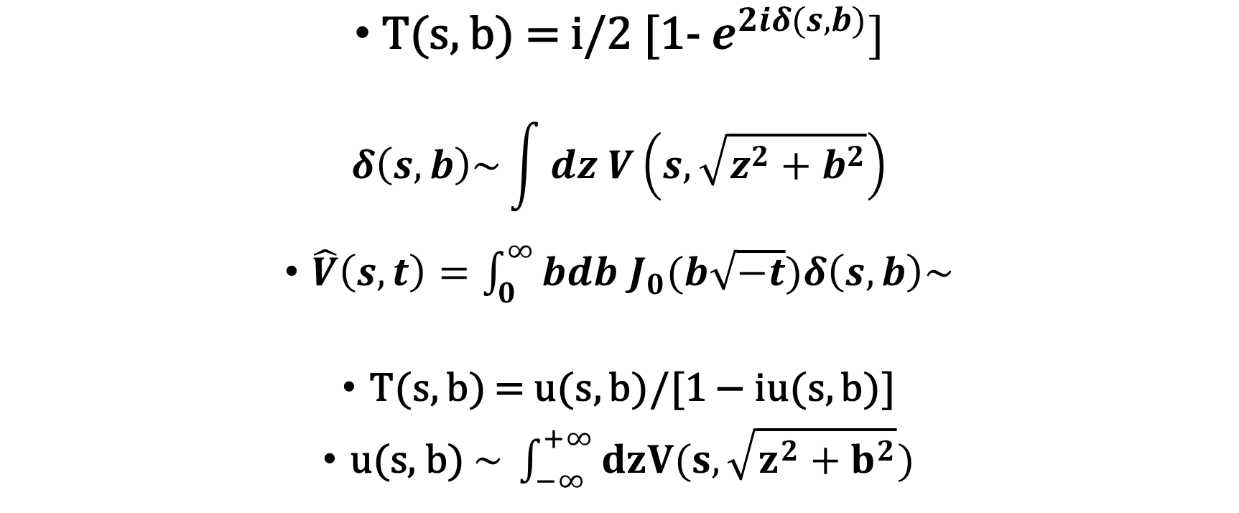

Eikonal or U-Matrix?
$\text{T}\text{(}\text{s}\text{, }\text{b}\text{) =} \text{i}\text{/2 [1−}{ e}^{2iδ(s,b)}]$
$$δ\left(s,b\right)\sim \int{dz V\left(s,\sqrt{z^{2}+b^{2}}\right)}$$
$\hat{V}\left(s,t\right)=\int_{0}^{∞}{bdb}$ $J_{0}(b\sqrt{−t})δ\left(s,b\right)\sim$
T(s, b) = u(s, b)/[1 − iu(s, b)]
$\text{u}\text{(}\text{s}\text{, }\text{b}\text{)} \sim \int_{−∞}^{+∞}{dzV(s,\sqrt{z^{2}+b^{2}}})$
$$\sum{s^{ J} \sim }$$
$$s^{α(t)}$$
?

Slide 3
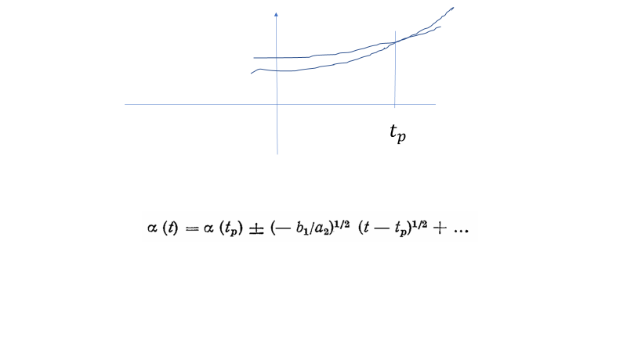
Intersecting trajectories are dangerous
(to Selyugin Model)

Slide 4
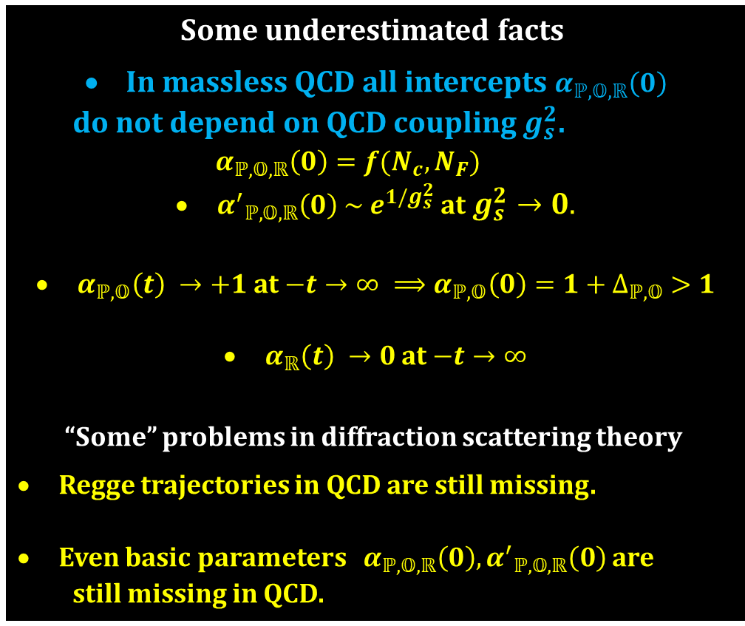
Some underestimated facts
In massless QCD all intercepts $α_{ℙ,𝕆,ℝ}\left(0\right)$
do not depend on QCD coupling $g_{s}^{2}$.
$$α_{ℙ,𝕆,ℝ}\left(0\right)=f(N_{c}, N_{F})$$
${α^{′}}_{ℙ,𝕆,ℝ}\left(0\right) \sim { e}^{1/g_{s}^{2}}$ at $g_{s}^{2}→0.$
$α_{ℙ,𝕆}\left(t\right) →+1$at $−t→∞ ⟹α_{ℙ,𝕆}\left(0\right)=1+∆_{ℙ,𝕆} >1$
$α_{ℝ}\left(t\right) →0$at $−t→∞$
“Some” problems in diffraction scattering theory
Regge trajectories in QCD are still missing.
Even basic parameters $α_{ℙ,𝕆,ℝ}\left(0\right), {α^{′}}_{ℙ,𝕆,ℝ}\left(0\right)$ are
still missing in QCD.

