Slide 1

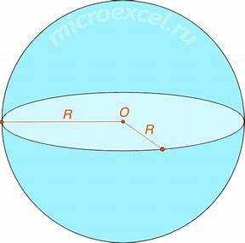
On Radii of Hadrons
XXXVII International Workshop on High Energy Physics
“Diffraction of hadrons: Experiment, Theory, Phenomenology.”
Protvino, 22-24 July 2025.
Vladimir A. Petrov
A.A. Logunov Institute for High Energy Physics
NRC ”Kurchatov Institute”, Protvino, RF

Slide 2

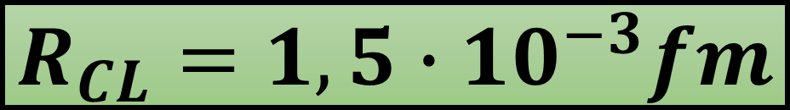
Classical proton radius
$$R_{CL}=1,5∙{10}^{−3}fm$$

Slide 3
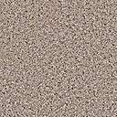
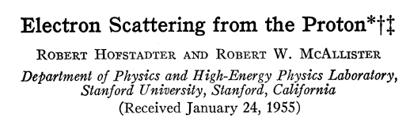
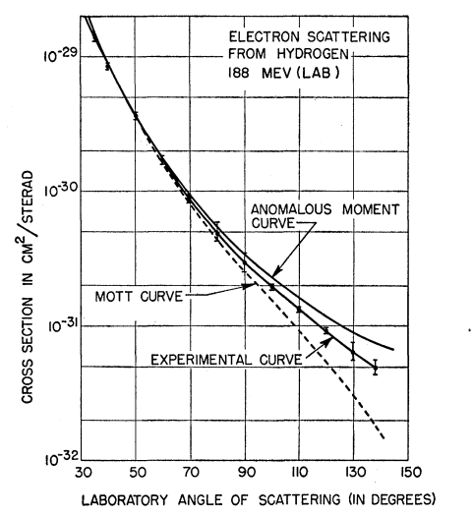
“If the proton were a spherical ball of charge, this rms radius would indicate a true radius of $9.5×{10}^{−14}$cm…” (0.95 fm)

Slide 4

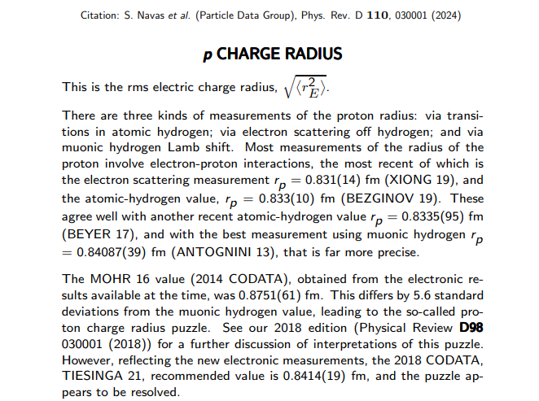
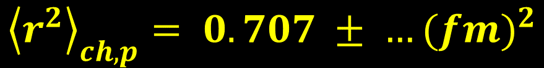
MEAN-SQUARE CHARGE RADIUS
$${\left\langle r^{2}\right\rangle }_{ch, p}= 0.707 ± …({fm)}^{2}$$
$${\left\langle r^{2}\right\rangle }_{ch, n}= −0.115 ± …({fm)}^{2}$$

Slide 5
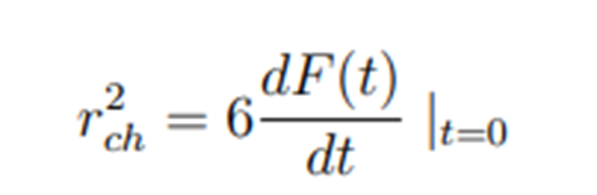
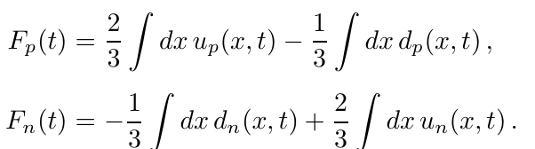
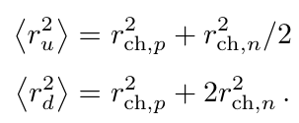
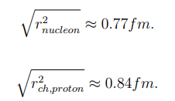


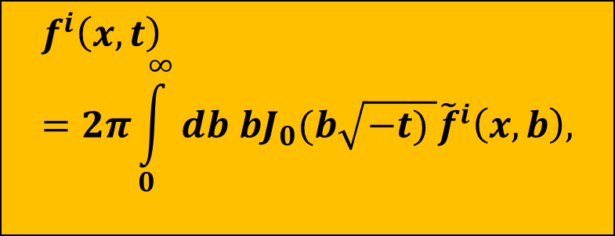
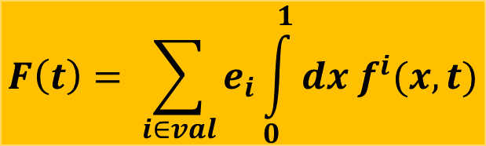
From “charge radius" to physical radius of nucleon
$$F\left(t\right)= \sum_{i∈val}{e_{i}\int_{0}^{1}{dx f^{i}(x,t)}}$$
$$f^{i}\left(x,t\right)=2π\int_{0}^{∞}{db bJ_{0}(b\sqrt{−t) }{\tilde{f}}^{i}\left(x,b\right), }$$
$f^{i}\left(x,t=0\right)$ ${= f}^{i}\left(x\right), i=u,d$
Physical radii

Slide 6
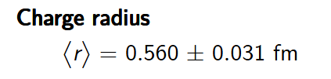
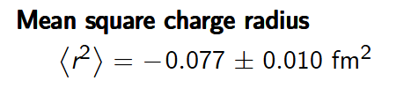



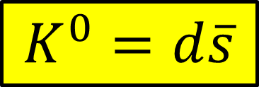
$K^{+}=u\overline{s}$
MESONS
$\left\langle r\right\rangle ={\left\langle r^{2}\right\rangle }^{1/2}, \left\langle r^{2}\right\rangle =0.313±0.001 {fm}^{2}$
$$K^{0}=d\overline{s}$$
$F_{K^{+}}\left(t\right)=\frac{2}{3}\int{dx}u_{K^{+}}\left(x,t\right)+\frac{1}{3}\int{dx}{\overline{s}}_{K^{+}}\left(x,t\right),$ ${ F}_{K^{0}}\left(t\right)=−\frac{1}{3}\int{dx}d_{K^{0}}\left(x,t\right)+\frac{1}{3}\int{dx}{\overline{s}}_{K^{0}}\left(x,t\right)$
${SU}_{f}\left(3\right):d_{K^{0}}\left(x,t\right)=u_{K^{+}}\left(x,t\right)$; ${\overline{s}}_{K^{0}}\left(x,t\right)= {\overline{s}}_{K^{+}}\left(x,t\right)$
${\left\langle r^{2}\right\rangle }_{\left\langle K^{+}\right\rangle }=\frac{2}{3}{\overline{r}}_{u}^{2}\left(K^{+}\right)+\frac{1}{3}$ ${\overline{r}}_{\overline{s}}^{2}\left(K^{+}\right){; \left\langle r^{2}\right\rangle }_{\left\langle K^{0}\right\rangle }=−\frac{1}{3}{\overline{r}}_{u}^{2}\left(K^{+}\right)+\frac{1}{3} {\overline{r}}_{\overline{s}}^{2}\left(K^{+}\right)$
$${\overline{r}}_{u}^{2}\left(K^{+}\right)=0.39{fm}^{2}$$
$${\overline{r}}_{\overline{s}}^{2}(K^{+})=0.16{fm}^{2}$$
Physical radii:
$${\overline{r}}_{K^{+}}^{2}= {\overline{r}}_{K^{0}}^{2}=0.275{fm}^{2}={(0.525 fm)}^{2}$$

Slide 7

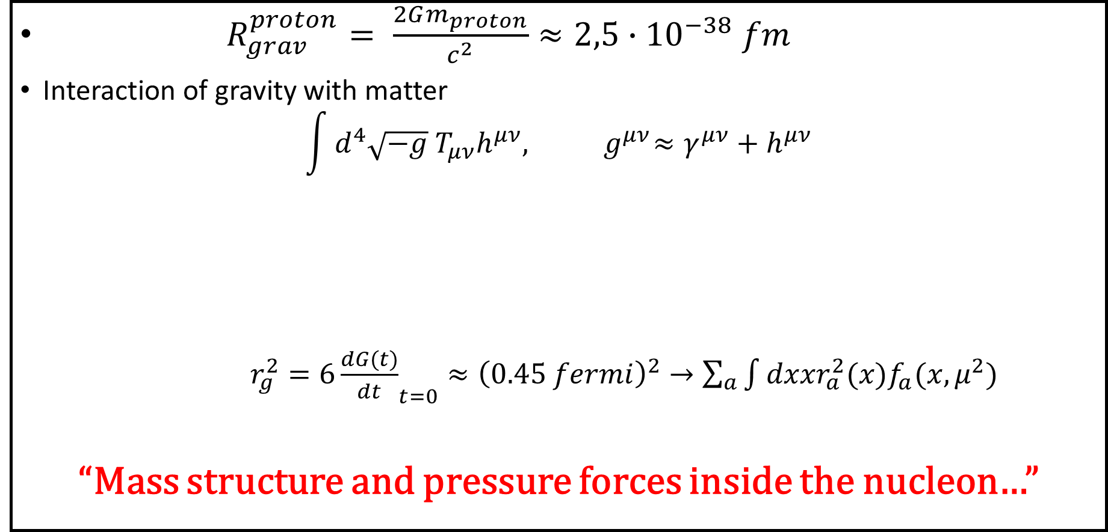
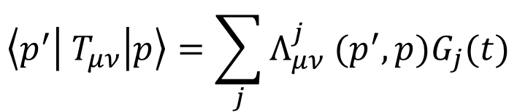
"Gravitational radius" of the proton.
Strength of materials inside a hadron?!
$R_{grav}^{proton}= \frac{2Gm_{proton}}{c^{2}}≈2,5∙{10}^{−38} fm$
Interaction of gravity with matter
$$\int{d^{4}\sqrt{−g}{ T}_{μν}h^{μν}, { g}^{μν}≈γ^{μν}+h^{μν}}$$
$r_{g}^{2}=6{\frac{dG(t)}{dt}}_{t=0}≈{\left(0.45 fermi\right)}^{2}→\sum_{a}{\int{dxxr_{a}^{2}(x)f_{a}(x, μ^{2})}}$
“Mass structure and pressure forces inside the nucleon…”
$$\left\langle p^{′} | T_{μν} | p\right\rangle =\sum_{j}{Λ_{μν}^{j} (p^{′},p)G_{j}(t)}$$

Slide 8
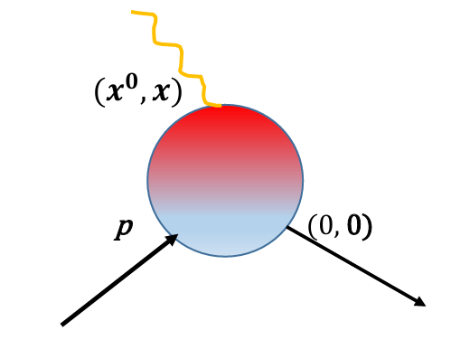
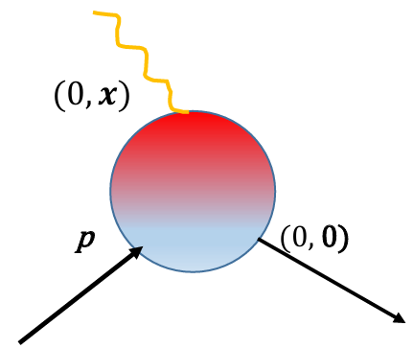
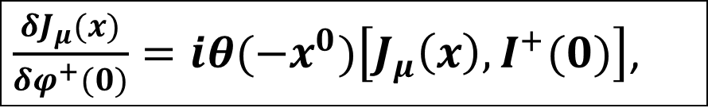
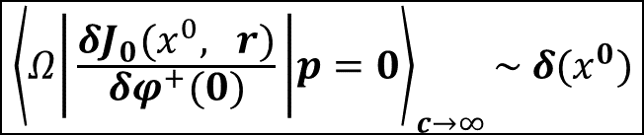

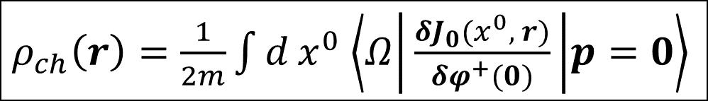

Distance and time
$F\left(t\right)= \frac{2p_{μ}}{4m^{2} −t}\left\langle p′ | J_{μ} | p\right\rangle =\int{d^{4}x e^{iqx}\left\langle Ω | \frac{δJ_{μ}(x)}{δφ^{+}(0)} | p\right\rangle , t= q^{2}}$
$\frac{δJ_{μ}(x)}{δφ^{+}(0)}=iθ(−x^{0})\left[J_{μ}\left(x\right), I^{+}(0)\right]$,
$$I^{+}\left(x\right)=(∂^{2}+m^{2}) φ^{+}(x)$$
$r_{ch}^{2}= \int{d r r^{2}}ρ_{ch}(r)$
$ρ_{ch}\left(r\right)=\frac{1}{2m}\int{d}x^{0}$ $\left\langle Ω | \frac{δJ_{0}(x^{0}, r)}{δφ^{+}(0)} | p=0\right\rangle$
$${\left\langle Ω | \frac{δJ_{0}(x^{0}, r)}{δφ^{+}(0)} | p=0\right\rangle }_{c→∞}\sim δ(x^{0})$$

Slide 9
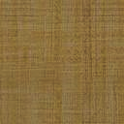
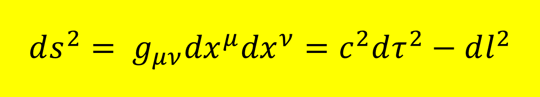
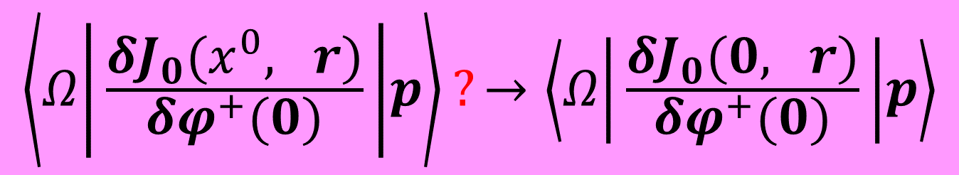
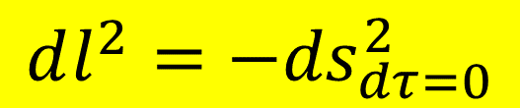
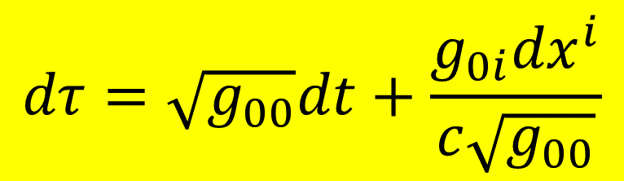
$$ds^{2}= g_{μν}{dx}^{μ}{dx}^{ν}=c^{2}dτ^{2}−dl^{2}$$
On the spatial size of bodies
$$dτ=\sqrt{g_{00}}dt+\frac{g_{0i}{dx}^{i}}{c\sqrt{g_{00}}}$$
$$dl^{2}=\left(−g_{ik}+g_{0i}g_{0k}/g_{00}\right){dx}^{i}{dx}^{k}$$
$$dl^{2}=−{ds}_{dτ=0}^{2}$$
$$\left\langle Ω | \frac{δJ_{0}(x^{0}, r)}{δφ^{+}(0)} | p\right\rangle ?→\left\langle Ω | \frac{δJ_{0}(0, r)}{δφ^{+}(0)} | p\right\rangle$$
Requires going
off mass shell!

Slide 10




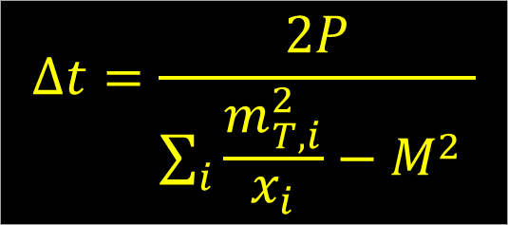
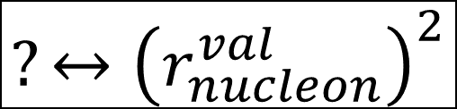
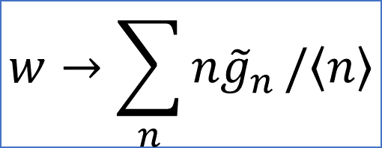
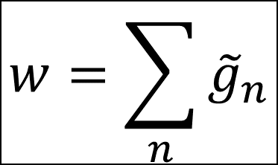
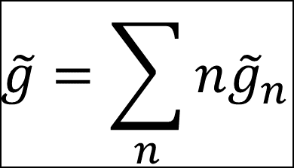

Parton picture (Bjorken-Feynman-Gribov)
$$∆t=\frac{2P}{\sum_{i}{\frac{m_{T, i}^{2}}{x_{i}}}−M^{2} }$$
$${(x}_{i}P, k_{T})$$
$$(P,0)$$
$$\tilde{g}=\sum_{n}{n{\tilde{g}}_{n}}$$
$$?↔{\left(r_{nucleon}^{val}\right)}^{2}$$
$$w=\sum_{n}{{\tilde{g}}_{n}}$$
$$w→\sum_{n}{n{\tilde{g}}_{n}}/\left\langle n\right\rangle$$
NO THEORY !

Slide 11
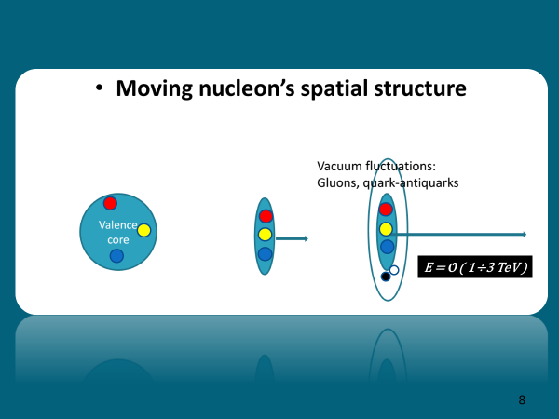



$$P^{∗}≈10 GeV$$

Slide 12
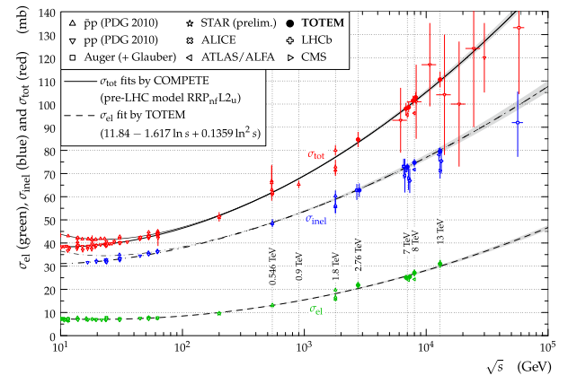

Slide 13
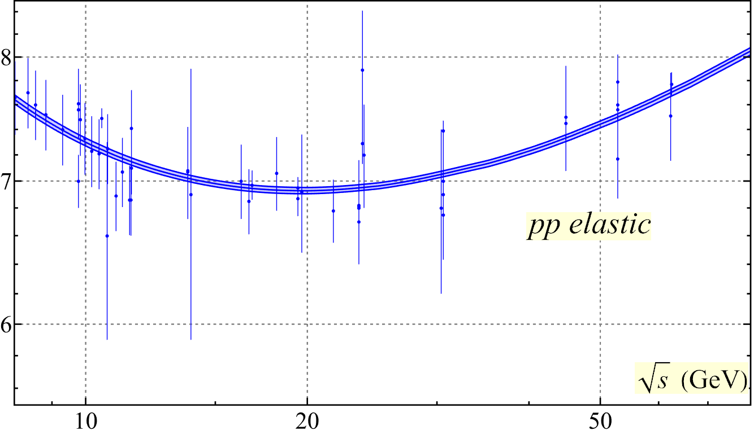
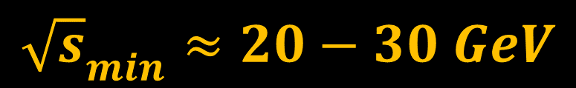
$${\sqrt{s}}_{min}≈20−30 GeV$$

Slide 14
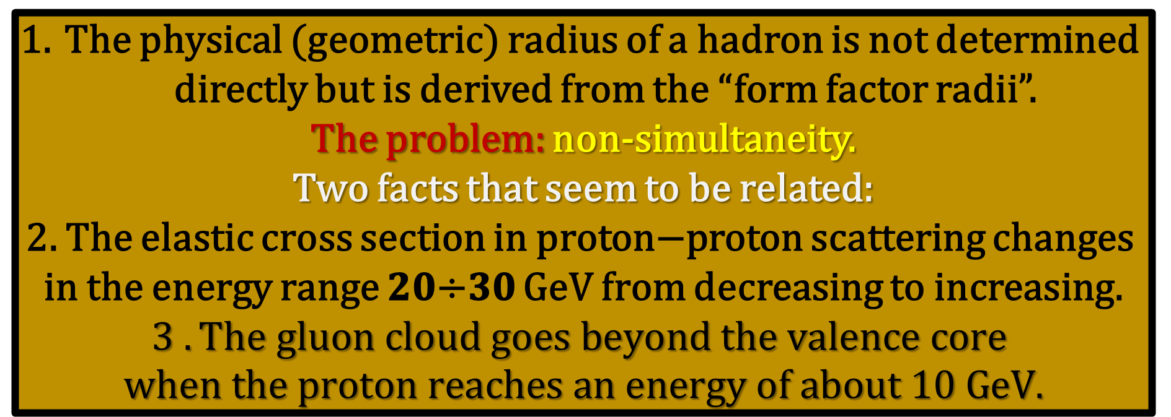
(Interim) conclusions
The physical (geometric) radius of a hadron is not determined
directly but is derived from the “form factor radii”.
The problem: non-simultaneity.
Two facts that seem to be related:
2. The elastic cross section in proton−proton scattering changes
in the energy range 𝟐𝟎÷𝟑𝟎 GeV from decreasing to increasing.
$$3 .The gluon cloud goes beyond the valence core$$
$$when the proton reaches an energy of about 10 GeV.$$

Slide 15
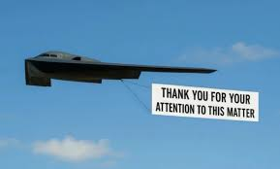

Slide 16
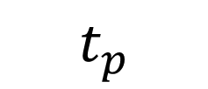
$$t_{p}$$

