Slide 1
Covariant reggeization framework
for diffraction
Roman Ryutin
NRC “Kurchatov institute” – IHEP, Protvino
XXXVII International Workshop on High Energy Physics “Diffraction of hadrons: Experiment, Theory, Phenomenology”
July 22-24, NRC “Kurchatov institute” – IHEP, Protvino

Slide 2
Plan
Introduction
Basics of the framework
Calculations
Further study
[V.A. Petrov, R.A. Ryutin, A.E. Sobol and J.-P. Guillaud, Azimuthal Angular Distributions in EDDE
as Spin-Parity Analyser and Glueball Filter for LHC, JHEP06(2005)007]
[R.A. Ryutin , Visualizations of exclusive central diffraction, Eur. Phys. J. C 74, 3162 (2014)]
[V.A. Petrov and R.A. Ryutin, Single and double diffractive dissociation and the problem of
extraction of the proton–Pomeron cross-section, Int. J. Mod. Phys. 31, No. 10, 1650049 (2016)]
[ R. Ryutin, Covariant reggeization framework for diffraction.
Part I: Hadronic tensors in Minkovsky space-time of any dimension
arXiv:2507.16019 [hep-ph] ]
XXXVII International Workshop on High Energy Physics “Diffraction of hadrons: Experiment, Theory, Phenomenology”
July 22-24, NRC “Kurchatov institute” – IHEP, Protvino
Notes:
This work is mainly concerned with mathematical combinatorial calculations. It may also have some pedagogical application, as it discusses ways of working with tensor representations of the Poincaré group and multivariate recurrent equations. This study is the direct continuation of our works which were written about 10 and 20 years ago.

Slide 3
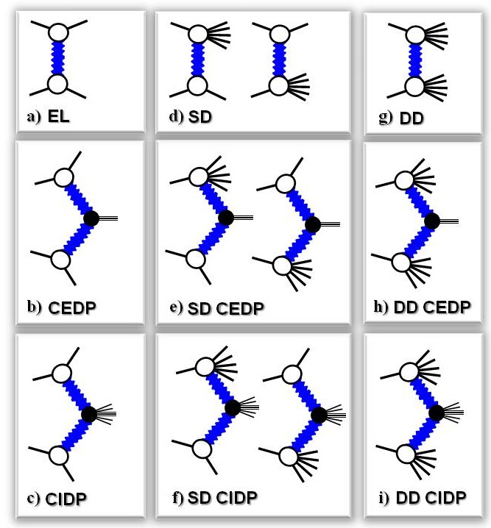
Introduction
Soft diffractive processes
(“bare” amplitudes)
What is a
“REGGEON”?
“POMERON”?
(trajectory, intercept,
residue, slope, …)
What if the reggeon is
a quantum field?
XXXVII International Workshop on High Energy Physics “Diffraction of hadrons: Experiment, Theory, Phenomenology”
July 22-24, NRC “Kurchatov institute” – IHEP, Protvino
Notes:
Here is the zoo of basic soft diffractive processes, which are usually under consideration. (EL,SD,...). Every of them has been studied experimentally for a long time. And the most important question for us, how to describe them properly in terms of the quantum field theory. Since Regge introduced an object which is the fundamental, say, "unity of diffraction" like a , for example, DNA in biology, every person who deals with it has been trying to find its characteristics like trajectory and intercept from basic principles, from the axioms of quantum field theory, from QCD, from string theory and so on.
In particular we are interested in Pomeron, which is supposed to give the main contribution to diffractive processes.
In this talk we ask another question, which begins with words that are common to us: "What if ...?" What if we consider a reggeon as a usual quantum field with a "complex" spin, which means that we consider the situation for any integer spin and then make analytical continuation for amplitudes into the complex momentum plane? The answer is that we can obtain something like classical Regge model, but with some nuances. Let us consider this approach.

Slide 4
What is “REGGEON”?
Gribov Reggeons
(in 2+1 …)
BFKL (QCD) …
Classical …
(10+ phenomenological models)
Continuous & High Spin Particles
(Wigner, Fronsdal etc.)
Hyper-Fields & Strings
+ Complex Momentum Plane
XXXVII International Workshop on High Energy Physics “Diffraction of hadrons: Experiment, Theory, Phenomenology”
July 22-24, NRC “Kurchatov institute” – IHEP, Protvino

Slide 5
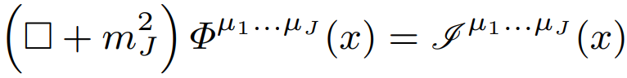
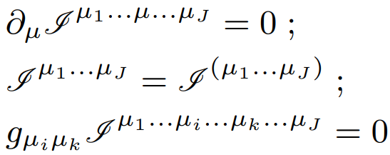
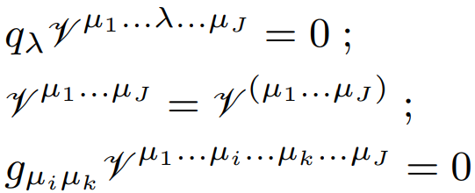
Basics
Current operator related to the
hadronic spin-J Heisenberg field operator
Rarita-Schwinger TST conditions
XXXVII International Workshop on High Energy Physics “Diffraction of hadrons: Experiment, Theory, Phenomenology”
July 22-24, NRC “Kurchatov institute” – IHEP, Protvino

Slide 6
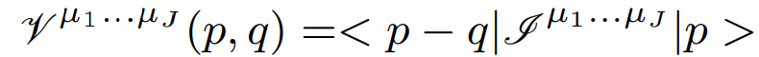
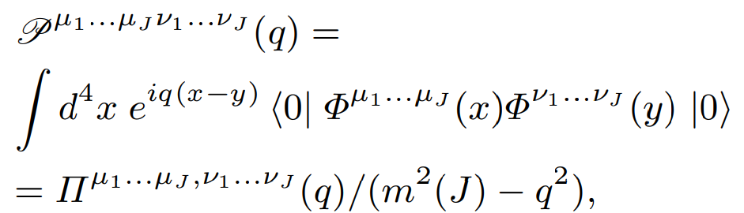
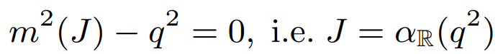
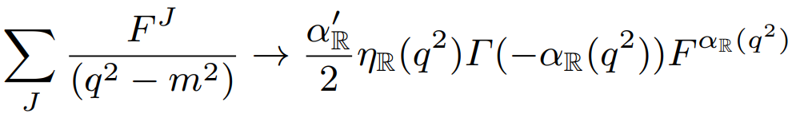
Basics
Scalar-Scalar-Spin-J vertex
Spin-J Propagator
Pole at
Reggeization prescription
XXXVII International Workshop on High Energy Physics “Diffraction of hadrons: Experiment, Theory, Phenomenology”
July 22-24, NRC “Kurchatov institute” – IHEP, Protvino

Slide 7
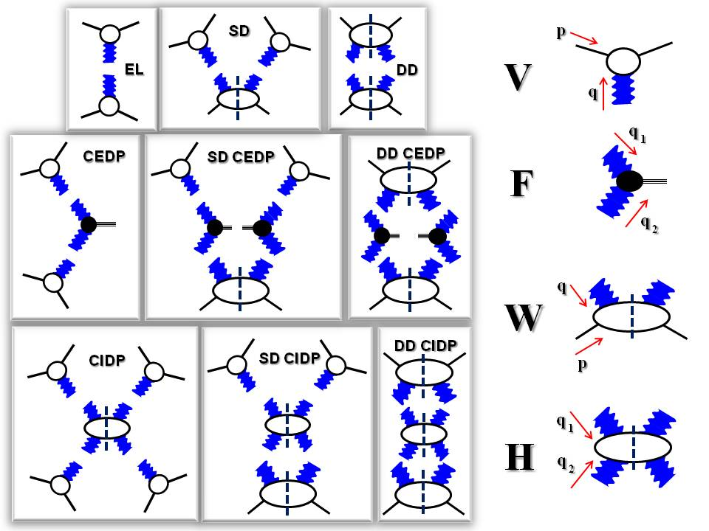
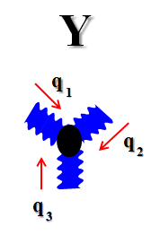
Diffractive Lego
XXXVII International Workshop on High Energy Physics “Diffraction of hadrons: Experiment, Theory, Phenomenology”
July 22-24, NRC “Kurchatov institute” – IHEP, Protvino

Slide 8


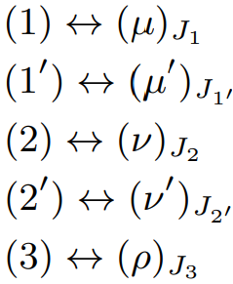




Irreducible tensors
p
q
q
1
q
2
q
p
q
1
q
2
XXXVII International Workshop on High Energy Physics “Diffraction of hadrons: Experiment, Theory, Phenomenology”
July 22-24, NRC “Kurchatov institute” – IHEP, Protvino

Slide 9
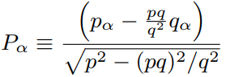

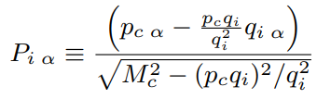

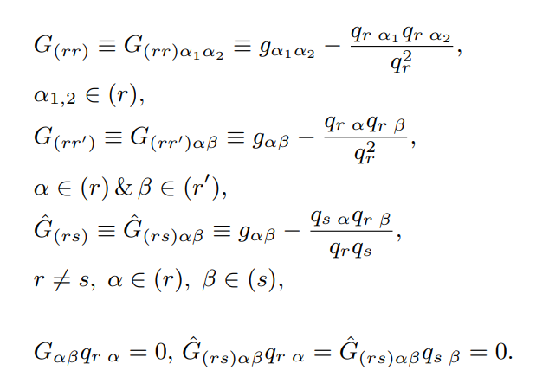
Transverse Symmetric tensors (V,W,F)
XXXVII International Workshop on High Energy Physics “Diffraction of hadrons: Experiment, Theory, Phenomenology”
July 22-24, NRC “Kurchatov institute” – IHEP, Protvino

Slide 10

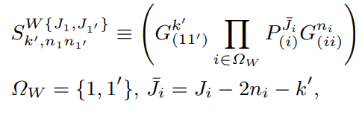

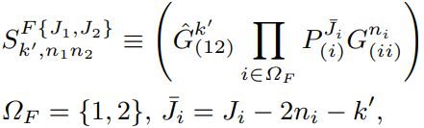
Transverse Symmetric tensors (V,W,F)
XXXVII International Workshop on High Energy Physics “Diffraction of hadrons: Experiment, Theory, Phenomenology”
July 22-24, NRC “Kurchatov institute” – IHEP, Protvino

Slide 11

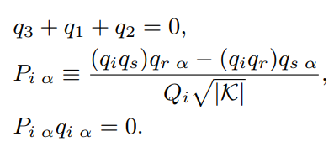
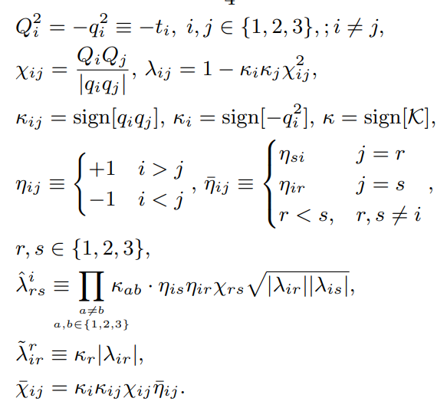
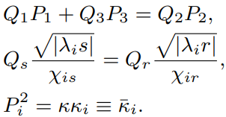
Transverse Symmetric tensors (Y)
XXXVII International Workshop on High Energy Physics “Diffraction of hadrons: Experiment, Theory, Phenomenology”
July 22-24, NRC “Kurchatov institute” – IHEP, Protvino

Slide 12
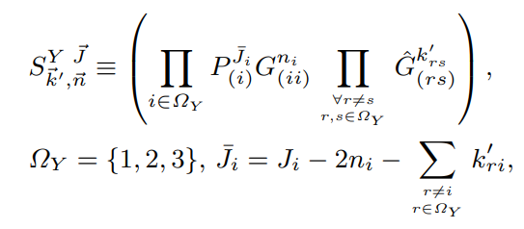
Transverse Symmetric tensors (Y)
XXXVII International Workshop on High Energy Physics “Diffraction of hadrons: Experiment, Theory, Phenomenology”
July 22-24, NRC “Kurchatov institute” – IHEP, Protvino

Slide 13
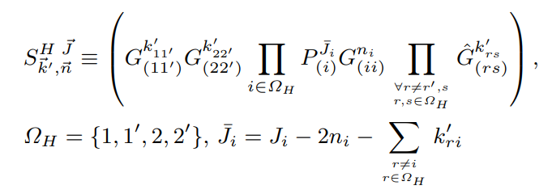
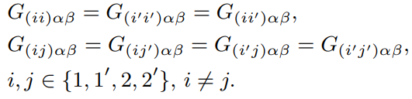
Transverse Symmetric tensors (H)
XXXVII International Workshop on High Energy Physics “Diffraction of hadrons: Experiment, Theory, Phenomenology”
July 22-24, NRC “Kurchatov institute” – IHEP, Protvino

Slide 14
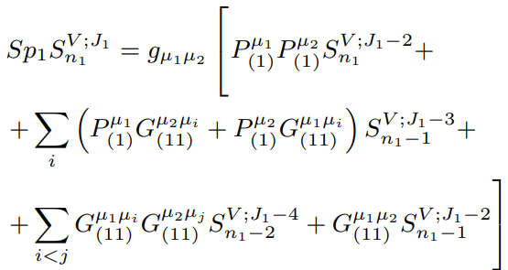
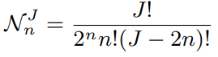
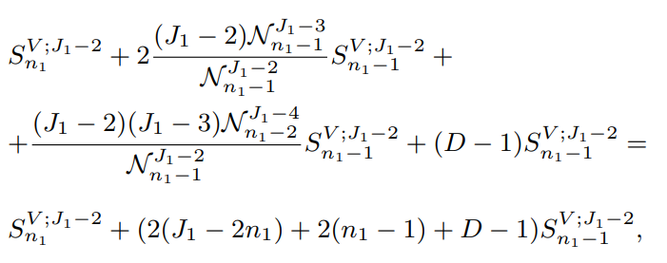
Irreducible tensors (spur S )
V
XXXVII International Workshop on High Energy Physics “Diffraction of hadrons: Experiment, Theory, Phenomenology”
July 22-24, NRC “Kurchatov institute” – IHEP, Protvino

Slide 15
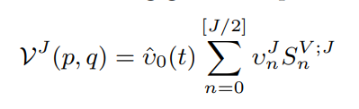
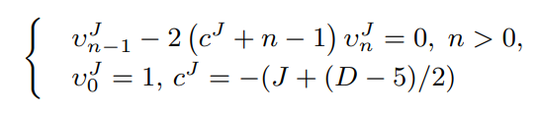

Irreducible tensors (V)
XXXVII International Workshop on High Energy Physics “Diffraction of hadrons: Experiment, Theory, Phenomenology”
July 22-24, NRC “Kurchatov institute” – IHEP, Protvino

Slide 16
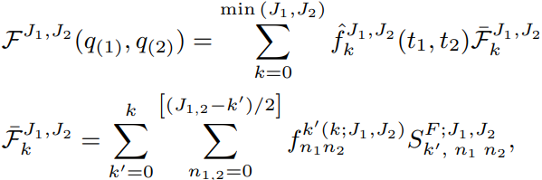
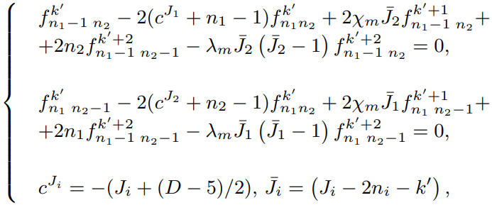
Irreducible tensors (F)
XXXVII International Workshop on High Energy Physics “Diffraction of hadrons: Experiment, Theory, Phenomenology”
July 22-24, NRC “Kurchatov institute” – IHEP, Protvino

Slide 17

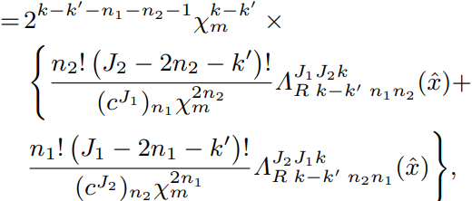
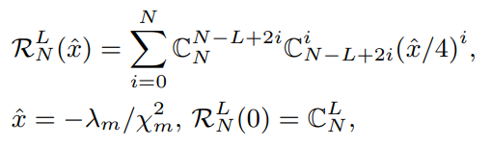

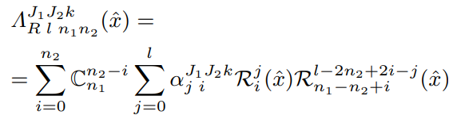
Irreducible tensors (F)
XXXVII International Workshop on High Energy Physics “Diffraction of hadrons: Experiment, Theory, Phenomenology”
July 22-24, NRC “Kurchatov institute” – IHEP, Protvino

Slide 18
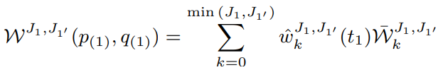
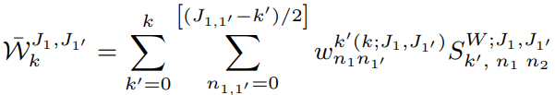
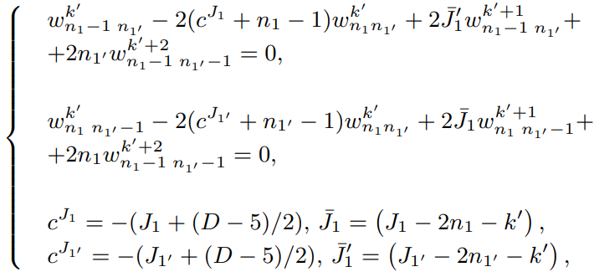
Irreducible tensors (W)
XXXVII International Workshop on High Energy Physics “Diffraction of hadrons: Experiment, Theory, Phenomenology”
July 22-24, NRC “Kurchatov institute” – IHEP, Protvino

Slide 19

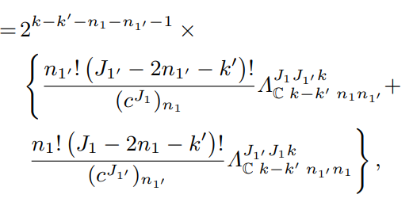
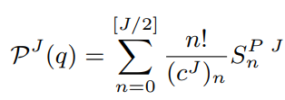
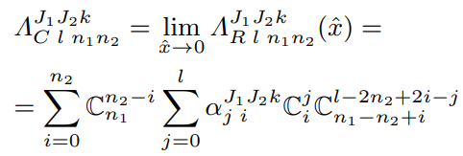
Irreducible tensors (W)
XXXVII International Workshop on High Energy Physics “Diffraction of hadrons: Experiment, Theory, Phenomenology”
July 22-24, NRC “Kurchatov institute” – IHEP, Protvino

Slide 20
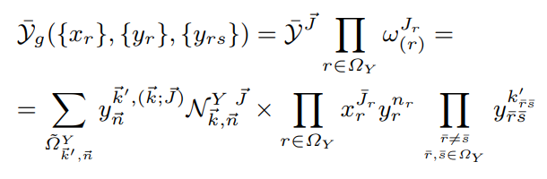
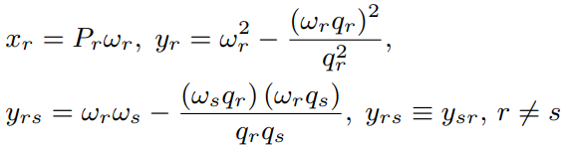
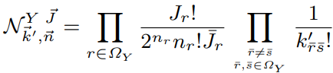
Generating function method (Y)
XXXVII International Workshop on High Energy Physics “Diffraction of hadrons: Experiment, Theory, Phenomenology”
July 22-24, NRC “Kurchatov institute” – IHEP, Protvino

Slide 21
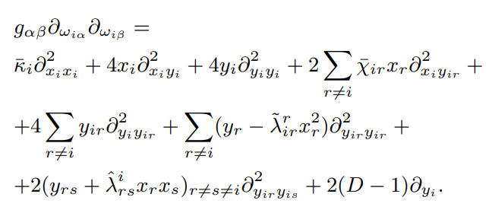
Generating function method (Y)
XXXVII International Workshop on High Energy Physics “Diffraction of hadrons: Experiment, Theory, Phenomenology”
July 22-24, NRC “Kurchatov institute” – IHEP, Protvino

Slide 22
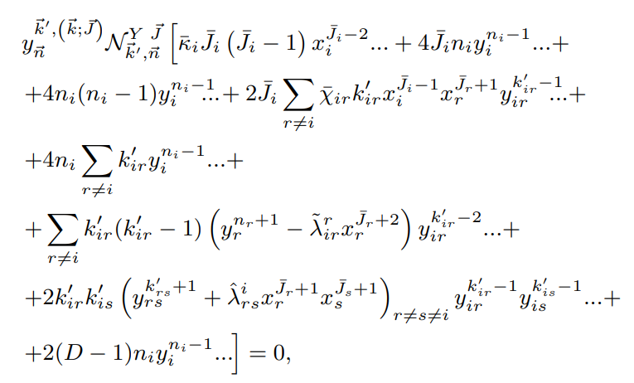
Generating function method (Y)
XXXVII International Workshop on High Energy Physics “Diffraction of hadrons: Experiment, Theory, Phenomenology”
July 22-24, NRC “Kurchatov institute” – IHEP, Protvino

Slide 23
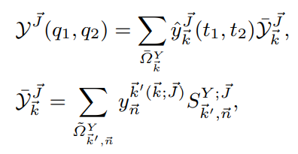


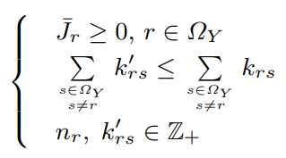
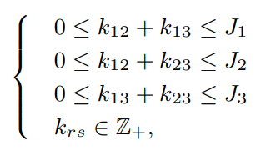
Irreducible tensors (Y)
XXXVII International Workshop on High Energy Physics “Diffraction of hadrons: Experiment, Theory, Phenomenology”
July 22-24, NRC “Kurchatov institute” – IHEP, Protvino

Slide 24
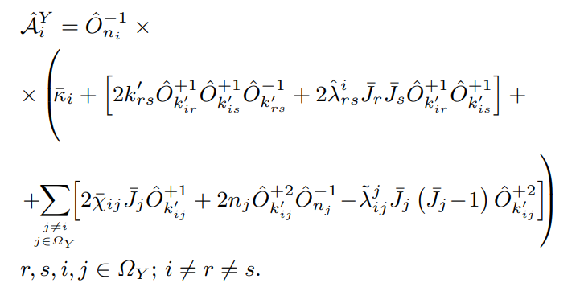

Irreducible tensors (Y)
XXXVII International Workshop on High Energy Physics “Diffraction of hadrons: Experiment, Theory, Phenomenology”
July 22-24, NRC “Kurchatov institute” – IHEP, Protvino

Slide 25
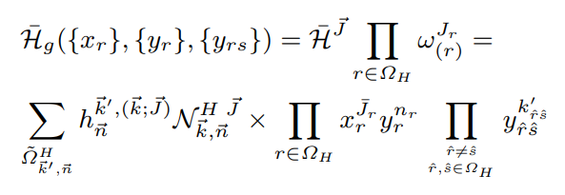
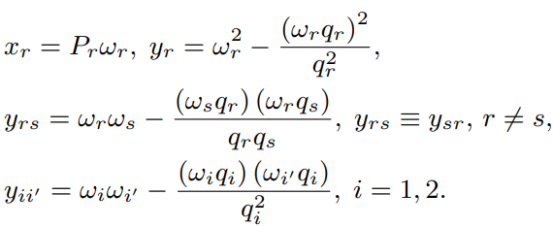
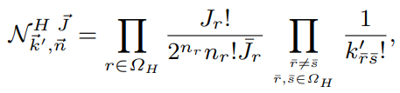
Generating function method (H)
XXXVII International Workshop on High Energy Physics “Diffraction of hadrons: Experiment, Theory, Phenomenology”
July 22-24, NRC “Kurchatov institute” – IHEP, Protvino

Slide 26

Generating function method (H)
XXXVII International Workshop on High Energy Physics “Diffraction of hadrons: Experiment, Theory, Phenomenology”
July 22-24, NRC “Kurchatov institute” – IHEP, Protvino

Slide 27

Generating function method (H)
XXXVII International Workshop on High Energy Physics “Diffraction of hadrons: Experiment, Theory, Phenomenology”
July 22-24, NRC “Kurchatov institute” – IHEP, Protvino

Slide 28





Irreducible tensors (H)
XXXVII International Workshop on High Energy Physics “Diffraction of hadrons: Experiment, Theory, Phenomenology”
July 22-24, NRC “Kurchatov institute” – IHEP, Protvino

Slide 29


Irreducible tensors (H)
XXXVII International Workshop on High Energy Physics “Diffraction of hadrons: Experiment, Theory, Phenomenology”
July 22-24, NRC “Kurchatov institute” – IHEP, Protvino

Slide 30








General multivariate recurrence
XXXVII International Workshop on High Energy Physics “Diffraction of hadrons: Experiment, Theory, Phenomenology”
July 22-24, NRC “Kurchatov institute” – IHEP, Protvino

Slide 31


Solution (Y)
Change of variables and initial condition
XXXVII International Workshop on High Energy Physics “Diffraction of hadrons: Experiment, Theory, Phenomenology”
July 22-24, NRC “Kurchatov institute” – IHEP, Protvino

Slide 32

Solution (Y)
Parameters for the general recurrence
XXXVII International Workshop on High Energy Physics “Diffraction of hadrons: Experiment, Theory, Phenomenology”
July 22-24, NRC “Kurchatov institute” – IHEP, Protvino

Slide 33

Solution (Y)
XXXVII International Workshop on High Energy Physics “Diffraction of hadrons: Experiment, Theory, Phenomenology”
July 22-24, NRC “Kurchatov institute” – IHEP, Protvino

Slide 34

Solution (Y)
XXXVII International Workshop on High Energy Physics “Diffraction of hadrons: Experiment, Theory, Phenomenology”
July 22-24, NRC “Kurchatov institute” – IHEP, Protvino

Slide 35

Solution (Y)
XXXVII International Workshop on High Energy Physics “Diffraction of hadrons: Experiment, Theory, Phenomenology”
July 22-24, NRC “Kurchatov institute” – IHEP, Protvino

Slide 36

Solution (Y)
XXXVII International Workshop on High Energy Physics “Diffraction of hadrons: Experiment, Theory, Phenomenology”
July 22-24, NRC “Kurchatov institute” – IHEP, Protvino

Slide 37
Solution (Y)
XXXVII International Workshop on High Energy Physics “Diffraction of hadrons: Experiment, Theory, Phenomenology”
July 22-24, NRC “Kurchatov institute” – IHEP, Protvino

Slide 38
Solution (Y)
XXXVII International Workshop on High Energy Physics “Diffraction of hadrons: Experiment, Theory, Phenomenology”
July 22-24, NRC “Kurchatov institute” – IHEP, Protvino

Slide 39



Solution (H)
Change of variables and initial condition
XXXVII International Workshop on High Energy Physics “Diffraction of hadrons: Experiment, Theory, Phenomenology”
July 22-24, NRC “Kurchatov institute” – IHEP, Protvino

Slide 40

Solution (H)
Parameters for the general recurrence
XXXVII International Workshop on High Energy Physics “Diffraction of hadrons: Experiment, Theory, Phenomenology”
July 22-24, NRC “Kurchatov institute” – IHEP, Protvino

Slide 41

Solution (H)
XXXVII International Workshop on High Energy Physics “Diffraction of hadrons: Experiment, Theory, Phenomenology”
July 22-24, NRC “Kurchatov institute” – IHEP, Protvino

Slide 42

Solution (H)
XXXVII International Workshop on High Energy Physics “Diffraction of hadrons: Experiment, Theory, Phenomenology”
July 22-24, NRC “Kurchatov institute” – IHEP, Protvino

Slide 43

Solution (H)
XXXVII International Workshop on High Energy Physics “Diffraction of hadrons: Experiment, Theory, Phenomenology”
July 22-24, NRC “Kurchatov institute” – IHEP, Protvino

Slide 44
Solution (H)
XXXVII International Workshop on High Energy Physics “Diffraction of hadrons: Experiment, Theory, Phenomenology”
July 22-24, NRC “Kurchatov institute” – IHEP, Protvino

Slide 45

Solution (H)
XXXVII International Workshop on High Energy Physics “Diffraction of hadrons: Experiment, Theory, Phenomenology”
July 22-24, NRC “Kurchatov institute” – IHEP, Protvino

Slide 46

Solution (H)
XXXVII International Workshop on High Energy Physics “Diffraction of hadrons: Experiment, Theory, Phenomenology”
July 22-24, NRC “Kurchatov institute” – IHEP, Protvino

Slide 47

Solution (H)
XXXVII International Workshop on High Energy Physics “Diffraction of hadrons: Experiment, Theory, Phenomenology”
July 22-24, NRC “Kurchatov institute” – IHEP, Protvino

Slide 48

Solution (H)
XXXVII International Workshop on High Energy Physics “Diffraction of hadrons: Experiment, Theory, Phenomenology”
July 22-24, NRC “Kurchatov institute” – IHEP, Protvino

Slide 49


Other method to find solutions
S
F
S
W
XXXVII International Workshop on High Energy Physics “Diffraction of hadrons: Experiment, Theory, Phenomenology”
July 22-24, NRC “Kurchatov institute” – IHEP, Protvino

Slide 50




Other method to find solutions
XXXVII International Workshop on High Energy Physics “Diffraction of hadrons: Experiment, Theory, Phenomenology”
July 22-24, NRC “Kurchatov institute” – IHEP, Protvino

Slide 51




Non-conserved vertexes expansions
Symmetric Traceless
Recurrence + solution
Orthogonality
XXXVII International Workshop on High Energy Physics “Diffraction of hadrons: Experiment, Theory, Phenomenology”
July 22-24, NRC “Kurchatov institute” – IHEP, Protvino

Slide 52




Non-conserved vertexes expansions
Symmetric Traceless
Orthogonality
Solution
XXXVII International Workshop on High Energy Physics “Diffraction of hadrons: Experiment, Theory, Phenomenology”
July 22-24, NRC “Kurchatov institute” – IHEP, Protvino

Slide 53




Non-conserved vertexes expansions
Symmetric
Traceless
Orthogonality
Solution
XXXVII International Workshop on High Energy Physics “Diffraction of hadrons: Experiment, Theory, Phenomenology”
July 22-24, NRC “Kurchatov institute” – IHEP, Protvino

Slide 54




Non-conserved vertexes expansions
Orthogonality
Symmetric Traceless
Solution
XXXVII International Workshop on High Energy Physics “Diffraction of hadrons: Experiment, Theory, Phenomenology”
July 22-24, NRC “Kurchatov institute” – IHEP, Protvino

Slide 55




Non-conserved vertexes expansions
Symmetric Traceless
Solution
Orthogonality
XXXVII International Workshop on High Energy Physics “Diffraction of hadrons: Experiment, Theory, Phenomenology”
July 22-24, NRC “Kurchatov institute” – IHEP, Protvino

Slide 56
3-Reggeon vertex contractions
Y
q
=
q
1
p
q
2
q
3
q
1
=
q
2
XXXVII International Workshop on High Energy Physics “Diffraction of hadrons: Experiment, Theory, Phenomenology”
July 22-24, NRC “Kurchatov institute” – IHEP, Protvino

Slide 57



Applications: spin-parity analyzer
CEDP
[A.B. Kaidalov, V.A. Khoze, A.D. Martin et al, Central exclusive diffractive production as a spin-parity analyser: from hadrons to Higgs. Eur. Phys. J. C 31, 387–396 (2003)]
[V.A. Petrov, R.A. Ryutin, A.E. Sobol and J.-P. Guillaud, Azimuthal angular distributions in EDDE as spin-parity analyser and glueball filter for LHC, JHEP06(2005)007]
XXXVII International Workshop on High Energy Physics “Diffraction of hadrons: Experiment, Theory, Phenomenology”
July 22-24, NRC “Kurchatov institute” – IHEP, Protvino

Slide 58

Problems with conserved currents
[R.A. Ryutin , Visualizations of exclusive central diffraction,
Eur. Phys. J. C 74, 3162 (2014)]
“Non-Conserved”=
Unitarization?
Extra Dimension?
Both?
[F.E. Close, G.A. Schuller, Evidence that the pomeron transforms as a nonconserved vector current, Phys. Lett. B 464, 279 (1999)]
[F.E. Close, G.A. Schuller, Central production of mesons: Exotic states versus pomeron structure, Phys. Lett. B 458, 127 (1999)]
XXXVII International Workshop on High Energy Physics “Diffraction of hadrons: Experiment, Theory, Phenomenology”
July 22-24, NRC “Kurchatov institute” – IHEP, Protvino

Slide 59

Applications: extract cross-sections
q
W
Hadron-Reggeon
cross-section
Hadron-Hadron
cross-section
p
q
Reggeon-Reggeon
cross-section
H
1
q
2
1 mb – 100 mb?
~10 – 100 mb
H
What is the meaning
of these values?
H
-”Reggeon”?
XXXVII International Workshop on High Energy Physics “Diffraction of hadrons: Experiment, Theory, Phenomenology”
July 22-24, NRC “Kurchatov institute” – IHEP, Protvino

Slide 60
Further study
Spin-parity analysis in CEDP
Half-integer spins, helicity amplitudes
Curved spaces, “non-conserved” currents
Hyper-fields, strings
Non-diffractive processes
Unitarization
Wolfram Mathematica package
Universal framework for diffraction
XXXVII International Workshop on High Energy Physics “Diffraction of hadrons: Experiment, Theory, Phenomenology”
July 22-24, NRC “Kurchatov institute” – IHEP, Protvino

Slide 61
To be continued …
THANK
YOU !
XXXVII International Workshop on High Energy Physics “Diffraction of hadrons: Experiment, Theory, Phenomenology”
July 22-24, NRC “Kurchatov institute” – IHEP, Protvino

