Slide 1
ИФВЭ, Протвино
23 Июля 2025
Unified Description of Elastic Hadron Scattering
at Low and High Energies
( pp, , pn,
(√s = 3.6 GeV up to √s = 13 TeV
О.В. Селюгин
(БЛТФ, ОИЯИ )
хотя асимптотика может быть очень далека, путь к ней лежит не через пустыню, а через цветущий регион захватывающей физики
“…although asymptopia may be very far away
indeed, the path to it is not through a desert
but through a flourishing region of exciting Physics…”
-Elliot Leader in CERN Courier

Slide 2
Hadron elastic scattering interactions.
There are some problems as confinement, hadron interaction at larger distances, non-perturbative hadron structure (parton distribution functions (PDFs),
generalized parton distributions (GPDs) and others)
that should be explored in the framework of the Standard Model.
These problems are connected with the hadron interaction at high and super-high energies and with the problem of energy dependence of the structure
of the scattering amplitude and total cross sections.
Researches into the structure of the elastic hadron scattering amplitude at super-high energies and small momentum transfer – t outlines a connection between experimental knowledge and the fundamental asymptotic theorems, which are based on the first principles.
This reflects a tight connection of the main properties of elastic hadron scattering with the first principles of quantum field theory and the concept of the scattering amplitude as a unified analytic function of its kinematic variables
which introduce by N.N. Bogolyubov

Slide 3
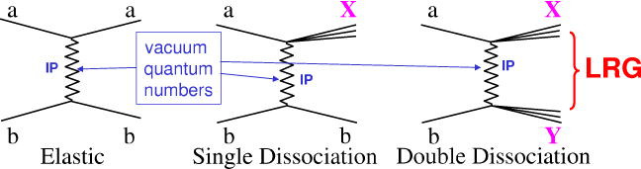
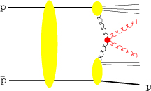
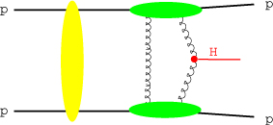

Slide 4
SIMPLEX SIGILLUM VERI
(простота - знак истины)

Slide 5
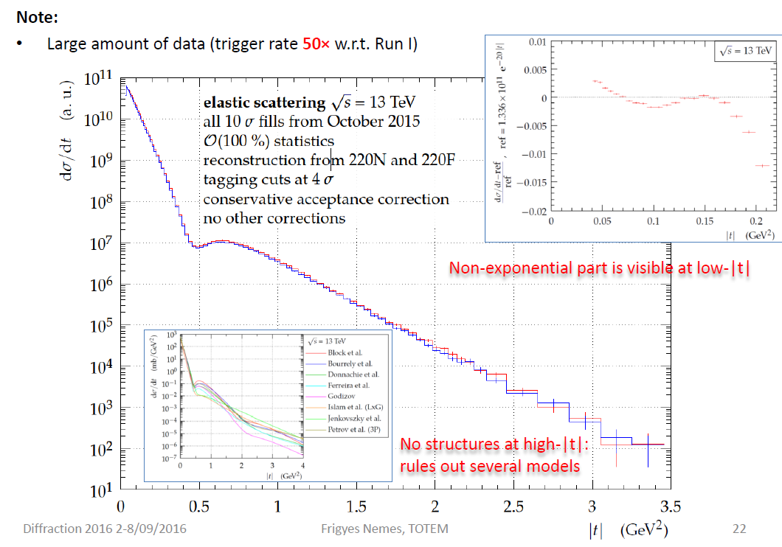
the new LHC data (elastic scattering)
at 7 and 8 TeV
7 TeV (TOTEM) - t [0.00515 – 0.371] 17.08.2012
7 TeV (ATLAS) - t [0.0062 – 0.3636] 25.08.2014
8 TeV (TOTEM) - t [0.028500 – 0.1947] 12.09.2015
8 TeV (TOTEM) - t [0.000741 – 0.201] 11.12.2015
8 TeV (ATLAS) - t [0.01050 – 0.3635] 25.06.2016

Slide 6
The Very Low t Region
around t ~ −10⁻³ (GeV/c)² A_{hadronic} ≈ A_{Coulomb}
⇒ INTERFERENCE
CNI = Coulomb – Nuclear Interference
scattering amplitudes modified to include also electromagnetic contribution
hadronic interaction described in terms of Pomeron (Reggeon) exchange
electromagnetic single photon exchange
σ = |A_{hadronic} + A_{Coulomb}|²
unpolarized ⇒ clearly visible in the cross section dσ/dt
polarized ⇒ “left – right” asymmetry A_{N}
P
+
γ

Slide 7
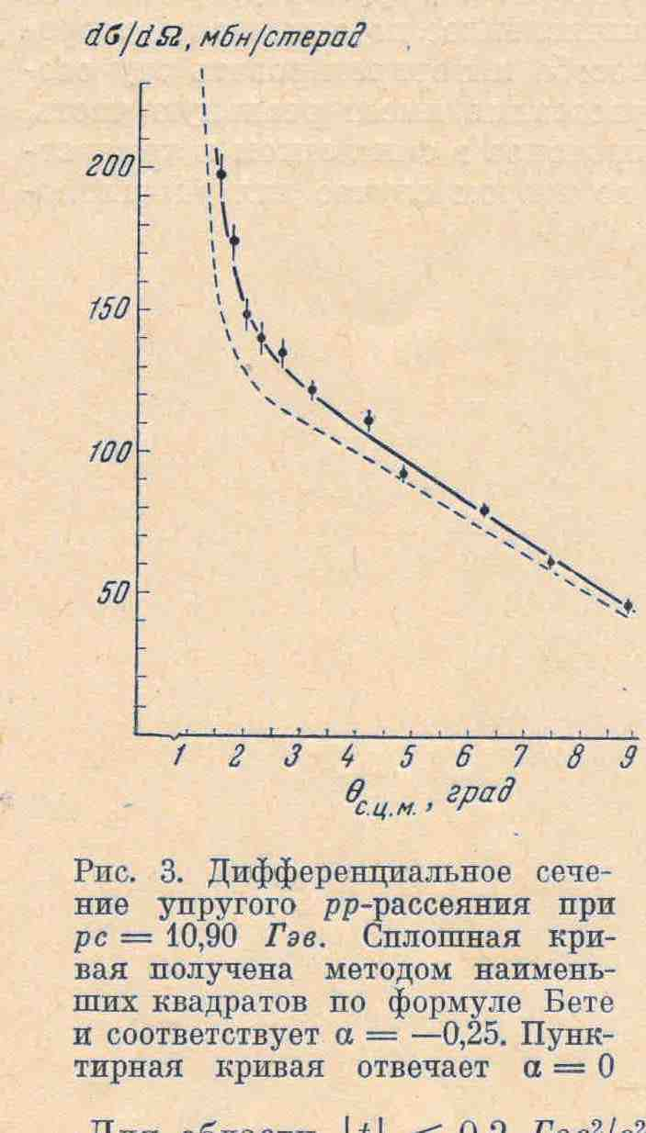
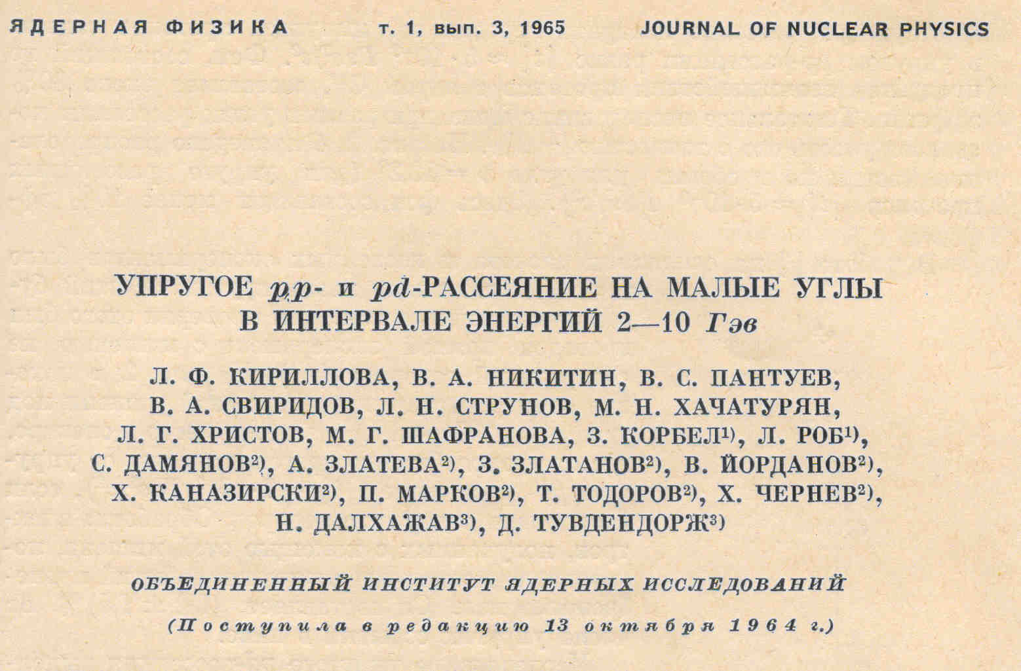

Slide 8
General properties associated with the phenomenon of diffraction:
1. Froissart – Martin bound
2. Derivative dispersion relation
3. Auberson-Kinoshita-Martin scaling
4. Crossing even
Frankfurt, Strickman, Weiss, and Zhalov (hep-ph/0412260)

Slide 9
σ_{tot}(s)~
Regge theory
Simple pole – (s/s₀)^{α}
α = 0.08
Landshoff 1984 – soft P
Double pole – Ln (s/s₀)
Triple pole – Ln²(s/s₀) +C
1976 BFKL (LO) - P -α₂ = 0.4
α₂ = 0.45
1988 HERA data (Landshoff ) – hard P
2005 – Kovner – 7 P -α_{ι} = 0. ..0.4. .0.8

Slide 10
2 clases of models
  Born amplitudes -> eikonal phase (impact parameter) -> unitarization -> full amplitude ( t-space)
2. Full amplitude as sum of terms with different signs

Slide 11
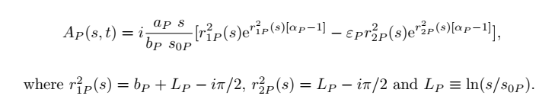

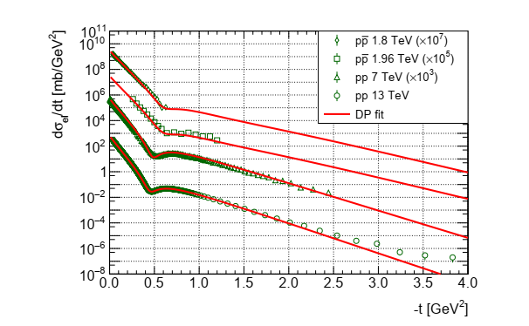
Laslo Jenkovszky, István Szanyi Modern Physics E Vol. 27, No. 08, 1830005 (2018)

Slide 12
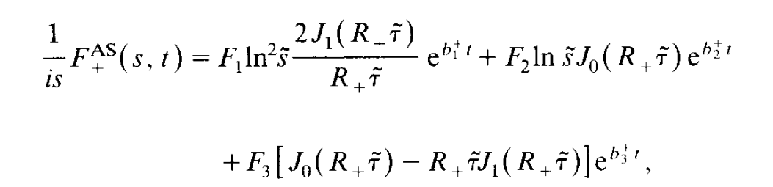
P. Gauron, B. Nicolescu, and E. Leader, Nucl. Phys. B299, 640 (1988)
,
R. F. Avila, P. Gauron, B. Nicolescu, Eur.Phys.J.C49:581-592,2007

Slide 13
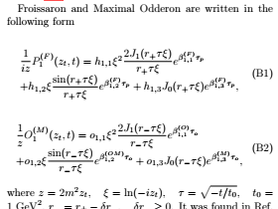
E. Martynov and others…..
(P. Guaron, E. Leader, B. Nicolescu)

Slide 14



E. Martynov and others (last …arXiv:2010.11987..

Slide 15
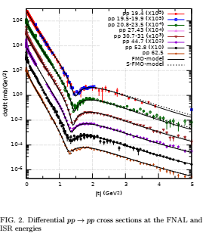
E. Martynov ….

Slide 16
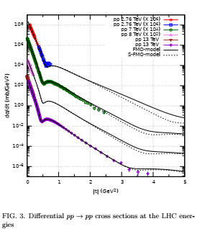

Slide 17


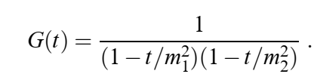
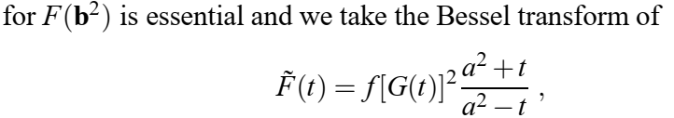

Slide 18
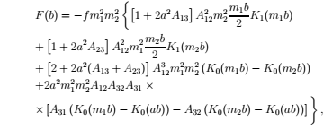



Jacques Soffer∗, Claude Bourrely† and Tai Tsun Wu
F(t) = f [G(t)]2 (a2+t)/(a2−t),
G(t) =1/(1−t/m21)(1−t/m22.)

Slide 19
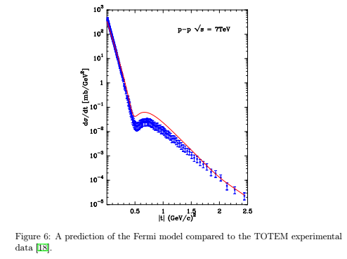
B-S-W

Slide 20
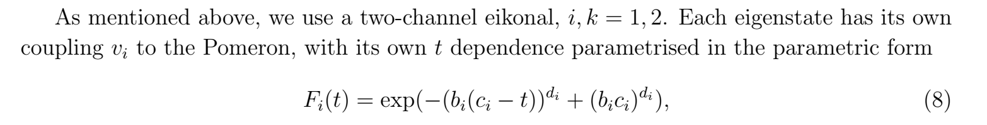
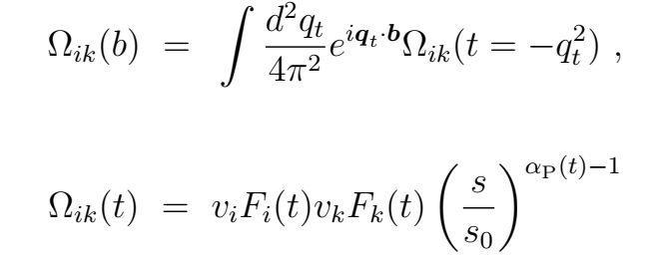
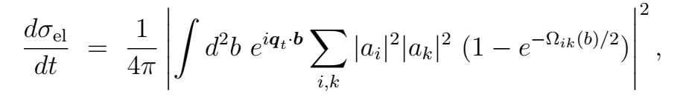

Slide 21
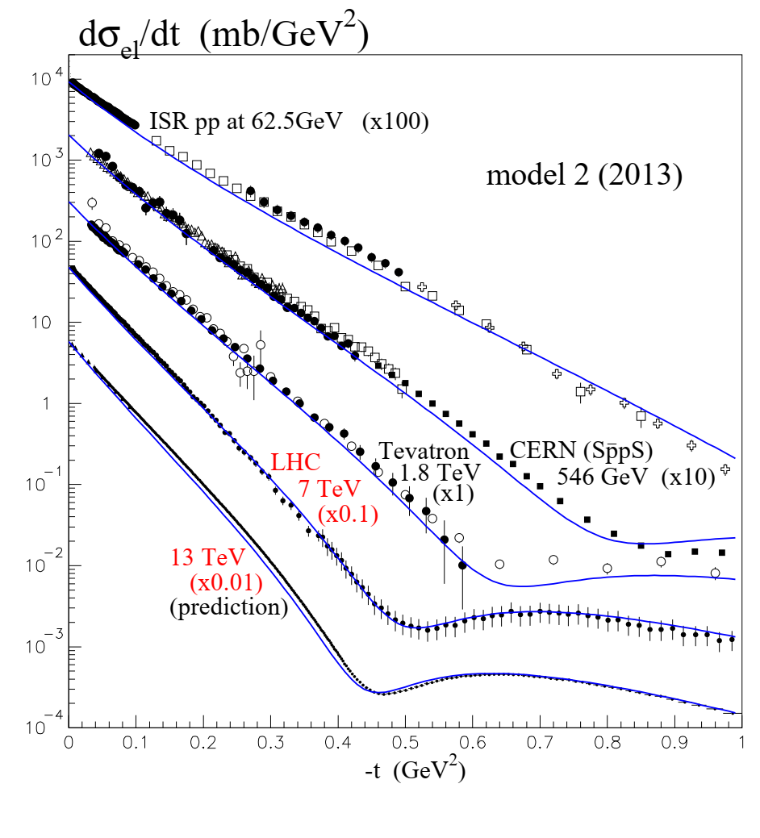

Slide 22
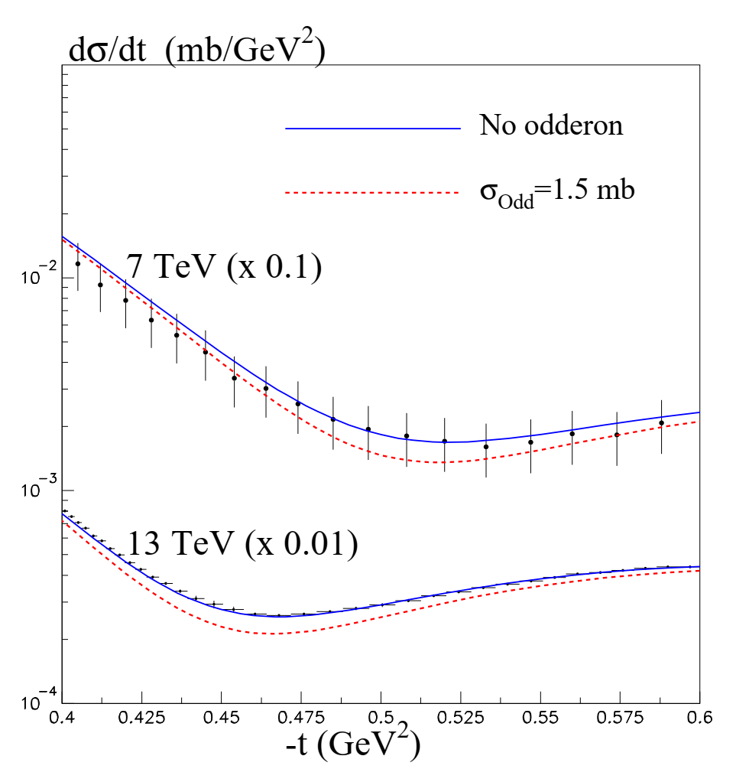
Physics Letters B, 784, 192 (2018)

Slide 23



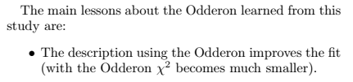
Khoze
2411.15275v1 E. G. S. Luna, M. G. Ryskin, V. A. Khoze-

Slide 24
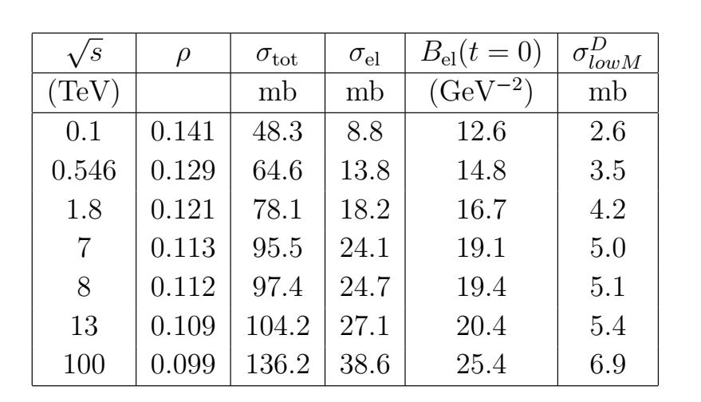
Khoze

Slide 25

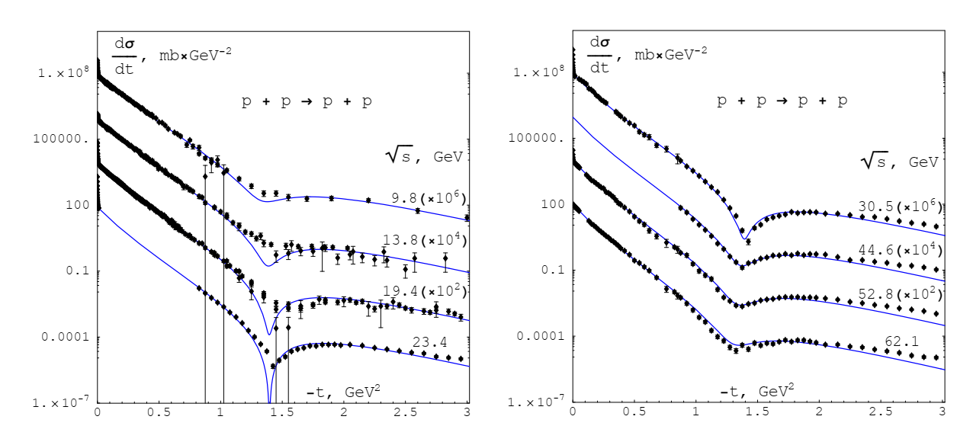
A. Godizov …
Eur. Phys. J. C 84 (2024) 143

Slide 26
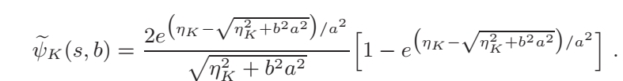
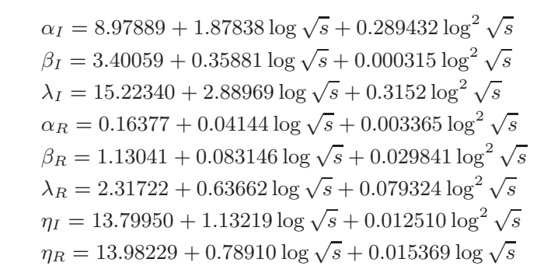
E. Ferreira, A. K. Kohara, and T. Kodama
2011.13335v2

Slide 27
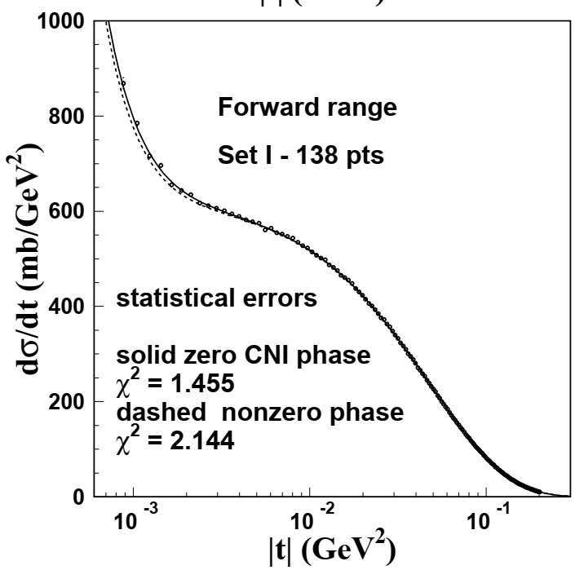
E. Ferreiraa, A. K. Koharab, and T. Kodama

Slide 28

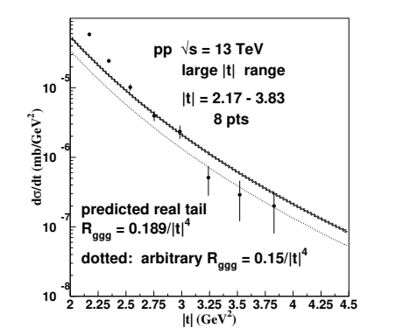
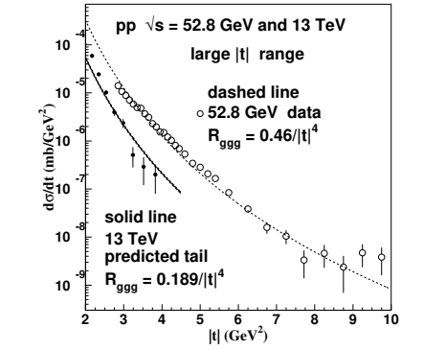
Erasmo Ferreiraa, Anderson Kendi Kohara
Kohara 2308.08474v2

Slide 29
Regge-eikonal High Energy
Generalized Structure (HEGS) model,
Stucture of hudrons -
Generalized parton distributions →
(electromagmetic and gravitomagnetic form factors),
differential cross sections (−t = 10 − 15 GeV)
and spin correlations AN(s, t)
a feature of the differential cross sections at high energies;
hadron potential at large distance and

Slide 30
Hadron elastic scattering amplitude

Slide 31
Scattering process described in terms of Helicity Amplitudes φ_{i}
All dynamics contained in the Scattering Matrix M
(Spin) Cross Sections expressed in terms of
spin non–flip
double spin flip
spin non–flip
double spin flip
single spin flip
?
⟨ M ⟩
observables:
3 ×-sections
5 spin asymmetries
identical spin ½ particles
- GPDs → electromagnetic FF
- GPDs → gravimagnetic FF
15

Slide 32
Factorization [Reggions + Form Factors (FF) ]
Chow-Yang model (1968) - hadrom form factor -
Charge distributions - electromagnetic form factors
T.T. Chou, C.N. Yang, Phys.Rev.Lett. 20 (1968)
E. Leader, U. Maor, P.G. Williams, J. Kasman, Phys.Rev. D14 (1976)
“The Chou-Yang Hypothesis – A Critical Assessment”,

Slide 33
Form factors
Mittenen (1973) – “matter distribution”
Bourrely-Soffer-Wu (1978) -
G(t) –”stands for the proton “nuclear form factor” parameterized like the e-m form factor, as a two poles, the slowly varying function reflect the approximate proportionality between the charge density and hadronic matter distribution inside a proton.”
Broniowski – Arriola (2008)
"..The gravitation form factors, related to the matrix
elements of the energy-momentum tensor [1] in a hadronic
state and thus providing the distribution of matter within
the hadron..."

Slide 34
Our ansatz of GPDs
O.V.S., O. Terayev, Phys.Rev.D79:033003,2009
Found.Phys.40:1042,2010
1. Simplest;
2. Not fare from Gaussian representation
3. Satisfy the (1-x)^{n} (n>= 2)
4. Valid for large t
q(x) is based on the MRST2002

Slide 35
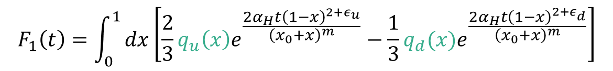
- GPDs → electromagnetic FF
$$F_{1}\left(t\right)=\int_{0}^{1}{dx\left[\frac{2}{3}q_{u}\left(x\right)e^{\frac{2α_{H}t{\left(1−x\right)}^{2+ε_{u}}}{{\left(x_{0}+x\right)}^{m}}}−\frac{1}{3}q_{d}(x)e^{\frac{2α_{H}t{\left(1−x\right)}^{2+ε_{d}}}{{\left(x_{0}+x\right)}^{m}}}\right]}$$
- GPDs → gravimagnetic FF
$A\left(t\right)=\int_{0}^{1}{xdx\left[q_{u}\left(x\right)e^{\frac{2α_{H}t{\left(1−x\right)}^{2+ε_{u}}}{{\left(x_{0}+x\right)}^{m}}}+q_{d}\left(x\right)e^{\frac{2α_{H}t{\left(1−x\right)}^{1+ε_{d}}}{{\left(x_{0}+x\right)}^{m}}}\right]}$,

Slide 36
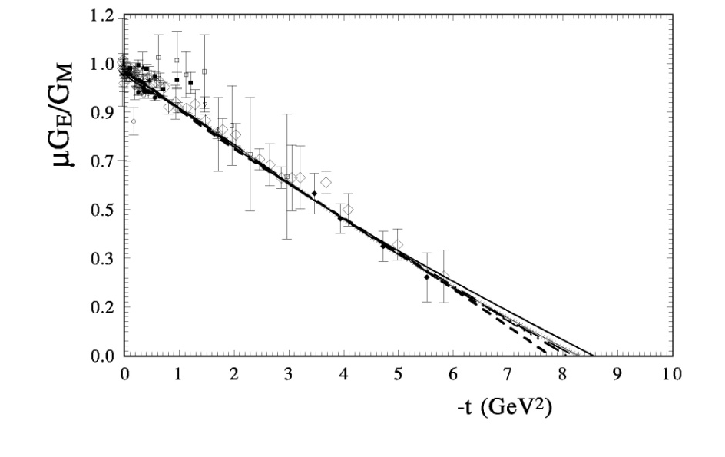
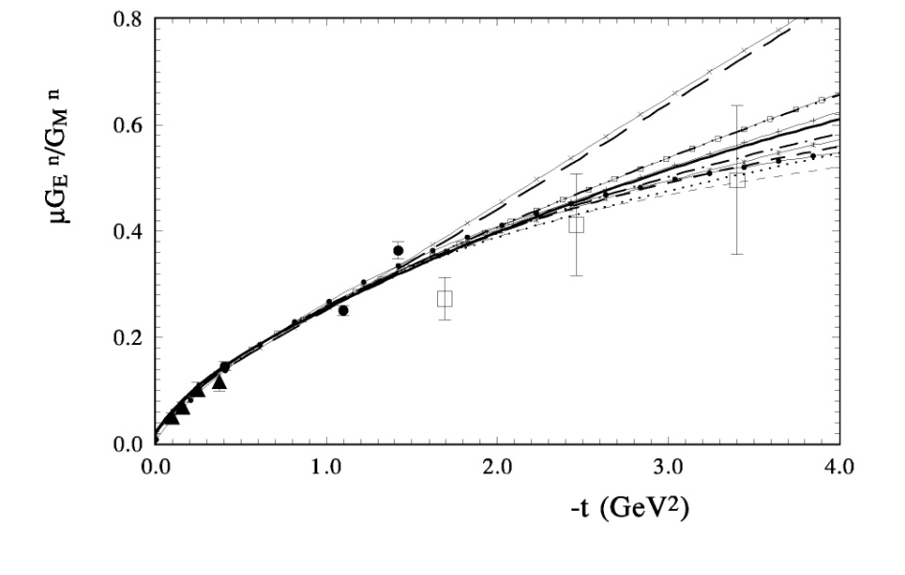
O.V.S., Phys. Rev., D 89, 093007-22, 2014

Slide 37
The differential cross section for that reaction can be written as

Slide 38
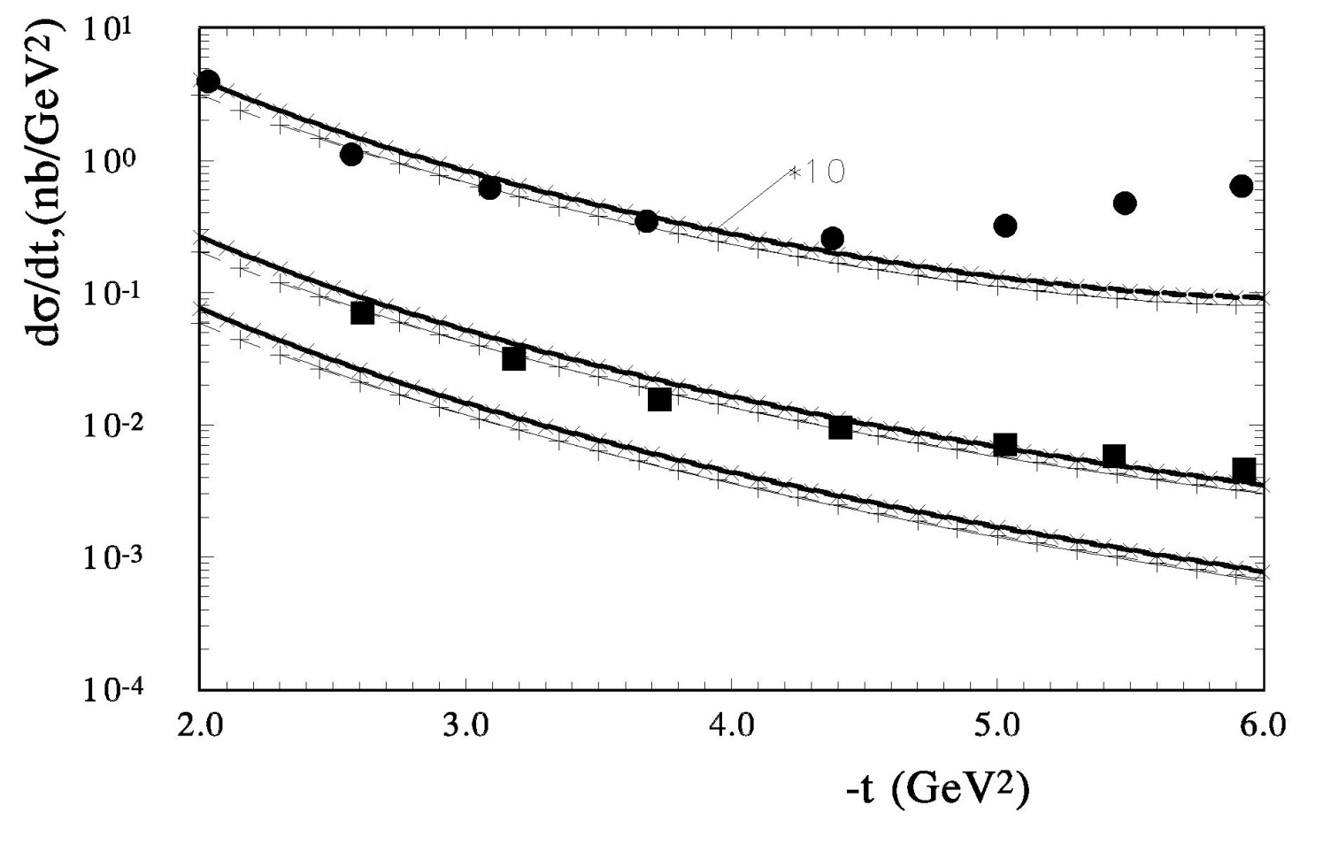
O.V.S., Phys. Rev., D 89, 093007-22, 2014

Slide 39
Gravimagnetic form factor
“Future studies using higher-statistics data will be crucial to justify or falsify model assumptions about the kinematic dependence of the GPDs.

Slide 40
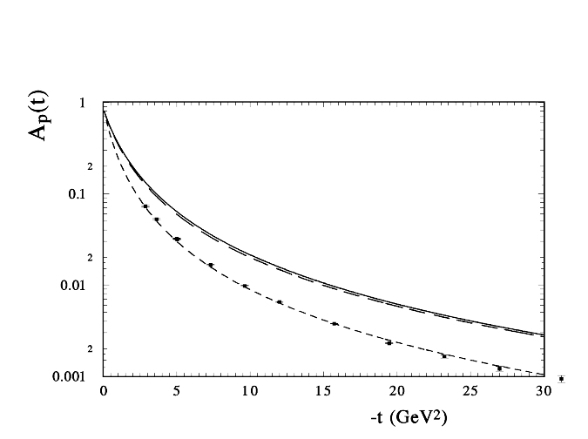
A(t) Gravitational form factor A and proton Dirac F_1

Slide 41
“TOMOGRAPHY” of NUCLEONS
M.Burkardt Phys.Rev, D74(2004)
C.Carlson, M. Vanderhaeghen
Phys.Rev.Lett., 100,(2008)

Slide 42
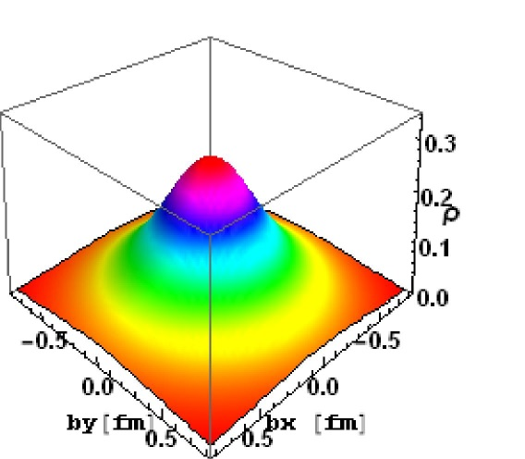
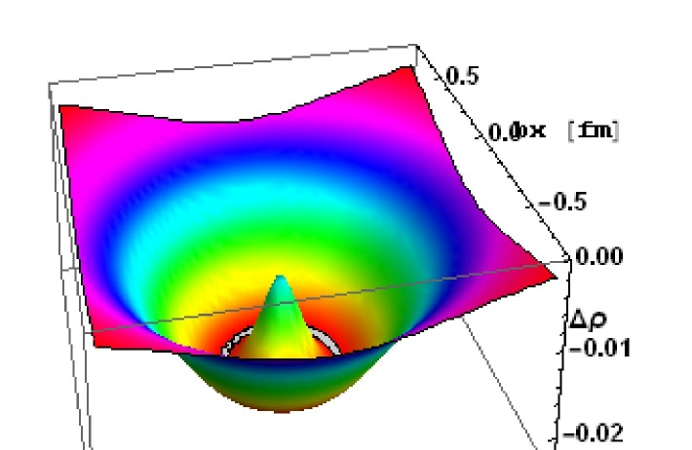
[left] Charge density of u-quark b) [right] charge density of d-quark

Slide 43
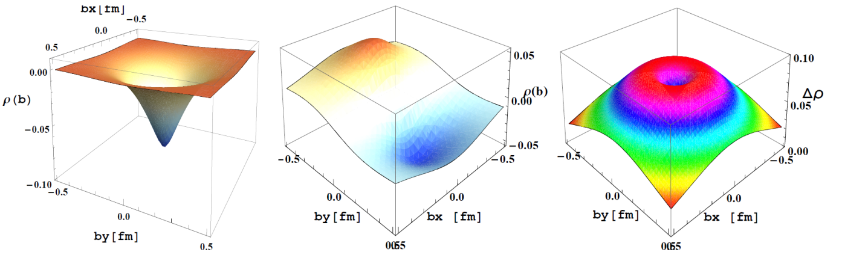
The transverse density ρ0nb (left);
the angle dependence of the transverse charge density distribution of the proton ρTpb-ρ0pb (middle);
the difference of the charge F1P and mass A density of the proton (right).

Slide 44
O.V. Selyugin, Phys.Rev. D 91, 113003 (2015)
Обобщенные партонные распределения
Generalized Parton Distributions -GPDs
Electromagnetic form factors
(charge distribution)
Gravitomagnetic
form factors
(matter distribution)

Slide 45
t = 0
As a result of unitarization of Born Regge amplitudes:
The Froissart bound

Slide 46
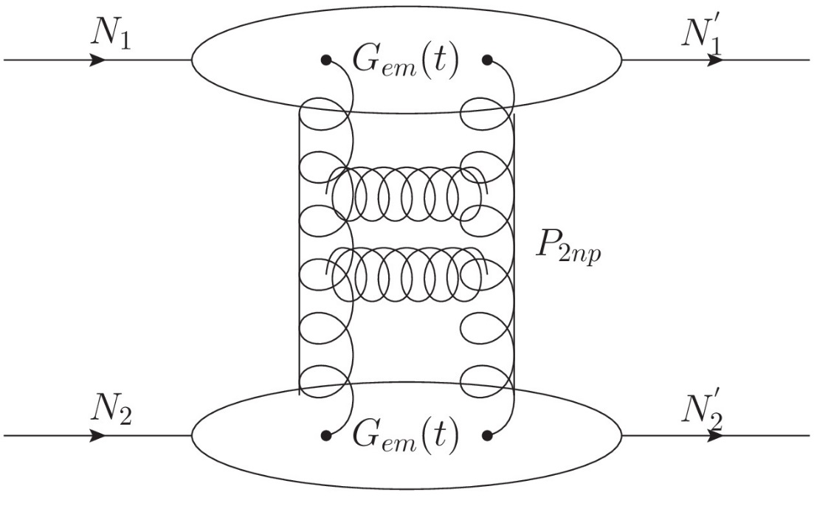
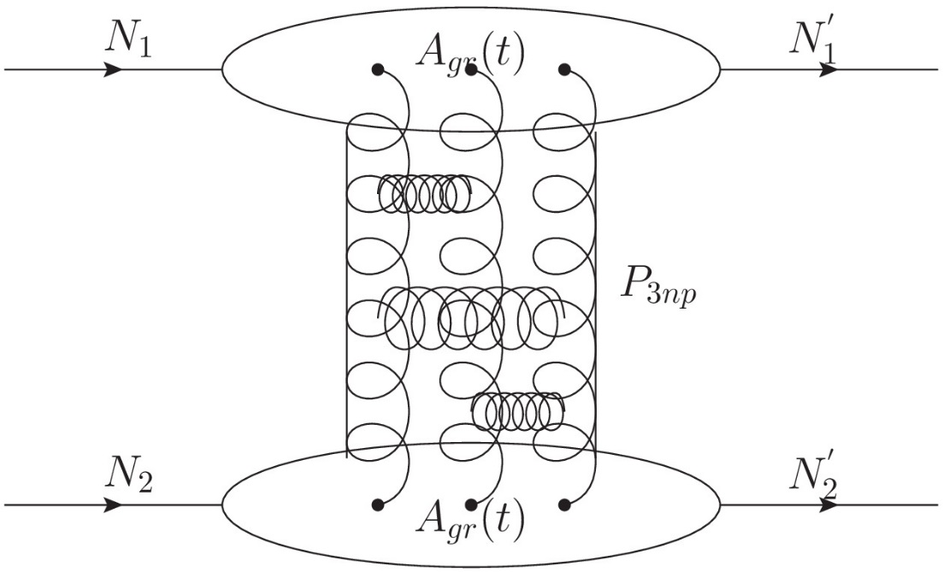

Slide 47
Extending of model (HEGS2) – O.V. S. Phys.Rev. D 91, (2015) 113003
O.V. S., Phys. At. Nucl. V. 87, (2024)

Slide 48
Hard Pomeron in the HEGS model calculation
O.V.S., Nucl.Phys. A 903 (2013) 54-64; arxiv[1205.5867]
Donnachie, P.V. Landshoff- arXiv:1112.2485 (hard Pomeron); arxiv[1309.1292] – “Although a satisfactory fit can also be obtained with the hard pomeron included, our results show
that is not necessary.”

Slide 49
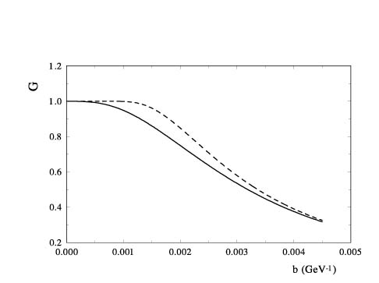
UNITARIZATION → eikonal representation
UNITARIZATION → eikonal representation

Slide 50
UNITARIZATION → eikonal representation
Impact parameter representation
Saturation and non-linear equation
J.-R. Cudell, E.Predazzi, O.V. S., Phys.Rev.D79(2009)
J.-R. Cudell, O.S., Phys.Rev.Lett.102 (2009)

Slide 52
TABLE I. The simultaneously fit of the sum of all sets of different reactions from
√s = 3.6 GeV up to √s = 13 TeV
Reac. | N_exp. | √s min GeV | √s max GeV | −t, min GeV2 | −t, max GeV2
 | 3170 | 6.4 | 13000 | 0.00029 | 14 | 3579
 | 921 | 3.52 | 1960 | 0.001 | 3 | 947
 | 235 | 3.6 | 23.5 | 0.01 | 3 | 263
 | 4326 | 3.6 | 13000 | 3 10^(-4) | 14 |  | 4789
 | 536 | 4.6 | 27.4 | 10^(-6) | 1.8 | 601
 | 2009 | 7.8 | 23.5 | 0.014 | 10 | 2415

Slide 53
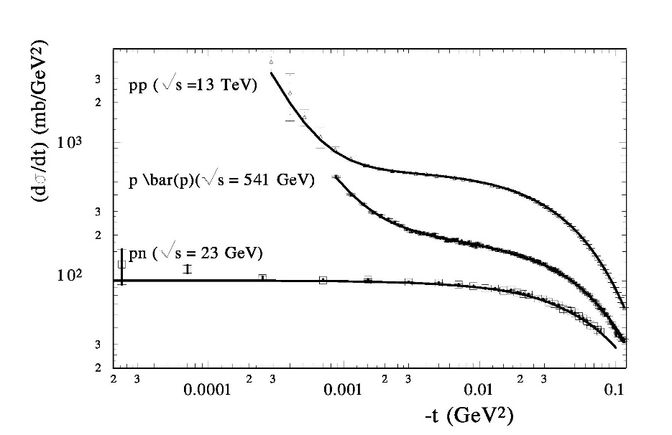

Slide 54
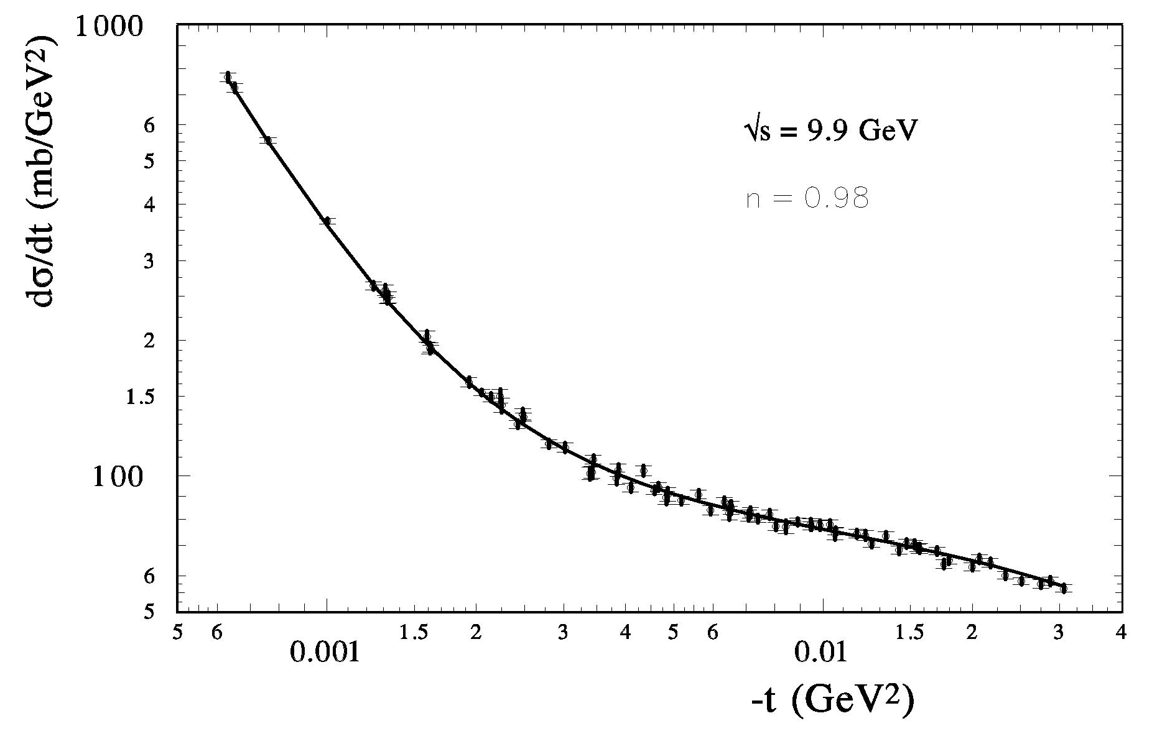

Slide 55
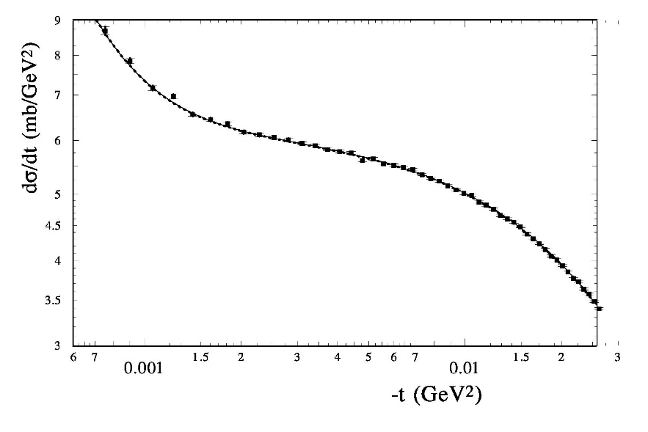
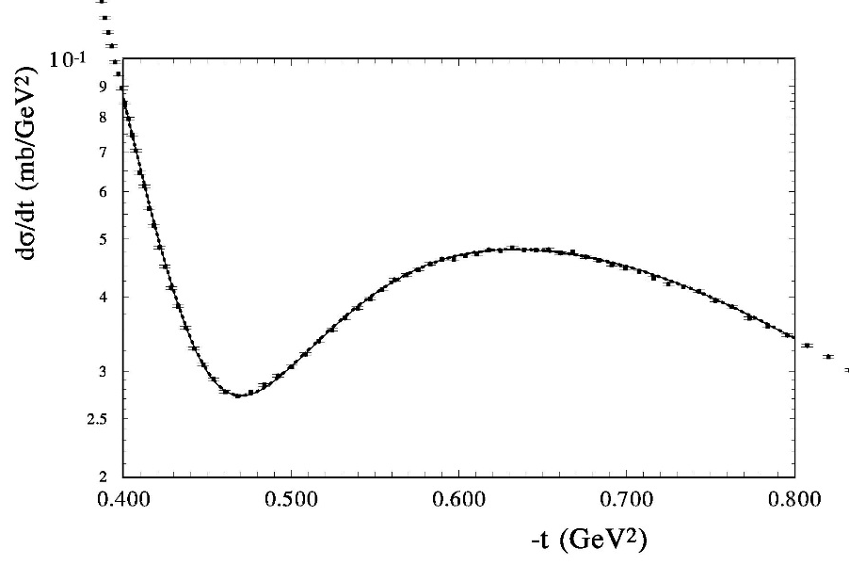

Slide 56
Ch-III

Slide 57
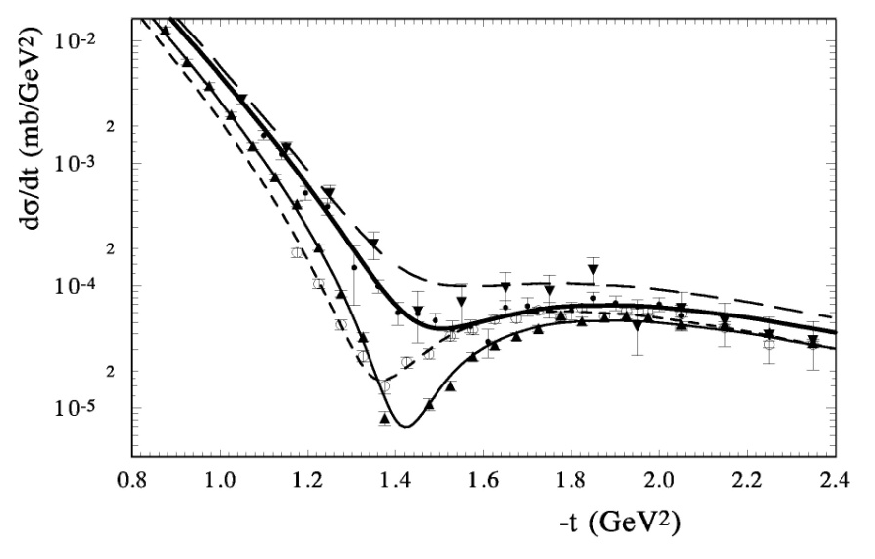

Slide 58
Diffraction (2018) Odderon and LHC data
Nemez, talk on workshop , May 28 (2018)

Slide 59
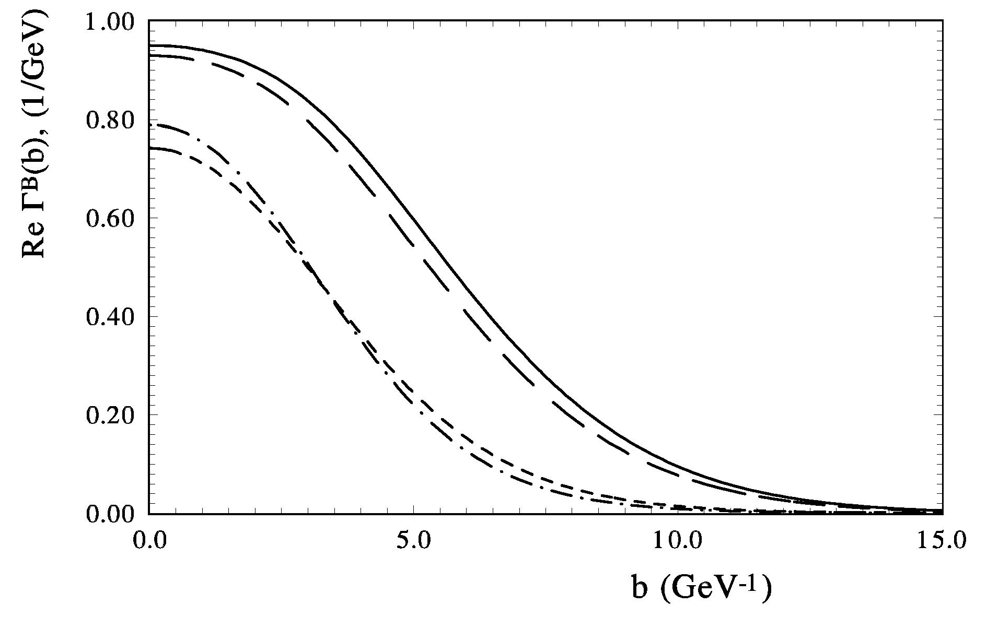

Slide 60
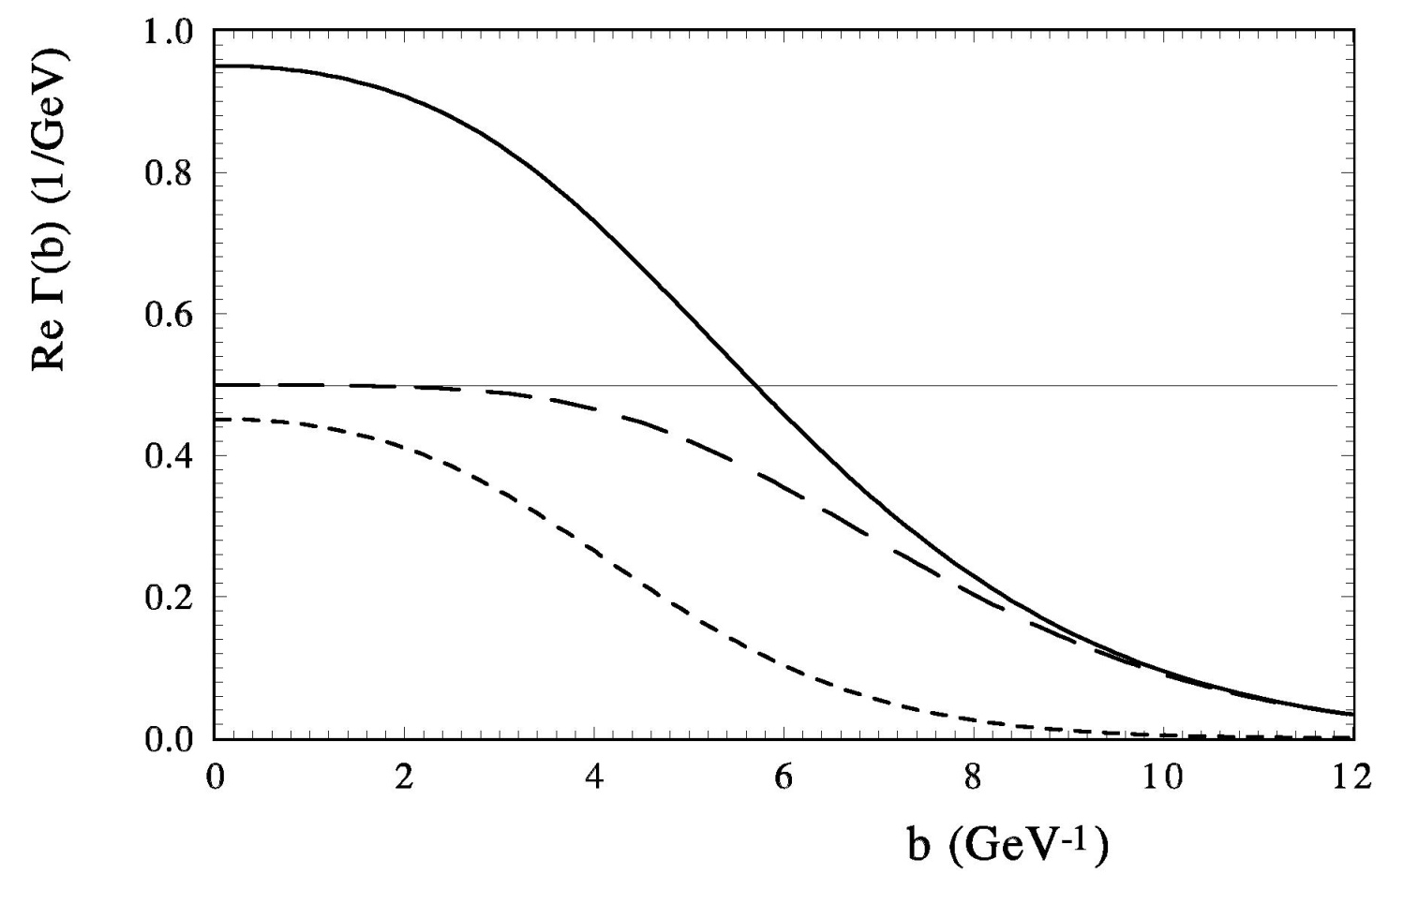

Slide 61
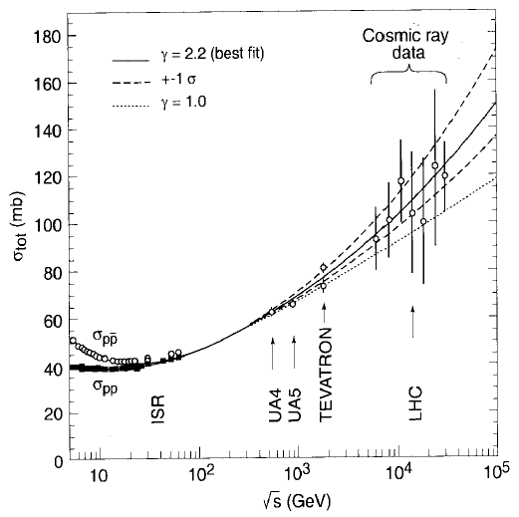
Total cross-section
Understand the asymptotic behavior of σ_{tot}
new (precise) data to constraint the fit: σ_{tot} vs (ln s)^{γ}
1% error → ~1mb

Slide 62
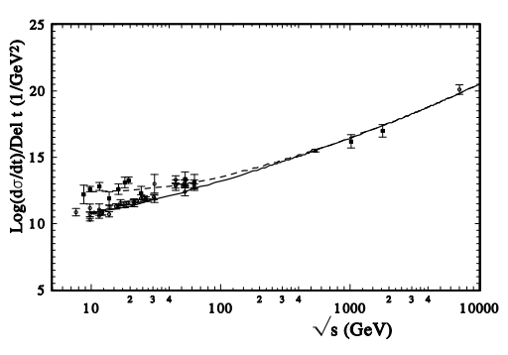

Slide 63
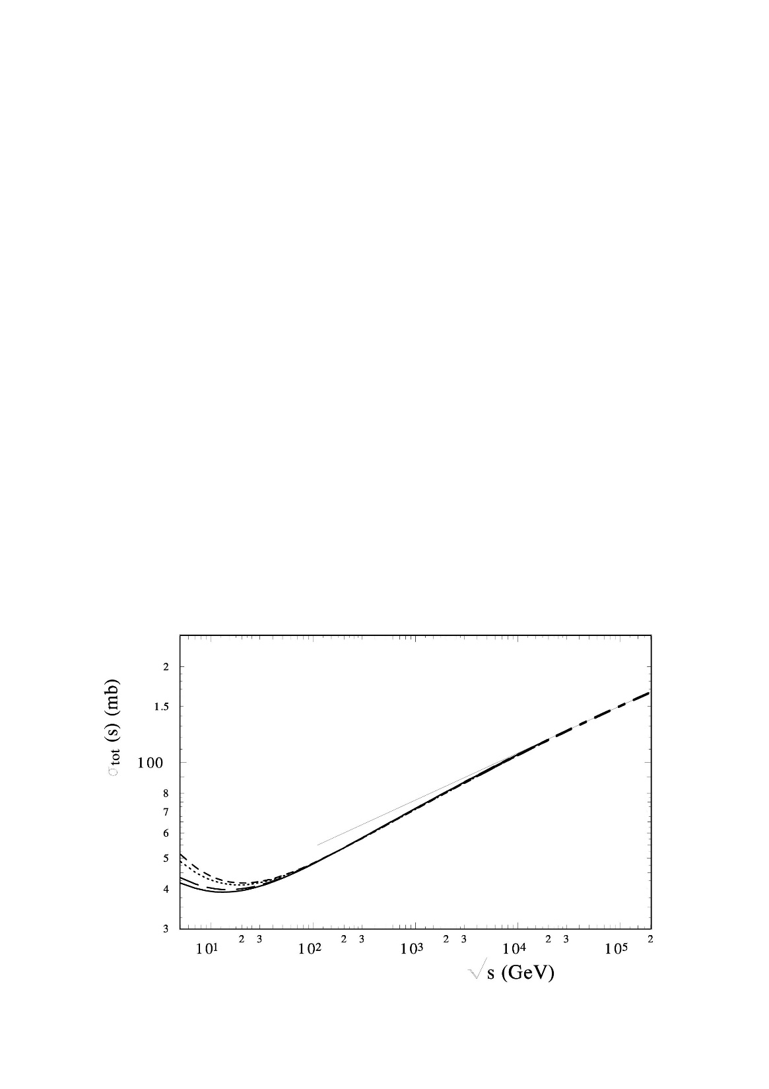

Slide 64




proton – neutron
elastic scattering

Slide 65


Pion – proton
elastic scattering
Pi⁻P
Pi⁺P

Slide 66




Slide 67
Analysing power
9

Slide 68





Slide 69
Non-exponential behavior (origins)
1. Non-linear Regge trajectory
a) Contributions of the meson cloud (J.Pumplin, G.L. Kane; O.V.S.)
b) Pion loops (Anselm, Gribov, Khoze, Martin; Jenkovski et al.)
2. Different slopes of the other contributions
(real part, odderon, spin-flip amplitude)
3. Unitarization

Slide 70

arXiv: 2009.10129 [hep-ph, hep-ex] (2020).
(accepted in Mod.Phys.Lett. A)
The result was obtained with a sufficiently large addition coefficient of
the normalization n = 1/k = 1.135. It can be for a large momentum transfer, but
unusual for the small region of t.
Let us put the additional normalization coefficient to unity and continue
to take into account in our fitting procedure only statistical errors.
We examined two different forms. One is the simple exponential form
The parameters of the additional term are well defined
hd = 1.07 ± 0.02 ; d = 0.516 ± 0.018;
$$α$$

Slide 71
The amplitude F_dop(b) in the impact parameter representation
hard line – the real part; dashed line – the imaginary part

Slide 72


Slide 73


Slide 74
outcome
The new Regge-eikonal model of hadron interaction based
on the analyticity of the scattering amplitude
with taking into account the hadron structure.
The main features of the model are:
a unique energy dependence of the basic asymptotic terms of the Born amplitude
(all Born terms have one fixed intercept) and fixed slopes;
the real part of the hadronic elastic scattering amplitude is determined only
through the complex Mandelstam variable S, satisfying the dispersion relations;
The elastic scattering reflects the generalized structure of the hadron. The model
use of two fixed forms of factors determined by different momenta of the same
Generalized Parton Distribution (GPDs).
The model used in fitting procedure only statistical errors,
the systematical errors used as additional normalization coefficient which is the same for experimental data of one set.

Slide 75
An additional term with large slope is require for the quantitatively
description of the experimental data in the case of the standard normalization of 13 TeV data. The analysis of whole sets
of high energy experimental data support the existence such anomalous term
The experimental data show some periodical structure in the Coulomb-hadron interference region of t and in a wide energy region.1
The small period of the “oscillation” is related with the long hadron screening potential at large distances
The non-fitting (statistical) method can show the existence of some oscillations in the differential cross sections and help to check the values of B, ρ ,
In the framework of the model the contribution
of the hard pomeron do not feeling.
The extending variant of the model shows the contribution
of the “maximal” odderon with specific kinematic properties.
Its contribution is important at 13 TeV.

Slide 76
The model shows the small contribution of the energy independence
spin-flip amplitude . (It is require the further researches
with take into account the polarization data)
We do not see the contributions of the second Reggions with large slope and intercept essentially above 0.6 (near 0.8).
More experimental data in the Coulomb-hadron interference region are needed. [NICA (low energy) and LHC(high energy)] .
It is crucial that the experiments measure – and simultaneously.
The forward experiments at NICA can give valuable information for the improvement of our theoretical understanding the strong hadrons interaction.
This is especially true for the experiment at NICA with polarized beams.
The calculations of the model are used in the works under the grant of RSF
for the theoretical preparation of experiments at the NIKA research center.

Slide 77
Спасибо за внимание

Slide 78
ν₁ − 2 second Born approximation (2 photon diagram)
O.V. Selyugin Mod.Phys.Lett. A11, 2317 (1996)
ν₂ − 2 second Born approximation (photon-Pomeron interference with taking into account dipole form-factor of the nucleons)
O.V. Selyugin, Mod.Phys.Lett., A12, 1379, (1997);
Phys.Rev. D60, 074028 (1999)

Slide 79
O.V. S., O.V. Teryaev, Phys.Rev. D 79, 033003 (2009).
O.V. S., Mod. Phys. Lett. A, v. 26 (2011).
O.V.S. - Eur. PhysJ. C 72: 2073 (2012)
O.V.S. Nucl.Phys. A 903 54 (2013)
O.V. S., Phys. Rev., D 89, 093007 (2014) .
O.V. S, Nucl. Phys. A 922, 180 (2014)
O.V. S., Phys. Rev., D 91, 113003 (2015)
O.V. S., Nucl.Phys. A 959, 116 (2017).
O.V. S., Phys.Lett. B 797, 134870 (2019).
O.V. S., Symmetry, v.13, 00164 (2021)
O.V. S, Mod.Phys.Lett. A 36, 215148 (2021)
O.V. S., Phys. Rev., D 104, 003154 (2021)
O.V. S., Symmetry, MDPI, 15, 760, (2023).
O.V. S., Eur. Phys. J. C 84:649 (2024)
O.V. S., Phys. At. Nucl. V. 87, n.3, p. 252 (2024)
O.V. S. PEPAN Lett., v.55, n4, 1000 (2024).
O.V. S., Phys. At. Nucl. V. 87, (2024)
O.V. S., Phys. Rev., D (2024)

Slide 80

Notes:
Diffraction-2018 (Regio Calabria)

Slide 81

-t GeV²

Slide 82

Yu.M. Antipov et al.,
Preprint IHEP (Protvino) 76-95 (1976)
Problem:
Compare non-exponential and
exponential forms
O.V. Selyugin
Int.workshop, Protvino (1982)

Slide 83

Slope of the differential cross sections
Eikonal represantation

Slide 85

V.A. Tzarev
Model of complex Regge poles
Preprint NAL-Pub-74/17, 1974; DAN-USSR, v.95 (1977)

Slide 86
Potential of rigid string
O.V. Selyugin
Fit over (q)
Ukr.J. Phys., v.41 (1996)

Slide 87

Experimental data UA4/2

Slide 89


Slide 90
Statistical analysis

Slide 91
HEGS model analysis
Results:
with F(osc)
Witout F(osc)

Slide 92



Slide 93
K. Chadan, A. Martin: “Scattering theory and dispersion relations for a class of long-range oscillating potentials”, CERN (1979)
2. a) Van-der-Waals potential V_{ad} ~ h/r⁴
b) F. Ferrer, M. Nowakowski (1998)
(Golstoun boson – long range forces) V_{ad} ~ h/r³
3. S-L interaction
N-dimensional gravipotential (ADD-model) Oscillations”- I. Aref’eva [1007.4777:arXiv-hep-ph]
Universal scenario?

Slide 94
and were reported on the international conferences by O.V.S. :
International Spin Physics Symposium: SPIN2012, JINR, Dubna, Russia (2012);
The 15th conference on Elastic and Diffractive scattering, EDS Blois, , Swaareselka, Finland (2013);
Spin physics at NICA,Charles University, Prague, Czech Republic (2013);
XVI Workshop on high energy spin physics dspin-15, Dubna, Russia (2015);
”Selected problems in quantum field theory”, Dubna (2015) dedicated to the memor of E.A. Kuraev
Diffraction in High-Energy Physics (Diffraction-2016), , Acirialle, Italy (2016);
XXXIth International Workshop on High Energy Physics, Protvino, Russia (2017);
17th workshop on Elastic and Diffractive Scattering (EDS Blois workshop), Czech Republic (2017);
Ginzburg Centinental Conference on Physics, Lebedev Institute, Moscow, Russia (2017);
Diffraction and Low-x physics, , Reggio-Calabria, Italy (2018);
The XXIV Intern. Workshop HE Physics and QFTh. (QFTHEP-2019), Sochi, Russia (2019);
XVIII Workshop on High Energy Spin Physics DSPIN-19, Dubna, Russia (2019);
XXXIII Intern. Workshop on HE Physics: Hard Problems of Hadron Physics, Protvino, RF (2021);
International Conference on QFTh, High-Energy Physics, and Cosmology ,Dubna, Russia (2022);
International Conference on High Energy Physics 2023, Yerevan, Armenia (2023);
XXV Intern. Baldin Seminar on HE Phys. Relativistic Nuclear Physics and QCD, Dubna, RF (2023);
XIXth Workshop on High Energy Spin Physics dedicated to 90th anniversary of A.V. Efremov birth,
Dubna, Russia (2023);
XXXiV Intern. Workshop on HE Phys.: ”Hard Problems of Hadron Physics: Non-Perturbative
QCD”, Protvino, RF (2024);

Slide 95

Khoze

Slide 96


Slide 97
O.V. Selyugin, Phys.Rev. D 91, 113003 (2015)
Обобщенные партонные распределения
Generalized Parton Distributions -GPDs
Electromagnetic form factors
(charge distribution)
Gravitomagnetic
form factors
(matter distribution)

Slide 98
NEW EFFECT
Fitting procedure:

Slide 99


Slide 100
Screening long range potential

Slide 101

1 1 1 1 1 1 1
2 2 2 2 2 2 2

Slide 102


O.V. Selyugin, Phys.Lett. B 797, 134870 (2019).

Slide 103
General Parton Distributions (GPDs)
Sanielevici-Valin (1984) –Valon model – Phys.Rev.D29 (1984).
“matter form factor” (MFF) measures the interaction of a gluonic probe with the excited matter of the overlapping hadrons and should incorporate the static matter distributions of the participating hadrons…”

Slide 104



Slide 105
The transverse density ρ0nb (left);
the angle dependence of the transverse charge density distribution of the proton ρTpb-ρ0pb (middle);
the difference of the charge F1P and mass A density of the proton (right).

Slide 106
Martin – 2002 // H. KHANPOUR..-2012 (1205.5194)
Pumplin et al. 2002 (CTEQ6M)
Martin et al. 2002 (MRST02) .– Martin -2009 (LO, NLO, NNLO)
Gluck-Pisano 2008
Alekhin et al. 2012 (ABM12)

Slide 107
Problems
Comment

Slide 108

The profile function Г(s,b): the real part (left) and imaginary part (middle)
at energies s=9.8 GeV (dashed line), s=52.8 GeV (dash-dotted line),
s=7 TeV (long dashed line), s=14 TeV (solid line).
he spin-flip amplitude in the b- representation (right) (solid line - eq.(12),
dashed line - eq.(13) long dashed line - with q factor and normal exponential form

Slide 109
V.A. Tzarev
Model of complex Regge poles
Preprint NAL-Pub-74/17, 1974; DAN-USSR, v.95 (1977)

Slide 110

Khoze

Slide 111
H. Pagels, Phys.Rev., v.144, (1966)
“Energy-Momentum Structure Form Factors of Particles”
“in analogy to the condition

Slide 112
Summary
In the framework of the HEGS model the differential cross sections at large momentum transfer are described well in a wide energy region and up to –t=15 GeV^2..
  . The hard pomeron is not visible
  . The anomalous term has Log(s) dependence
  . The new oscillation term has cross-odd properties
The examined low energy spin-flip amplitude has small energy independent part
Sm all
It is proportional to the electromagnetic form factor.

Slide 113
Summary
The experimental data show some periodical structure in the Coulomb-hadron interference region of t and in a wide energy region.
The small period of the “oscillation” is related with the long hadron screening potential at large distances.
An additional term with large slope is require
for the quantitatively description of the experimental data
in the case of the standard normalization of 13 TeV data

Slide 114
Summary
To investigate the non-linear behavior of the parameters of the scattering amplitude, one needs to develop new methods.
The new method for the determination of the real part
of the elastic hadron amplitude gives the possibility to find special features in its behavior
The non-fitting (statistical) method can show the existence of some oscillations in the differential cross sections and help to check the values of L, s, B, ρ

Slide 115
Such term leads to the increasing
the size of
and decreasing the size of
Preliminary analysis of whole sets of high energy experimental data support the existence such anomalous term.
More experimental data in the Coulomb-hadron interference region are needed. [NICA (low energy) and LHCB(high energy)]
It is crucial that the experiments measure – and simultaneously.

Slide 116
Summary
6. In the framework of the model the contribution of the hard pomeron do not feeling.
6. In the framework of the model the contribution of the hard pomeron do not feeling.
7. The extending variant of the model show the contribution of the “maximal” odderon with specific kinematic properties.
8. The model shows the small contribution of the energy independence spin-flip amplitude . (It is require the further researches with take into account the polarization data)
9. The slope of the differential cross sections at small t has the small
peculiarity and has the same properties in the whole examined energy
region. (It is require the further researches)
10. Hence we do not see the contributions of the second Reggions with large slope and intercept above 0.5.
11. The model open the new way to determine the true form of the GPDs and standard parton distributions.

Slide 117
Summary
1. The elastic scattering reflects the generalized structure of the hadron.
2. The our model GPDs leads to the well description of the proton and neutron electromagnetic form factors and its elastic scattering simultaneously.
3. The new High Energy Generalized Structure model (HEGS) gives the quantitatively description of the elastic nucleon scattering at high energy with only 6 fitting high energy parameters.
4. The model leads to the good coincides the model calculations with the preliminary data at 8 TeV.
The standard eikonal approximation works perfectly from Sqrt(s}=9 GeV up to 8 TeV.
THANKS For your attention

Slide 118
Summary
The experimental data show some periodical structure in the
Coulomb-hadron interference region of t and in a wide energy region.
The small period of the “oscillation” is related with the long hadron
screening potential at large distances.
It is likely that this effect has an electromagnetic origin, or
it comes from the odderon.
More experimental data in the Coulomb-hadron interference region are needed. [NICA (low energy) and LHC(high energy)] It is crucial that the experiments measure – simultaneously.

Slide 119
Researches into the structure of the elastic hadron scattering amplitude at super-high energies and small momentum transfer – t outlines a connection between experimental knowledge and the fundamental asymptotic theorems, which are based on the first principles.
This connection provides information about hadron interaction
at large distances where the perturbative QCD does not work ,
which gives the premise for a new theory to be developed.

Slide 120
Summary
Such term leads to the increasing the size of
and decreasing the size of
6. In the framework of the model the contribution of the hard pomeron do not feeling.
7. The extending variant of the model show the contribution of the “maximal” odderon with specific cinematic properties.
8. The model show the small contribution of the energy independence spin-flip amplitude . (It is require the further researches with take into account the polarization data)
9. The slope of the differential cross sections at small t has the small
peculiarity and has the same properties in the whole examined energy
region. (It is require the further researches)
10. Hence we do not see the contributions of the second Reggions with large slope and intercept above 0.5.
11. The model open the new way to determine the true form of the GPDs and standard parton distributions.

Slide 121
Summary
1. The elastic scattering reflects the generalized structure of the hadron.
2. The our model GPDs leads to the well description of the proton and neutron electromagnetic form factors and its elastic scattering simultaneously.
3. The new High Energy Generalized Structure model (HEGS) gives the quantitatively description of the elastic nucleon scattering at high energy with only 6 fitting high energy parameters.
4. The model leads to the good coincides the model calculations with the data up to 13 TeV.
The standard eikonal approximation works perfectly from Sqrt(s}=3.6 GeV up to 13 TeV.

Slide 122
Answers
1. regions of t ?;
Coulomb-hadron interference region of t.
The effect is large for the smaller values of t.
The effect does not come from statistical fluctuations, otherwise it would appear for any t.
size of the periodical structure?
Order 10⁻² of the main hadron amplitude.
. phase of the additional amplitude?
Almost real, changes sign when it goes
from particle to antiparticle.
. energy dependence?;
Constant or small energy dependence log(s)

Slide 123


Slide 124
UNITARIZATION → eikonal representation

Slide 126
Answers
1. regions of t ?;
Coulomb-hadron interference region of t.
The effect is large for the smaller values of t.
The effect does not come from statistical fluctuations, otherwise it would appear for any t.

Slide 127
Saturation and non-linear equation
J.-R. Cudell, E.Predazzi, O.V. S., Phys.Rev.D79:034033,2009
J.-R. Cudell, O.S., Phys.Rev.Lett.102:032003,2009
Factorization
The Froissart bound

Slide 129
High Energy General Structure (HEGS) model
O.V.S. - Eur. Phys. J. C (2012) 72:2073

Slide 131
Radius of the saturation
Low s

Slide 132
Integral dispersion relations
Local DDR

Slide 133
Answers
2. size of the half period?;
q₀=0.01 GeV and q₀=0.02 GeV
(maybe, q₀(s) 0.02→0.01)
3. size of the periodical structure?
Order 10⁻² of the main hadron amplitude.

Slide 135
High energy parameers
Low energy parameters

Slide 136


Slide 137



Slide 138

High energy elastic hadron
scattering models
Hadron as whole
T.T.Wu, B. McCoy, “Theory “bags” with scattering”, P.R. D9 (1974);
B. Schrempp, F. Schrempp
“Strong interaction - a tunnelling phenomenon?”, N.Phys. B163 (1980) )

Slide 139



Slide 140
ν₁ − 2 second Born approximation (2 photon diagram)
O.V. Selyugin Mod.Phys.Lett. A11, 2317 (1996)
ν₂ − 2 second Born approximation (photon-Pomeron interference with taking into account dipole form-factor of the nucleons)
O.V. Selyugin, Mod.Phys.Lett., A12, 1379, (1997);
Phys.Rev. D60, 074028 (1999)

Slide 141
Общенные партонные распределения
General Parton Distributions (GPDs)
Можно определить как Фурье-преобразование нелокального матричного элемента

Slide 142

Seminar in the TOTEM O.V.S. (2009) ; and Phys.Rev.Lett. (2009)
LHC
14 TeV
Simulation of the experimental data by the model with non-exponential behavior of B(s,t) and r(s,t)
N=90

Slide 145



PRELIMINARY

Slide 146
Born Regge spin-flip amplitude
Predazzi, E.; Selyugin, O.V. Behavior of the hadronic potential at Large Distances. Eur. Phys. J. A 2002, 13, 471–475.
Β_{(sf.)} >= 2Β_{(nf.)}

Slide 147
The predictions of HEGS model
19.42 | 38.98 0.4 | 39.58 | -0.005
22.2 | 30.42 0.4 | 39.89 | -0.0013
52.8 | 42.85 0.7 | 43.28 | 0.074
541 | 62.72 0.2 | 62.8 | 0.128
1800 | 77.3 0.38 | 77.4 | 0.127
7000 | 98.3 2.6 | 97.2 | 0.121
7000 | 96.4 2. | 97.2 | 0.121
8000 | 101 2.1 | 99.4 | 0.12
14000 | 104 26. | 108.76 | 0.1176
300000 | 120 15.. | 122.7 | 0.11
57000 | 133 23. | 135.4 | 0.11

Slide 149
The predictions of the model in the case HP-1=0.32 versus
The TOTEM data at sqrt(s)=13 TeV
A.A. Godizov, Phys.Rev. D101, 074028 (2020)
A.A. Godizov, Phys. Rev. D 96 034023 (2017)

Slide 150

A. De Rujula , arXiv:1008.3861
critic: I. Cloet, G.A. Miller
arXiv: 1008.4345

Slide 151
O.S. - New methods for calculating parameters of the diffraction
scattering amplitude, "VI Intern. Conf. On Diffraction...", Blois, France,(1995).
O.S. “Additional ways to determination of structure of high energy elastic scattering
amplitude” arxiv.org:[hep-ph/0104295]
P. Gauron, B. Nicolescu, O.S. “A New Method for the Determination of the Real Part of the Hadron Elastic Scattering Amplitude at Small Angles and High Energies”
Phys.Lett. B629 (2005) 83-92

Slide 152



Slide 153


The fit of ds/dt by the Born hard scattering amplitude
In one exponential form using the eikonal representation
The fit of ds/dt by the Born hard scattering amplitude
In two exponential form using the eikonal representation

Slide 155

The comparison 0f Sumchi^2 from the fit of d\sigma/dt in exponential and two exponential forms

Slide 157
The amplitude F_dop(b) in the impact parameter representation
hard line – the real part; dashed line – the imaginary part

Slide 159
Answers
4. energy dependence?;
Constant or small energy dependence log(s)
5. phase of the additional amplitude?
Almost real, changes sign when it goes
from particle to antiparticle.

Slide 160
k(d) | model
0.87 |  | 525/415 | 106.1 | 0.146
0.87 | Fd=0 | 515/425 | 106.2 | 0.142
0.87 |  | 527/425 | 106.2 | 0.148
1 | Fd(rd) | 539/425 | 113.2 | 0.109
1 | Fd (rd) | 549/425 | 113.2 | 0.113
1 | Fd(exp) | 550/425 | 112.6 | 0.115

Slide 161


BFKL Pomeron
Balitsky, Fadin, Kuraev, and Lipatov (BFKL)
Brodsky, Fadin, Kim, Lipatov, and Pivovarov

Slide 162
Analysis of the all LHC data (719 experimental points)

Slide 163
LHC
Final results (or) the beginning new story
* The new data bounded essentially the limits of the models.
The new High Energy Generalized Structure model (HEGS) gives the quantitatively description of the elastic nucleon scattering at high energy with only 6 fitting high energy parameters.
Phenomenological analysis
The problems of the determination of
The thin structure of the slope - B(s,t), (non-exponential, oscillations)
The term ct^2 mimic the unitarization procedure –> it is better use the eikonal representation
The term play important value;
It is need taking into account the form factors of hadrons
Slope of Re F(s,t) exceeded the slope of Im F(s,t);
The new LHC data show the problem with the normalization.
$$\left.α_{2}^{;}(\sqrt{4μ^{2}−t } −2μ\right)$$
It is need obtain the data in CNI region.
Wait the high precision new data at small t and 13 TeV

Slide 164
Summary
The experimental data show some periodical structure in the
Coulomb-hadron interference region of t and in a wide energy region.
The small period of the “oscillation” is related with the long hadron
screening potential at large distances.
It is likely that this effect has an electromagnetic origin, or
it comes from the odderon.
More experimental data in the Coulomb-hadron interference region are needed. [NICA (low energy) and LHC(high energy)] It is crucial that the experiments measure – simultaneously.

Slide 165
Summary
1. The elastic scattering reflects the generalized structure of the hadron.
2. The our model GPDs leads to the well description of the proton and neutron electromagnetic form factors and its elastic scattering simultaneously.
3. The new High Energy Generalized Structure model (HEGS) gives the quantitatively description of the elastic nucleon scattering at high energy with only 6 fitting high energy parameters.
4. The model leads to the good coincides the model calculations with the preliminary data at 8 TeV.
The standard eikonal approximation works perfectly from Sqrt(s}=9 GeV up to 8 TeV.
THANKS For your attention

Slide 166

Elastic scattering at the CNI region
Coulomb region: ∝1/t²
C–N interference
Sensitivity to ρ
2*10⁻³<|t|<8 (GeV²)
BSW - 2003
Nuclear slope: ∝e^{bt}
Using the optical theorem, the measured elastic rate at small t
values can be expressed as: which can be fitted to obtain:
σ_{tot}, ρ, b, and L
“structure”

Slide 167
the new LHC data (elastic scattering)
at 7 and 8 TeV
7 TeV (TOTEM) - t [0.00515 – 0.371] 17.08.2012
7 TeV (ATLAS) - t [0.0062 – 0.3636] 25.08.2014
8 TeV (TOTEM) - t [0.028500 – 0.1947] 12.09.2015
8 TeV (TOTEM) - t [0.000741 – 0.201] 11.12.2015
8 TeV (ATLAS) - t [0.01050 – 0.3635] 25.06.2016

Slide 168


Slide 169
Total cross sections
TOTEM
ATLAS

Slide 170

The ρ parameter
linked to σ_{tot} via dispersion relations
sensitive to σ_{tot} beyond the energy
at which is measured
  predictions of σ_{tot} beyond LHC energies
  Or, are dispersion relations still valid at LHC energies?
J.-R. Cudell, O.S. –
Phys.Rev.Lett. 102, 032003, (2009)

Slide 171
Problems
Comment

Slide 172
Potential of rigid string
O.V. Selyugin
Fit over (q)
Ukr.J. Phys., v.41 (1996)

Slide 173
K. Chadan, A. Martin: “Scattering theory and dispersion relations for a class of long-range oscillating potentials”, CERN (1979)
2. a) Van-der-Waals potential
b) F. Ferrer, M. Nowakowski (1998)
(Golstoun boson – long range forces)
3. S-L interaction
N-dimensional gravipotential (ADD-model) Oscillations”- I. Aref’eva [1007.4777:arXiv-hep-ph]
Universal scenario?

Slide 174
The ρ parameter
linked to σ_{tot} via dispersion relations
sensitive to σ_{tot} beyond the energy
at which is measured
predictions of σ_{tot} beyond LHC energies
or, are dispersion relations still valid at LHC energies?
J.-R. Cudell, O.S. –
Phys.Rev.Lett. 102, 032003, (2009)

Slide 175


Slide 176
Problems
Comment
Very likely that this difference reflects the true errors of the fitting procedure of the experimental data obtained by the luminosity independent method.

Slide 177


Slide 178
Total cross-section
Understand the asymptotic behavior of σ_{tot}
new (precise) data to constraint the fit: σ_{tot} vs (ln s)^{γ}
1% error → ~1mb

Slide 179
O.S. EPJC (2012); arXiv: 1204.4418
predictions

Slide 180

S.Barshay, D. Rein Z. Phys. C56, (1992)
S. Barshay

Slide 181


Slide 184



Slide 185
V.A. Tzarev
Model of complex Regge poles
Preprint NAL-Pub-74/17, 1974; DAN-USSR, v.95 (1977)

Slide 188
Answers
1. regions of t ?;
Coulomb-hadron interference region of t.
The effect is large for the smaller values of t.
The effect does not come from statistical fluctuations, otherwise it would appear for any t.

Slide 189
Summary
The experimental data show some periodical structure in the
Coulomb-hadron interference region of t and in a wide energy region.
The small period of the “oscillation” is related with the long hadron
screening potential at large distances.
It is likely that this effect has an electromagnetic origin, or
it comes from the odderon.
More experimental data in the Coulomb-hadron interference region are needed. [NICA (low energy) and LHC(high energy)] It is crucial that the experiments measure – L, s, B, ρ simultaneously.

Slide 190
Transverse density ρGr_{T} (~b) − ρGr 0 (b)
the difference of the forms of charge density F₁^{P} and matter density (A)

Slide 191
Summary
6. In the framework of the model the contribution of the hard pomeron do not feeling.
7. The extending variant of the model show the contribution of the “maximal” odderon with specific cinematic properties.
8. The model show the small contribution of the energy independence spin-flip amplitude . (It is require the further researches with take into account the polarization data)
9. The slope of the differential cross sections at small t has the small
peculiarity and has the same properties in the whole examined energy
region. (It is require the further researches)
10. Hence we do not see the contributions of the second Reggions with large slope and intercept above 0.5.
11. The model open the new way to determine the true form of the GPDs and standard parton distributions.

Slide 192
Summary
To investigate the non-linear behavior of the parameters of the scattering amplitude, one needs to develop new methods.
The new method for the determination of the real part
of the elastic hadron amplitude gives the possibility to find special features in its behavior
The non-fitting (statistical) method can show the existence of some oscillations in the differential cross sections and help to check the values of L, s, B, ρ

Slide 194


J.E. Kontros, .L. Lengyel
Fit of the local slope at Dt
Ukr.J. Phys., v.41 (1996)

Slide 195
Unitarity in impact parameter representation
S S⁺ = 1

Slide 196
III) Factorization [Reggions + Form Factors (FF) ]
Chow-Yang model (1968) - hadrom form factor -
Charge distributions - electromagnetic form factors
T.T. Chou, C.N. Yang, Phys.Rev.Lett. 20 (1968)
E. Leader, U. Maor, P.G. Williams, J. Kasman, Phys.Rev. D14 (1976)
“The Chou-Yang Hypothesis – A Critical Assessment”,

Slide 197
GPDs
Общенные партонные распределения
X.Ji Sum Rules (1997)
F_{x=0} (x;t) = F (x;t)
H^{q}(x;t) = H ^{q}(x,0,t) + H ^{q}(-x,0,t)
E^{q}(x;t) = E ^{q}(x,0,t) + E ^{q}(-x,0,t)

Slide 198
H. Pagels, Phys.Rev., v.144, (1966)
“Energy-Momentum Structure Form Factors of Particles”
“in analogy to the condition

Slide 199


Slide 200


Slide 202
Dispersion Relations
- Dielectric susceptibility
- Refractive index

Slide 203


Slide 204


Slide 205


Slide 206


Slide 207
LHC
ИТОГ (или) НАЧАЛО
* Значения дифференциальных и полных сечений существенно ограничили пределы моделей.
Реджистика работает (Открытие Свиридова продолжает действовать)
GPDs открывают новые пути для связи упругих и неупругих взаимодействий
Но: где жесткий Померон?; t и s зависимость Оддерона?
Унитаризация – эйконал?
* Проблемы определения r (s,t) остаются.
Тонкая структура ( - зависимость наклона - B(s,t),
возможные осцилляции) - проблемы
Асимптотика амплитуды - широкий выбор
Ждем новых эксперементальных данных
TOTEM; ATLAS

Slide 208


Slide 209
Saturation bound

Slide 211
The standard procedure to extract the magnitude of the real part
A fit to the experimental data by minimizing the function:
The interval of t is the sufficiently large --- 0.0005 …< -t <….0.1 (GeV²)

Slide 212
Forward scattering and
possible fine structure
Phase of the scattering amplitude
Coulomb-hadron interference
High energy effect
Low energies
Fitting analysis
New statistical analysis
Properties of the “oscillation” potential
Summary

Slide 213
Questions
1. regions of t ?;
2. size of the half period?;
3. energy dependence?;
4. amplitue of the oscillation?
5. phase of the additional amplitude?

Slide 214
BSW_1 | BSW_2 | AGN | MN | HESG0 | HESG1
369 | 955 | 1728+238 | 2600+300 | 980 | 3090
7+Regge | 11 | 36 | 36+7 | 3+2 | 6+3
23.4-630 | 13.4 -1800 | 9.3-1800 | 5-1800 | 52-1800 | 9-7000
 | 0.1 - 5 | 0,1- 2.6 | 0.1- 16 | 0.000875- 10 | 0.00037- 15
4.45 | 1.95 | 1.16 | 1.23 | 2. | 1.28
N_exp.
n_par.

Slide 215
UNITARIZATION → eikonal representation

Slide 217
O.V. Selyugin, Nucl.Phys. A 959, 116 (2017).

Slide 218




Slide 219


Slide 220

O.V. Selyugin, Phys.Lett. B 797, 134870 (2019).

Slide 221


Nonlinear effects

Slide 224
Proton-proton

Slide 225
Proton-antiproton

Slide 226
High energy hadron elastic scattering
High Energy Generelized Structure (HEGS) model
O.V. S., Eur. Phys. J. C 84:649 (2024)
O.V. S. Part. Nucl. Lett, 13, 03 (2016)
O.V. S. Acta Phys. Pol. B 12 741 (2019)
O.V. S, Mod..Phys.Lett. in print (2021)
arXiv: 2009.10129 [hep-ph, hep-ex] (2020)..

Slide 228
Notes:
Diffraction-2018 (Regio Calabria)

Slide 229
High Energy General Structure (HEGS) model O.V.S. - Eur. Phys. J. C (2012) 72:2073
High Energy General Structure (HEGS) model O.V.S. - Eur. Phys. J. C (2012) 72:2073
Extending of model (HEGS1) – O.V. S. Phys.Rev. D 91, (2015) 113003

Slide 230
T. Csörgő, S. Hegyi, I. Szanyi “Difracton on low X” - 2024

