Slide 1

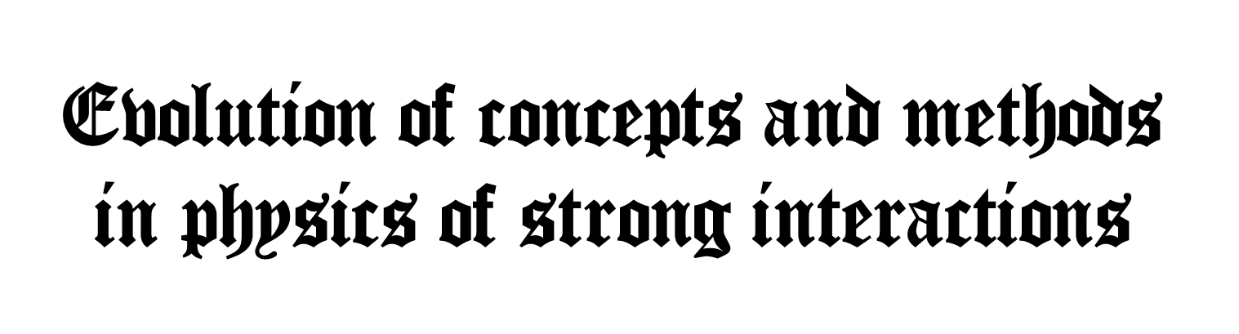
Vladimir A. Petrov,
A. A. Logunov IHEP,
NRC, KI, Protvino
XXXVI International Workshop on High Energy Physics
“Strong Interactions: Experiment, Theory, Phenomenology”
23-25 July 2024, Protvino

Slide 2

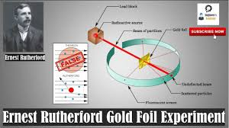
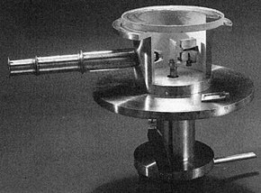

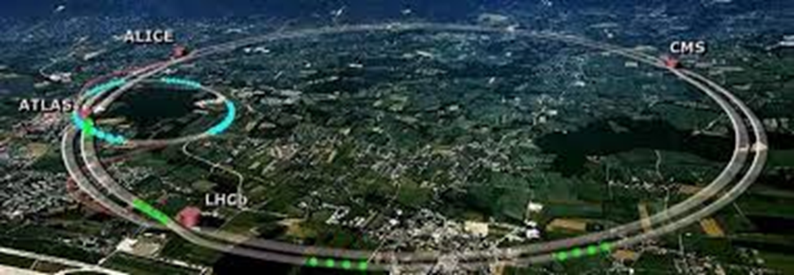
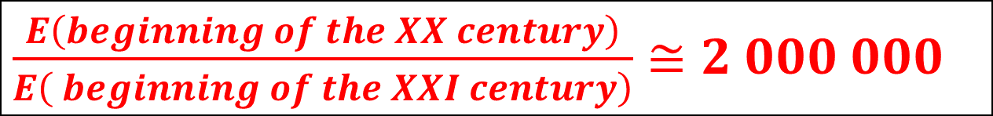
Progress in Experimental Means
1911-2021
$E_{α}=7.7MeV$

Slide 3
Stages of the Evolution of Ideas in Historical Perspective
Pre-Yukawa (1920-1934)
Mesonic Theory (1935)
Early S-Matrix Program (1943-1954)
Axiomatic Field Theory of (1954 -1956).
Renormalization. Renormalization Group.
Unified Field Theory of Elementary Particles (1957-1975)
Analytic S-matrix & Bootstrap Program (1960-1966)
Reggeology (1961).
Quasipotential (1963)
Duality. Dual Resonance Model. (1967-1975)
Unitary Symmetry. Quarks. Colour (1960-1965)
Localization of symmetries as a field-theoretic source of strong interactions. QCD.
(1954 – 1960: 1 stage ) ( 1967-1973 : 2 stage) .
Topological field configurations (instantons) (1975-1980)
* Perversion : AdS/CFT(QCD) “Holography” (1997)

Slide 4

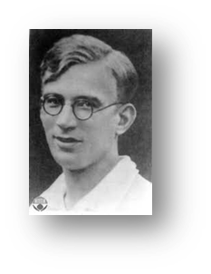
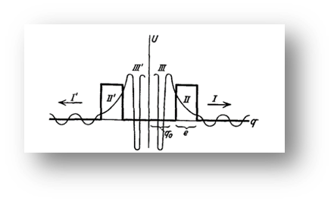
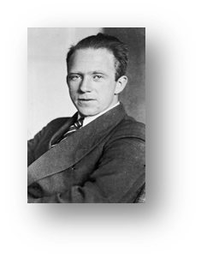
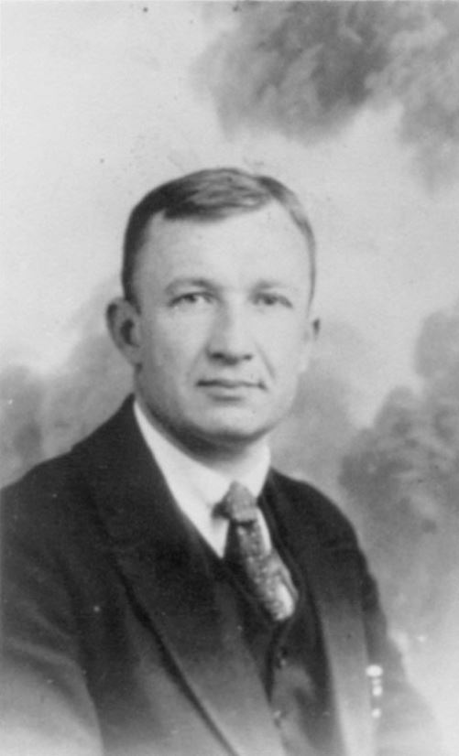
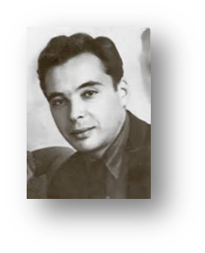
Pre-Yukawa (1920-1934)
Exchange

Slide 5

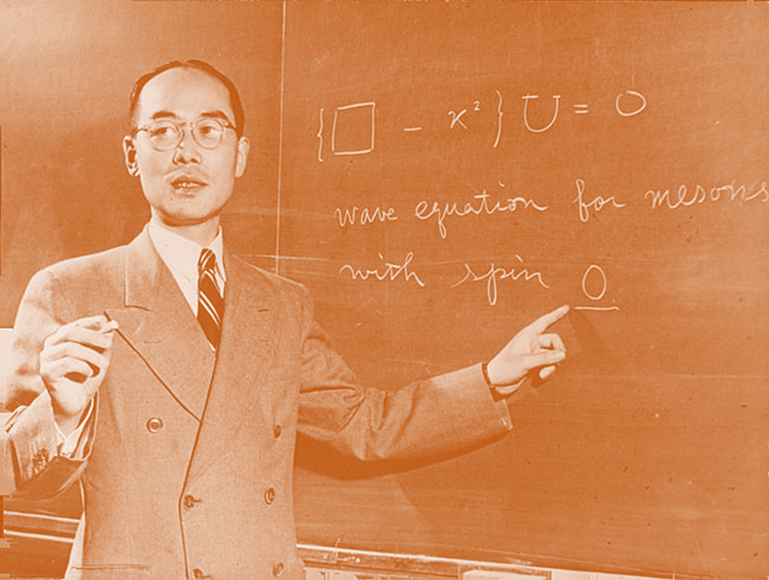
YUKAWA
湯川

Slide 6
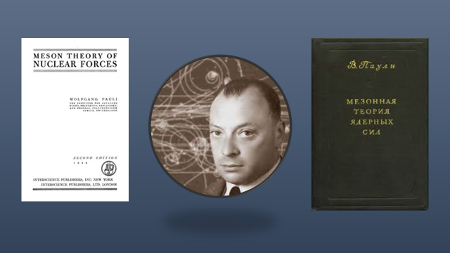
Mesonic theory (1934-1959)

Slide 7

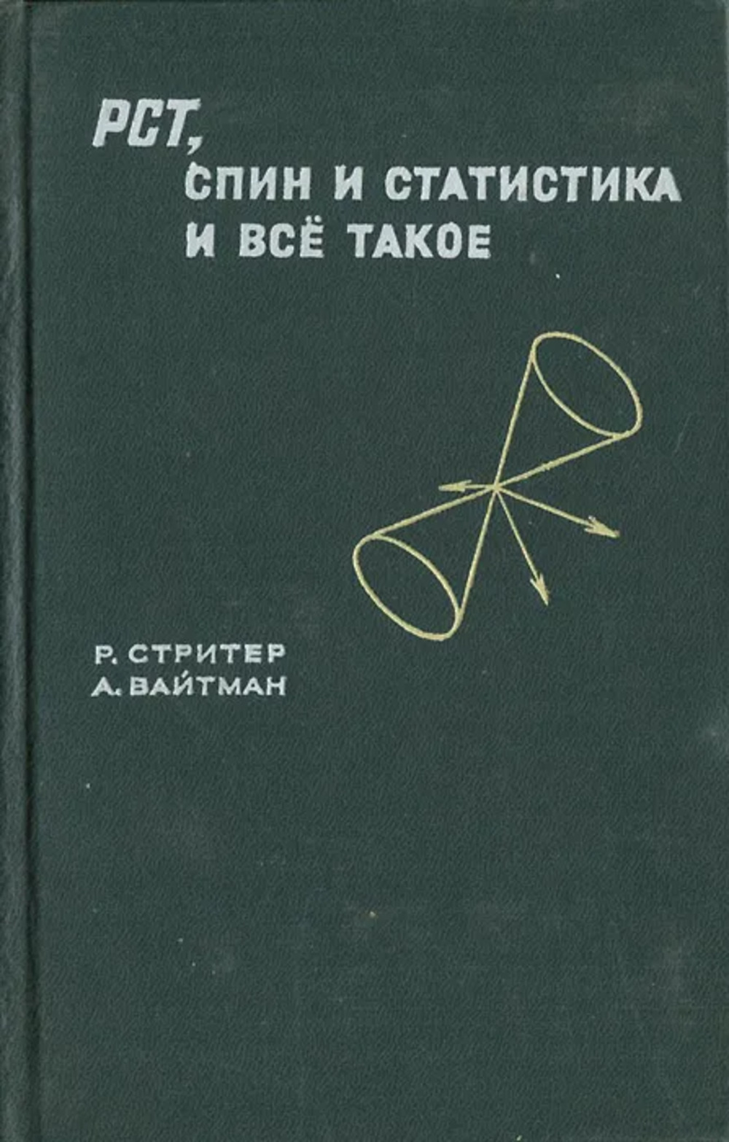
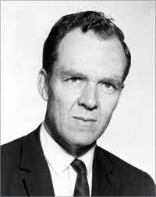
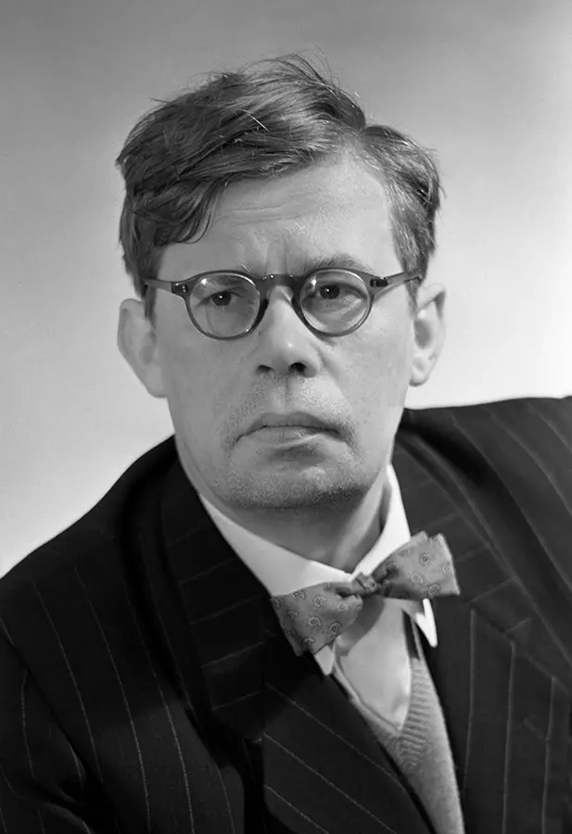
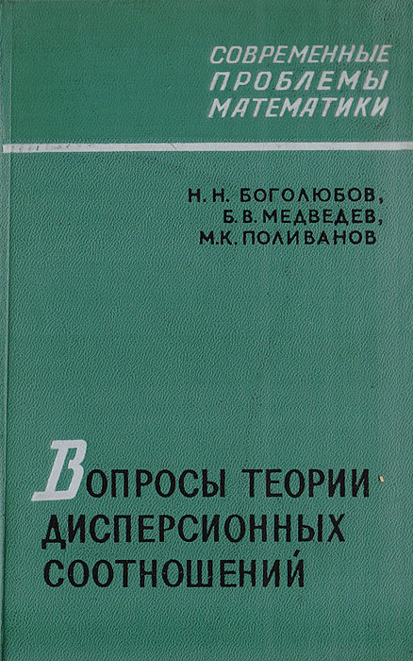
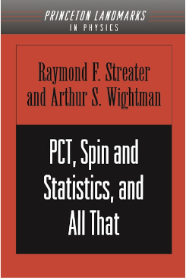
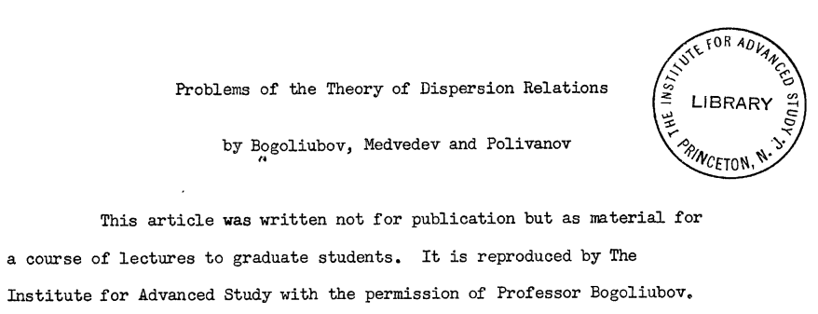

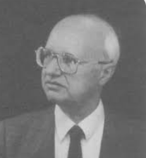
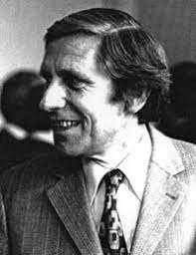
Axiomatic Field Theory of (1954 -1956)
Asymptotic fields and the LSZ formalism

Slide 8
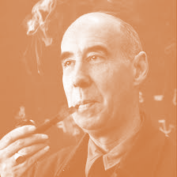
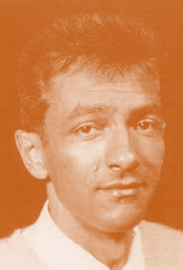
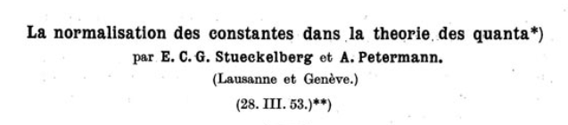
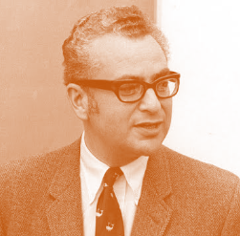
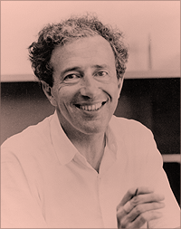
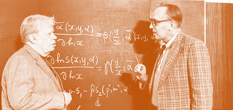

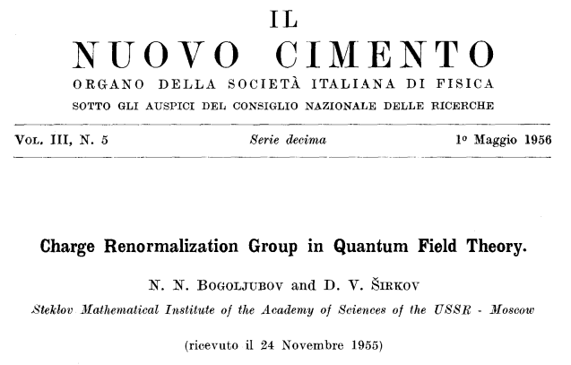
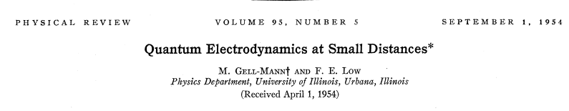
Renormalization Group.

Slide 9
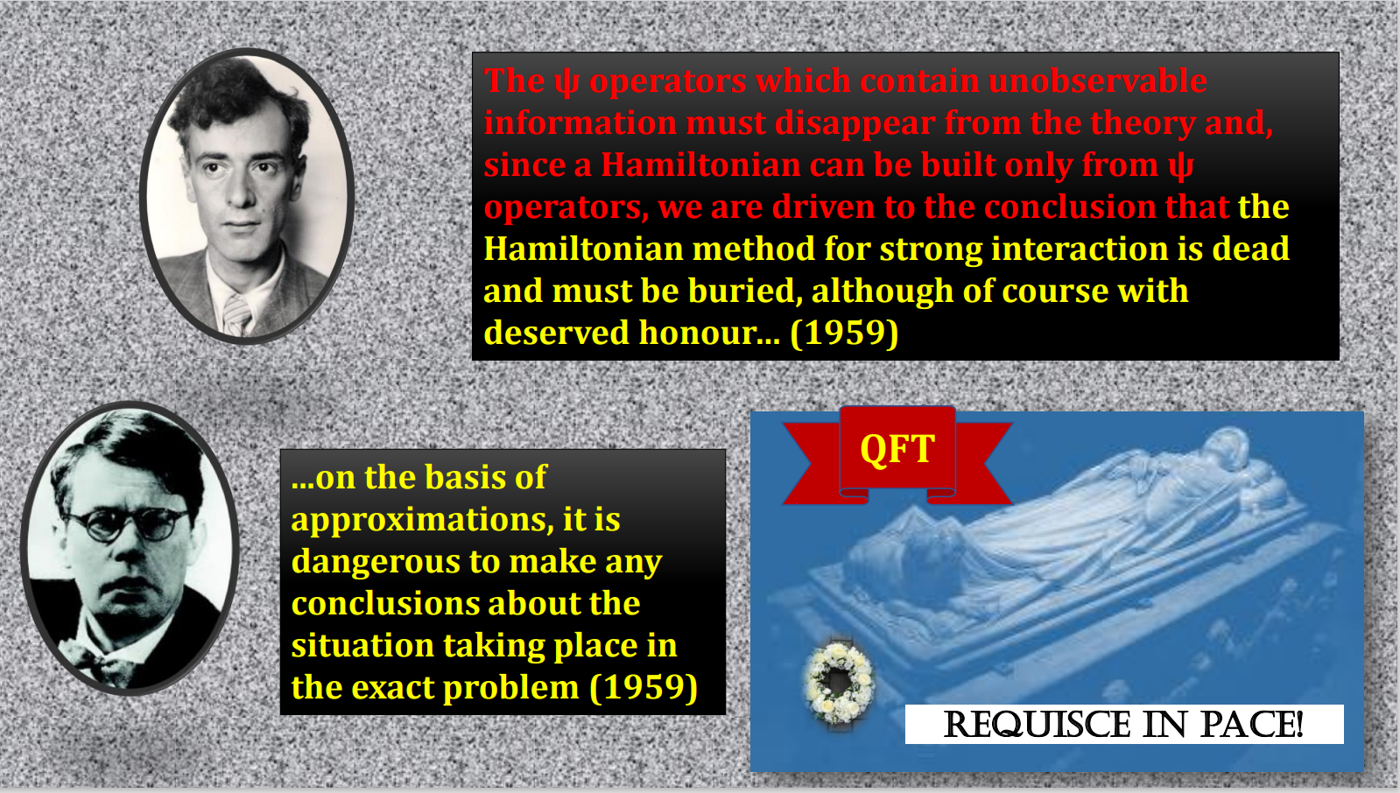

Slide 10
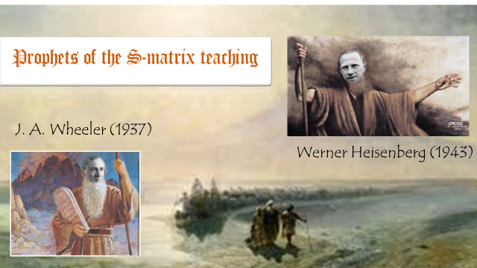
Analytic S-matrix & Bootstrap Program (1960-1966). Reggeology (1961).

Slide 11
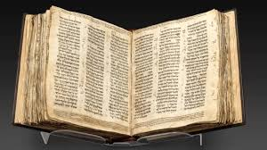
Commandments of the S-matrix teaching

Slide 12

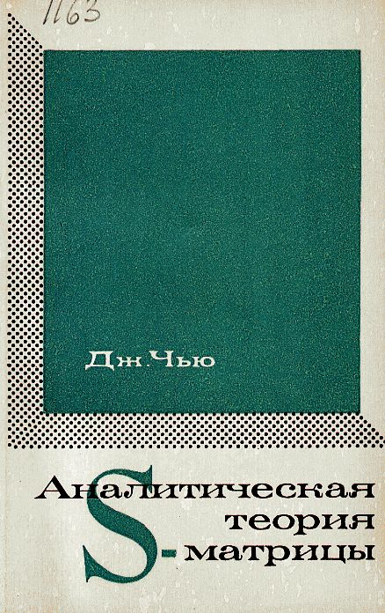
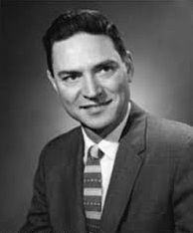
The Rise and “Fall” of the Analytic S-Matrix

Slide 13
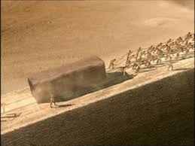
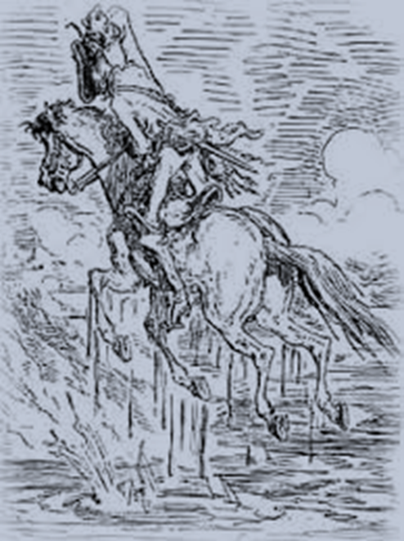
Bootstrap

Slide 14
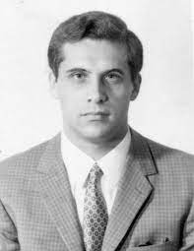

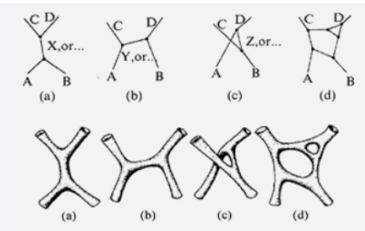
Duality. Dual Resonance Model (1967-1975)

Slide 15

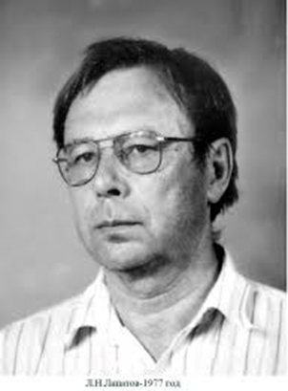
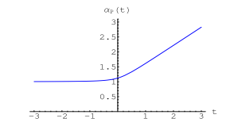
QCD for strong interactions ?

Slide 16
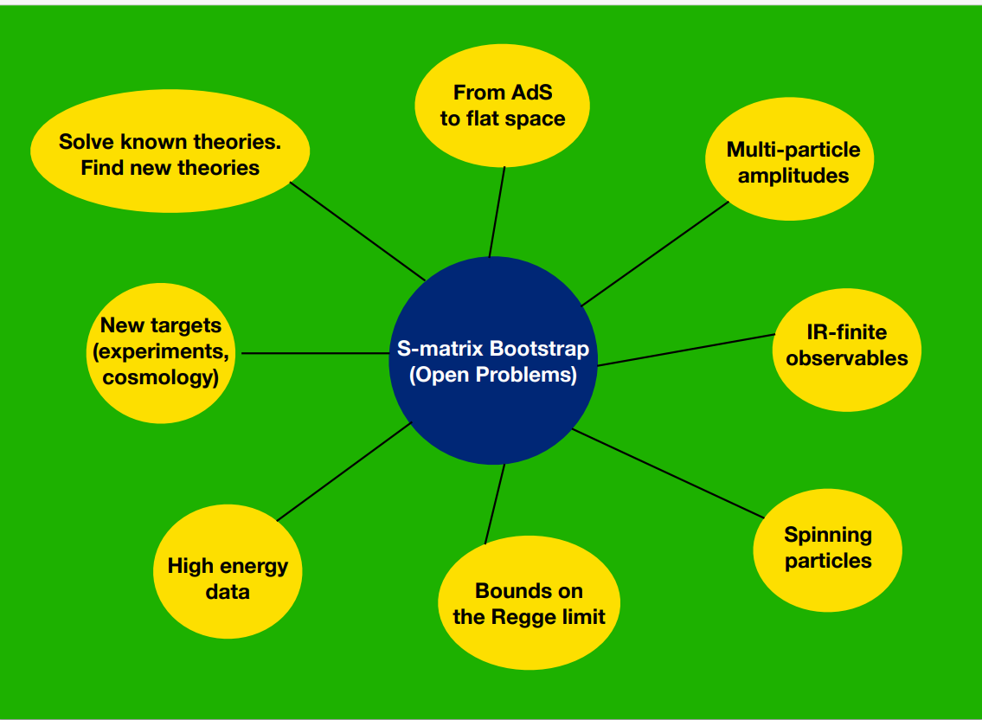

Discussion S-matrix Bootstrap - Strings2021
Strings 2021, Sao Paulo, Brazil

Slide 17
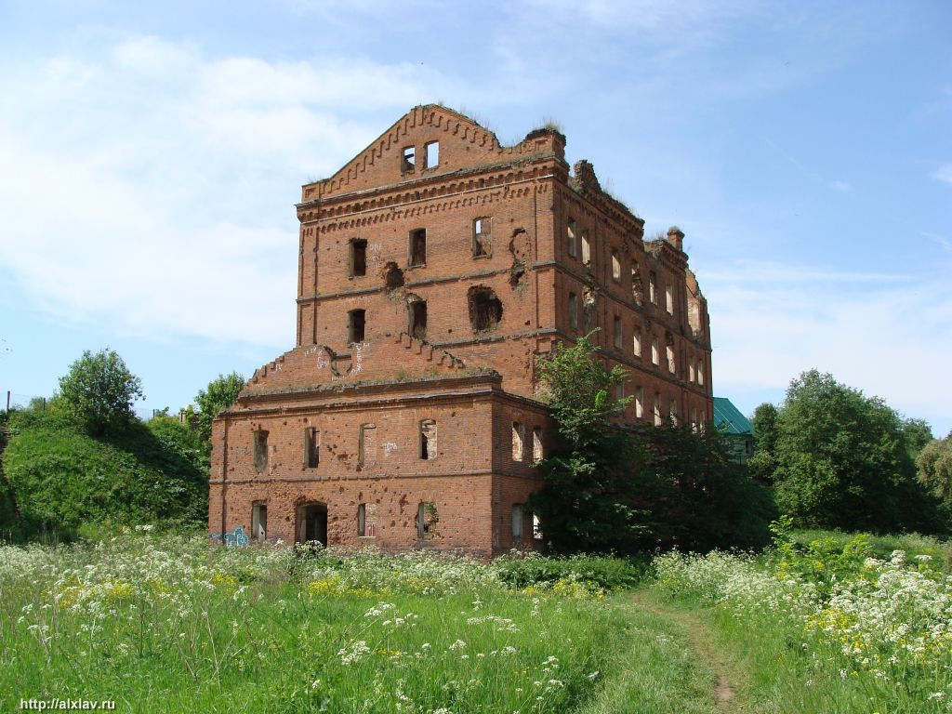

Is there a hope for High Energy Physics
in Protvino?

