Slide 1
25 June 2024
Logunov Institute for High Energy Physics
International Workshop on High Energy Physics “Strong Interactions: Experiment, Theory, Phenomenology”,
Oscillations (quasi-periodical structure)
of elastic hadron scattering
at high energies
O.V. Selyugin
(JINR Dubna)

Slide 2
Introduction and hystory
Forward scattering and possible thin structure
Phase of the scattering amplitude
Low energies
High energy effect
Fitting analysis
New statistical analysis
Properties of the “oscilation” potential
Summary

Slide 3
Questions
1. regions of t ?;
2. size of half period?;
3. energy dependence?;
4. size of the constant?
5. sign of constant for particle and antiparticle?
6. phase of the additional amplitude?

Slide 4
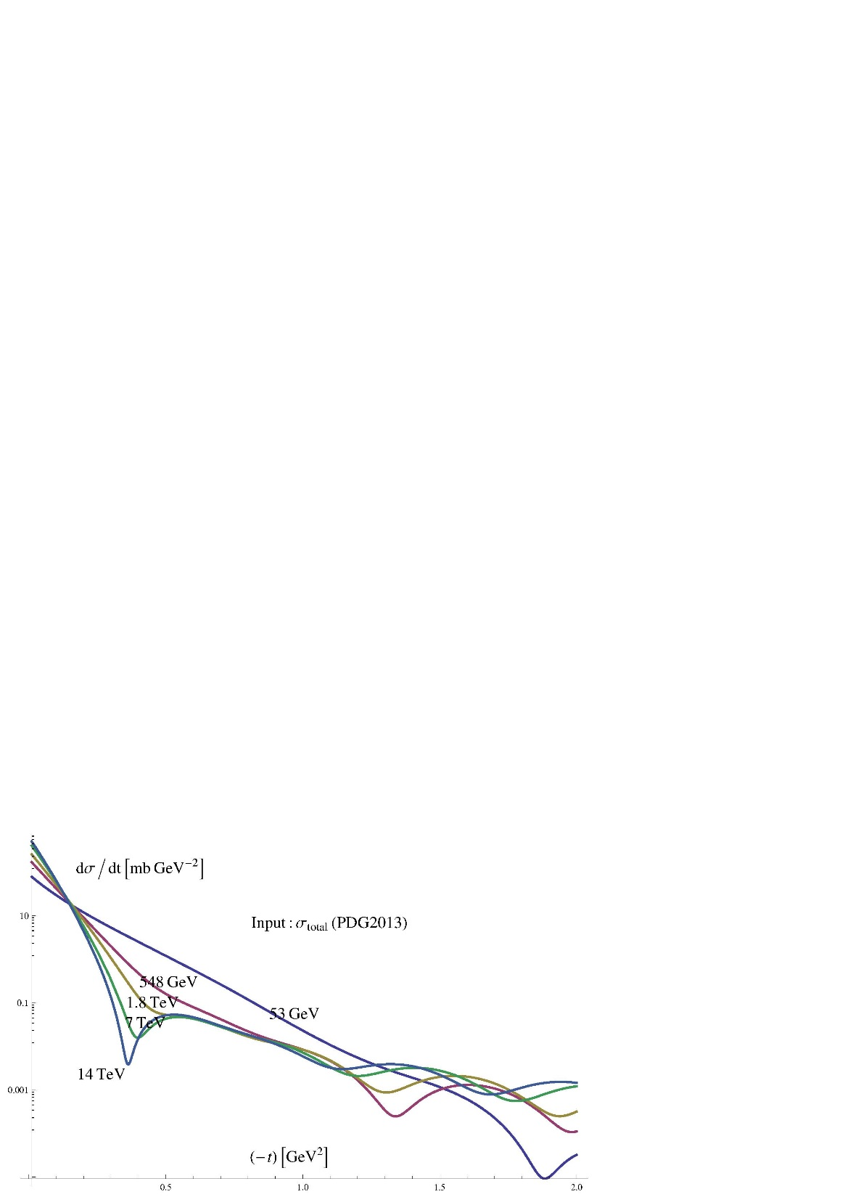
S.M. Roy arXiv:1602.03627

Slide 5
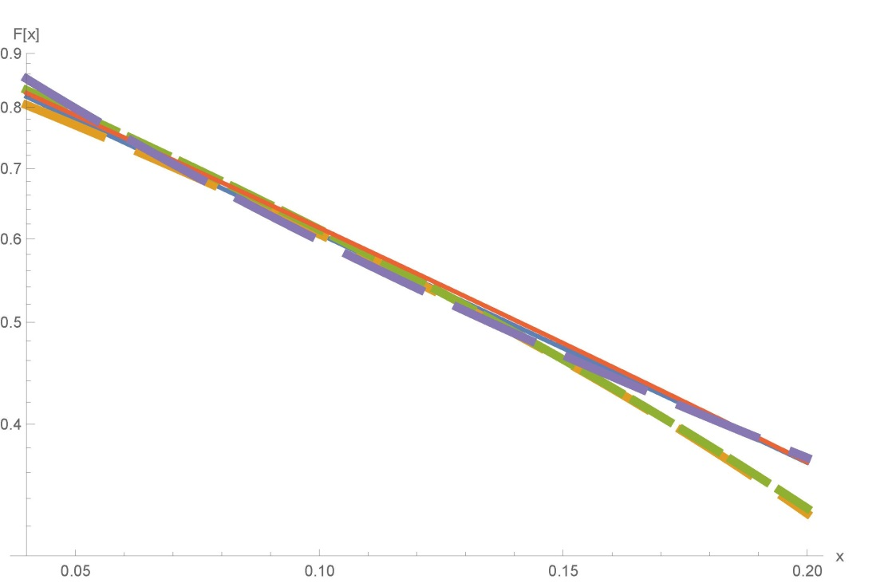
Notes:
Diffraction-2018 (Regio Calabria)

Slide 6
S. M. Troshin, N. E. Tyurin, arXiv:2310.17921
“Comments on oscillations in elastic scattering of hadrons”
1. The recent analysis of the LHC measurements at the energy of √s = 13 TeV
indicated an absence of oscillations in small-t differential cross–section of pp elastic scattering [1] (. Grafstr¨om, arXiv: 2307.15445v1)
P. Grafstr¨om, arXiv: 2307.15445v1
1. The result shown in Figure 1a (UA4/2) is completely identical to the result presented
in Figure 2 in Ref [2] (P.Guaron, B. Nicolescu, O. Selyugin Phys.Lett 1997.
2. We do not discuss the possibility of oscillations at higher t values and with much longer wavelength. The possible existence of such types of oscillations at the LHC, which are not of AKM nature, has been discussed by Oleg Selyugin in a number of papers, see Refs [6],[7],[8] and [9].

Slide 7
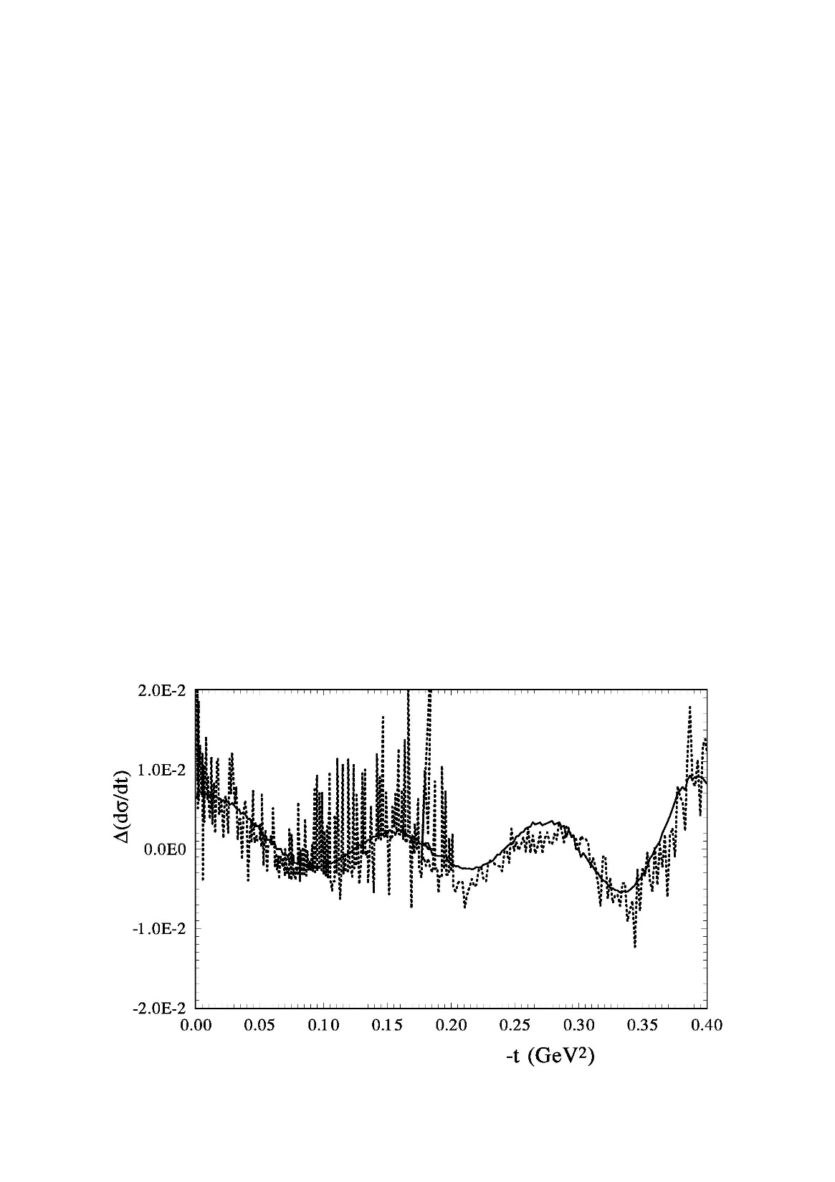
P. Grafstrom
UA4/2 541 GeV
O.S. ( TOTEM 13 TeV)

Slide 8
2. It should be noted that a presence of the coherent structures (oscillations)
in the differential cross-sections of hadron scattering is considered even
in the region of a fixed–angle scattering [7].
(A.W. Hendry, Phys. Rev. 10 (1974) 2300.
“Evidence for coherent effects in the large-angle hadron-hadron scattering”
For pp, the breaks seen to us to be located at or near:
t=-0.9, -3, -5.5, and -10.5 (GeV/c)^2
No an analysis, only by view.
For scattering from a gray disk, the main contribution comes from diffraction amplitude being of the form:
In the case of pp scattering, these breaks tie in nicely with the double zerous of the elastic polarization. ..

Slide 9
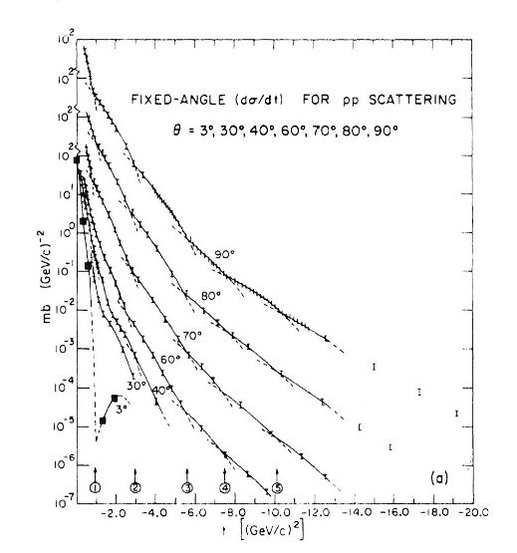

Slide 10
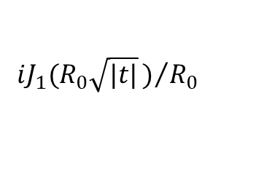
A.A. Anselm and I.T. Dyatlov , Phys.Lett (1967)
An attempt is made to determine the behavior of the elastic cross section at high energy s and large momentum transfer t by considering the contribution of Mandelstam branch points in the complex angular momentum plane. Outside the diffraction cone, but for |t| << s, the cross section do/dt decreases exponentially
with \sqrt{t} (which is in qualitative agreement with Orear’s formula) and also exhibit
$$iJ_{1}(R_{0}\sqrt{|t|})/{R_{0}}$$

Slide 11
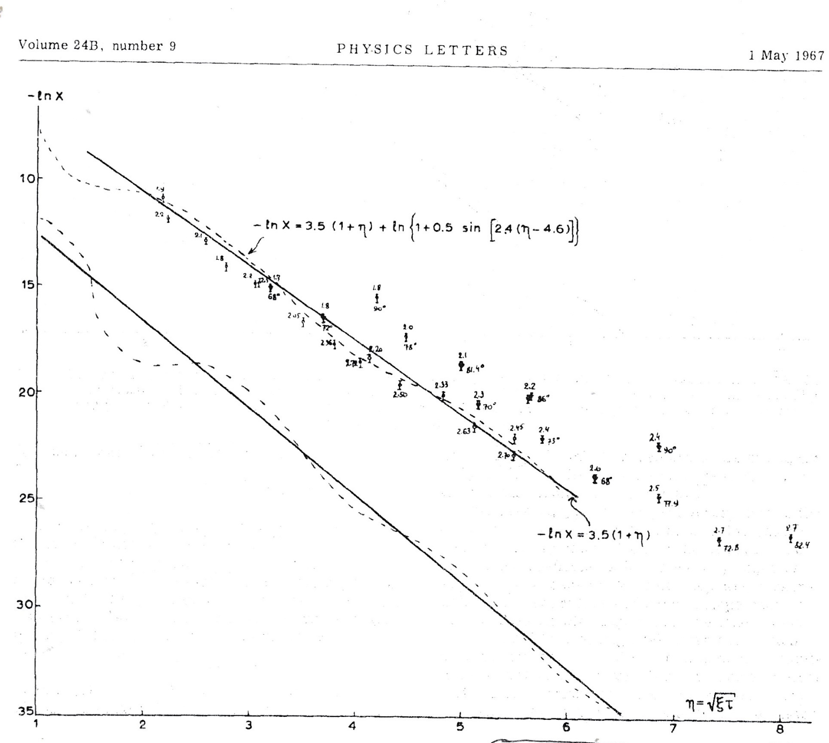

Slide 12
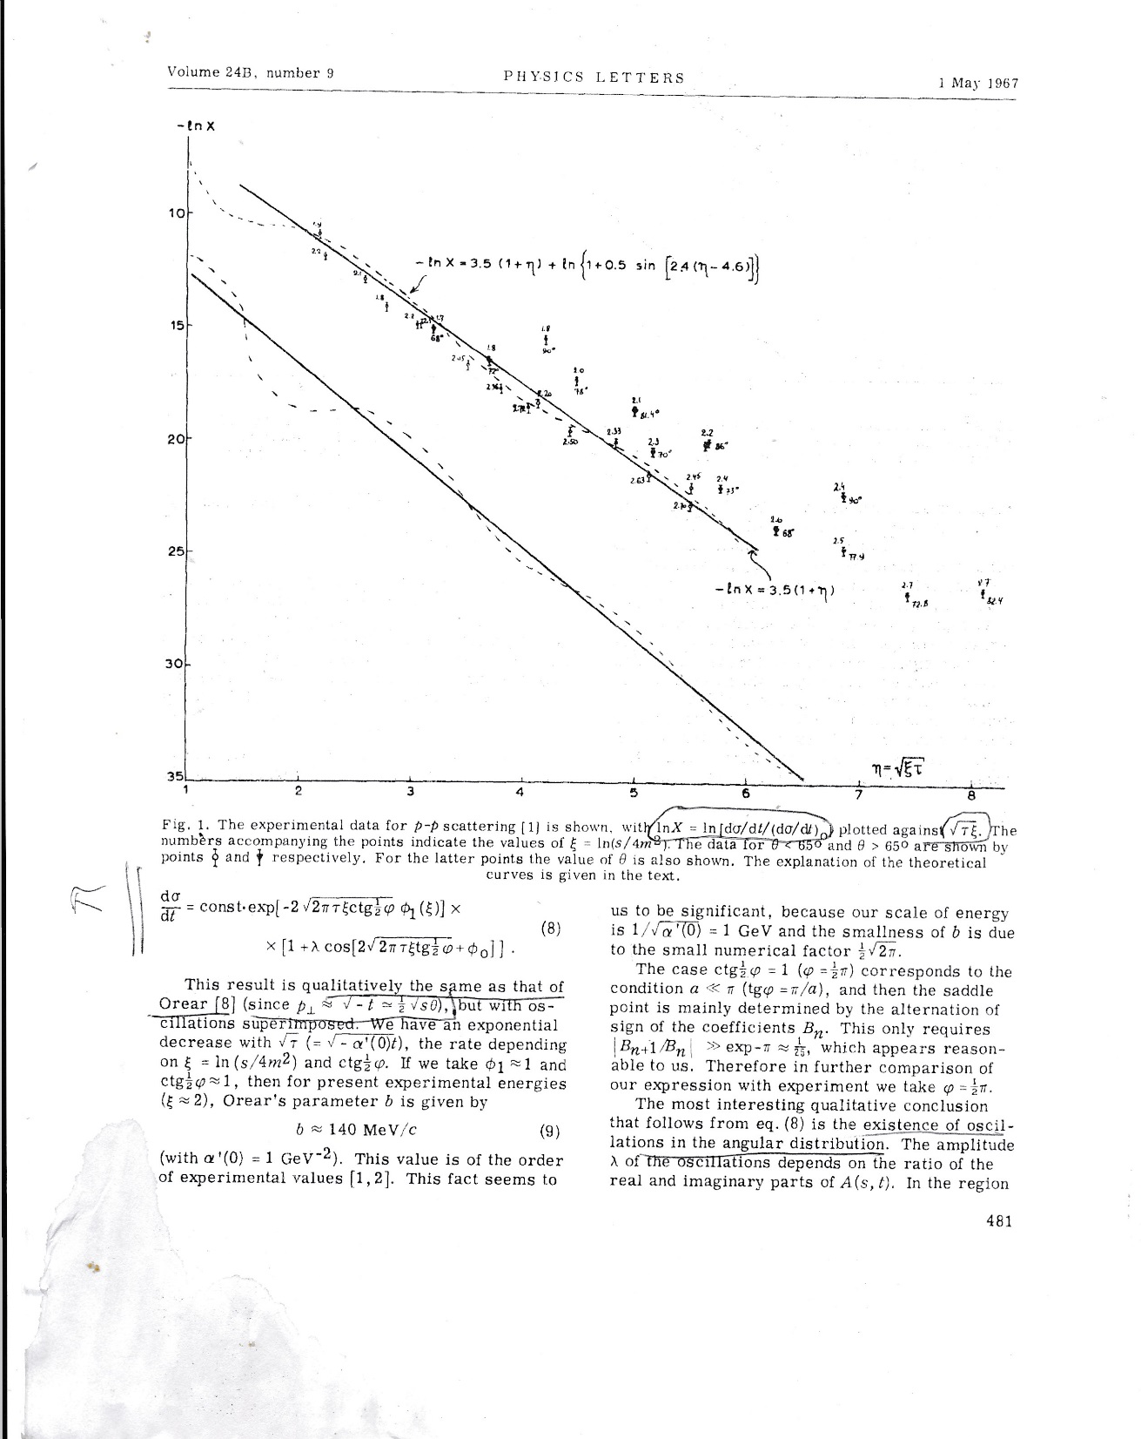

Slide 13
The history of oscillations begin for Serpuhov data
` J. Finkelstein, Phys.ReV.Lett (1970)
The possibility of a violation of the Pomeranchuk theorem, as suggested by recent Serpukhov data, is discussed in terms of Regge singularities
R.C. Gasella, Phys.Rev.Lett., (1970)
Assuming constant but unequal asymptotic total cross sections leads to a (Ins)2
shrinkage of the forward elastic peak. Moreover, under rather general assumptions,
ds_el/dt exhibits an infinitude of oscillations int as s>s_0, a result derived earlier by
Finkelstein within the Regge-cut model.
Couple with ln(s)² shrinkage of the forward elastic peak.

Slide 14
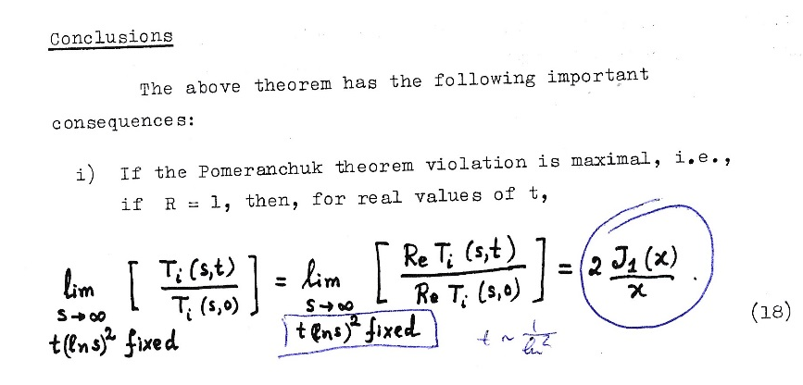
S.M. Roy CERN- Geneva Ref. TH.1281-CERN (15.01 1971)
We can show that the left-hand side of (18) is an entire function of x, and hence the result (18) must hold, by analytic continuation, also for complex values of t.
Hence, the amplitude ratio in (18) and, consequently, the asymptotic differential cross-sections ratio
has an infinite number of zeros tj, on the negative real t axis given the zeros of J1(x).; the first zero is at
14

Slide 15
AKM – G. Auberson, T. Kinoshita, A. Martin, Phys.Rev. D. 15.06.1971
Violation of the Pomeranchuk Theorem and Zeros of the Scattering Amplitudes
The data on high-energy total cross sections obtained at Serpukhov have raised the possibility of experimental violation of the Pomeranchuk theorem. …
Some of the models (Finkilstein, Anselm) have the feature that they predict an oscillation of the differential cross sections at near-forward angles.
The function defined by
Is not only analytic in t but is actually an entire function of order 1/2
We show that f(t) must have infinitely many zeros in the neighborhood on the positive t axis (i.e. negative t axis) defined by

Slide 16
AKM theorem (G.Anderson, T. Kinoshita, A. Martin)
This means that scattering amplitudes which are subject to no condition other than (3) are not requared in general to have zeros on negative t axis
The regime of the maximal axiomatic growth of F(s,t)
[Im F(s,t) ~ Re F(s,t) ~ Ln²(s)]
Allowed by asymptotic theorem
The scattering amplitude must have infinity many zerous in a very nerow region of t

Slide 17
S. Barshay
S.Barshay, D. Rein Z. Phys. C56, (1992)

Slide 18
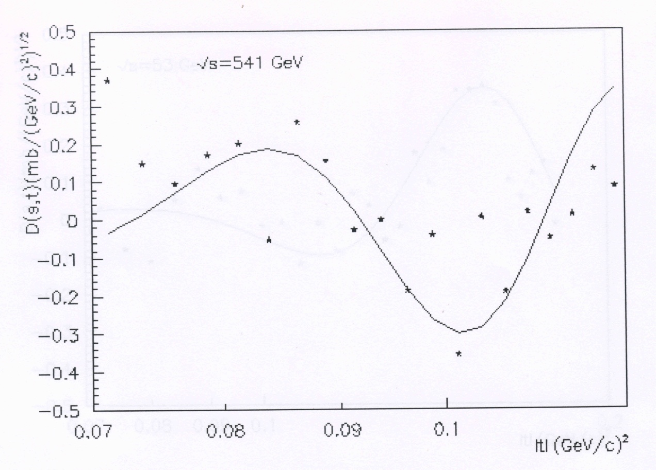
S.Barshay, D. Rein Z. Phys. C56, (1992)
S. Barshay

Slide 19
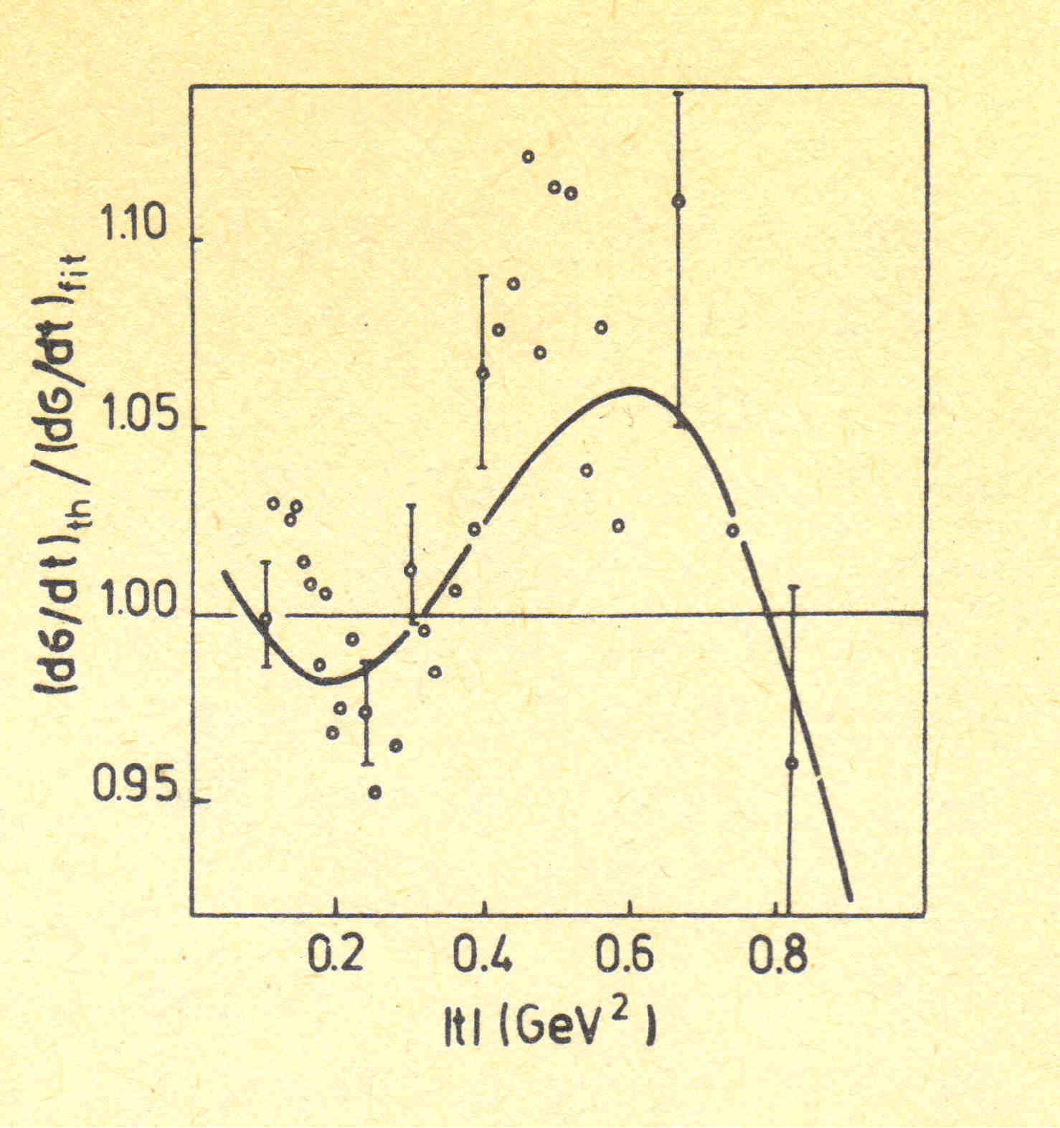
Yu.M. Antipov et al.,
Preprint IHEP (Protvino) 76-95 (1976)
Problem:
Compare non-exponential and
exponential forms
O.V. Selyugin
Int.workshop, Protvino (1982)

Slide 21
V.A. Baskov, O.D. Dalkarov, A.I. L’vov, and V.V. Polyanskiy
PEPAN, (2021)
Deviations of the pp differential cross section from smooth dependences F(t) = Ae^(Bt+Ct^2)
Small oscillations in the t-dependence of the differential cross section at low and medium t, observed in earlier experiments at Protvino, ISR, Fermilab
and now also at LHC, are probably related with the proton’s structure at impact parameters exceeding the size of the proton’s quark core and thus indicate involvement of meson periphery of the nucleon to diffractive scattering.

Slide 22
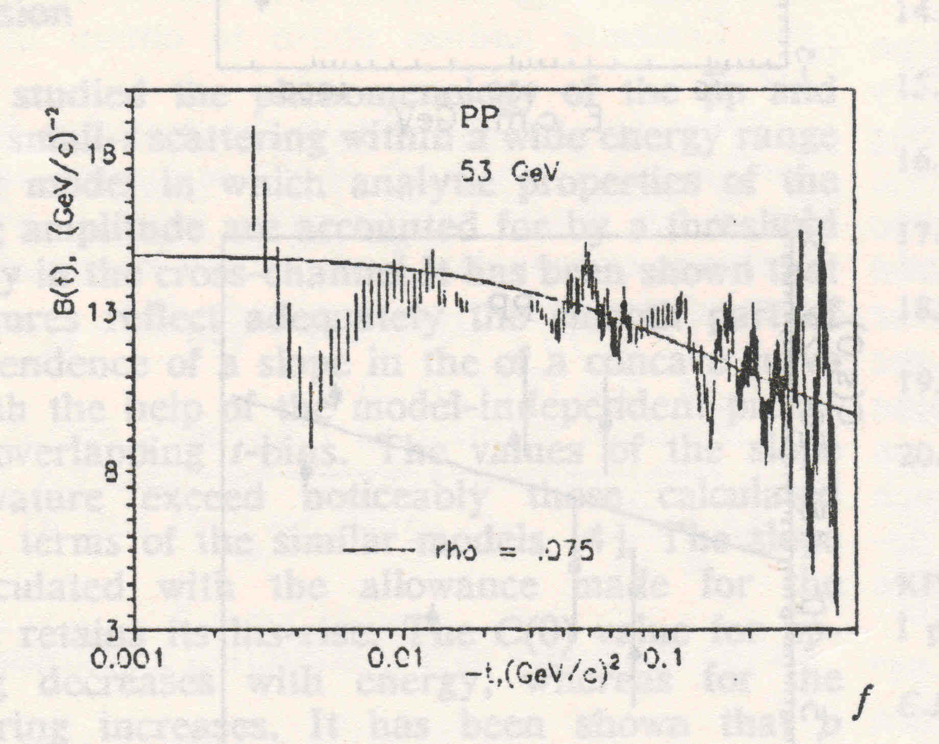
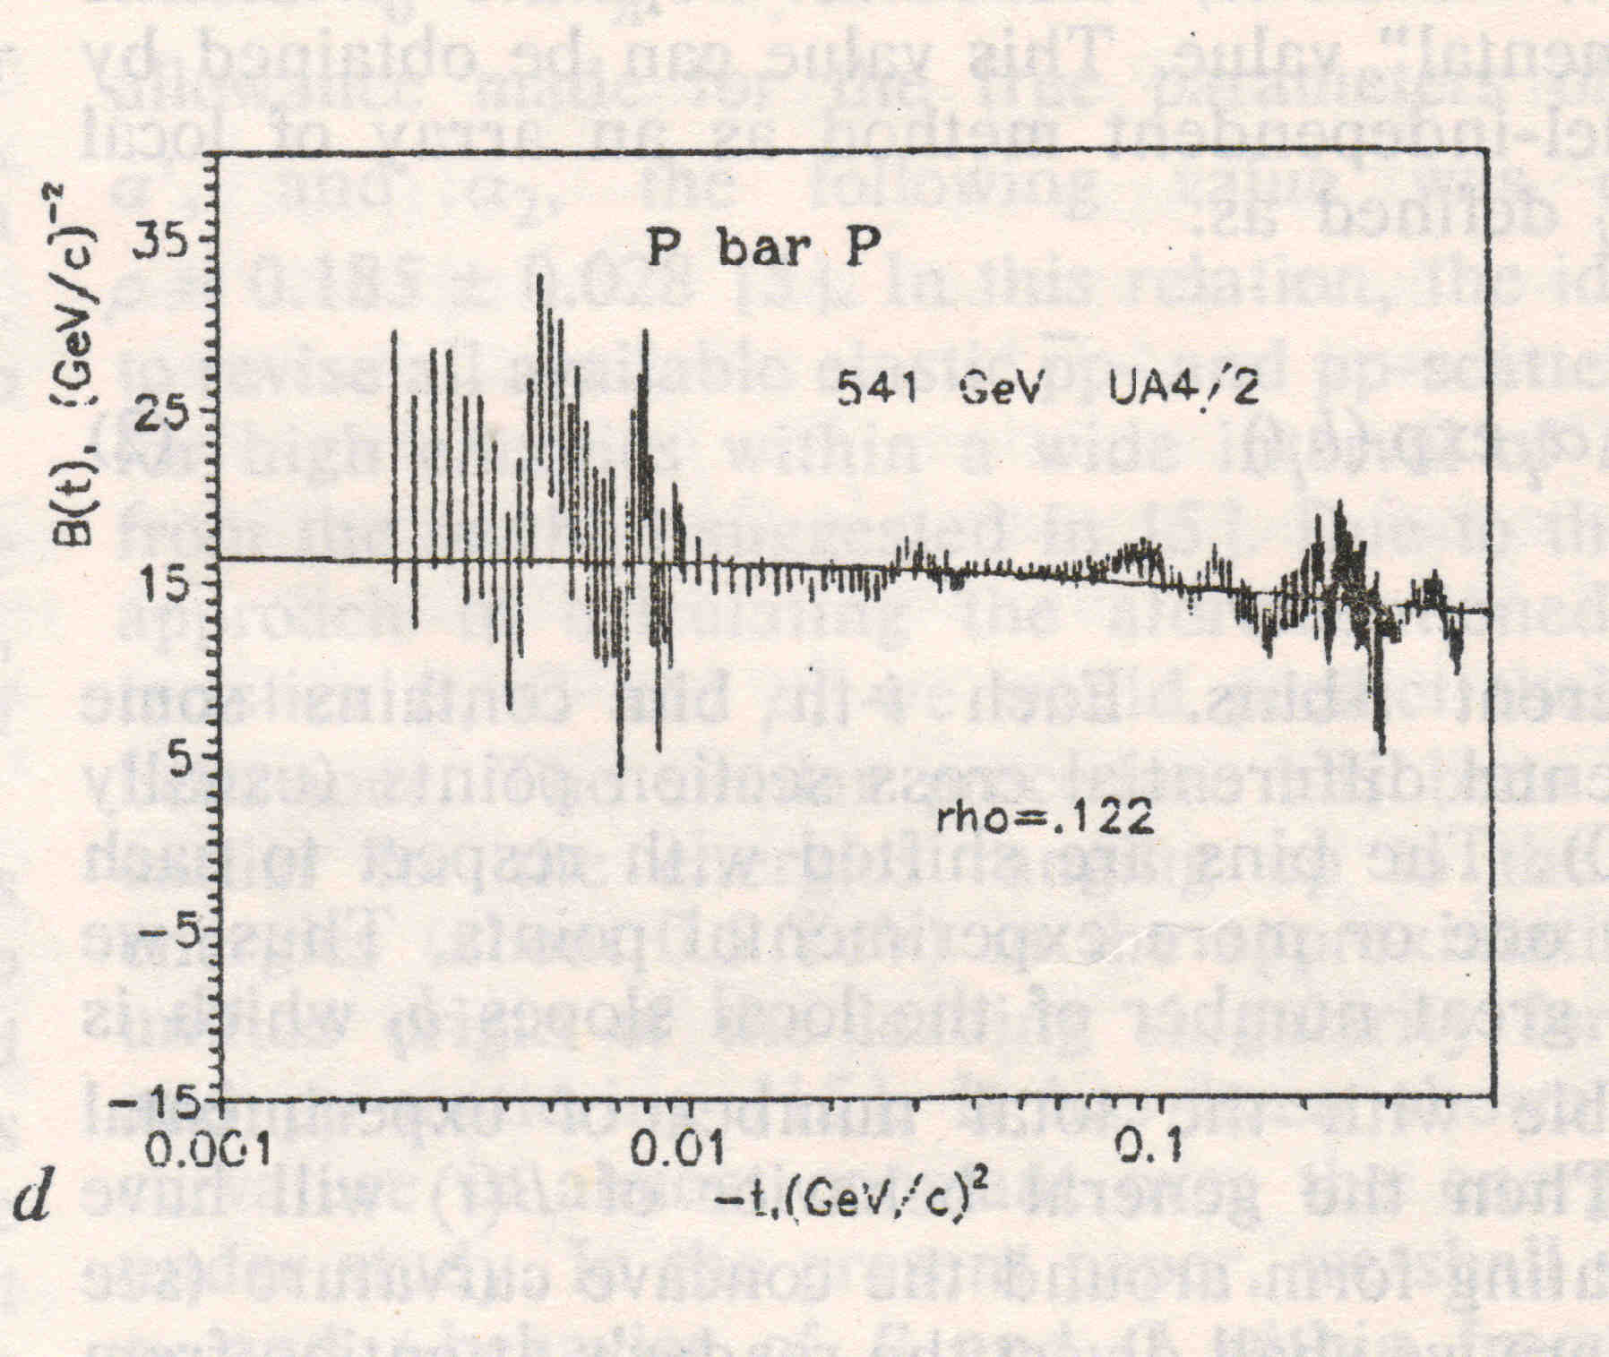
J.E. Kontros, .L. Lengyel
Fit of the local slope at Dt
Ukr.J. Phys., v.41 (1996)

Slide 23
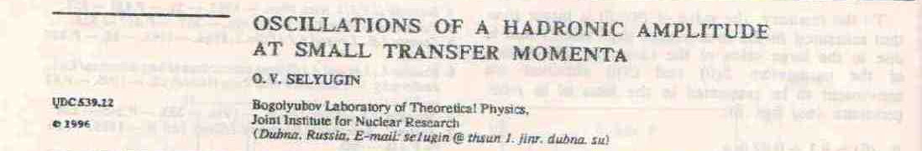
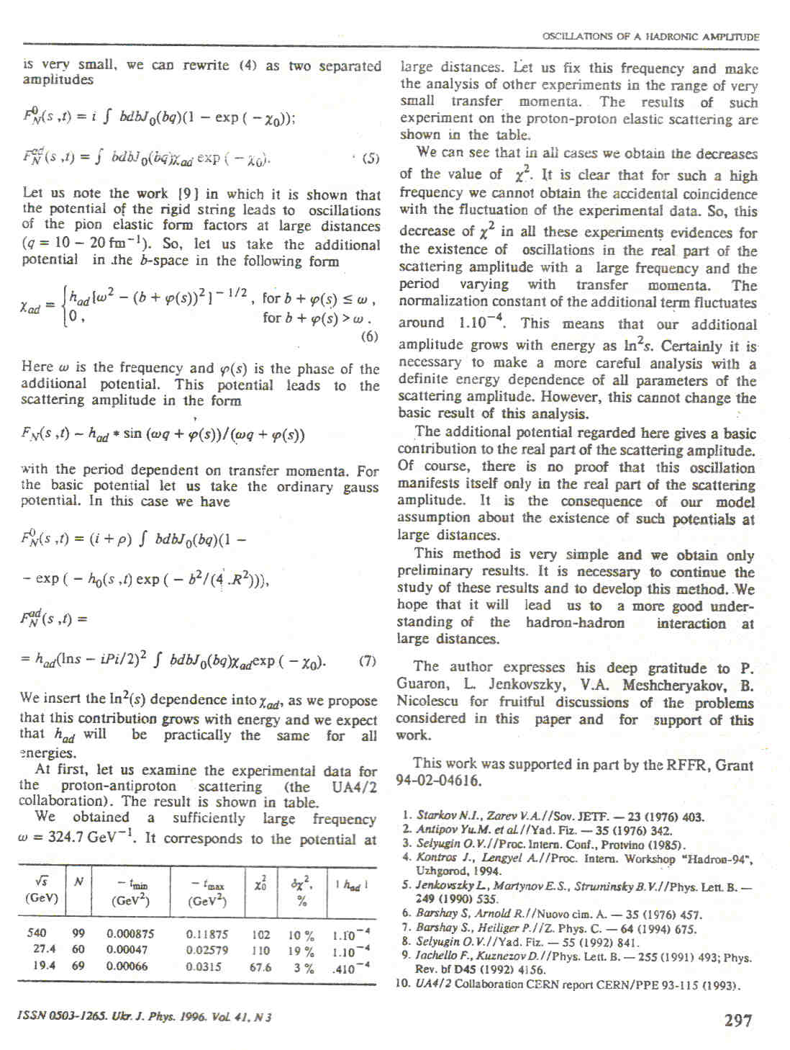
O.V. Selyugin, Ukr.J. of Physics, v.41, (1996), 296.

Slide 24
V.A. Tzarev
Model of complex Regge poles
Preprint NAL-Pub-74/17, 1974
DAN-USSR, v.95 (1977)

Slide 25
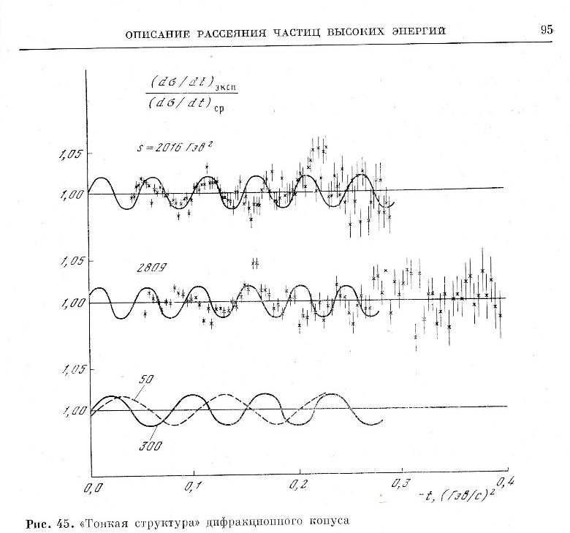

Slide 26
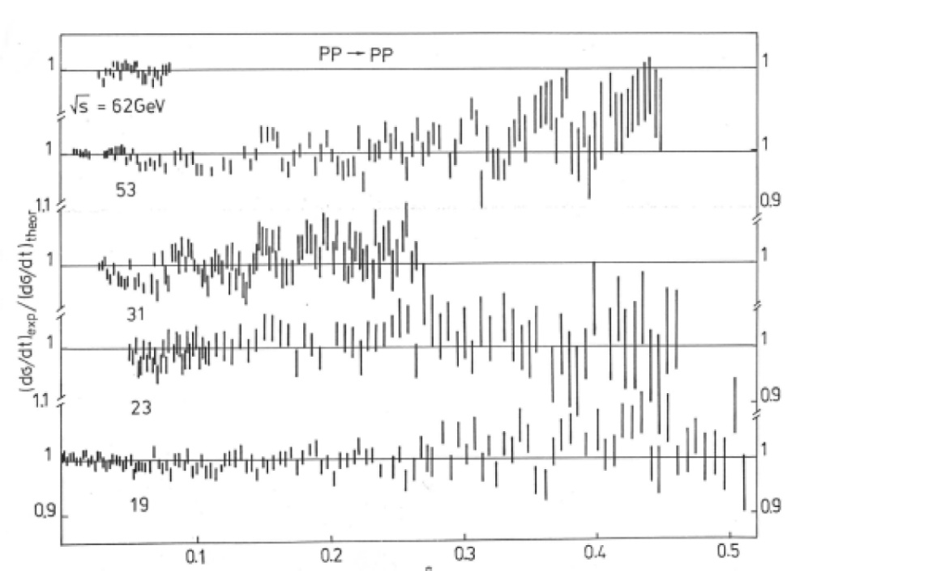
-t GeV²
26

Slide 27
Problems
Comment

Slide 28
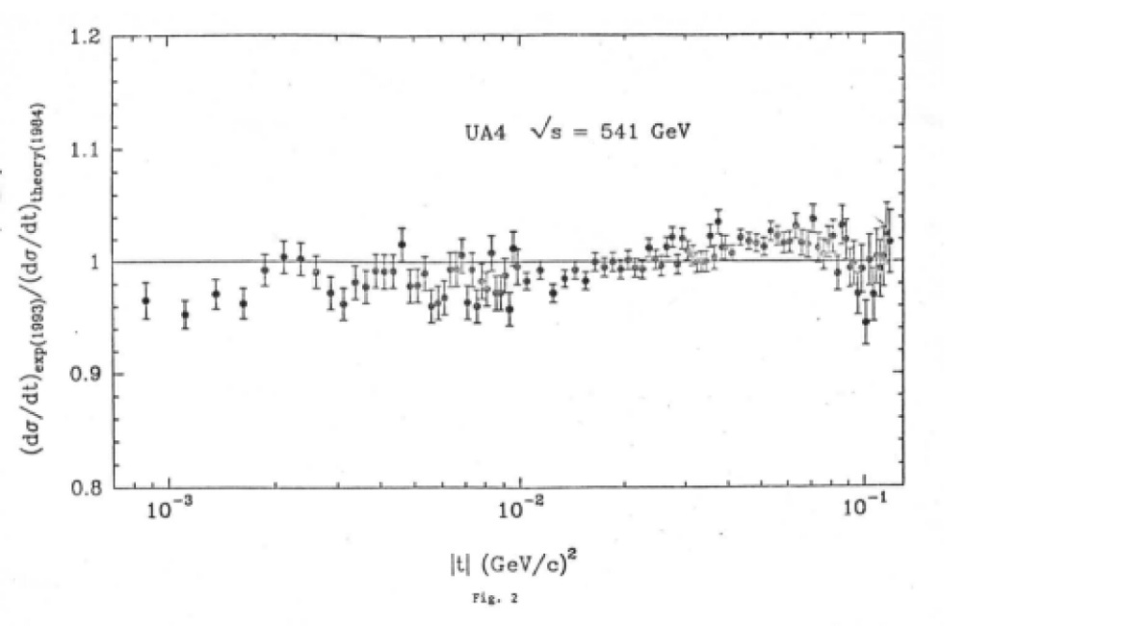

Slide 29
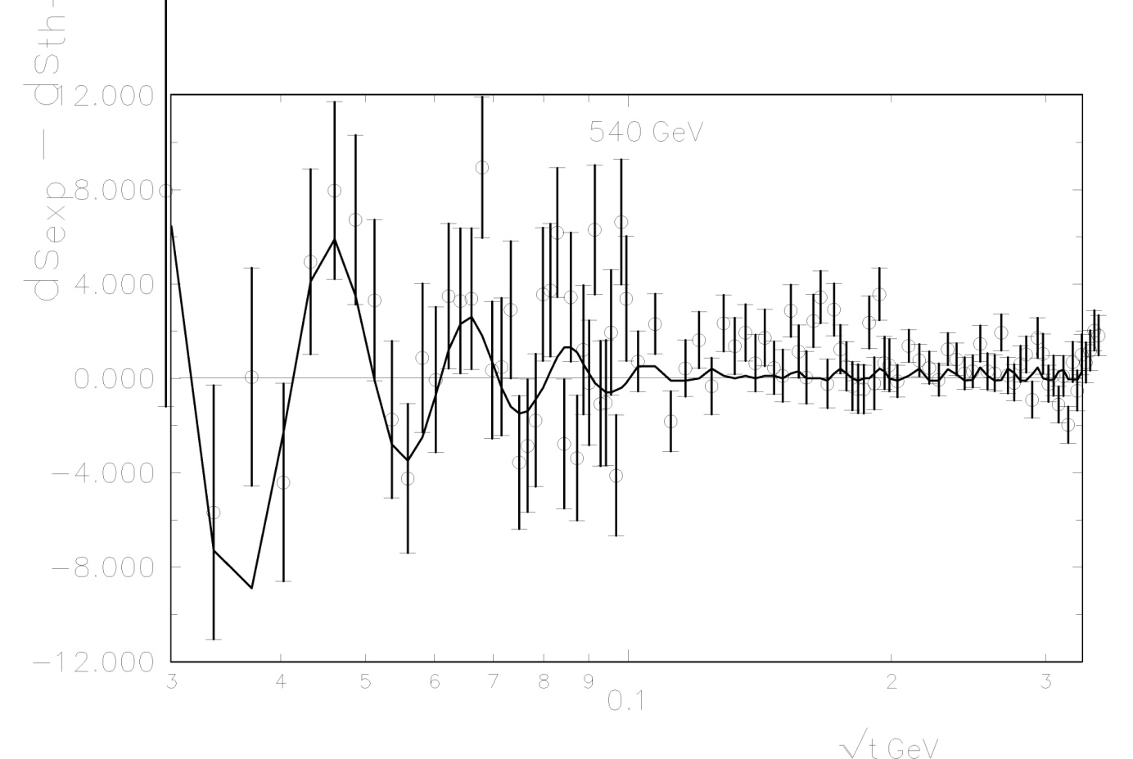
P. Gauron, B. Nicolescu, O.V. Selyugin, Phys. Lett. B 390 (1997) 405.
Analysis of UA4/2 data

Slide 30
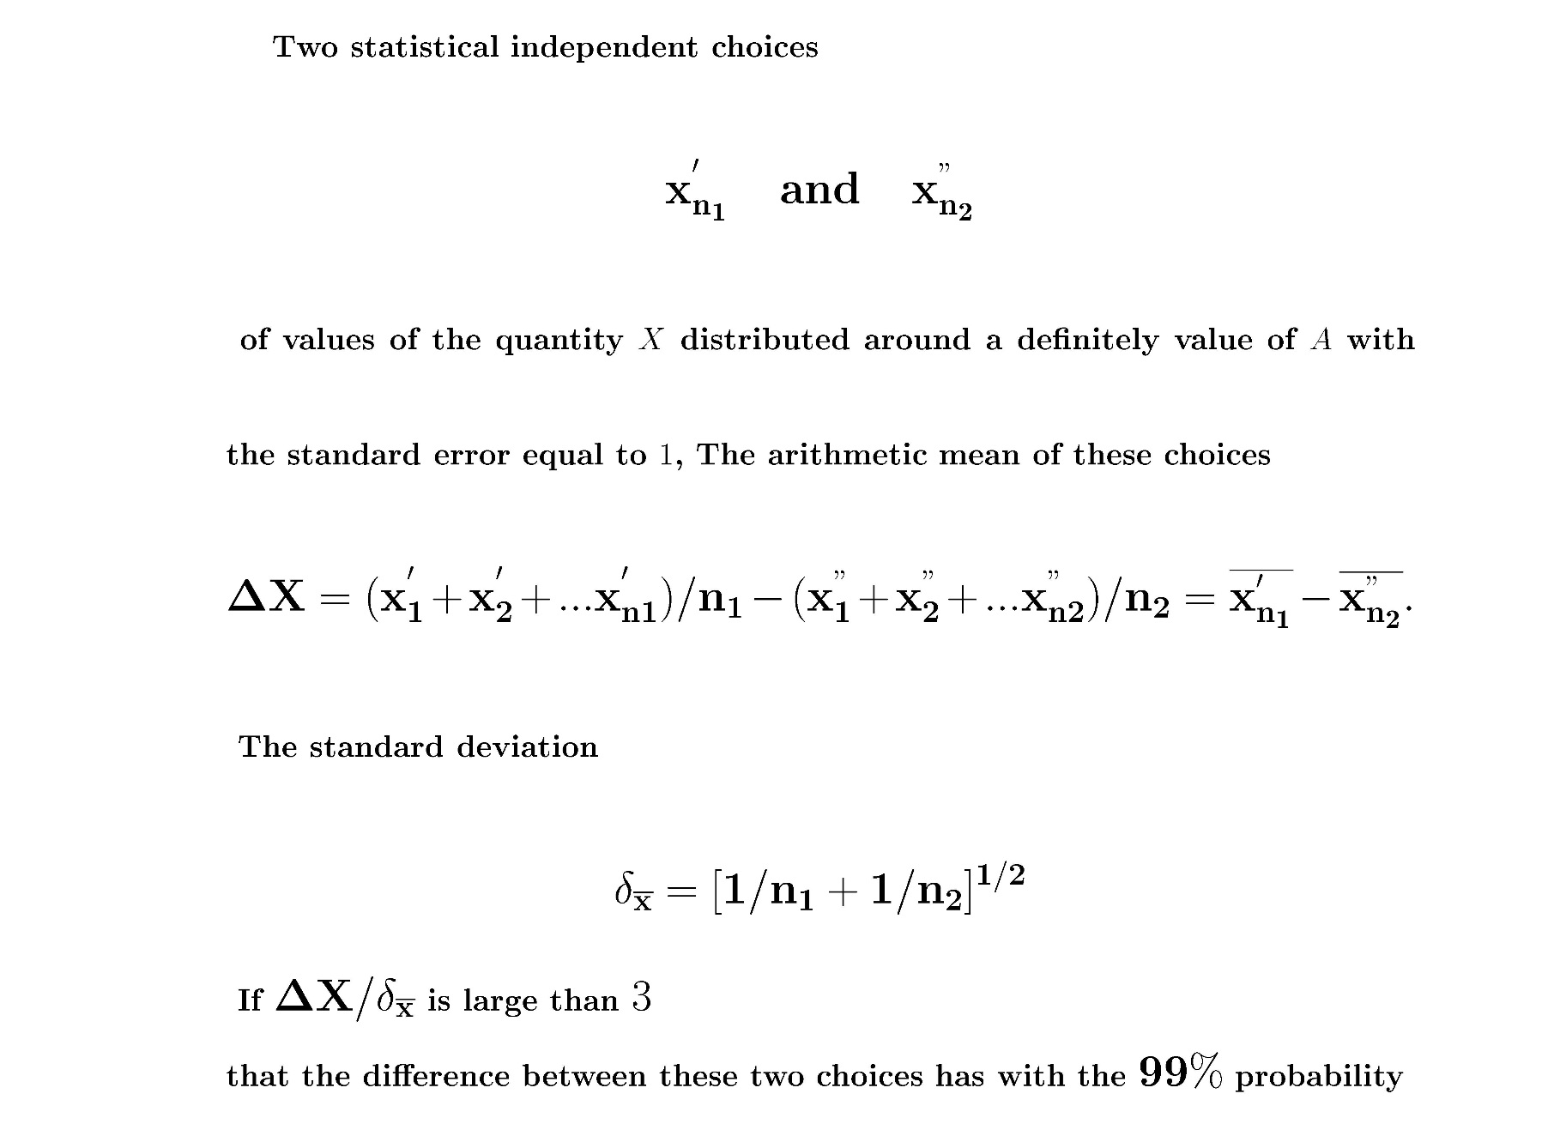

Slide 31
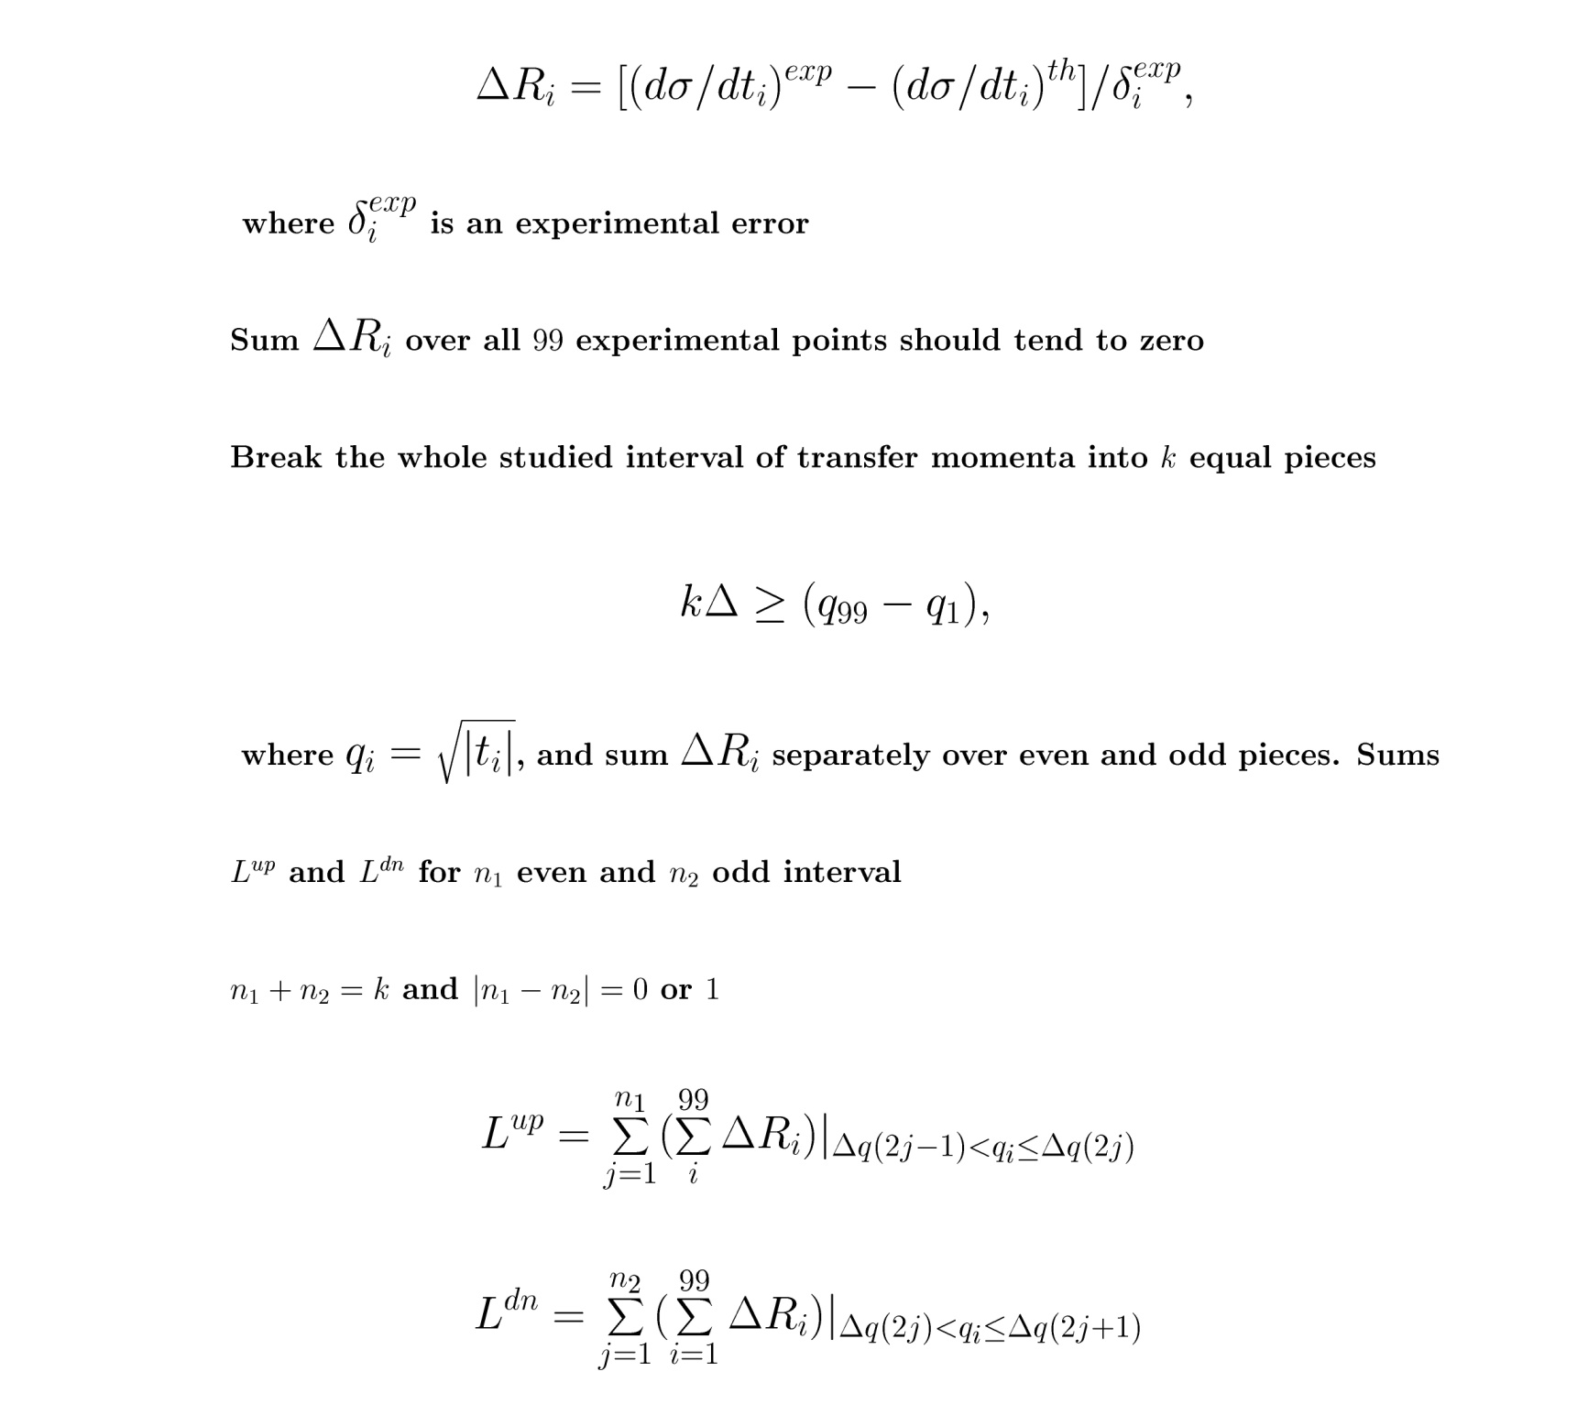

Slide 32
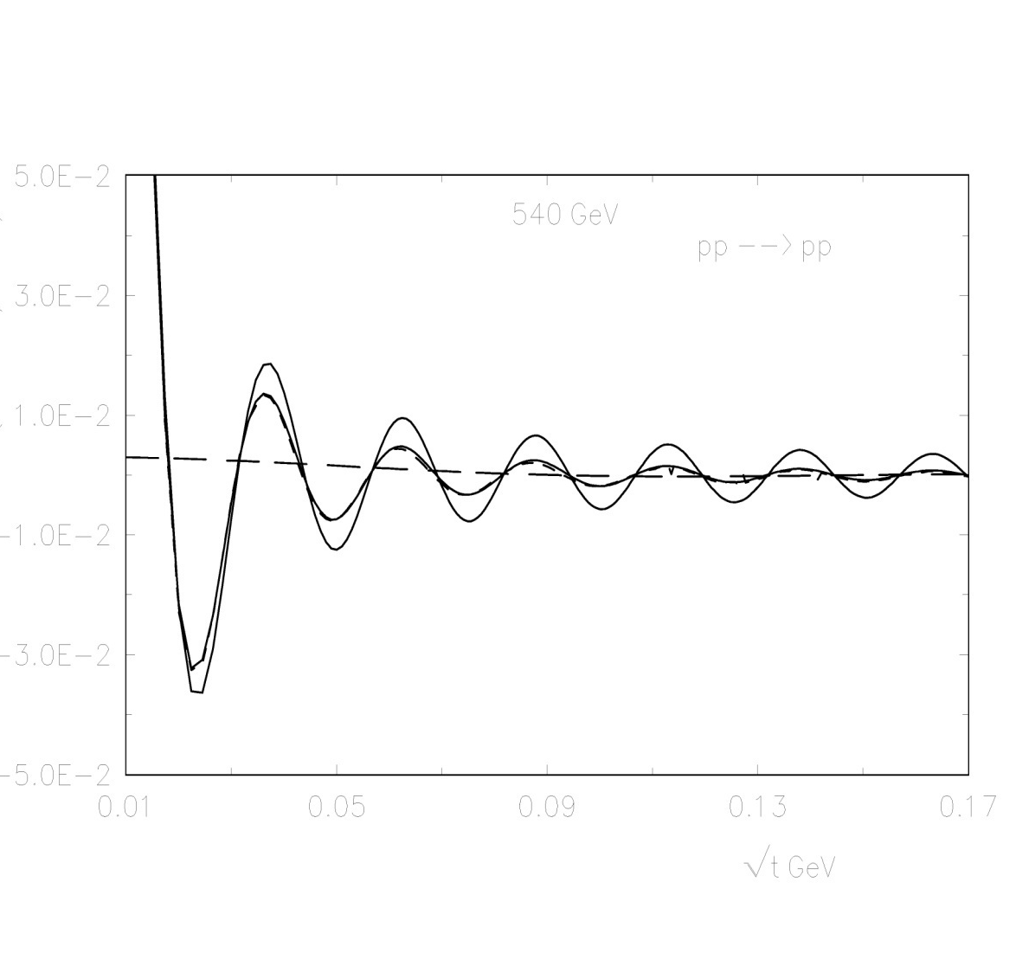
1 1 1 1 1 1 1
2 2 2 2 2 2 2

Slide 33
Statistical analysis

Slide 34
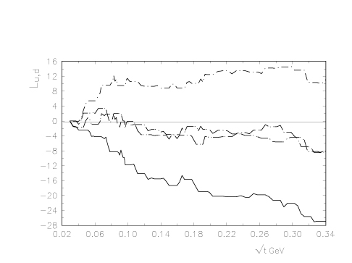
Proron-antiproton
UA4/2 - parameters
σ_{tot} = 62.2 mb;
B = 15.5 GeV⁻²;
ρ = 0.135;

Slide 35
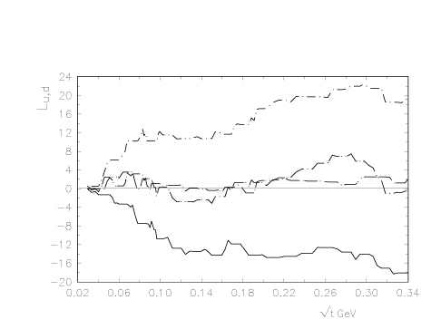
New parameters (model fit)
σ_{tot} = 63.54 mb;
B = 15.485 GeV⁻²;
ρ = 0.158;

Slide 36
P. Grafstrom, A.D. Martin, M. G. Ryskin – arXiv 2405.07802
“Oscillations in the elastic high energy amplitude”
Anselm, Dyatlov – multi-Pomeron contributions
AKM – zerous plased in the complex plane.
Impact parameter representation – Charecteristic radius:

Slide 37
Elastic scattering amplitude

Slide 38
The Very Low t Region
around t ~ −10⁻³ (GeV/c)² A_{hadronic} ≈ A_{Coulomb}
⇒ INTERFERENCE
CNI = Coulomb – Nuclear Interference
scattering amplitudes modified to include also electromagnetic contribution
hadronic interaction described in terms of Pomeron (Reggion) exchange
electromagnetic single photon exchange
σ = |A_{hadronic} + A_{Coulomb}|²
unpolarized ⇒ clearly visible in the cross section dσ/dt
polarized ⇒ “left – right” asymmetry A_{N}
P
+
γ

Slide 39
ν₁ − 2 second Born approximation (2 photon diagram)
O.V. Selyugin Mod.Phys.Lett. A11, 2317 (1996)
ν₂ − 2 second Born approximation (photon-Pomeron interference with taking into account dipole form-factor of the nucleons)
O.V. Selyugin, Mod.Phys.Lett., A12, 1379, (1997);
Phys.Rev. D60, 074028 (1999)

Slide 40
O.V. Selyugin, Phys.Rev. D 91, 113003 (2015)
Обобщенные партонные распределения
Generalized Parton Distributions -GPDs
Electromagnetic form factors
(charge distribution)
Gravitomagnetic
form factors
(matter distribution)

Slide 41
Scattering process described in terms of Helicity Amplitudes φ_{i}
All dynamics contained in the Scattering Matrix M
(Spin) Cross Sections expressed in terms of
spin non–flip
double spin flip
spin non–flip
double spin flip
single spin flip
?
⟨ M ⟩
observables:
3 ×-sections
5 spin asymmetries
identical spin ½ particles
- GPDs → electromagnetic FF
- GPDs → gravimagnetic FF

Slide 42
High energy hadron elastic scattering
High Energy Generalized Structure (HEGS) model
O.V. S., O.V. Teryaev, Phys.Rev. D 79, 033003 (2009).
O.V.S. - Eur. PhysJ. C 72: 2073 (2012)
O.V.S. Nucl.Phys. A 903 54 (2013)
O.V. S., Phys. Rev., D 89, 093007 (2014) .
O.V. S, Nucl. Phys. A 922, 180 (2014)
O.V. S., Phys. Rev., D 91, 113003 (2015)
O.V. S. Part. Nucl. Lett, 13, 03 (2016)
O.V. S., Nucl.Phys. A 959, 116 (2017).
O.V. S. Acta Phys. Pol. B 12 741 (2019)
O.V. S., Symmetry, v.13, 00164 (2021)
O.V. S., Phys.Lett. B 797, 134870 (2019).
O.V. S, Mod..Phys.Lett. in print (2021)
arXiv: 2009.10129 [hep-ph, hep-ex] (2020)..

Slide 43
O.V.S.arXiv:2407.01311
Elastic scattering at √s = 3.6 GeV up to √s = 13 TeV
(proton-proton; proton-antiproton; proton-neutron)
The data obtained at low energies (√s > 3.6 GeV and at high energies at FNAL, ISR, S¯ppS, TEVATRON and LHC with 4326 experimental points, including the polarization data of analyzing power.
Basic properties:
1. Two form factors are calculated from GPDs(x,t)
2. One intercept a(0)=0.11 (fixed) (2 Pomerons and Odderon)
3. Re F(s,t) is determined by complex S.
4. In fit only statistical errors are taking into account
σ_{tot}
ρ(s,t=0)
5. The “experimental” data of and
do not include in fit
Result:

Slide 44
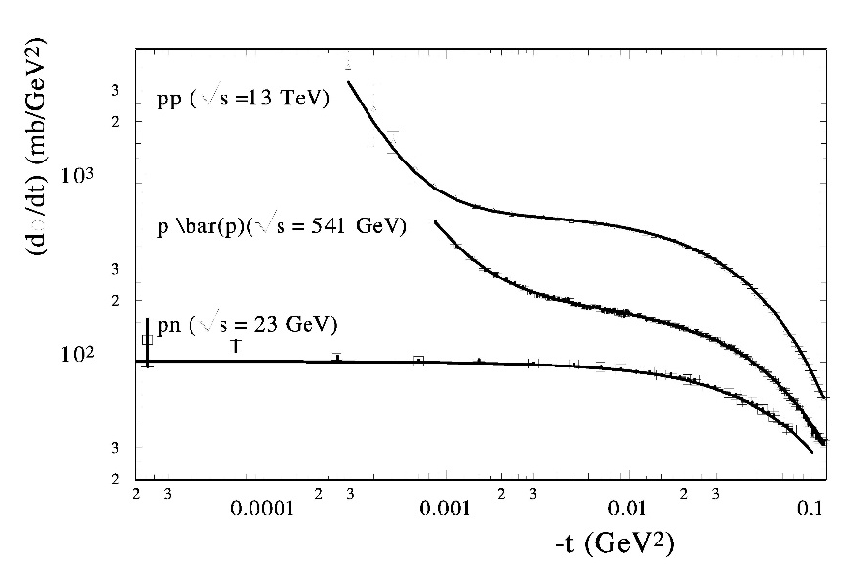
HEGS model

Slide 45
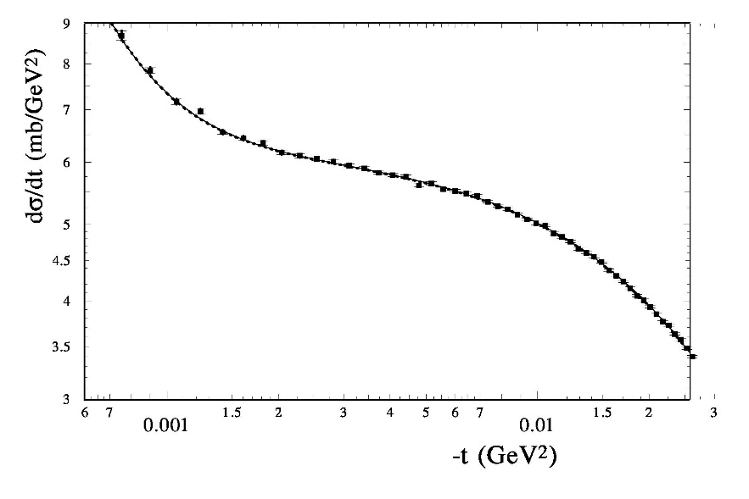
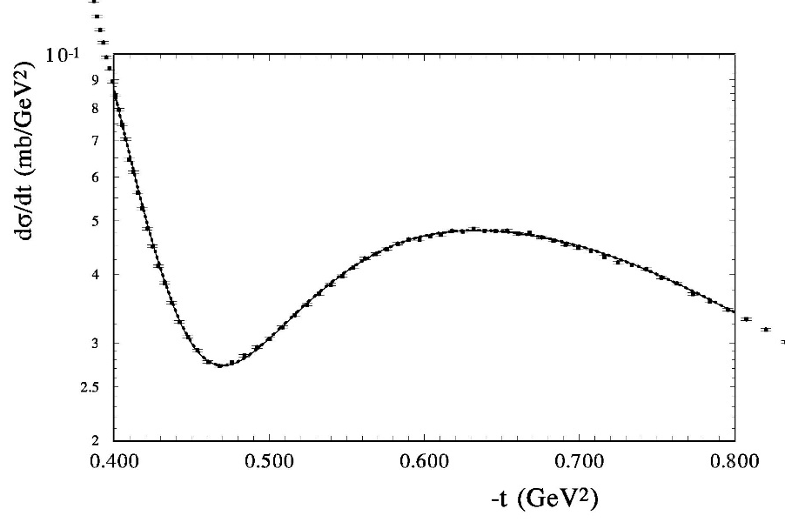

Slide 46
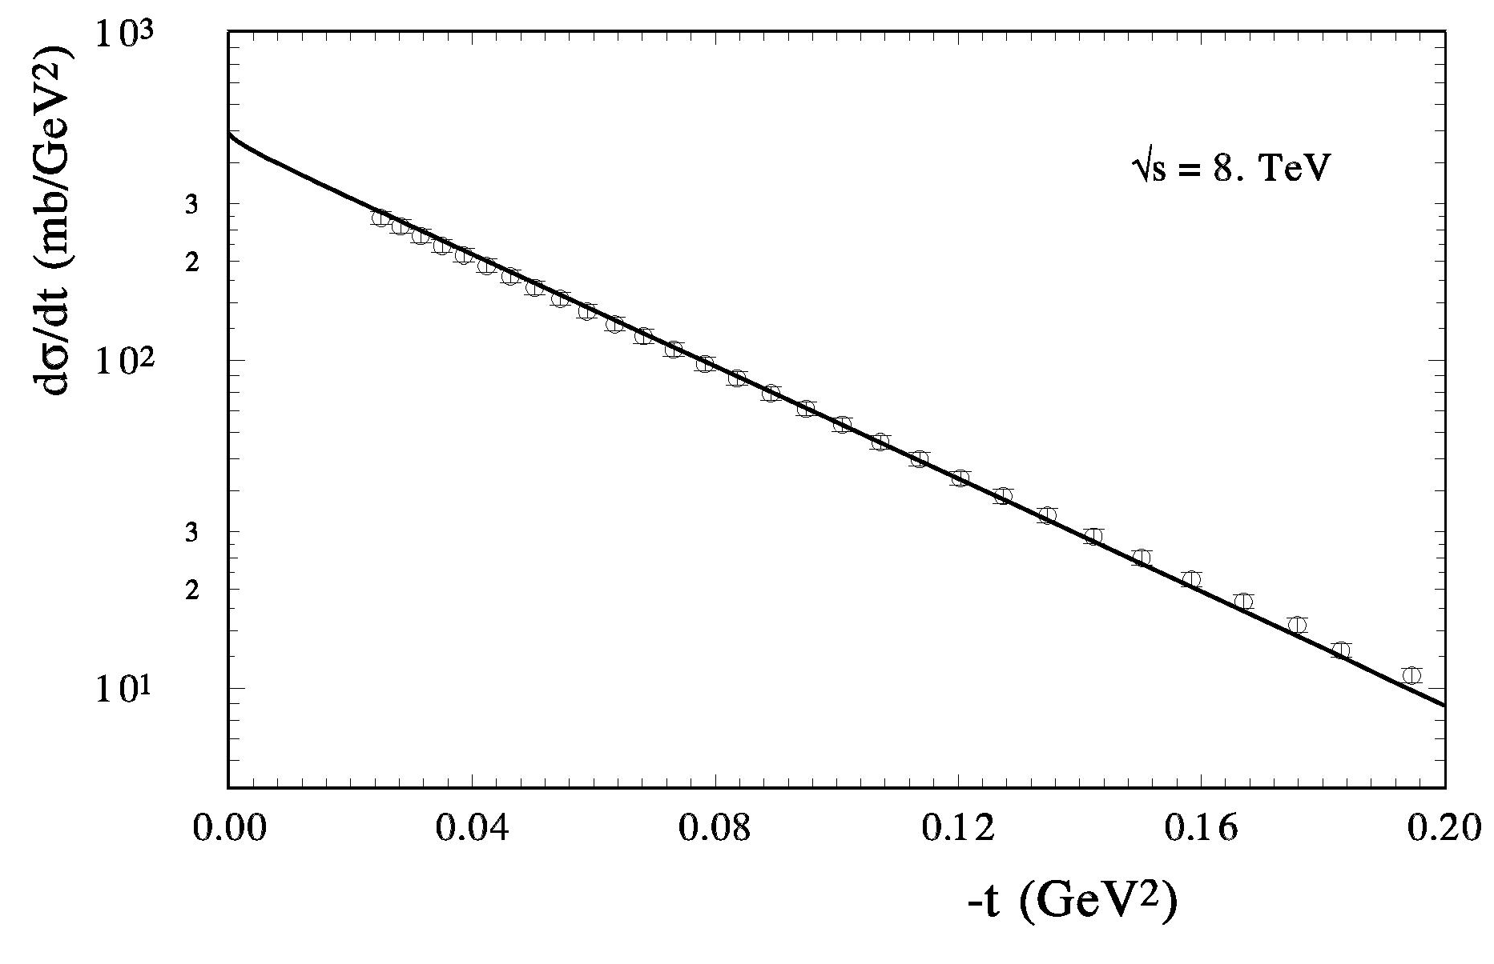
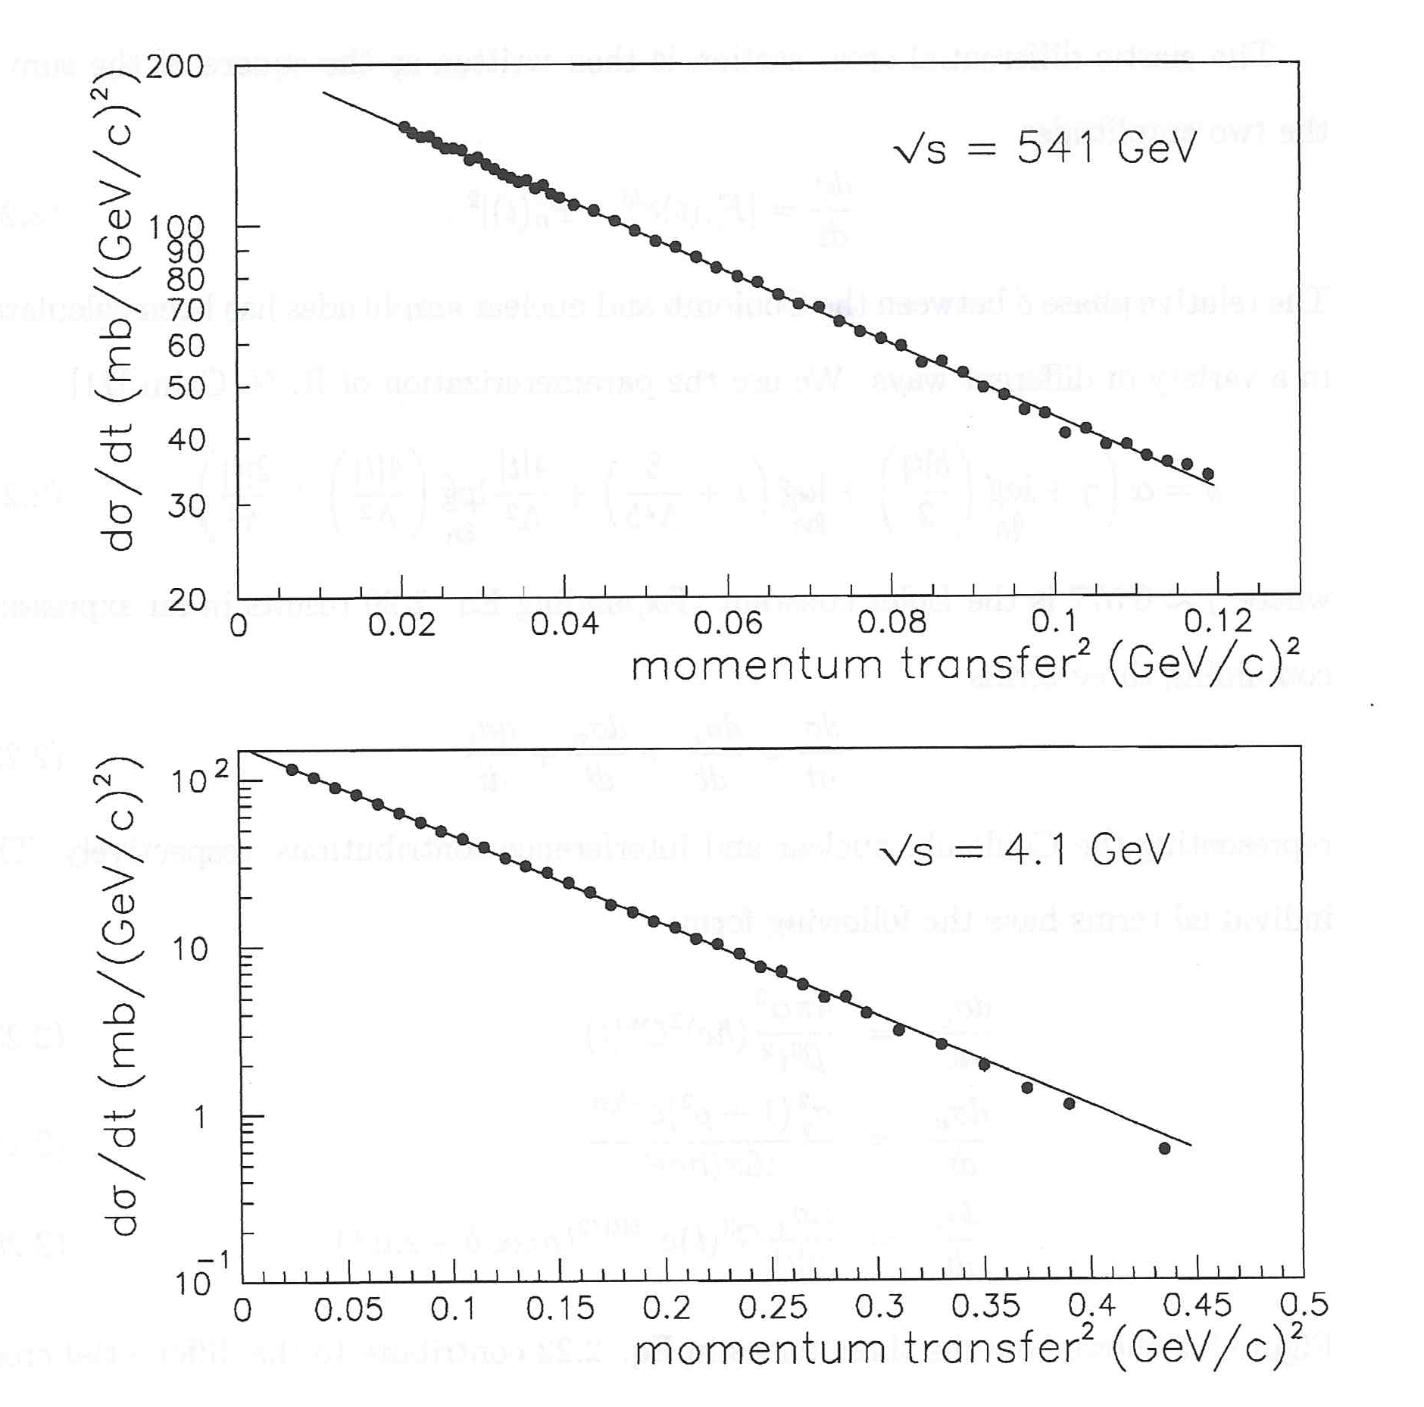

Slide 47
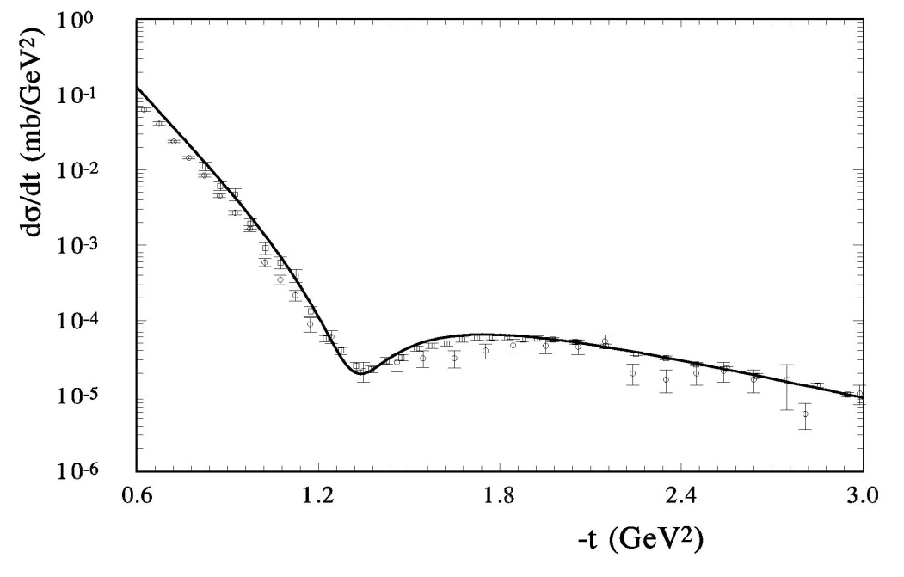
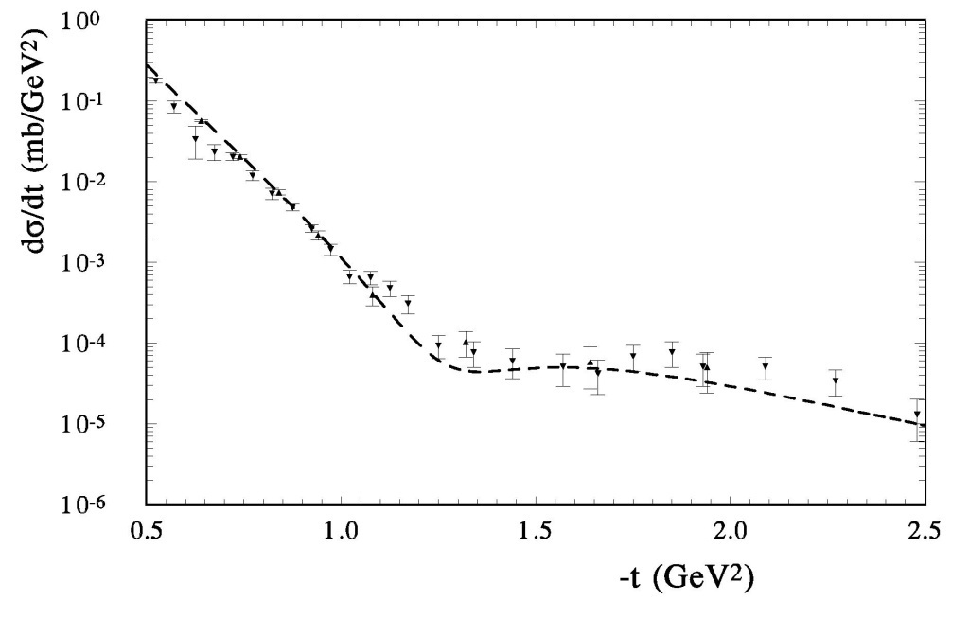

Slide 48
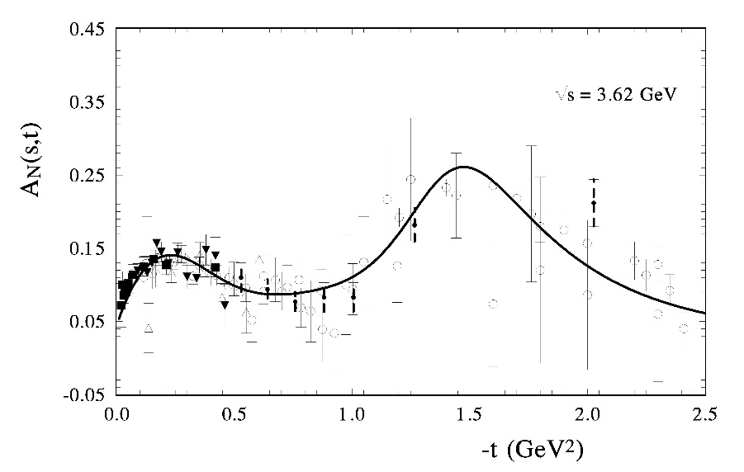
The analyzing power A_{N} of pp - scattering is calculated in HEGS model at \sqrt{s}=3.62 GeV.

Slide 49
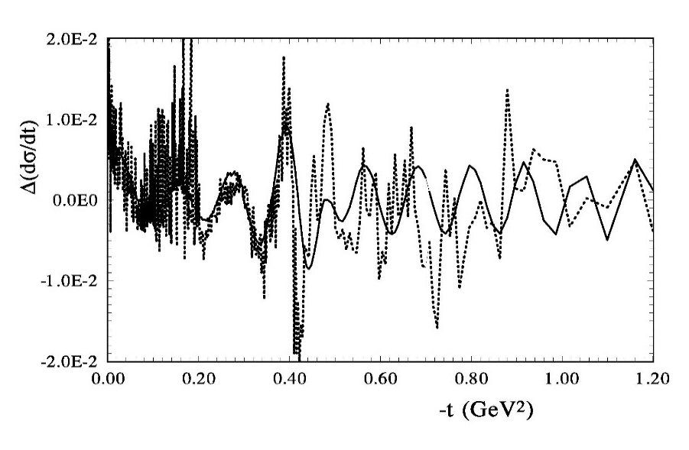
fosc=J1( (-phi₀+t)*p*t₀)/((-phi₀+t)*p*t₀ )*Gdq**2
t₀=17.4/(1+0.5*(lns/18.+0.5 √s /) +2.*(lns/18.+0.5/ √s )**2)
Hosc*fosc*( i -+/-1)*(lns/18. +1/ssc**2)
H_osc=0.23 GeV⁻²

Slide 50
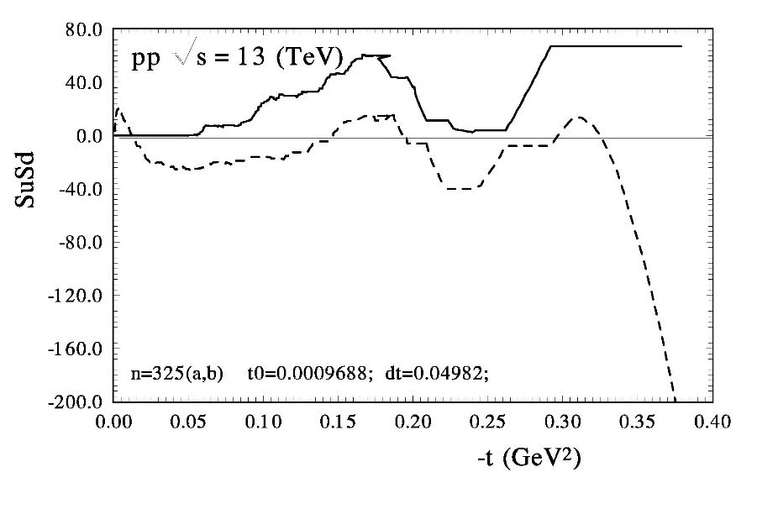
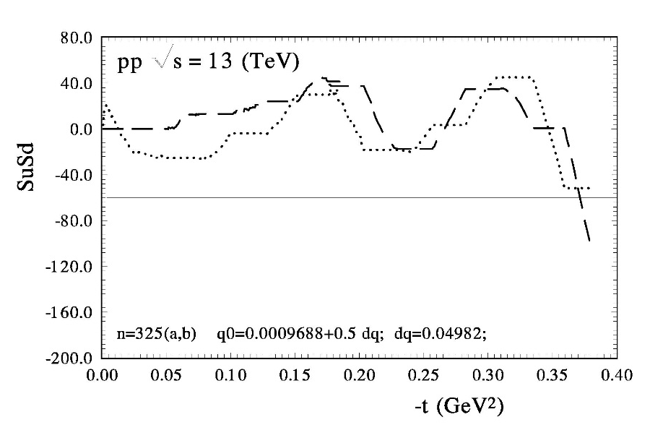
O.V. Selyugin, Phys.Lett. B 797, 134870 (2019).

Slide 51
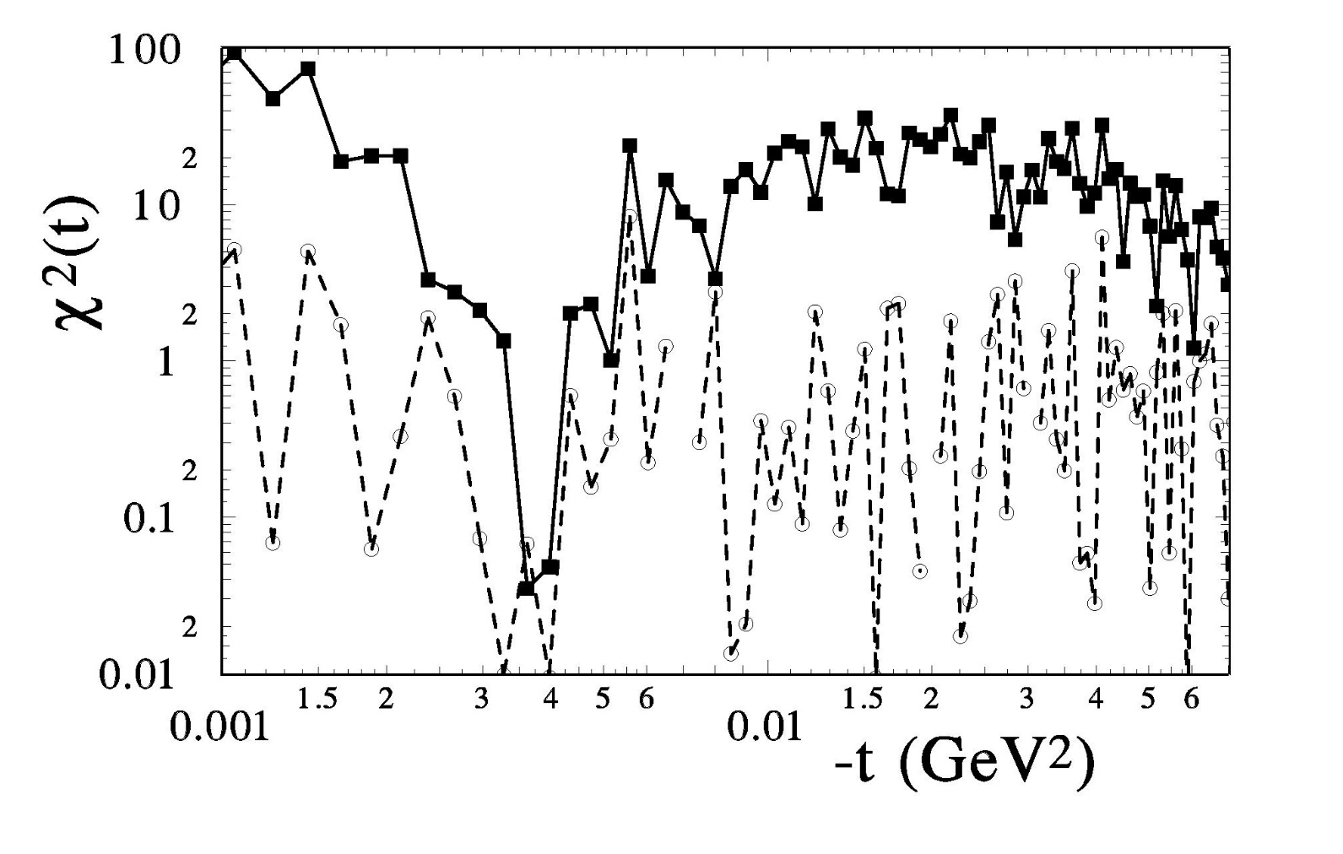

Slide 52
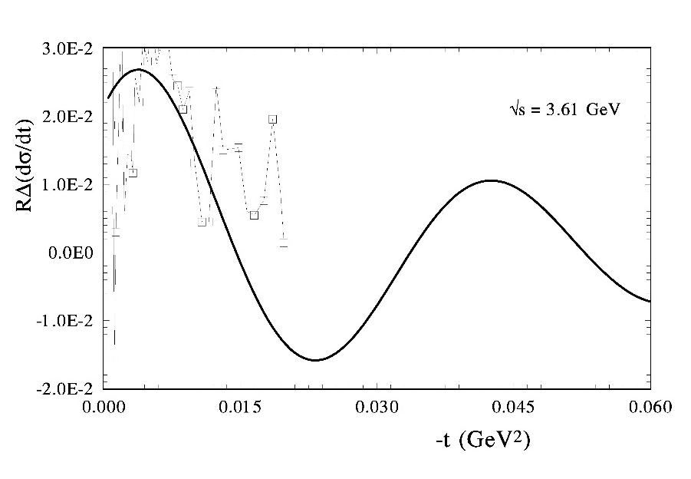
47

Slide 53
Potential of rigid string
O.V. Selyugin
Fit over (q)
Ukr.J. Phys., v.41 (1996)

Slide 54
Screening long range potential

Slide 55
K. Chadan, A. Martin: “Scattering theory and dispersion relations for a class of long-range oscillating potentials”, CERN (1979)
2. a) Van-der-Waals potential V_{ad} ~ h/r⁴
b) F. Ferrer, M. Nowakowski (1998)
(Golstoun boson – long range forces) V_{ad} ~ h/r³
3. S-L interaction
N-dimensional gravipotential (ADD-model) Oscillations”- I. Aref’eva [1007.4777:arXiv-hep-ph]
Universal scenario?

Slide 56
Answers
1. regions of t ?;
Coulomb-hadron interference region of t with max amplitude.
The effect is large for the smaller values of t.
The effect does not come from statistical fluctuations, otherwise it would appear for any t.
size of the periodical structure?
Order 10⁻¹ GeV^2 of the main hadron amplitude.
. phase of the additional amplitude?
Almost real, changes sign when it goes
from particle to antiparticle.
. energy dependence?;
Complicated energy dependence of log(s)

Slide 57
Summary
The experimental data show some periodical structure in the
Coulomb-hadron interference region and small t and in a wide energy region.
The small period of the “oscillation” is related with the long hadron
screening potential at large distances.
It is likely that this effect has an electromagnetic origin, or
it comes (some part) from the odderon.
P. Grafstrom, A.D. Martin, M. G. Ryskin –
We face a completely new and very interesting phenomena.

Slide 58
Спасибо за внимание

Slide 59
NEW EFFECT
Fitting procedure:

Slide 60
pp→pp
p(ap)→p(ap)

Slide 61
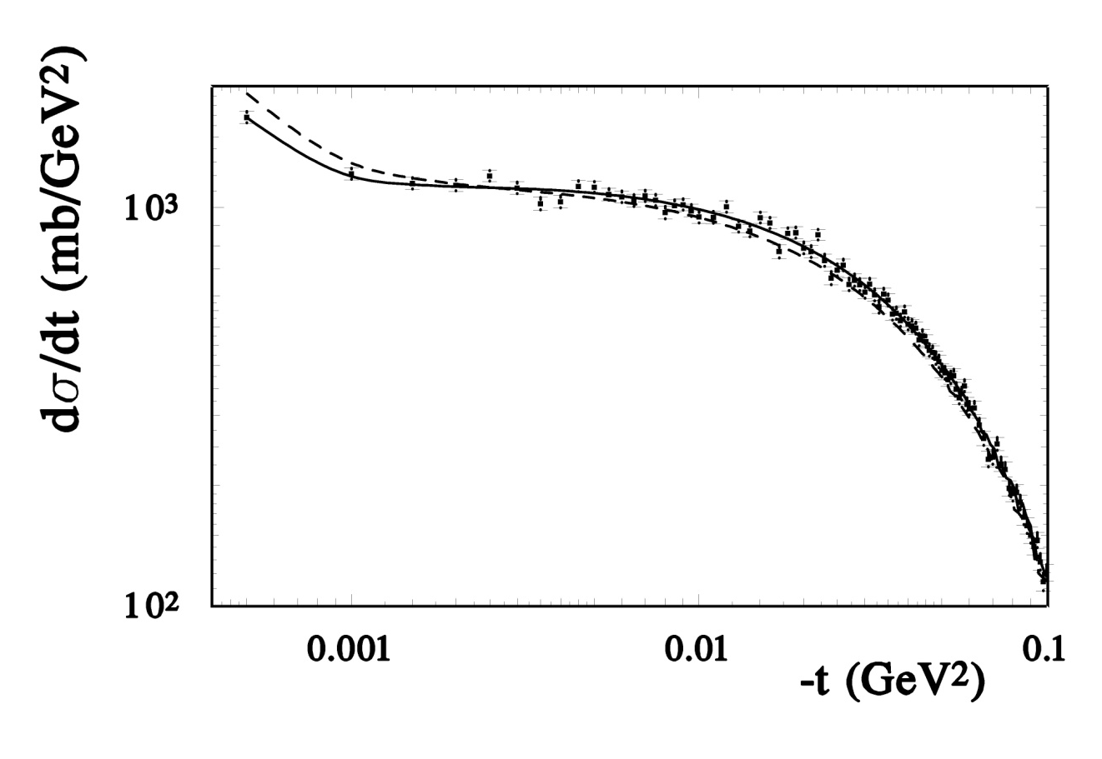
Seminar in the TOTEM O.V.S. (2009) ; and Phys.Rev.Lett. (2009)
LHC
14 TeV
Simulation of the experimental data by the model with non-exponential behavior of B(s,t) and r(s,t)
N=90

