Slide 1
Ether is alive! New derivation of the cosmological constant
Xiaosong Wang
Nov. 24, 2022

Slide 2
Contents
Problems of General theory of relativity;
Some ether theories in the history;
Theory of vacuum mechanics (VM);
Expansion of the universe is accelerating;
Derivation of cosmological constant;
Problems of theory of vacuum mechanics.
1
2
3
4
5
6

Slide 3
GR: matter curvature
$$The equation of motion of a particle in a$$
$gravitational$ field is the geodesic equation.

Slide 4
Problems of GR
1. The Einstein's field equations are valid in all reference frames is a fundamental assumption; R. P. Feynman once said: “What I cannot create, I do not understand.”
2. Many attempts to reconcile GR and quantum mechanics by using the techniques in quantum electrodynamics meet some mathematical difficulties;
3. Quantum field theory predicted a value of the cosmological constant that was 46 orders of magnitude larger than that observed. This is called the cosmological constant problem;
4. Because there is no continuum which acts as a medium of gravity in GR, GR may be regarded as a phenomenological theory.
Xiao-Song Wang. Derivation of generalized Einstein's equations of gravitation in some non-inertial reference frames based on the theory of vacuum mechanics. Reports on Mathematical Physics, 87(2):183-207, 2021.

Slide 5
Maxwell’s source or sink
An analogy between source or sink flows and electric charges.
E. Whittaker. A History of the Theories of Aether and
Electricity, v. 1. 1951.

Slide 6
Poincare’s sink model
Matters may be holes in fluidic aether ([22], p. 171).
[22] H. Poincare. The science and hypothesis, in Chinese,translated from the French edtion, Beijing,1997.

Slide 7
Wang’s mechanical model of vacuum and particles
1.The universe is filled by a ideal fluid which may be called Ω(0) substratum or gravitational ether.
2. All the microscopic particles are sinks in the Ω(0) substratum.
Xiao-Song Wang, Derivation of the Newton’s law of gravitation based on a fluid mechanical singularity model of particles, Prog. Phys. 4, 25 (2008).

Slide 8
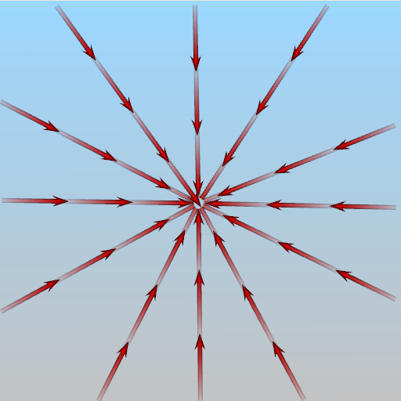
sink flow: 2D

Slide 9
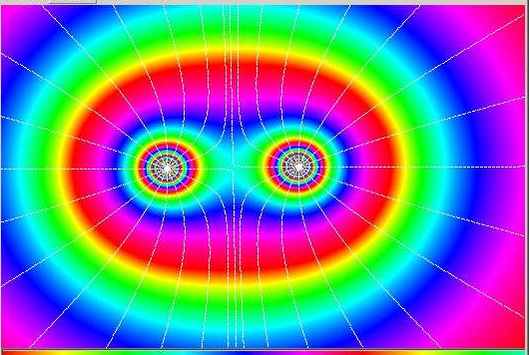
Example: two sinks model of two stars system

Slide 10
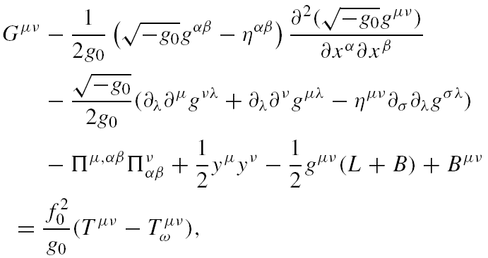
2019-2021: Theory of vacuum mechanics (VM): generalized Einstein Equations
Xiao-Song Wang. Derivation of generalized einstein's equations of gravitation in some noninertial reference frames based on the theory of vacuum mechanics. Reports on Mathematical Physics, 87(2):183-207, 2021.

Slide 11
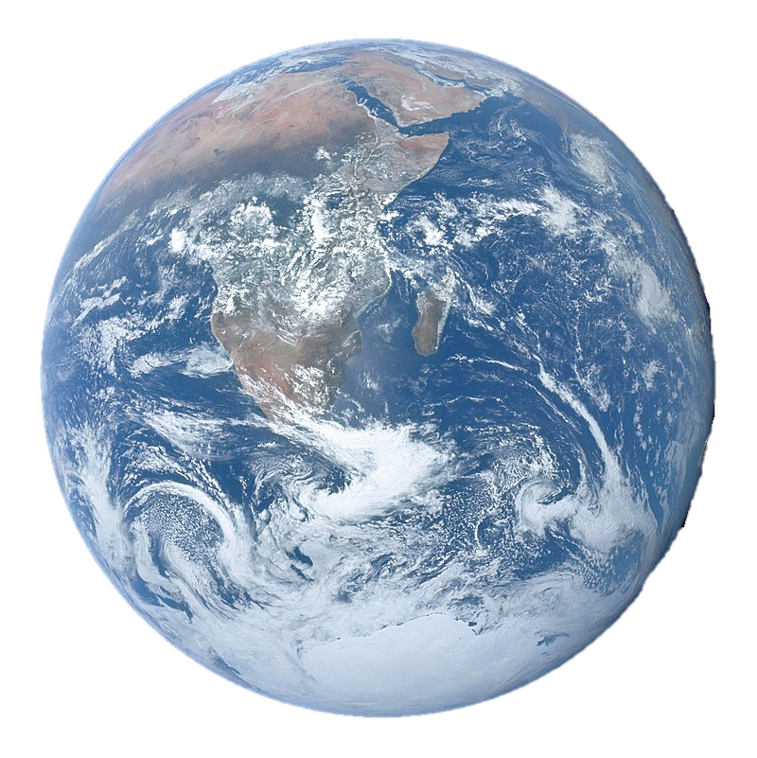
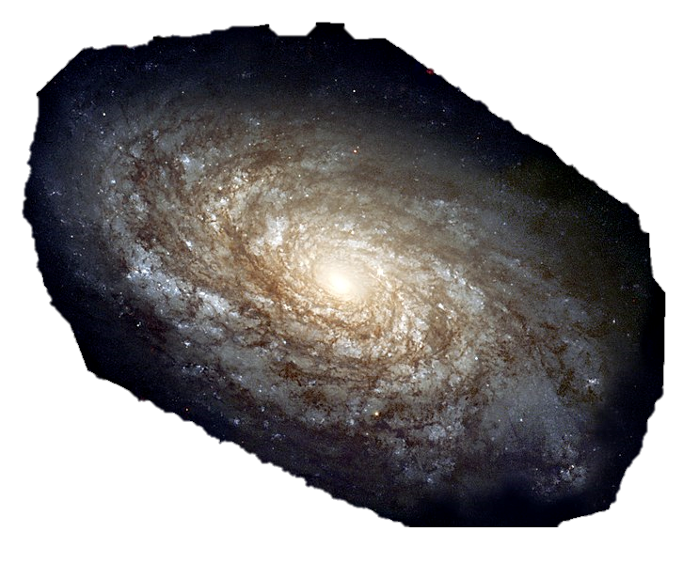
Accelerated expansion of the universe
1998: two independent groups observed supernova from galaxies at different distances from earth.
Type 1a supernova
Conclusion: speeds of various galaxies travelling away
from the Milky Way is INCREASING overtime!

Slide 12
Possible explanations for universe’s accelerating expansion
1. Cosmological Constant $Λ$>0,
Dark Energy?
2. Modified gravity theories
3. Other unknown reason

Slide 13
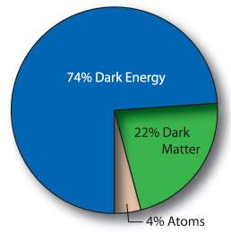
Dark Energy may be reponsible for Accelerated expansions
The Universe is accelerating implie the existence of dark energy that makes up about 74% of the Universe.
Dark Energy may be related to Einstein’s Cosmological Constant. Its nature is a mystery.

Slide 14
Lord Kelvin’s ether
supposing for the moment ether to be gravitationally attracted by the sun as if it were ponderable matter of 5×10^(-18) ×ρ_water.
Lord Kelvin (1901) XII. On ether and gravitational matter through infinite space , Philosophical Magazine Series 6, 2:8, 161-177, DOI: 10.1080/14786440109462676

Slide 15
Assumption: the Ω(2) substratum
Assumption 1. Vacuum is filled with a kind of continuously distributed substance which may be called the Ω(2) substratum. The Ω(2) particles are sinks in the Ω(0) substratum.
Xiao-Song Wang. A theoretical calculation of the cosmological constant based on a mechanical model of vacuum. Reports on Mathematical Physics, 90(1):1-24, 2022.

Slide 16
Liquid droplet model of elementary particles
Xiaosong Wang, Derivation of Zeldovich's formula and Weinberg's relation of the cosmological constant based on a liquid droplet model of electron, preprint, www.researchgate.com, 2022.

Slide 17
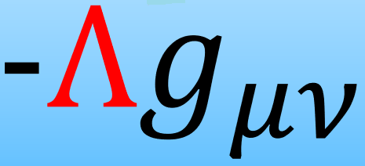
Derivation of CC
Our starting point: VM
$R_{μν}−\frac{1}{2}Rg_{μν}=\frac{κ}{g}T_{μν}$.
In vacuum, we have
guess:

Slide 18
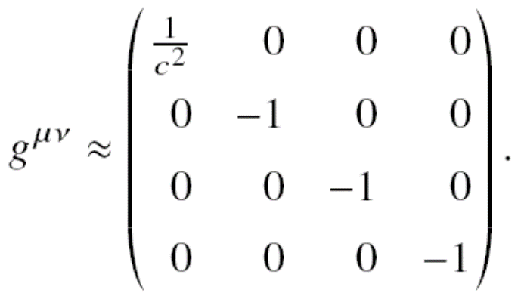
Derivation of CC
Comparision:
guess:

Slide 19
Derivation of CC
result:

Slide 20
calcution of CC
data:

Slide 21
The cosmological constant problem
1968, Y. B. Zeldovich, quantum field theory
VM predicts:

Slide 22
Problems of VM
1. The masses of particles depends on time and position in space;
2. The gravitational constant G depends on time and position in space;
3. In VM, the generalized Einstein’s equations are valid only in Fock coordinate systems; not valid in all reference frames as GR.
4. In VM, Einstein equations are valid approximately: weak, quasi-inertial.
Xiao-Song Wang. Derivation of generalized Einstein's equations of gravitation in some non-inertial reference frames based on the theory of vacuum mechanics. Reports on Mathematical Physics, 87(2):183-207, 2021.

Slide 23
Thank you!
Email: mrxiaosongwang@163.com

