Slide 1
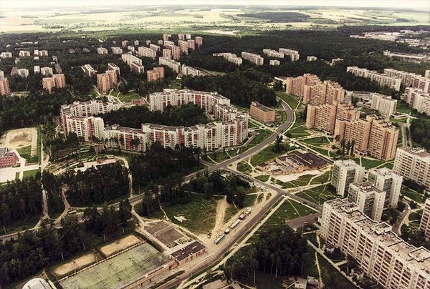
Closing Address
Vladimir A. Petrov
Logunov Institute for High Energy Physics , NRC KI,
Protvino, RF

Slide 2
XXXIIIth International Workshop on High Energy Physics Hard Problems of Hadron Physics: Non-Perturbative QCD & Related Quests 08-12 November 2021
New Results in Hadron Spectroscopy
Non-perturbative Methods for Soft Hadron Scattering
Quark-Gluon Matter at Finite Temperatures and Densities
Lattice simulations for hadron phenomenology
Chiral symmetry breaking in phenomenology and on the lattice
Progress in Confinement Problem
Rigorous Results in Gauge QFT

Slide 3
Thank You and Farewell !

