Slide 1

TWENTIETH LOMONOSOV CONFERENCE
ON ELEMENTARY PARTICLE PHYSICS
Moscow State University, Moscow, 19-25 August, 2021
New features of strong interactions revealed at the LHC
Vladimir A. Petrov
Logunov Institute for High Energy Physics
NRC KI, Prautvinault, RF

Slide 2


Quickie history of the LHC:
2009 - 2021
“Old Physics”:
- Completion of the SM with Higgs
- “Routine “measurements of cross-sections, life-times, masses, correlations…
“New Physics”:
- Supersymmetry:
- “Stringy effects”
- Dark matter (“dark photons”)
- Lepto-quarks
- Compositeness
- Extra dimensions
- Micro Black holes
DONE !
NONE !

Slide 3
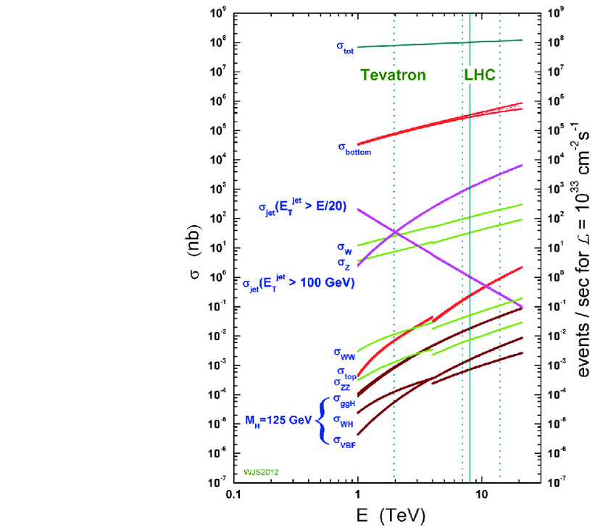

Slide 5










Reminder :
Strong Forces at Low and High Energies
Low energy
High energy
$$α\left(M_{J}^{2}\right)=J$$
t
$$A_{J}\left(s,t\right)=g_{J}^{2} \frac{s^{J}}{M_{J}^{2}−t}$$
$$→V\left(r\right)={± g}_{J}^{2}\frac{{s^{J−1}e}^{−M_{J }r}}{4πr}$$
s
$$M=π, ρ, ω, f,….$$
$$\sum_{J}{A_{J}\left(s,t\right)}→{±s}^{α_{±}(t)}$$
$$α_{±}(t)$$

Slide 6
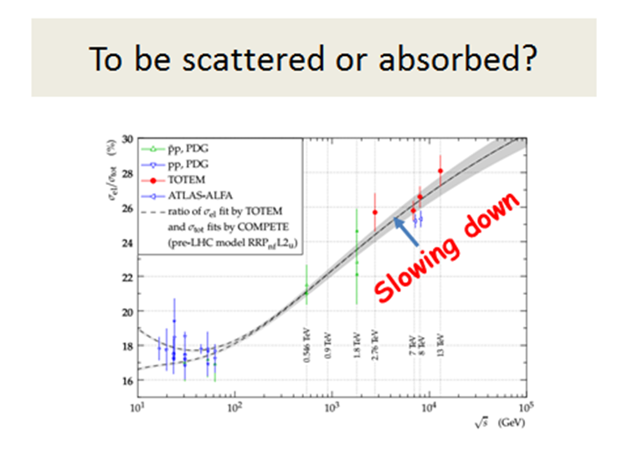

Slide 8
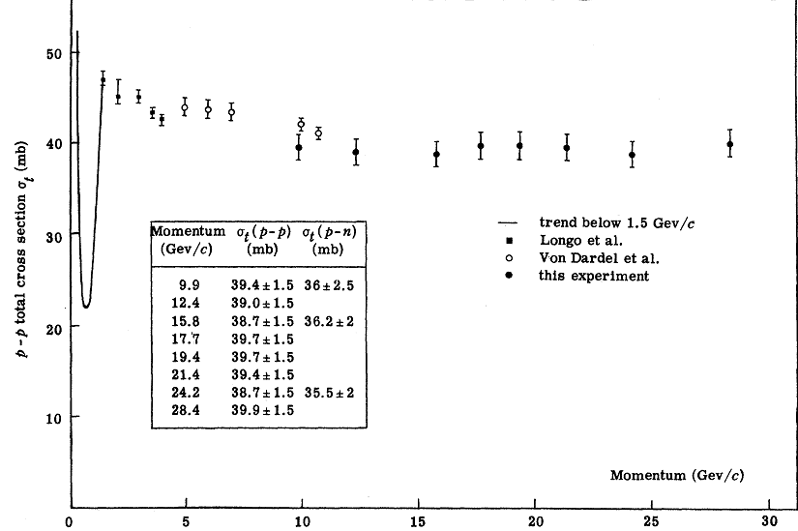
Prehistory (1953-70)
?

Slide 9
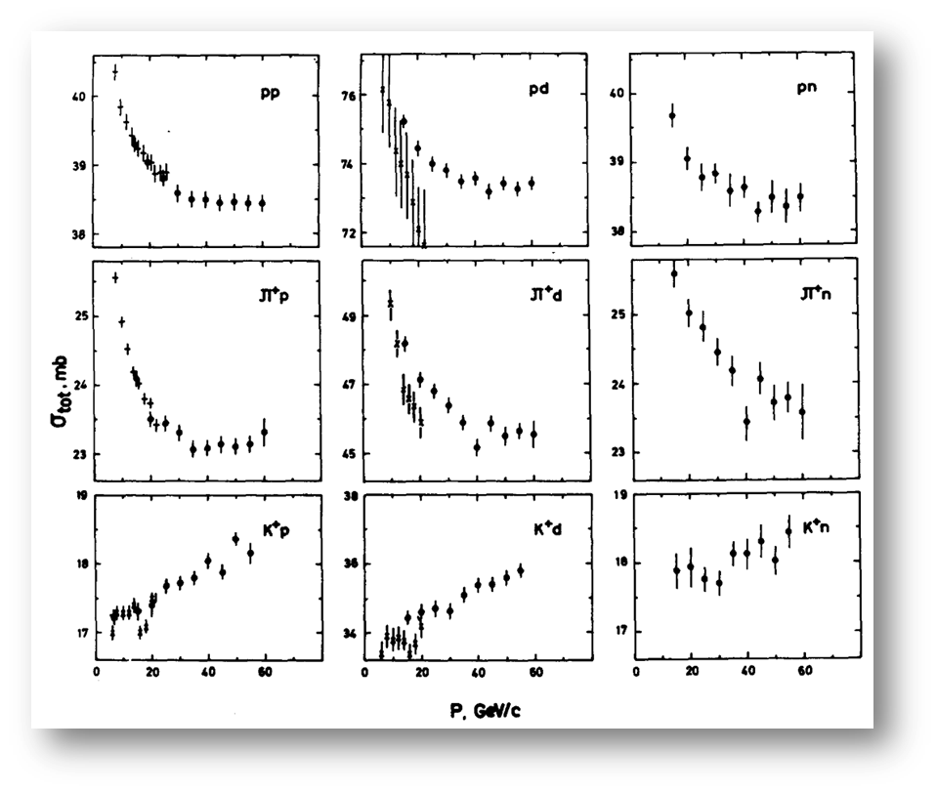
Middle Age (1971-73)

Slide 10
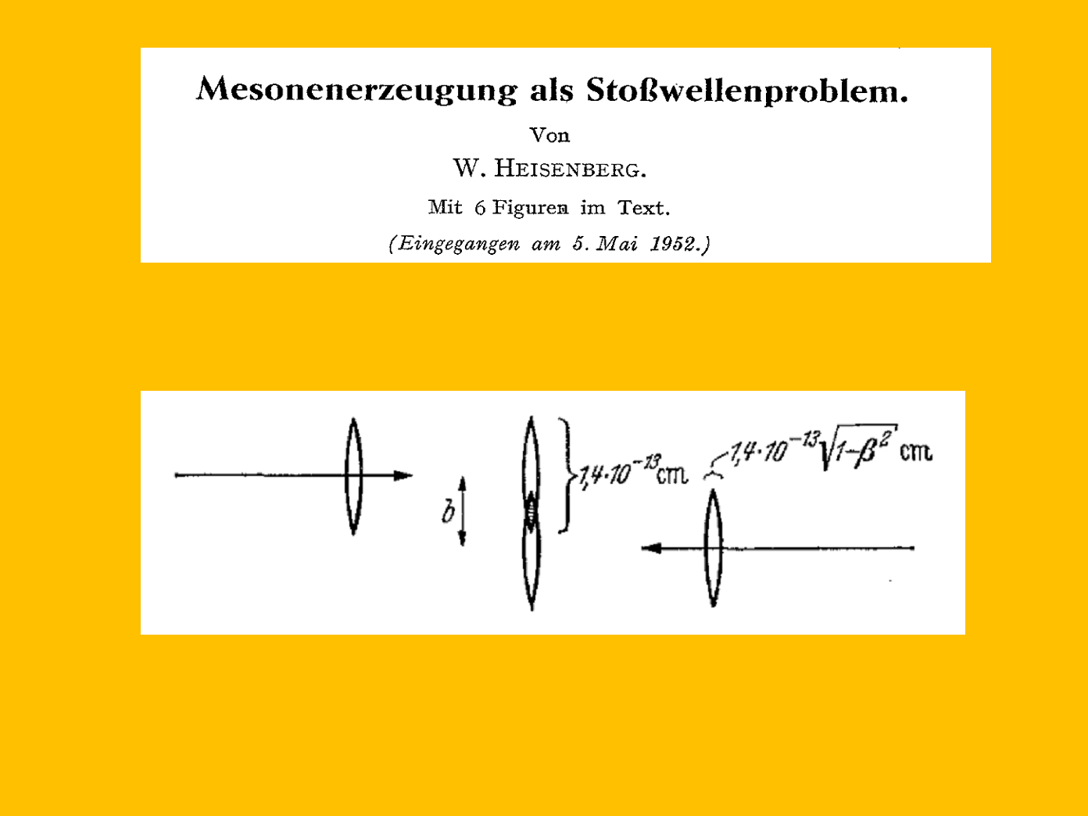

Slide 11

New Era (1973-…)

Slide 12
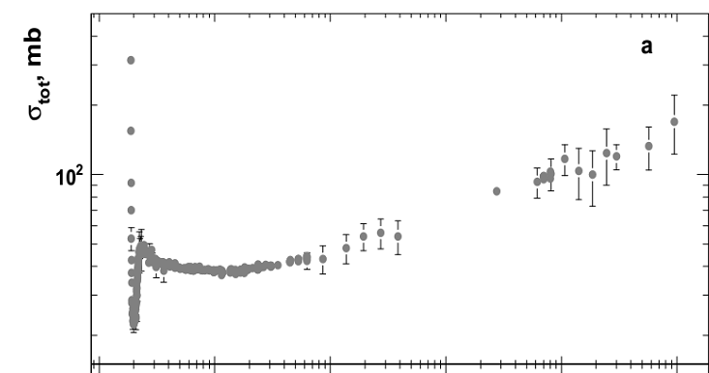

Slide 14

$$With Higgs$$
Without Higgs

Slide 15
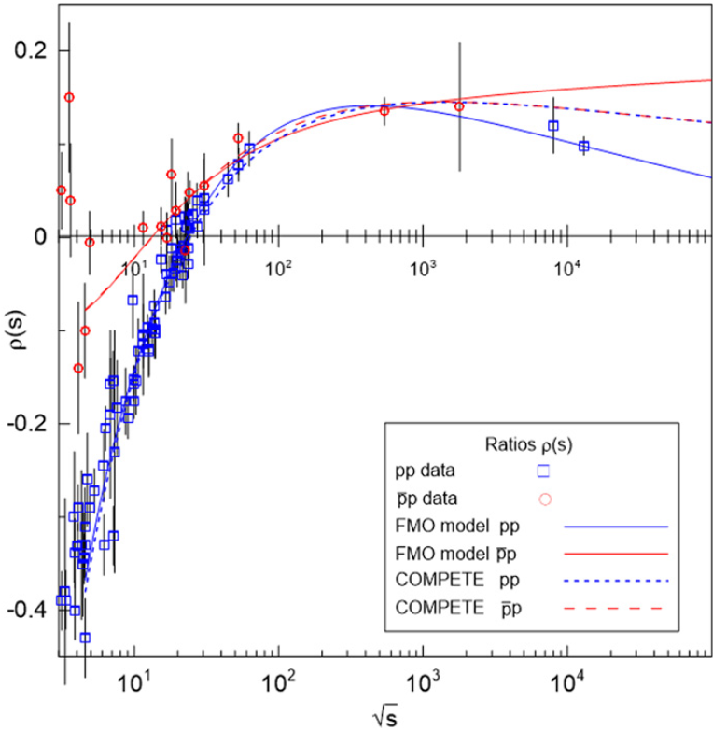
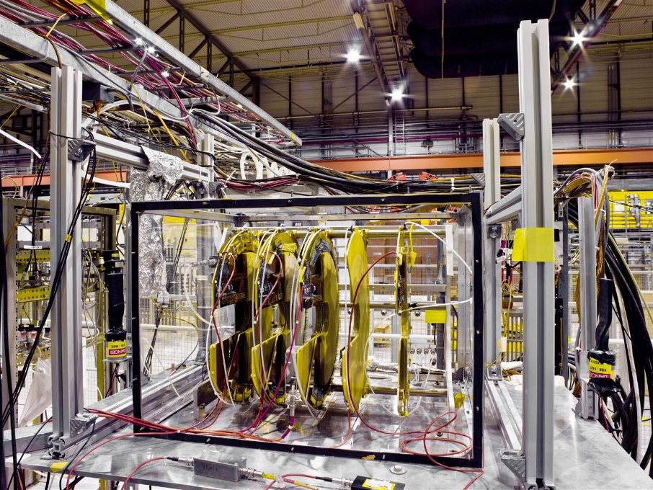


CERN COURRIER
STRONG INTERACTIONS NEWS
Oddball antics in pp collisions
23 March 2018
$$T\left(s,t\right)=\left|T\left(s,t\right)\right|e^{iΦ(s,t)}$$
$$ρ(s)=\cot{Φ(s,0)}$$

Slide 16


Slide 17




Repetitio est matur studiorum
$$\sqrt{s}=0.053 TeV ISR$$
$$A. Breakstone et al. (1985)$$
$$V. M. Abazov et al. (2021)$$

Slide 18
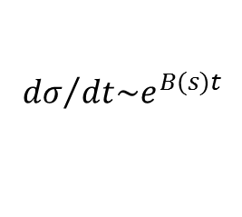
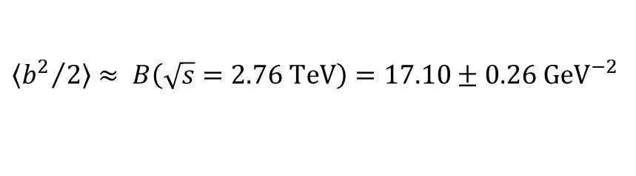

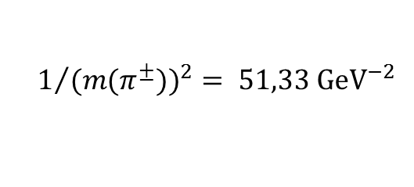
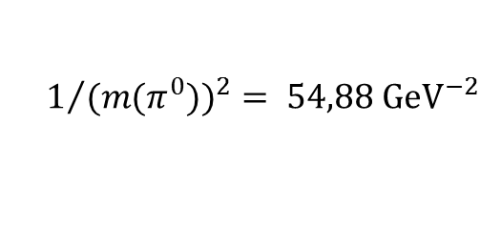
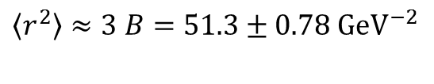

$${dσ}/{dt\sim e^{B(s)t}}$$
$\left\langle {b^{2}}/2\right\rangle$ $≈ B\left(\sqrt{s}=2.76 TeV\right)=17.10±0.26 {GeV}^{−2}$
$$1/{({m(π^{0}))}^{2}= 54,88{ GeV}^{−2}}$$
$\left\langle r^{2}\right\rangle$ $≈3 B=51.3{± 0.78 GeV}^{−2}$
$\text{Accidental} \text{coincidence}$ ?
$$1/{({m(π^{±}))}^{2}= 51,33{ GeV}^{−2}}$$
$$G. Antchev et al. (2019)$$

Slide 19

QUO VADIS ?

