Slide 1
Phys.Rept. 658 (2016) 1
Departamento de Física Teórica
Institute of Particle & Cosmos Physics (IPARCOS)
Universidad Complutense de Madrid
Determination of light scalar meson properties
from dispersive and analytic methods
applied to meson-meson scattering
J. R. Peláez
In collaboration with:
A.Rodas
J.Ruiz de Elvira
XXXIII International (online) Workshop on High Energy Physics 8-12 November 2021
Hard Problems of Hadron Physics: Non-Perturbative QCD & Related Quests
Supported by:

Slide 2
Motivation to study the scattering of pions and kaons and light scalar resonances
π,K are Goldstone Bosons of QCD → Test Chiral Symmetry Breaking
π,K appear as final products of almost all hadronic processes:
Examples: B,D, decays, CP violation studies, etc…
Meson-meson scattering main or relevant source for PDG parameters of many resonances
Much debated light scalar resonances appear there, in particular the f₀(500), f₀(980), f₀(1370), f₀(1500) and also the K*₀(700), K*₀(1430).
Strong indications for predominant non quark-antiquark nature
Relevant for glueball identification

Slide 3
Motivation
ππ and πK SCATTERING data are poor
π and K are unstable. Still, beams can be made.
But NOT luminous enough for ππ and πK collisions: Indirect measurements
1) From meson-Nucleon scattering
Chew-Low Extrapolation (see Gribov’s book Sect. 2.6.2)
Initial state not well defined, model dependent off-shell extrapolations
(OPE, absorption, A₂ exchange...).
Needs Meson- N-partial wave extraction. Problems with phase shift ambiguities, etc...
As a consequence… VERY LARGE SYSTEMATIC UNCERTAINTIES
π
π
π
π
N
N

Slide 4
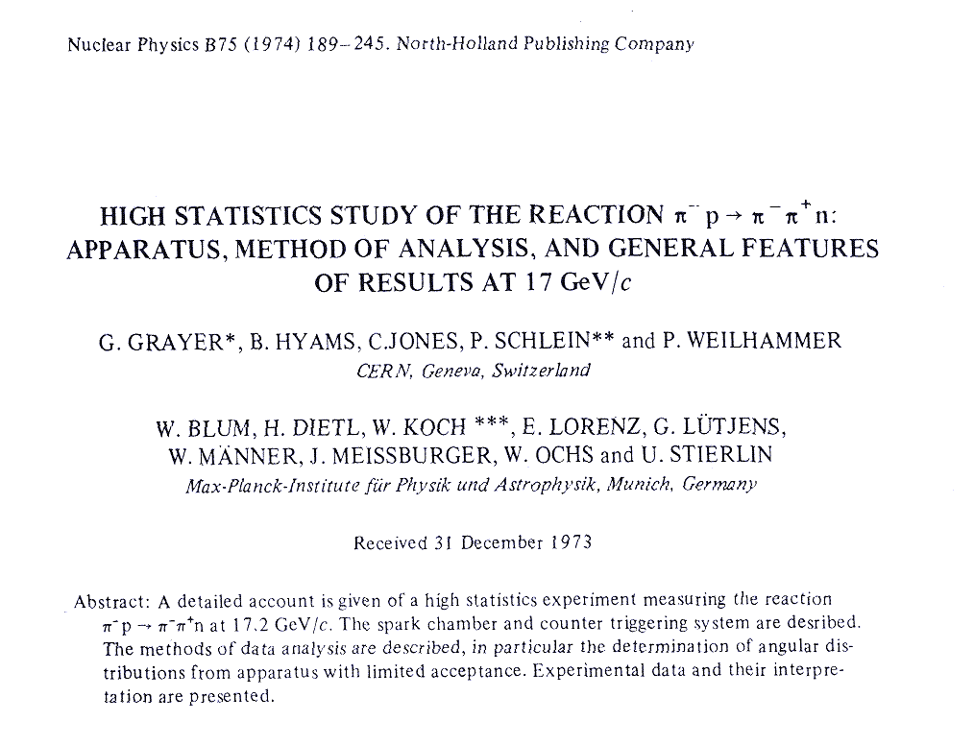
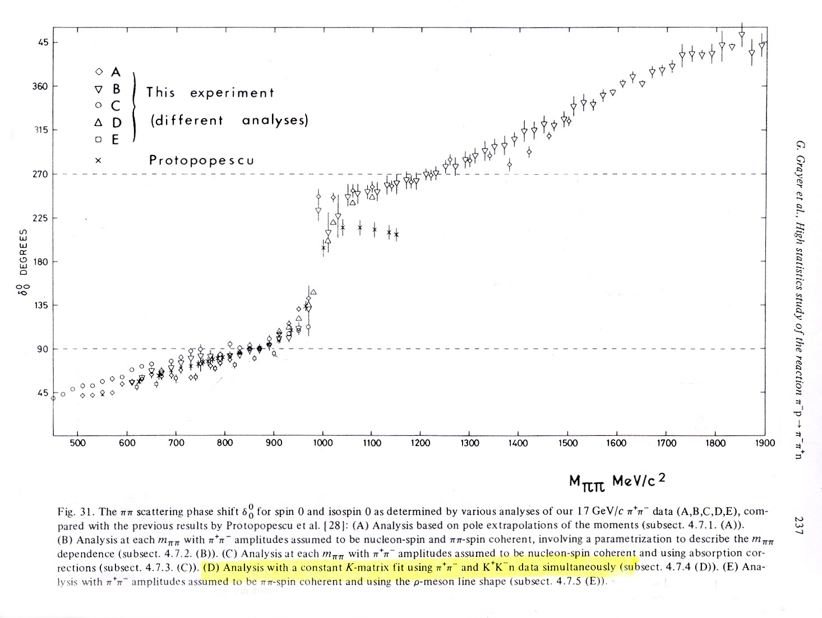
ππ scattering data. Example: CERN Munich Experiment
SYSTEMATIC uncertainties larger than STATISTICAL
Systematic errors of 10º !!
5 different ππ→ππ
analysis of same
πp→ππn data !!
And this is only below 1 GeV. Above there are another 4 analyses

Slide 5
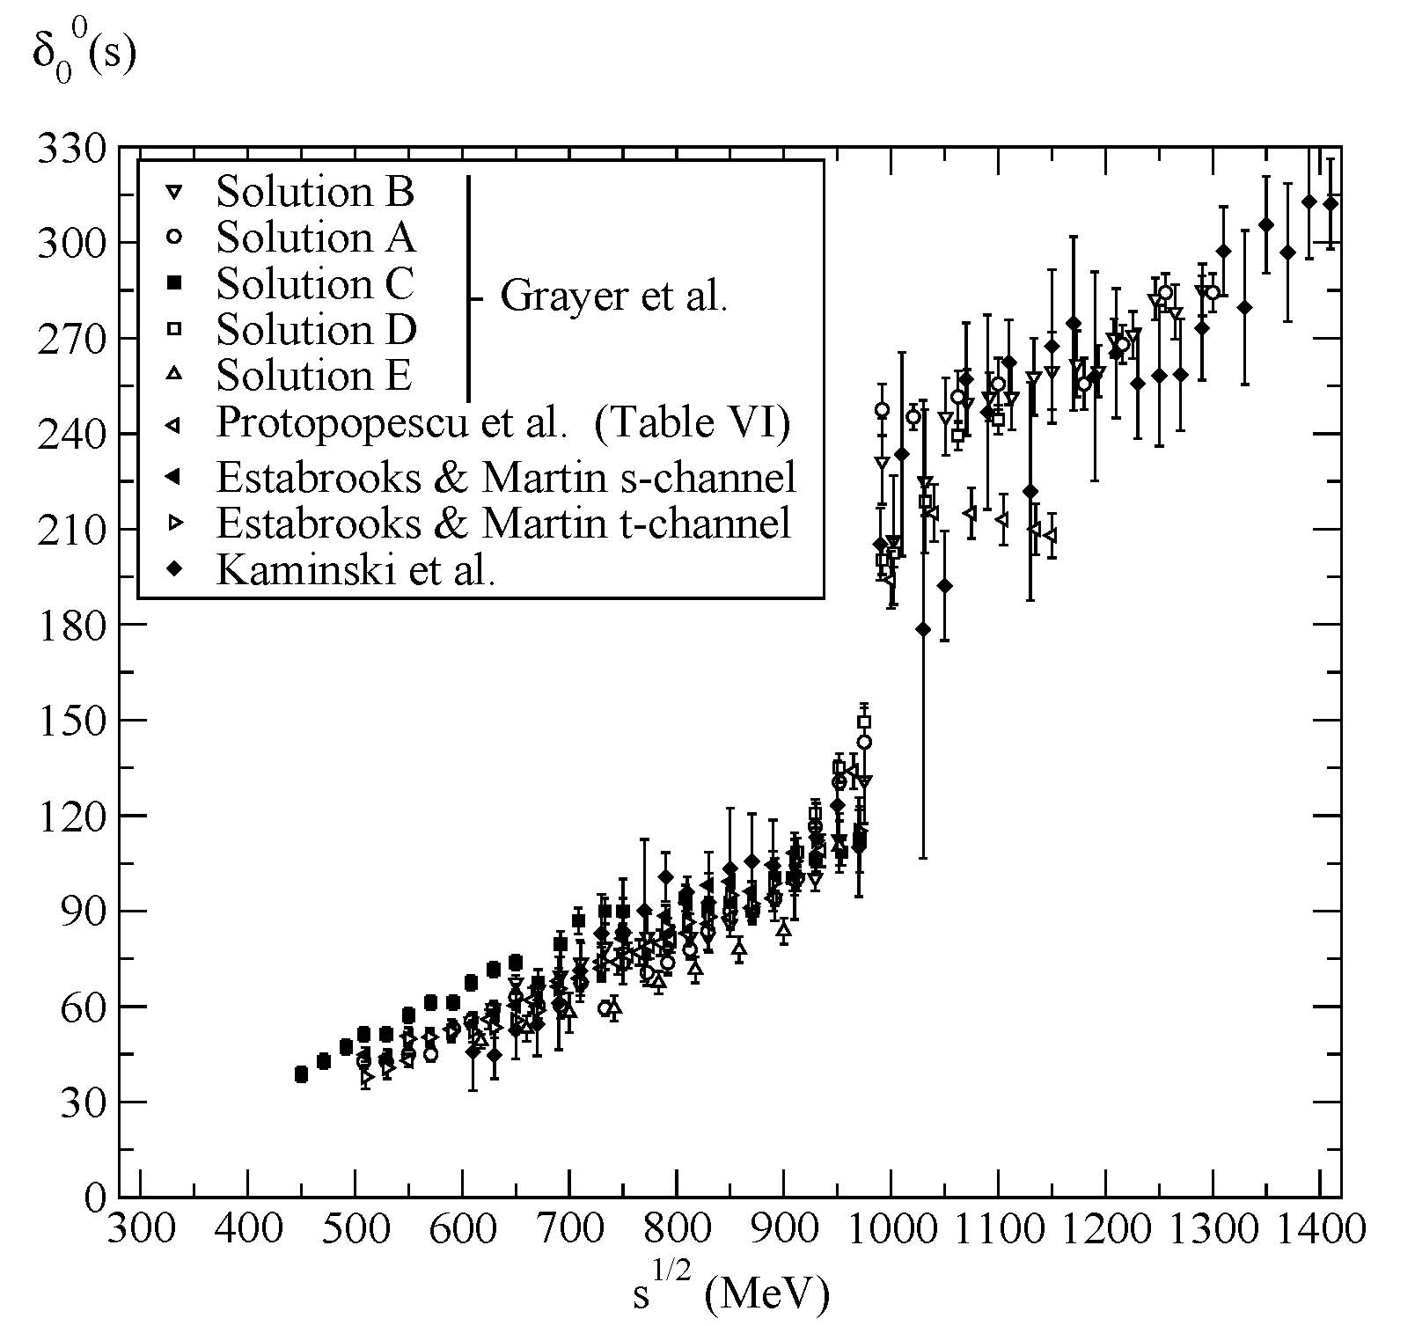
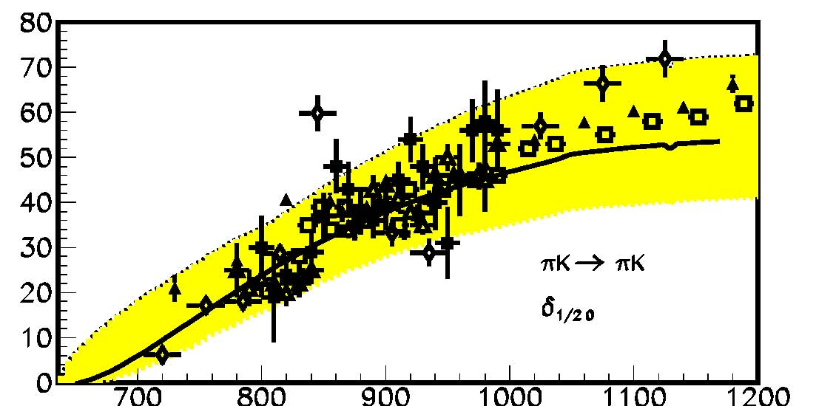
Motivation
ππ and πK SCATTERING data are often in conflict
First problem:
CONFLICTING DATA SETS
From meson- Nucleon
π π → π π
This talk:
use DISPERSION RELATIONS to obtain data parameterizations:
Precise, consistent and EASY TO IMPLEMENT

Slide 6
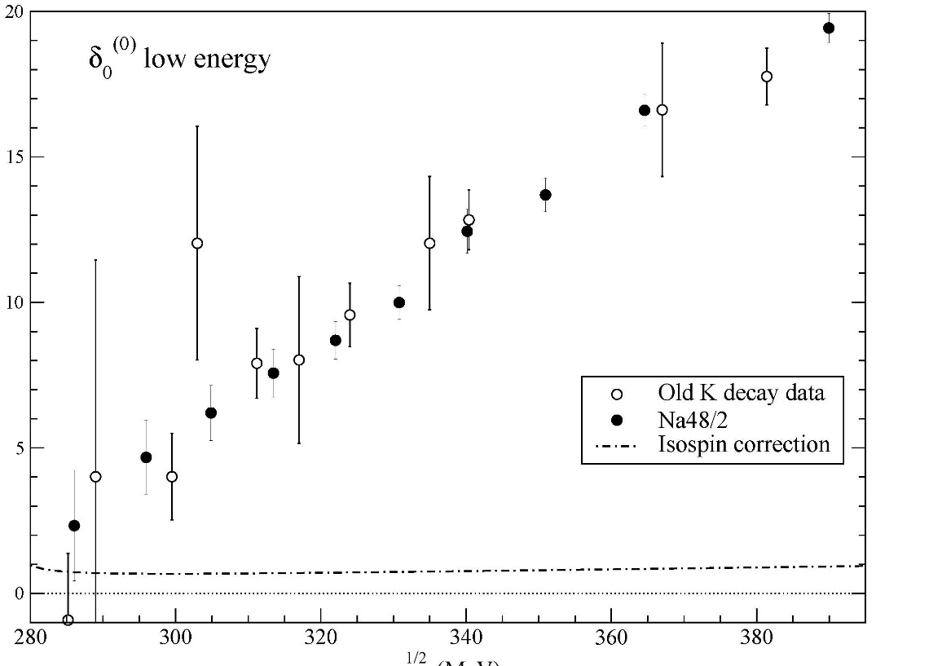
Motivation
ππ and πK SCATTERING data are bad
π and K are unstable. Still, beams can be made.
But NOT luminous enough for ππ and πK collisions: Indirect measurements
2) The only good data :From K→ππeν (“K_{l4} decays”)
Geneva-Saclay (77), E865 (01), NA48/2 (2010)
Pions on-shell.
Very precise
BUT Limited:
only ππ→ππ
only δ₀₀-δ_{11.}
only E<M_{K}

Slide 7
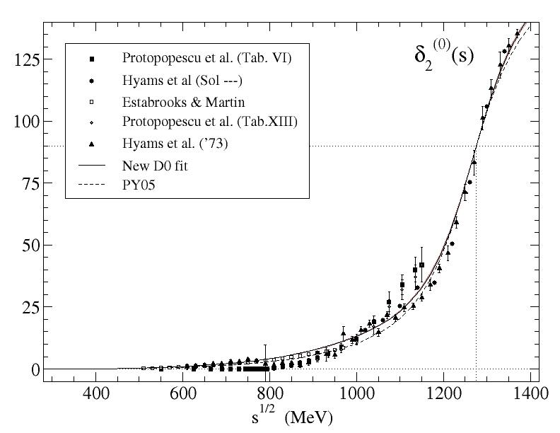
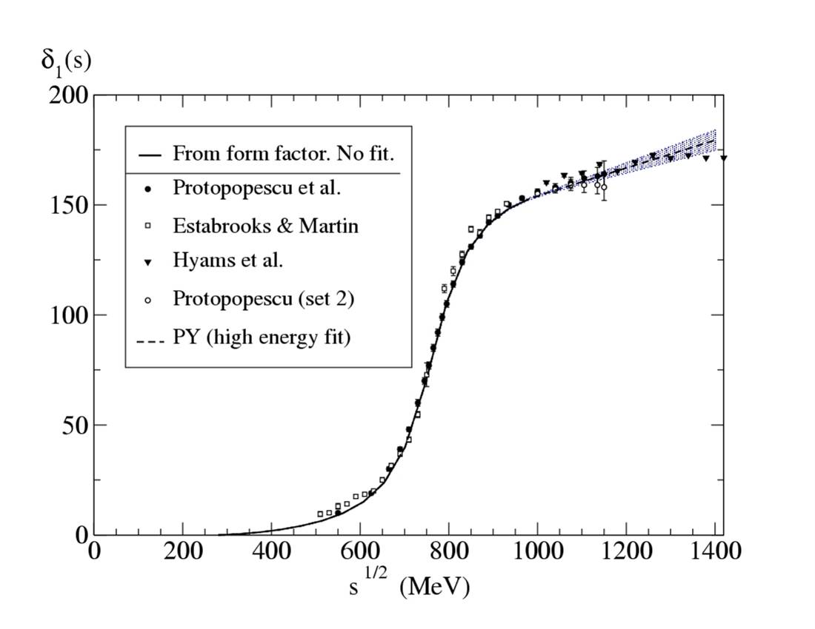
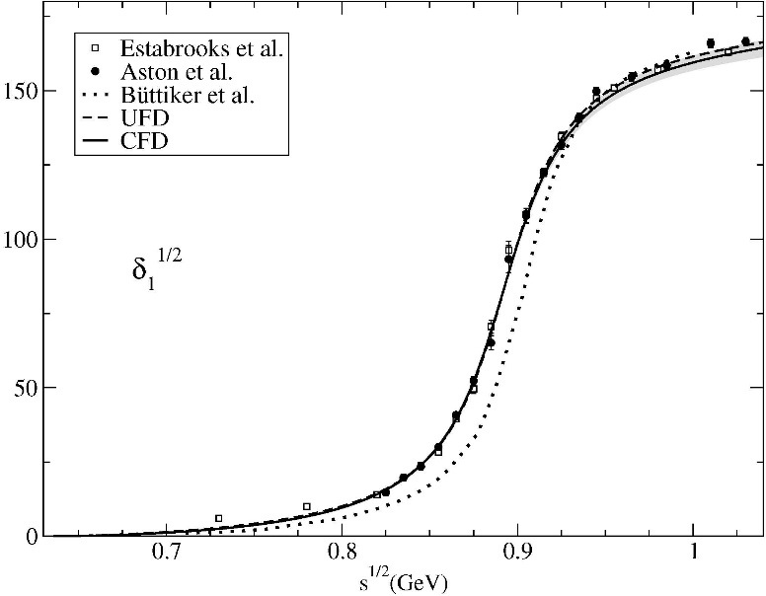
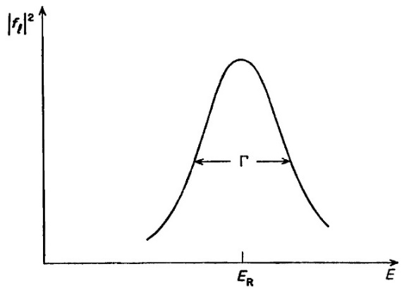
Motivation: Resonances in meson-meson scattering
Narrow resonances when far from other resonances or singularities (thresholds, cuts, etc…)
produce typical peaks and rapid 180º phase motions
ρ(770)
f₂(1275)
K*(892)
/f₀(500)
These are the “easy ones”
ONLY THEN, they are reasonably well approximated
by Breit-Wigner shapes
$$\sim \frac{M Γ(s)}{M^{2}−s−iM Γ(s)}$$

Slide 8
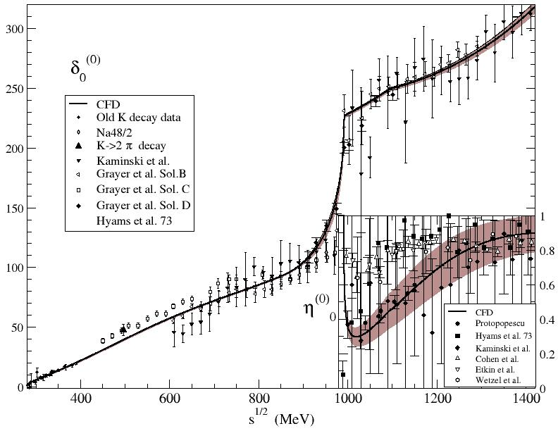
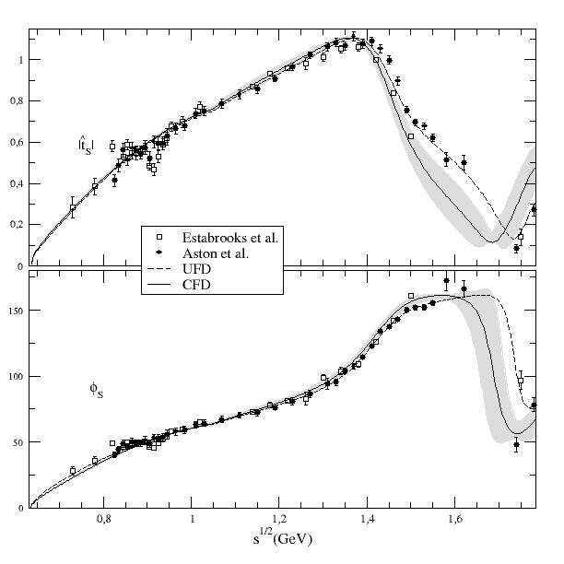
Motivation: Resonances in meson-meson scattering
Breit-Wigner shapes are easily recognizable…
But do you see resonances there?
Nevertheless there are resonances (a pole) in these regions: the σ/f₀(500), f₀(1370) and κ/K₀*(700) light scalars

Slide 9
Process dependent resonance shapes
In contrast, light scalars are wide, or even extremely wide and frequently overlap with one another or with thresholds like KK.
Very often they do not produce clear peaks, nor rapid phase motions
Moreover since they are not clear-cut peaks, their shape, apparent position, width, etc… can be different depending on the process where they are observed.
This also induces large model dependences

Slide 10
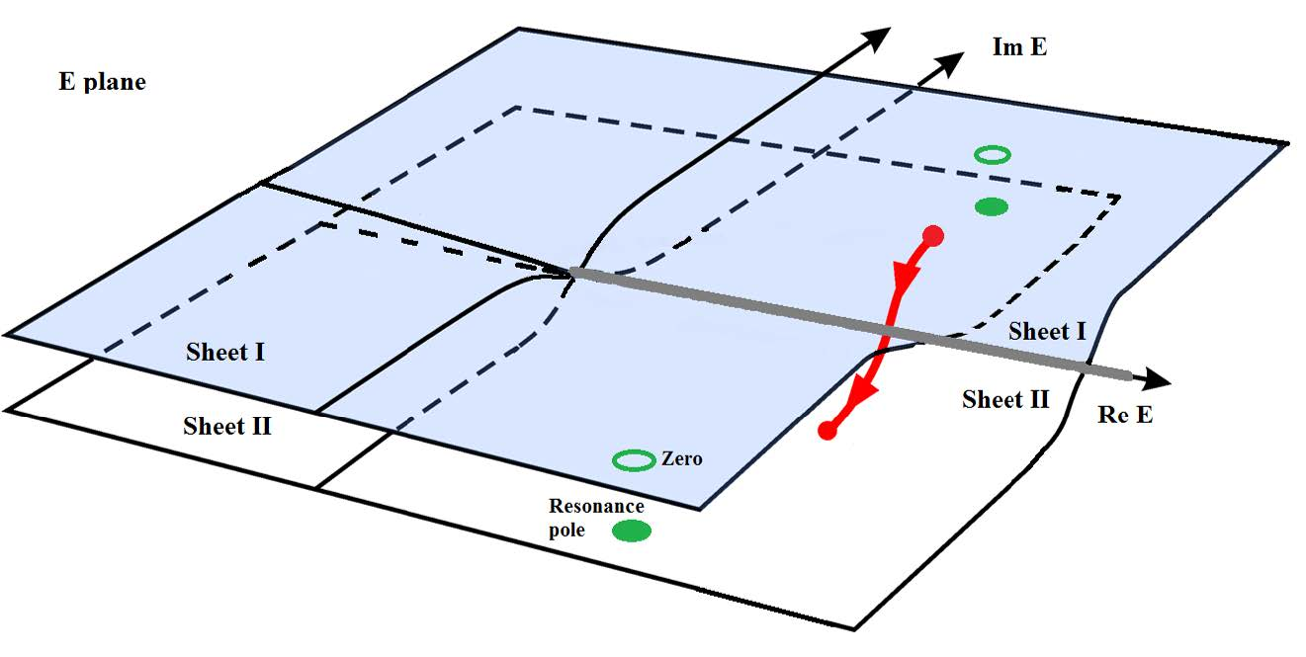
Process dependent peaks vs. Process independent poles
The universal features of resonances are their pole positions and residues *
$\sqrt{s_{pole}}≈$M-i Γ/2
*in the Riemann sheet obtained from an analytic continuation through the physical cut
s
s
s
The Review of Particle Physics has been adding pole determinations
for more and more resonances
unfortunately keeping also Breit-Wigner parameters even when not applicable
However, analytic continuations are a delicate mathematical problem and a good control of the analytic structure is needed. Many models fail at this.

Slide 11
Why worry about low energy and CORRECT ANALYTIC STRUCTURE?
ππ case
It is somewhat misleading to think of analyticity in terms of $\sqrt{s}$
Left cut due to
Crossed channels
in scattering, not in
production
500
σ
ρ
Since the partial wave is analytic in s ….
Threshold very close. Chiral behavior very relevant.Adler zero
left cut and subthreshold region very close
500²
Very deep
Re s ~ Im s
ρ
σ
For the σ and κ a good control of the left cut and threshold region is important.
This is why dispersion relations (Roy-like equations) are so relevant for precise pole determinations.

Slide 12
Why worry about LOW ENERGY and CORRECT ANALYTIC STRUCTURE?
πK case
Analyticity is expressed in the s-variable, not in $\sqrt{s}$
$$s−plane$$
(MeV²)
|s|=$m_{K}^{2}−m_{π}^{2}$
NO LASS data here
Just 2 Estabrooks points
with huge uncertainties
LASS data
$$Adler$$
zero
$$0$$
$${(m_{K}−m_{π} )}^{2}$$
$$πK$$
$$7002$$
$$8002$$
$$8902$$
$$ηK$$
$$K^{∗}(892)$$
$$κ/K_{0}^{∗}(700)$$
Important for
the $κ/K_{0}^{∗}(700)$
Threshold behavior (Theory: chiral symmetry)
Subthreshold behavior (Theory: chiral symmetry →Adler zeros)
Other cuts (Theory: Left & circular)
Thus, LOW ENERGY behavior and ANALYTICITY crucial for the $K_{0}^{∗}(700)$

Slide 13
What is a dispersion relation.? Very Briefly and for π π
CAUSALITY:
Partial waves t(s) are ANALYTIC in complex s plane
with cuts due to thresholds (also in crossed channels)
Cauchy Theorem determines t(s) at ANY s,
from an INTEGRAL on the contour
If t->0 fast enough at high s, curved part vanishes
We can calculate t(s)
anywhere we want using
the same integral expression
Otherwise, determined up to polynomial (subtractions)
Good for:
1) Calculating t(s) where there is not data
2) Constraining data analysis
3) ONLY MODEL INDEPENDENT extrapolation to complex s-plane

Slide 14
This work:
Data-Driven Dispersion Relations
on amplitude or partial waves (phase+elasticity)
Model independent constraints on data description
Enhanced precision
We choose to analyze meson-meson data
because it has THE MOST STRINGENT ANALYTICITY CONSTRAINTS
We have already presented dispersively constrained data fits:
$ππ→ππ$ with Forward Dispersion relations and Roy equations
García Martin, Kaminski, JRP, Ruiz de Elvira, Yndurain, Phys.Rev.D 83 (2011) 074004
$ππ→K\overline{K}$ with Roy Steiner Equations
JRP, A. Rodas, Eur.Phys.J.C 78 (2018) 11, 897

Slide 15
This work:
Data-Driven Dispersion Relations
on amplitude or partial waves (phase+elasticity)
Model independent constraints on data description
Enhanced precision
+
Analytic methods for the continuation to the complex plane in the contiguous sheet
avoiding specific parameterizations
(only phase and elasticity)
Reduced Model dependence or independence for pole determinations
We have already done this for the σ/f₀(500) , κ/K₀*(700)
and for the strange resonances below 2 GeV

Slide 16
Roy Eqs. vs. Forward Dispersion Relations
So, we need to get rid of ONE VARIABLE
to write CAUCHY THEOREM in terms of the other one
Fix one variable in terms of the other
(fixed-t, hyperbolic relations…)
2) Integrate one variable and keep the other
(partial wave dispersión relations)

Slide 17
Single variable Dispersion Relations (DR)
1) Fixed-t Dispersion Relations (or fixed-s) for T(s,t₀)
Simple analytic structure in s-plane, simple derivation and use
Left cut: With crossing may be rewritten in terms of physical region
Most popular: t₀=0, FORWARD DISPERSION RELATIONS (FDRs).
(Kaminski, Pelaez , Yndurain, Garcia Martin, Ruiz de Elvira, Rodas )
One equation per amplitude.
High Energy part very well known since Forward Amplitude~ Total cross section
Positivity in the integrand contributions, good for precision.
Calculated up to 1.4 GeV (ππ) or 1.7 GeV (πK)
Generally, not used for continuation to the 2nd sheet of complex since no straightforward relation between first and second sheet

Slide 18
Single variable Dispersion Relations (DR)
Partial-wave Dispersion Relations
Analytic structure complicated if unequal masses (Circular cuts)
Left cut: With crossing may be rewritten in terms of physical region.
But then different partial waves coupled.
In practice, limited to a finite energy
But good and simple for elastic resonance poles

Slide 19
Roy-like Eqs.
Derivation sketch
1) Choose the number of subtractions (2=Roy, 1=GKPY)
2) Write fixed-t dispersion relations and project them in partial waves.
Limited to s≤ 68 m_{π}² ~ O(1.1) GeV (More complicated extensions exist)
3) Use $s↔u$ crossing symmetry to re-write:
left cut in terms of partial wave expansions of the other channels. But crossed channels are also ππ→ππ. Coupled equations.
Subtraction terms
4) Truncate for low energy and low pw. The rest is input (driving terms)
Complications for πK→πK (Roy-Steiner Eqs). Also for πN and γγ→ππ)
2) Different masses. Better use “hyperbolic” Dispersion Relations for larger applicability domain.
3) Crossing involves other processes (ππ→KK). More equations coupled.

Slide 20
Structure of Roy vs. GKPY Eqs.
Both are coupled channel equations for the infinite partial waves:
I=isospin 0,1,2 , l =angular momentum 0,1,2….
DRIVING
TERMS
(truncation)
Higher waves
and High energy
SUBTRACTION
TERMS
(polynomials)
KERNEL TERMS
known
ROY:
2nd order
More energy suppressed
Very small
Partial wave
on
real axis
GKPY:
1st order
Less energy suppressed
small
“OUT”
=?
“IN (from our data parametrizations)”

Slide 21
Two strategies
SOLVE equations: (Ananthanarayan, Colangelo, Gasser, Leutwyler, Caprini, Moussallam, Stern…)
S and P wave solution for Roy or GKPY equations unique at low energy if high-energy, higher waves and scattering lengths known. (in isospin limit)
NO scattering DATA used at low energies ($\sqrt{s}≤0.8 \sim 1 GeV$)
Good if interested in low energy scattering and do not trust data.
Uses ChPT input for threshold parameters
Impose Dispersion Relations on fits to data. (García-Martín, Kaminski,JRP, Ruiz de Elvira, Ynduráin)
Also known as “DATA driven dispersive analyses”
Use any functional form and fit to DATA imposing DR within uncertainties.
Also needs input on other waves and high energy.
(But you can use physical inspiration for clever choices of parameterizations)

Slide 22
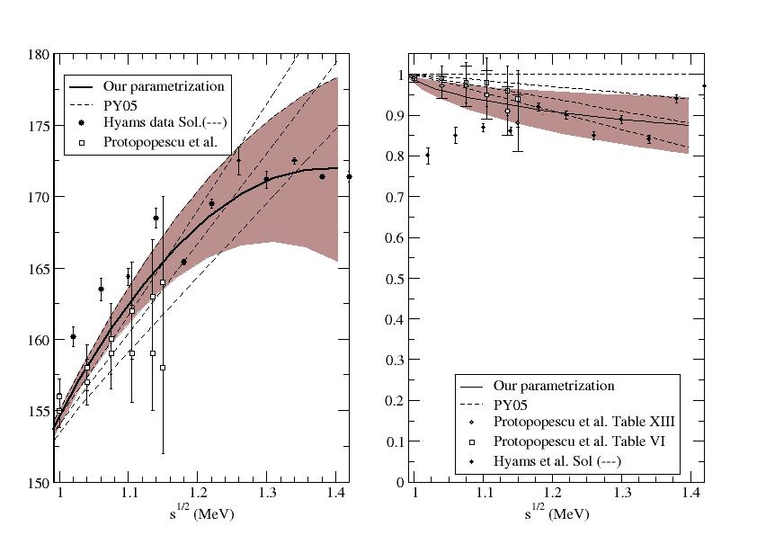
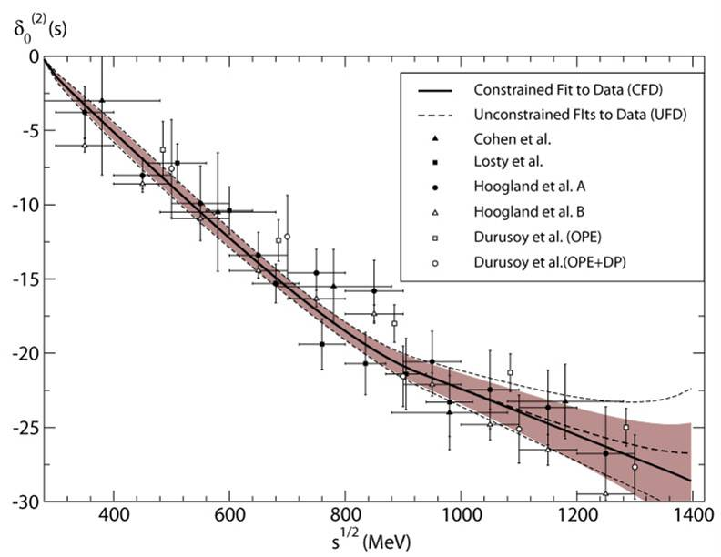
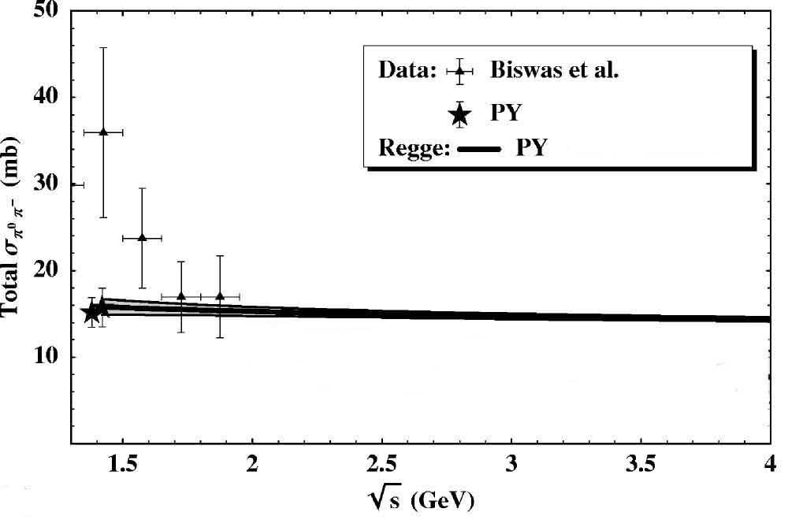
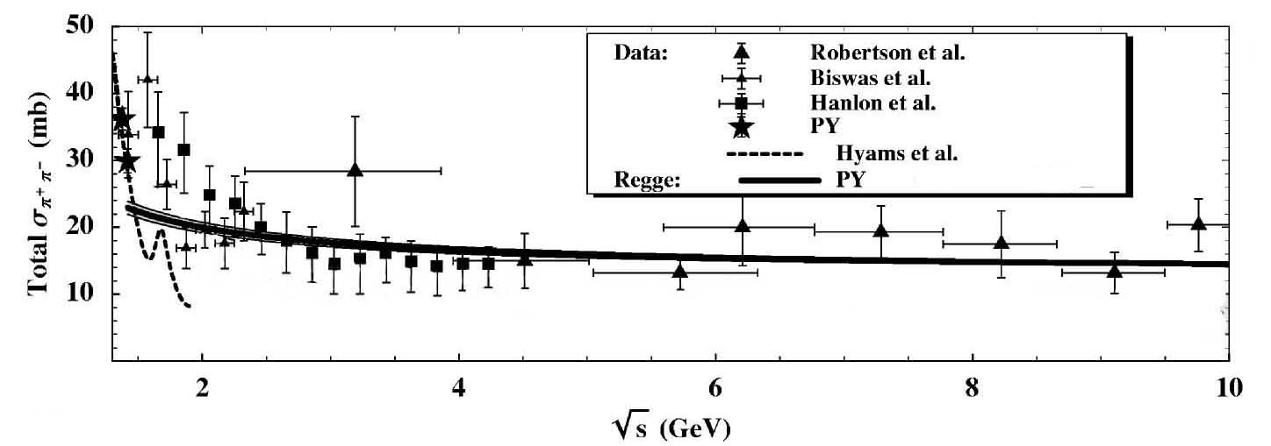
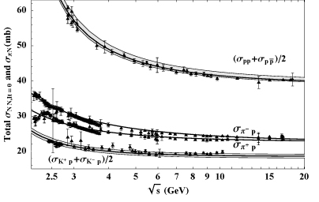
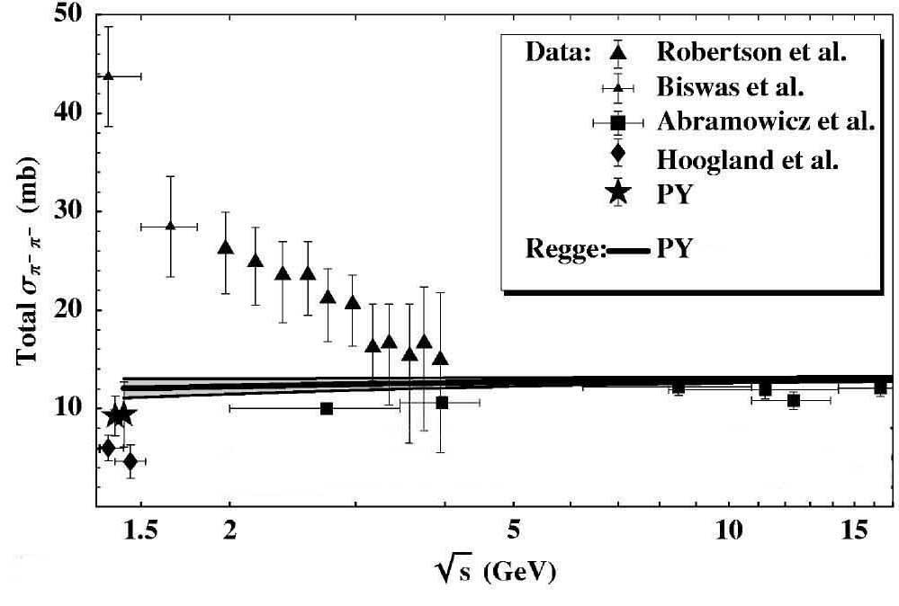
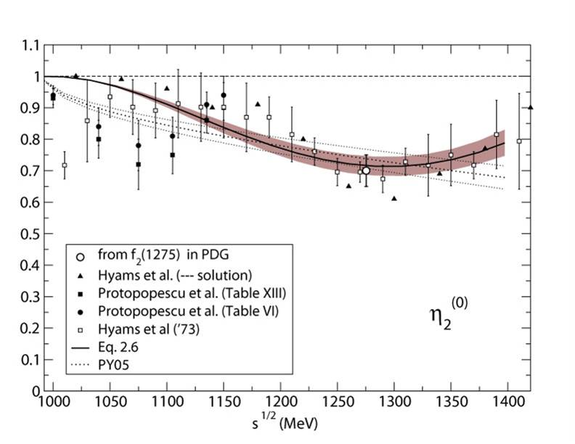
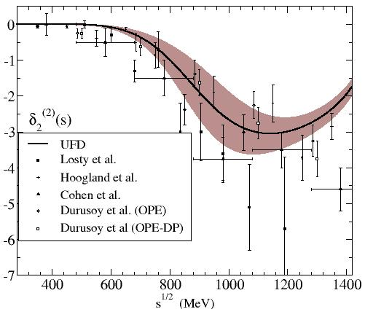
FIRST STEP: Simple Unconstrained Fits (UFD) to data
Estimation of statistical and SYSTEMATIC errors
ππ→ ππ partial-wave data
S-waves
P-waves
Regge at high energies
D-waves
F waves

Slide 23
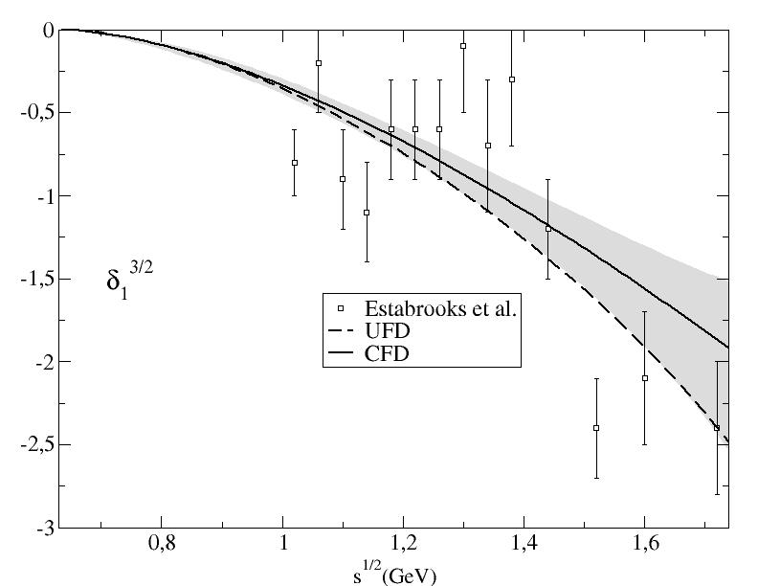
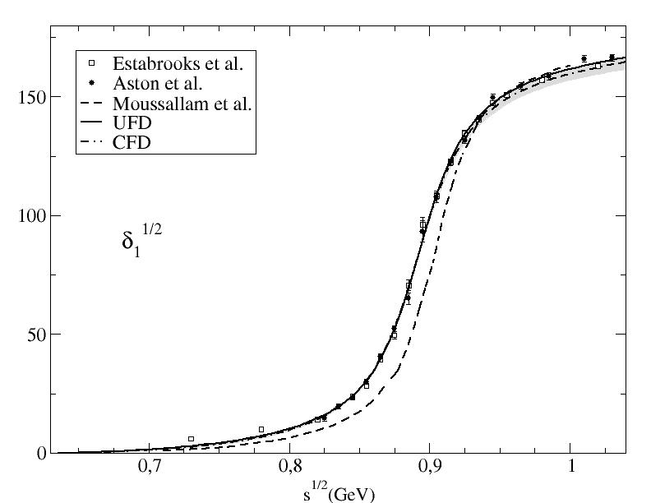
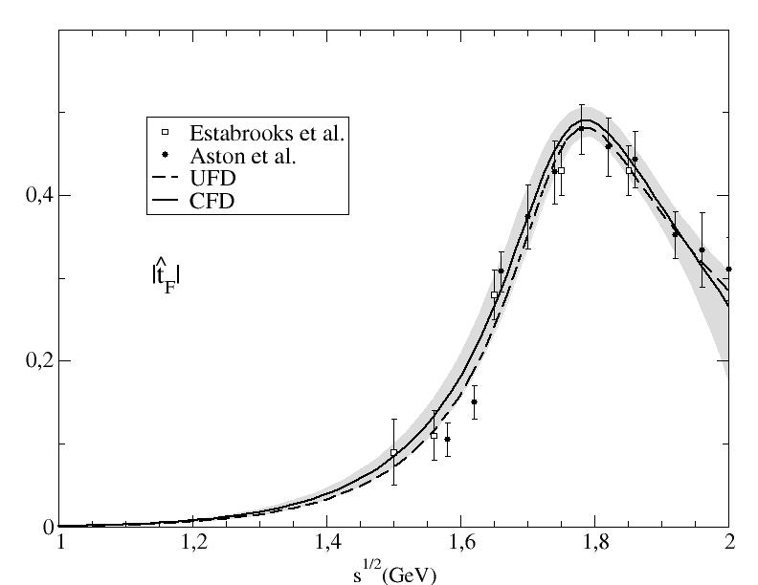
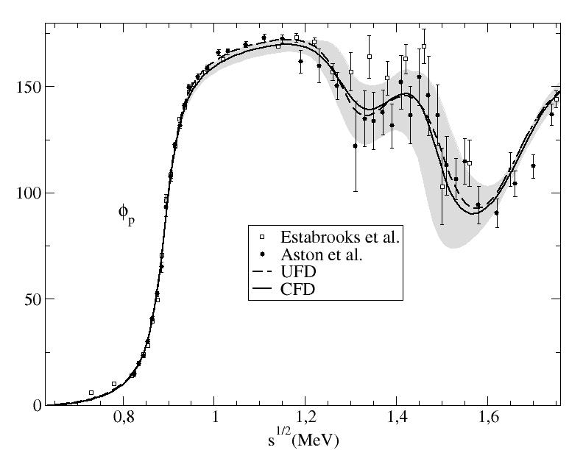
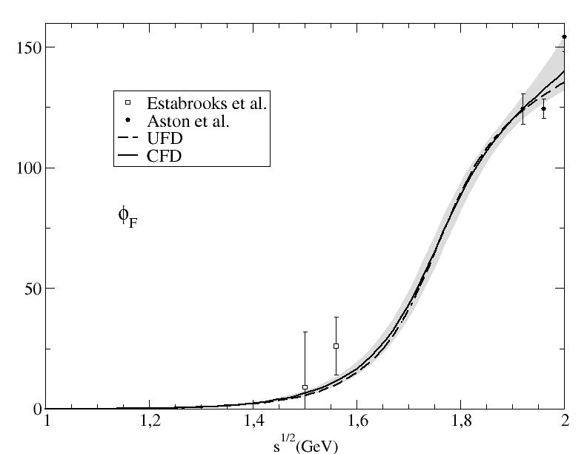
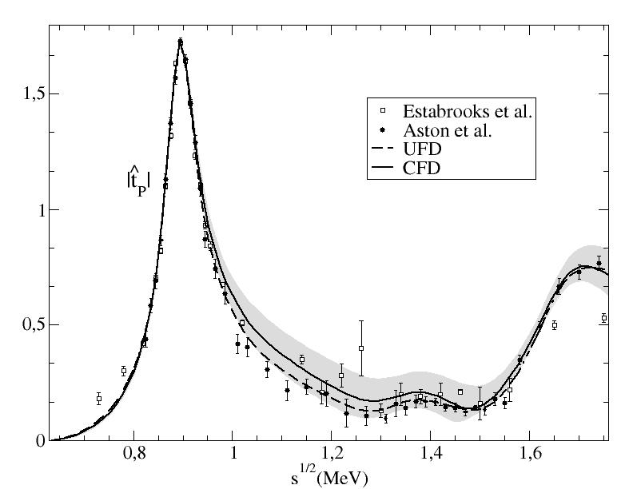
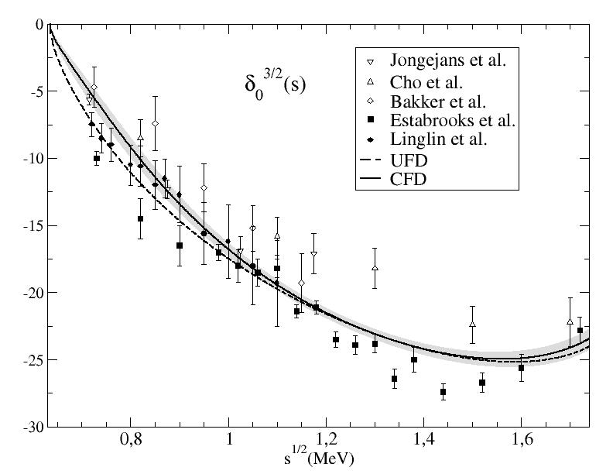
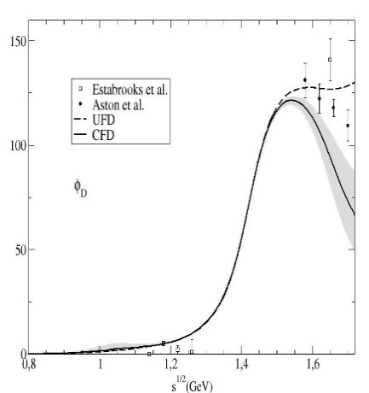
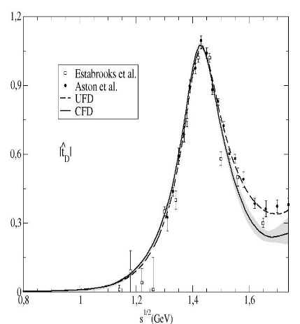
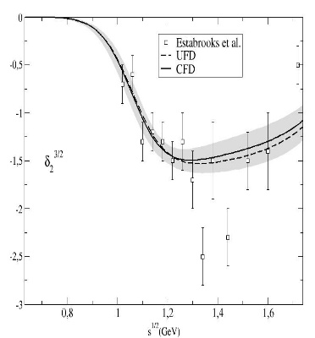
FIRST STEP: Simple Unconstrained Fits (UFD) to data
Estimation of statistical and SYSTEMATIC errors
πK and ππ→KK partial-wave Data
S-waves
P-waves
Even F-waves!!
D-waves

Slide 24
SECOND STEP: Check dispersión relations: ππ→ππ
In general, data does not satisfy well DR. Sometimes very badly indeed
FDRs
Roy
GKPY

Slide 25
THIRD STEP: Use dispersion relations as constraints for the fits: ππ→ππ
Very good fulfillment: Constrained Fits to Data
FDRs up to 1.4 GeV
Roy up to 1.1 GeV
GKPY up to 1.1 GeV

Slide 26
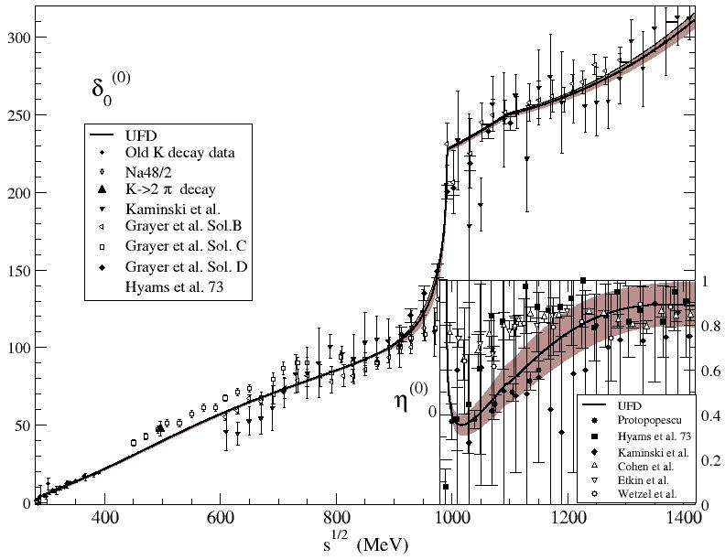
S0 wave: from UFD to CFD
The changes from Unconstrained to Constrained fits are not too large, but relevant in some regions
Only sizable change in f₀(980) region
Dip solution preferred

Slide 27
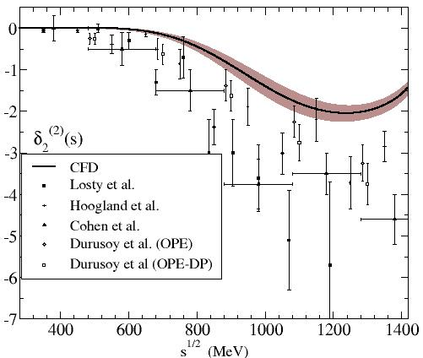
From UFD to CFD
As expected, the wave suffering the largest change is the D2
Apart from S0 and D2, changes in other waves from UFD to CFD is
imperceptible

Slide 28
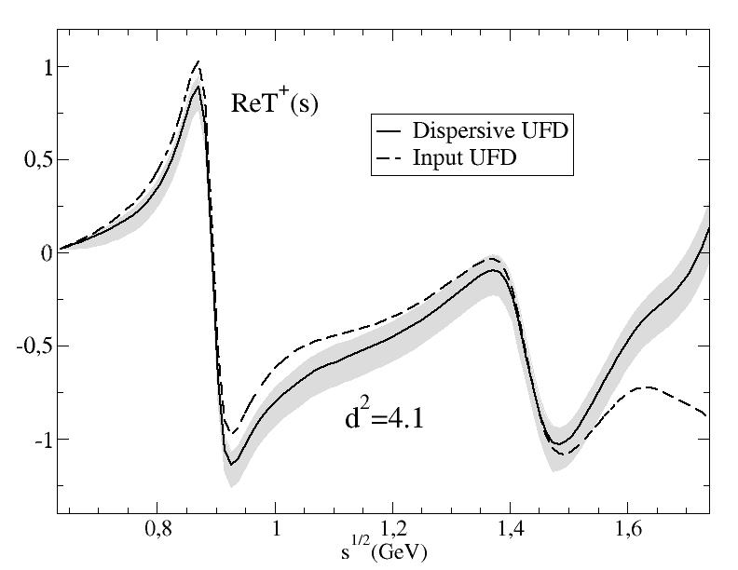
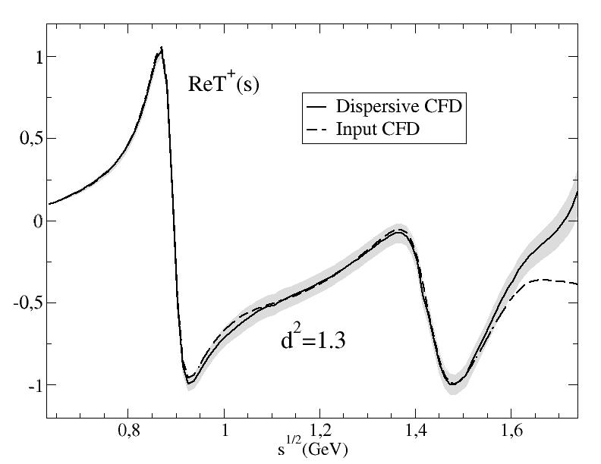
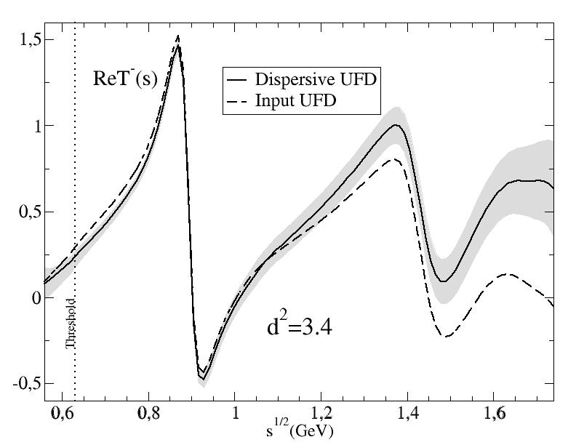
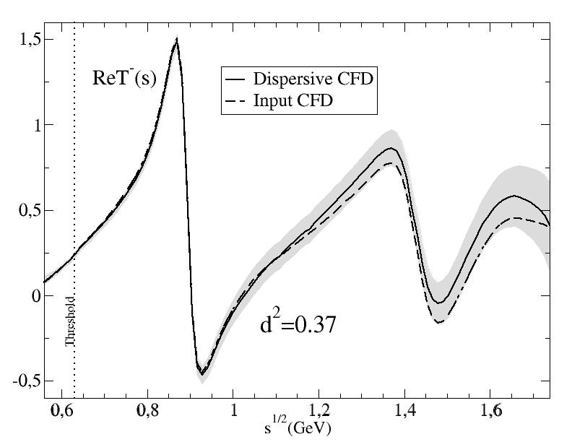
Similarly for πK→πK
In general, data does not satisfy well DR. Sometimes very badly indeed
Consistency up to 1.6 GeV!!
But we can get Constrained fits to Data (CFD)
Consistency up to 1.74 GeV!!

Slide 29
From Unconstrained (UFD) to Constrained Fits to data (CFD)
S-waves. The most interesting for the K₀* resonances
Largest changes from UFD to CFD
at higher energies

Slide 30
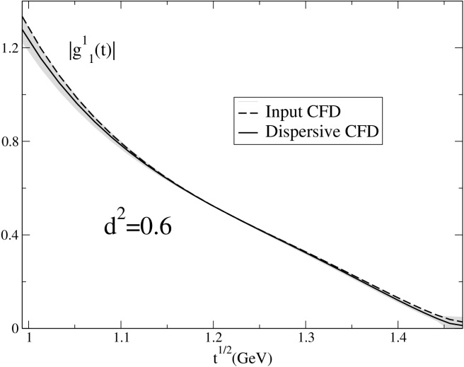
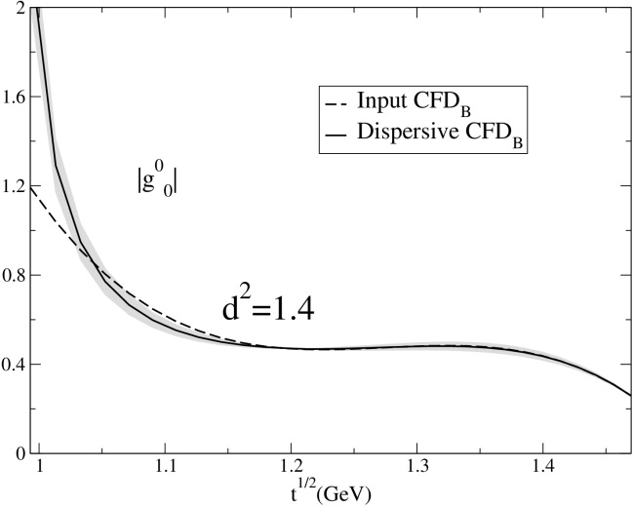
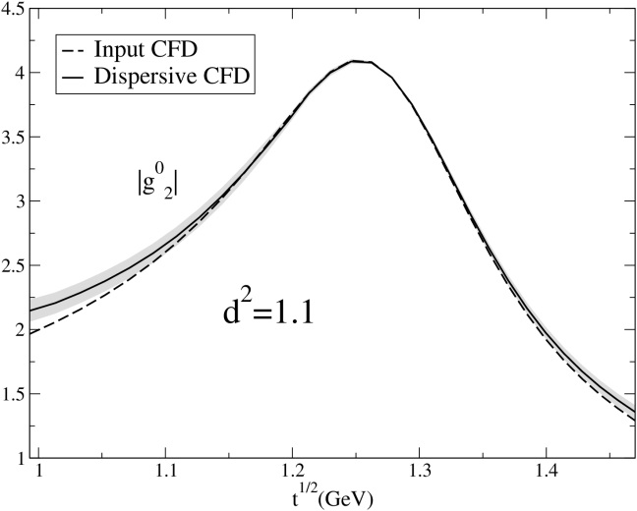
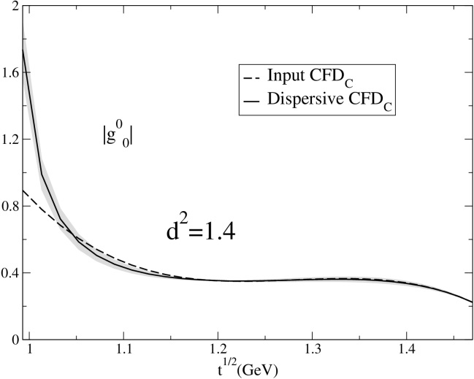
An also similarly for π π →KK
We can get Constrained fits to Data (CFD) consistent with Hyperbolic Dispersion relations
Two possible solutions for S0 wave
HDR P-wave
HDR S0-wave
HDR S0-wave
HDR D0-wave
This consistent input is needed for partial-wave πK dispersion relations

Slide 31
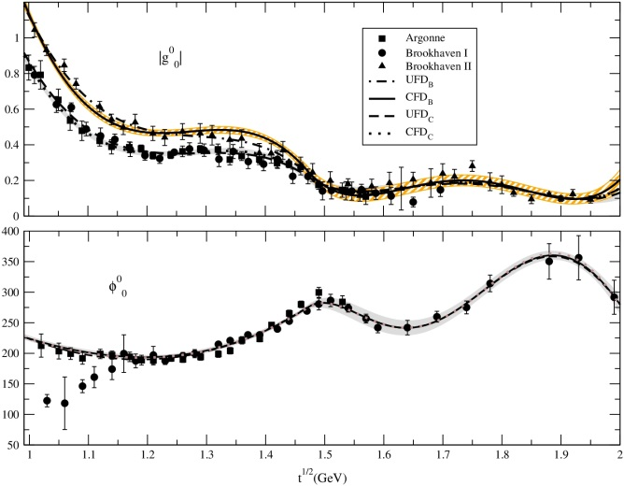
ππ→KK Hiperbolic Dispersion Relations
I=0,J=0, CFD
JRP, A.Rodas, Eur.Phys.J. C78 (2018)
Some 2-σ level differences between UFD_{B} and CFD_{B} between 1.05 and 1.45 GeV CFD_{C} consistent within 1-σ band of UFD_{C}
2-σ differences between
UFD_{B} and CFD_{B} phase
1-σ differences between
UFD and CFD phase

Slide 32
πK Hiperbolic Dispersion Relations (I,J)=(3/2,0),(1/2,1),(3/2,1)
LARGE inconsistencies IF UNCONSTRAINED
Unconstrained Fit to Data

Slide 33
πK Hiperbolic Dispersion Relations I=1/2, J=0
The most relevant wave for the kappa resonance.
LARGE inconsistencies with HDR Roy-Steiner from unconstrained fits (UFD)
One or no subtraction for F⁻ lie on opposite sides of input
Fixed-t Roy-Steiner is fair but kappa pole outside their applicability region
We have chosen the hyperbolae family so that the kappa pole
and its uncertainties lie within their applicability region

Slide 34
πK Hiperbolic Dispersion Relations I=1/2, J=0
JRP, A.Rodas, arXiv:2010.1122. To appear in Physics Reports
We provide a constrained fit to data (CFD) satisfying 16 Dispersion relations
(FDRs, fixed-t, HDR, different # subtractions)
Fairly simple and ready to use parameterizations
Recall previous plot
Our Constrained parameterization now yields consistent output
for all Dispersion Relations

Slide 35
πK Hiperbolic Dispersion Relations (I,J)=(3/2,0),(1/2,1),(3/2,1)
LARGE inconsistencies FOR THE OTHER WAVES IF UNCONSTRAINED
Made consistent within uncertainties for the CFD
Unconstrained Fit to Data
Constrained Fit to Data

Slide 36
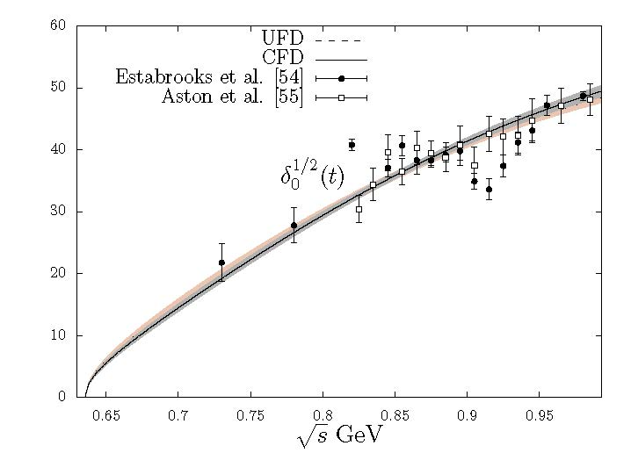
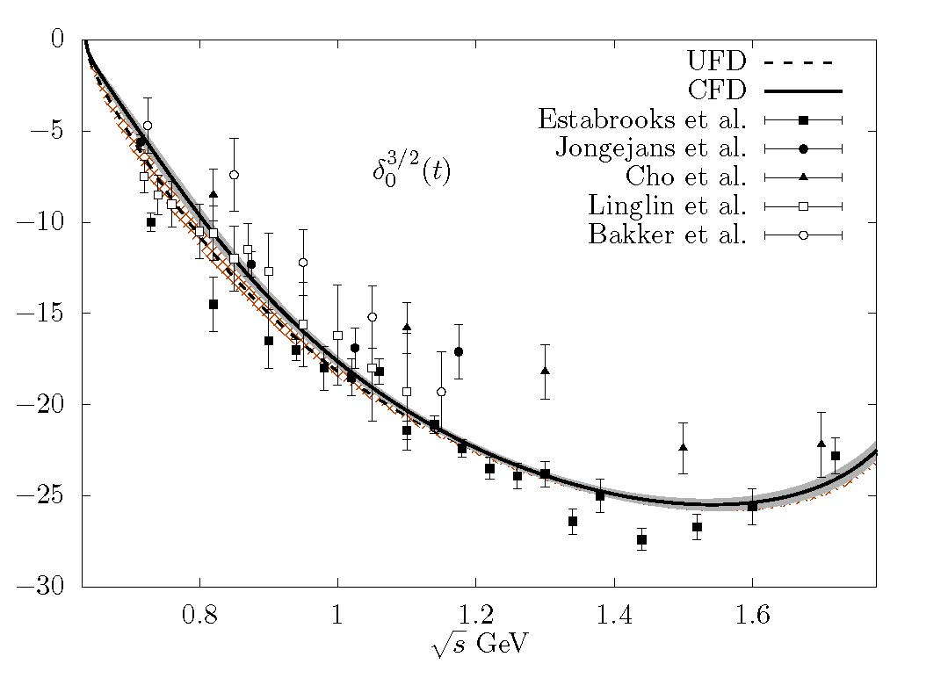
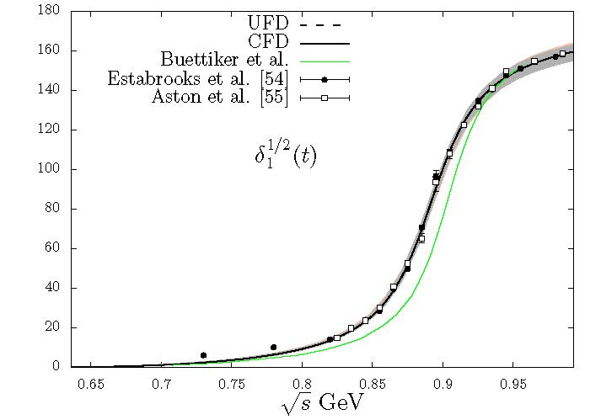
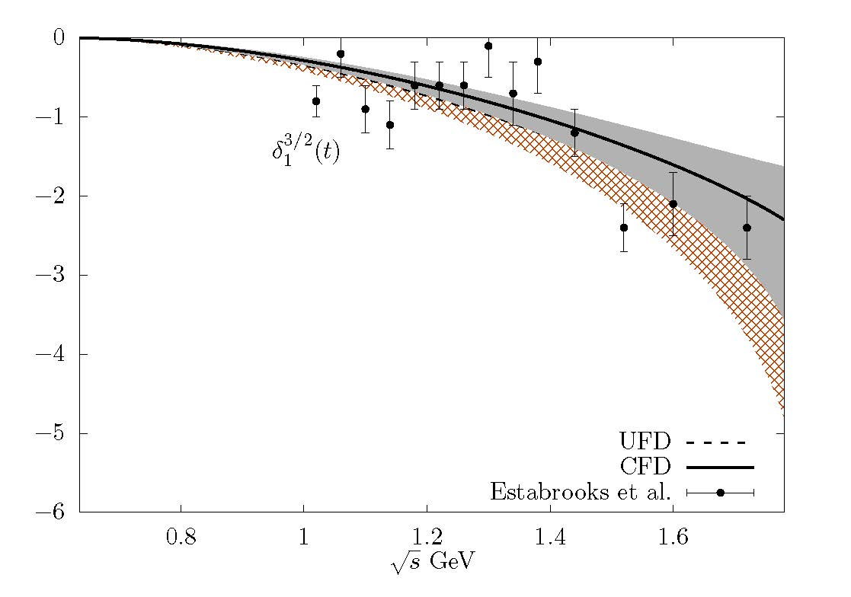
πK CFD vs. UFD
JRP, A.Rodas, arXiv:2010.1122. To appear in Physics Reports
Constrained parameterizations suffer minor changes but still describe
πK data fairly well. Here we compare the unconstrained fits (UFD) versus the constrained ones (CFD)
P-wave consistent
with scattering data

Slide 37
Analytic continuation to Contiguous (second) Riemann sheet
Dispersion relations provide model-independent analytic continuation to first Riemann sheet,
but the most relevant resonance poles live in the contiguous or second sheet
For elastic resonances, S^{II}=1/S^{I}
σ/f₀(500), κ/K₀*(700).
Purely Dispersive Determination

Slide 38
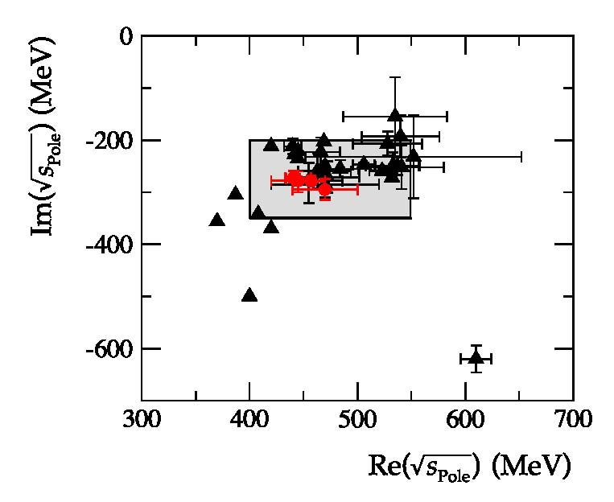
Actually, in the PDG 2017: “Note on scalars”
“One might just consider the most advanced dispersive analyses, Refs. [9–13]. They agree on a pole position close to (450−i 280) MeV.”
9. G. Colangelo, J. Gasser, and H. Leutwyler, NPB603, 125 (2001).
10. I. Caprini, G. Colangelo, and H. Leutwyler, PRL 96, 132001 (2006).
11. R. Garcia-Martin , R. Kaminski, JRP, J. Ruiz de Elvira, PRL107, 072001(2011).
12. B. Moussallam, Eur. Phys. J. C71, 1814 (2011)
13. P. Masjuan, J. Ruiz de Elvira, J.J. Sanz-Cillero, PRD90, 097901 (2014).
.
Combining conservatively statistical and systematic uncertainties I estimate:
${ (449}_{−16}^{+22}$)-i(275±12) MeV
JRP, Physics Reports 658-2016-1

Slide 39
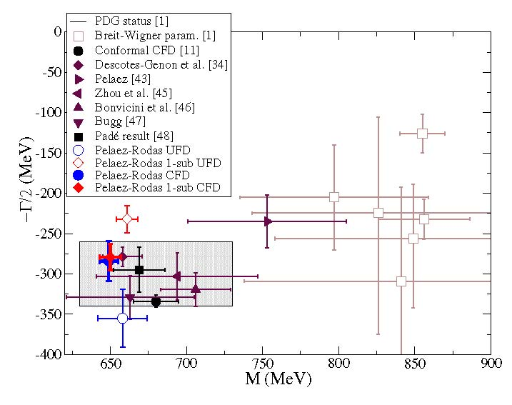
Dispersive pole analysis from constrained fit to data
JRP, A.Rodas. Physical Review Letters 124,172001 (2020)
When using the constrained fit to data the $K_{0}^{∗}$(700) poles come out nicely compatible
No sub: (648±6)-i(283±26) MeV
1 sub: (648±7)-i(280±16) MeV
Compatible with Paris group
Decotes-Genon-Moussallam 2006
(658±13)-i(278.5±12) MeV
And with our previous
“Pade sequence”
determination
(670±18)-i(295±28) MeV
JRP, A. Rodas. J. Ruiz de Elvira, Eur.Phys.J. C77 (2017)
We also provide pole positions for the $K^{∗}(892)$,

Slide 40
Analytic continuation to Contiguous (second) Riemann sheet
Dispersion relations provide model-independent analytic continuation to first Riemann sheet,
but the most relevant resonance poles live in the contiguous or second sheet
For elastic resonances, S^{II}=1/S^{I}
σ/f₀(500), κ/K₀*(700).
Purely Dispersive Determination
To reach the contiguous sheet in the inelastic case, we need an analytic continuation to the second sheet by means of general analytic functions reproducing the Dispersion Relation on the real axis or the upper-half complex plane.
Several methods in the literature: we use
Sequences of Padés
Continued Fractions
Both methods avoid specific parameterizations, have convergence theorems, etc…
We have tested then with the sigma and kappa

Slide 41
Strange resonance poles from CFD: Using Padé sequences JRP, A.Rodas & J. Ruiz de Elvira. Eur. Phys. J. C (2017)
Almost model independent: Does not assume any particular functional form
(but local determination)
Based on previous works by P.Masjuan, J.J. Sanz Cillero, I. Caprini, J.Ruiz de ELvira

Slide 42
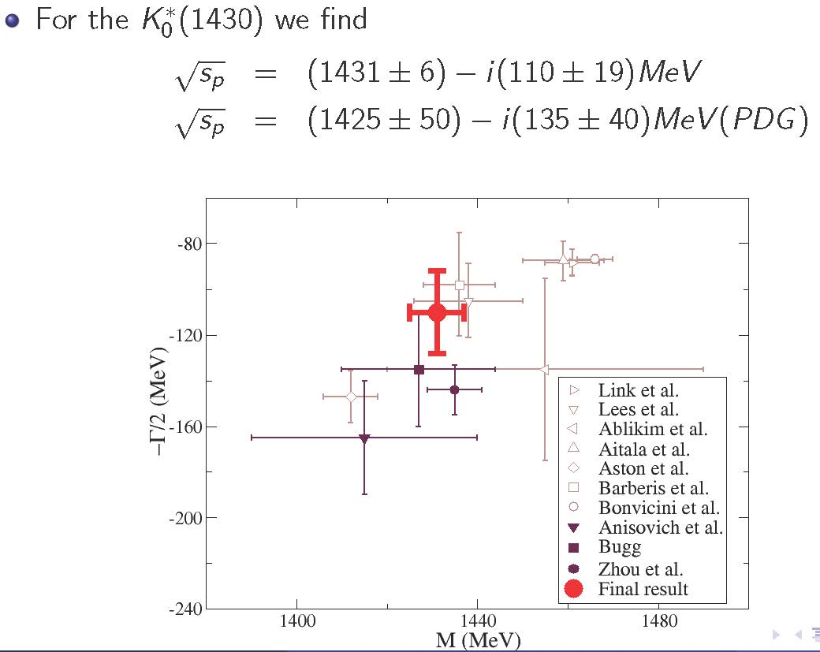
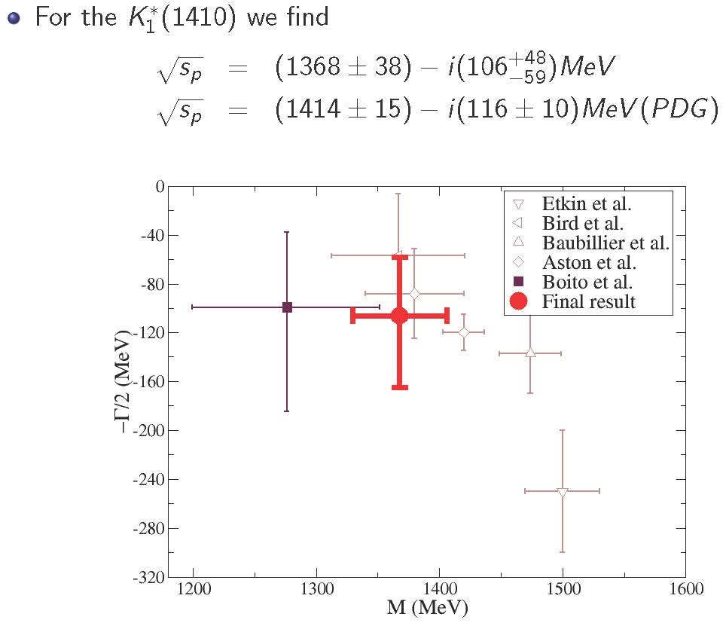
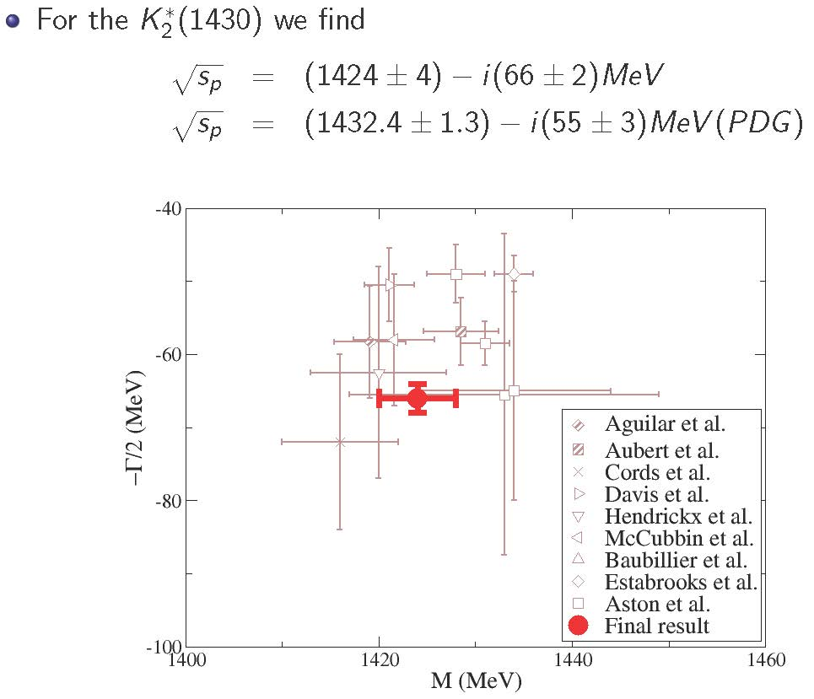
Strange resonance poles from CFD: Using Padé sequences JRP, A.Rodas & J. Ruiz de Elvira. Eur. Phys. J. C (2017)
The method can be used for inelastic resonances too. Provides resonance parameters WITHOUT ASSUMING SPECIFIC FUNCTIONAL FORM
Using Padé Sequences, the kappa:
JRP, A.Rodas & J. Ruiz de Elvira. Eur. Phys. J. C (2017) 77:91
(670±18)-i(295± 28) MeV Consistent with dispersive value

Slide 43
Continued fractions
We now use:
Once again no specific simple functional form assumed
More stable and accurate than Padés, since no derivatives needed.
Typically 50 terms
When Padé sequences converge, perfect agreement
Actually, could be rewritten as a Padé

Slide 44
Pole from ππ→ ππ
Roy equations applicability proof only up to 1.1 GeV. (But see later)
However, Forward Dispersion Relations applicability up to 1.42 GeV in our fits.
Complication, we see the isoscalar-wave with all spins
NEW!
Real axis and data
f₂(1270)
f₀(1370) seen behind
Thus, with just a few derivatives on the real axis, the Padé method does
not converge well behind the f₂(1270).
But continued fractions provide nice and stable pole description

Slide 45
PRELIMINARY results for f0(1370)
JRP A.Rodas, J.Ruiz de Elvira. In preparation
We use both continuation methods
Pade Sequences P
Continued fractions C
We use two inputs
Piece-wise Constrained fit to data (CFD)
Global analytic parameterization
Even though there is no proof for
Convergence of Roy Eqs. Above 1.1 GeV,
If we still use them: PERFECT CONSISTENCY
If you want a simple analytic form
consistent with data up to 2 GeV,
Dispersion Relations up to 1.42 GeV and
Roy eqs. applicability region in the complex plane
as well as the dispersive σ/f₀(500) f₀(980) and this f₀(1370), use our the “Global fit”
JRP A.Rodas, J.Ruiz de Elvira.Eur Phys.J. C79 (2019) no.12, 1008.

Slide 46
PRELIMINARY results for the f₀(1370)
PRELIMINARY
Final numbers and preprint soon.

Slide 47
Our series of works: Dispersive and analytic methods for scattering and resonances
ππ→ππ, σ/f₀(500), f₀(980) and f₀(1370)
JRP ,F.J. Ynduráin. PRD71, 074016 (2005) , PRD69,114001 (2004),
R. Kaminski, JRP, F.J. Ynduráin Eur.Phys.J.A31:479-484,2007. PRD74:014001,2006
R. García Martín, R. Kaminski, JRP, J. Ruiz de Elvira, F.J. Ynduráin, Phys.Rev. D83 (2011) 074004,
R. García Martín, R. Kaminski, JRP, J. Ruiz de Elvira ,Phys.Rev.Lett. 107 (2011) 072001
JRP, Physics Reports 658 (2016) 1 -111
JRP A.Rodas, J.Ruiz de Elvira.Eur Phys.J. C79 (2019) no.12, 1008.
JRP A.Rodas, J.Ruiz de Elvira. 2021 In preparation.
Fits to data and Regge. FDRs and sum rules
FDRs and Roy Eqs. Above 1 GeV
FDRs, Roy and GKPY dispersion relations
The dispersive sigma
Review on sigma. Sections on disp. rel.
Global analytic parameterization. Also up to 2 GeV
f0(1370) with FDR and analytic methods
πK→πK, ππ →KK, κ/$K_{0}^{∗}$(700) and strange resonances
JRP, A.Rodas. Phys. Rev. D 93, 074025 (2016)
JRP, A.Rodas, J.Ruiz de Elvira. Eur. Phys. J. C (2017) 77: 91
JRP A.Rodas, J.Ruiz de Elvira. Eur.Phys.J. C78(2018) no.11, 897
JRP, A.Rodas. Physical Review Letters 124,172001 (2020)
JRP, A.Rodas. To appear in Phys. Rept.
JRP A.Rodas, J.Ruiz de Elvira. Eur. Phys. J. Spec. Top. (2021) 230:1539–1574
Fits and FDR
Kappa and Strange resonances from analytic methods
Roy Steiner equations for ππ →KK
Kappa dispersive
Review: Roy Steiner for πK→πK, ππ →KK,
kappa and strange resonances Threshold parameters
Review:
Dispersion relations vs.unitarized ChPT for sigma and kappa
We follow a relatively similar pattern for all processes

Slide 48
Summary
Light scalars are not clear cut peaks. Simple models may fail at basic requirements.
Their rigorous description is in terms of poles (and is being adopted by the RPP)
Dispersion relations provide stringent model-independent constraints on meson-meson scattering
and rigorous continuations to the complex plane
Unconstrained Fits to Data fail to satisfy these constraints, but we have provided simple an ready-to-use constrained parameterizations, which still describe data fairly reasonably.
Elastic resonances like the sigma and kappa have been determined accurately purely from data driven dispersion relations.
In the inelastic regime Access to the contiguous sheet requires analytic continuation methods. These provide model independent determinations of other resonances from the output of dispersion relations in the physical axis.

