Slide 1
Discussion session on heavy quarks and heavy quarkonia: pp
How can we make reliable theory to data comparisons and LDME determinations in NRQCD?
How can the accuracy of non-perturbative methods in hadron physics be improved?
Can the theoretical uncertainties be decreased?
Can the difficulties with including NLO and higher order corrections be solved?
How can we understand the difference between the LHCb and SELEX results
on the mass of the only observed doubly charmed baryon, the Ξ_{cc} ?
What are the nature, structure and quantum numbers of the tetraquarks observed by LHCb?
Do some tetraquarks candidate, like the X(5568), really exist?
What is the nature of X(6900) and how to determine its quantum numbers?
How can we decide between the compact multiquark and the hadron molecule XYZ models?
Why is it that LHCb reported no mass hypothesis in the range [17.5, 20.0] GeV in the Yμμ invariant mass distribution, corresponding to T_{bb bb} ?
⁺⁺
_
_

Slide 2
Discussion session on heavy quarks and heavy quarkonia: HI
What is the key evidence for melting of quarkonia at high temperature from lattice QCD?
How reliable are the Bayesian methods for the spectral function reconstruction at high T,
given that the temporal extent is small?
Are the quarkonium correlators at T>0 consistent
between lattice and the potential model with color screening?
Can non-equilibrium dynamics effects be included in studies of in-medium bottomonia,
particularly at early times and in dilute regions of the QGP?
Will future data on bottomonium elliptic flow be precise enough to constrain models?
We need higher precision on R_{AA} of the excited states; can the lessons learned in the bottomonium system be extended to charmonia?
The solution of the Lindblad equation for the reduced density matrix is numerically expensive even when using the quantum trajectories approach. Could an expansion in the number of quantum jumps reduce the numerical complexity?

Slide 3
Theory - data comparison and LDME determinations in NRQCD (1)
It is crucial to do a reliable treatment of experimental uncertainties and their correlations
Statistical uncertainties are the only ones always independent from measurement to measurement and from bin to bin of a measured kinematic spectrum;
systematic uncertainties are often, at least in part, correlated from bin to bin of the same measurement and sometimes even between different measurements;
for example: luminosity uncertainties in the cross sections of the different quarkonia, branching fractions, etc.
A crucial source of correlation between all the points of a measured p_{T} distribution is the dependence of the detection acceptances on the assumed polarization;
this effect has always been neglected in theoretical analyses using data as inputs, but it can have very large effects on the results

Slide 4
Assumed polarizations affect measured cross sections
The χ_{c2} to χ_{c1} cross section ratio measured by several experiments provides a good example of the crucial importance of the polarization scenario assumed in the evaluation of the acceptance corrections.
Very different patterns and levels of agreement among data sets are seen for acceptance corrections reflecting two polarization hypotheses: spin alignments J_{z}(χ_{c1}) = ±1, J_{z}(χ_{c2}) = ±2 and J_{z}(χ_{c1}) = J_{z}(χ_{c2}) = 0. The “default” unpolarized hypothesis leads to intermediate values.
P. Faccioli et al.
EPJC 78 (2018) 268
P. Faccioli et al.
EPJC 80 (2020) 623
pp, 7 TeV

Slide 5
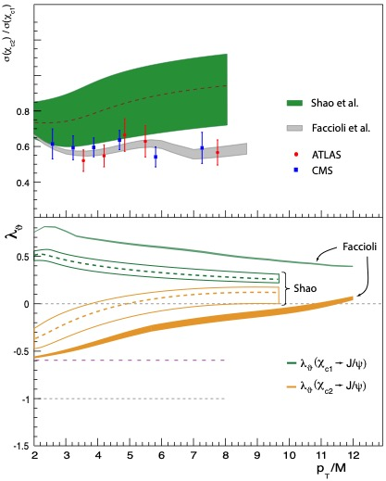
Comparison between two predictions
In NRQCD, one single parameter determines both
the χ_{c2} / χ_{c1} ratio and the two polarizations
$$r ≡{ m}_{c}^{2} \left\langle 𝒪^{χ_{c0}}(^{3}S_{1}^{\left[8\right]})\right\rangle \left\langle 𝒪^{χ_{c0}}(^{3}P_{0}^{[1]})\right\rangle$$
Faccioli et al. derive r = 0.217 ± 0.003
from CMS + ATLAS data (averaged)
with acceptance corrections corresponding
to the final polarization prediction
Shao et al. derive r = 0.27 ± 0.06 from CDF or CMS data with a wrong procedure:
= no correlated variations considered
= polarization uncertainty from maximum range
of correlated variations of λ_{θ}(χ_{c1}) and λ_{θ}(χ_{c2})
It is crucial to rigorously account for the correlations between the cross sections and the polarizations and for the uncertainties
The cross sections depend on the polarization but that is not an experimental uncertainty

Slide 6
Theory - data comparison and LDME determinations in NRQCD (2)
Also the treatment of theoretical uncertainties is a common problem
Most analyses do not use theoretical uncertainties within the fit, but only as a posteriori scale-variation bands overlapped on the best-fit curve; this procedure is wrong:
it completely invalidates goodness of fit evaluations
it prevents the model to really fit the data within the limits of the theory uncertainty
the fit result might be biased and the “a posteriori uncertainty band” will hide the bias
the lack of a low-p_{T} turn-down in NLO SDC calculations is an example of a missing uncertainty, not accounted for by scale variations
Even if it is difficult to evaluate theoretical uncertainties, one should study in detail the limitations of the calculations before imposing them as fit model of the data

Slide 7
A pedagogical look at past fits
An example of a fit that leads to the prediction of transverse polarization at high p_{T}
The poor fit quality was hidden by the a posteriori
theory uncertainty band (from scale variations)
octet ¹S₀
This is not a fit uncertainty band !
octet ³S₁
total
octet ³P_{J}
singlet ³S₁
The free parameters of the fit are the normalizations (LDMEs) of the ¹S₀, ³S₁ and ³P_{J}
colour-octet terms
J/ψ
The fit starts at p_{T} = 3 GeV
SDC functions at NLO by
M. Butenschön and B. Kniehl

Slide 8
The low-p_{T} SDC problem
The SDCs used in most theory-driven analyses of the data are not valid in the low p_{T} region.
Fitting data with a wrong fit model necessarily leads to wrong fit results, such as
“the quarkonium polarization puzzle”.
H. Han et al.
PRD 94 (2016) 014028
Conclusion:
the transverse polarization expectation is not a “first principles NRQCD prediction” but rather the result of fits biased by the inclusion of too-low p_{T} data

