Slide 1




Future Compact star observations that could confirm the existence of a Critical End Point in the QCD phase diagram
David E. Álvarez Castillo
Joint Institute for Nuclear Research
Dubna, Russia
&
Institute of Nuclear Physics PAS
Cracow, Poland
Workshop on High Energy Physics
“Hot problems of Strong Interactions”
November 10 2020

Slide 2
Outline
A brief introduction to the neutron star matter equation of state (EoS), its location within the QCD phase diagram and related compact star properties.
The mass twins compact stars scenario and the possibility of probing deconfined quark matter.
Multi-messenger astronomy measurements that could prove the mass twins hypothesis.
Bayesian analyses for model parameter estimation and statistical inference.

Slide 3
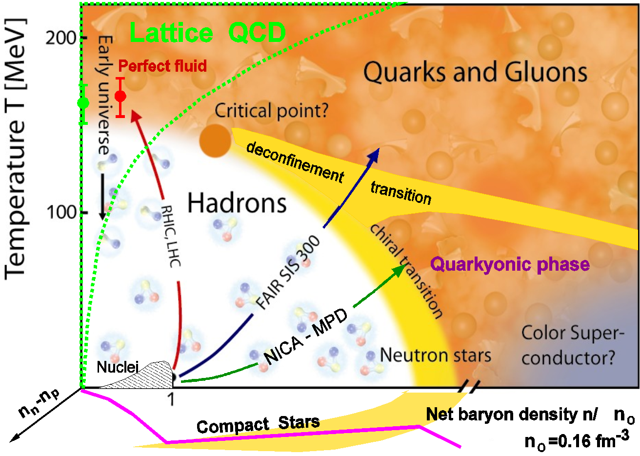
Critical Endpoint in QCD

Slide 4
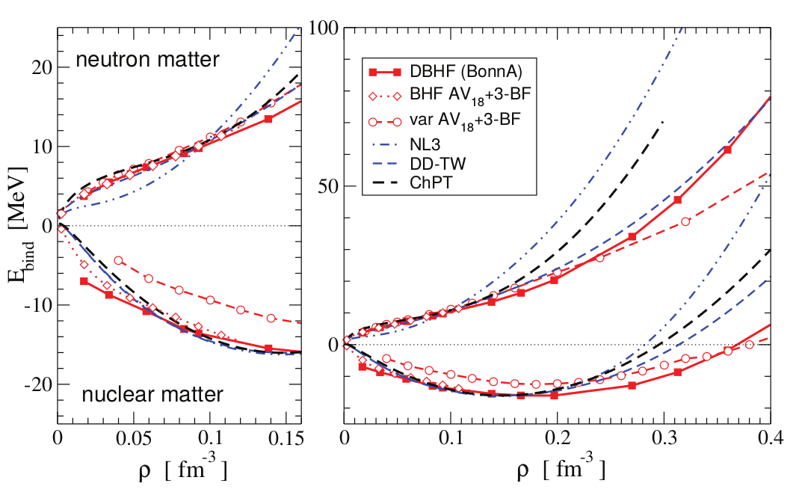
Nuclear Matter
C. Fuchs, H.H. Wolter, EPJA 30(2006)5

Slide 5
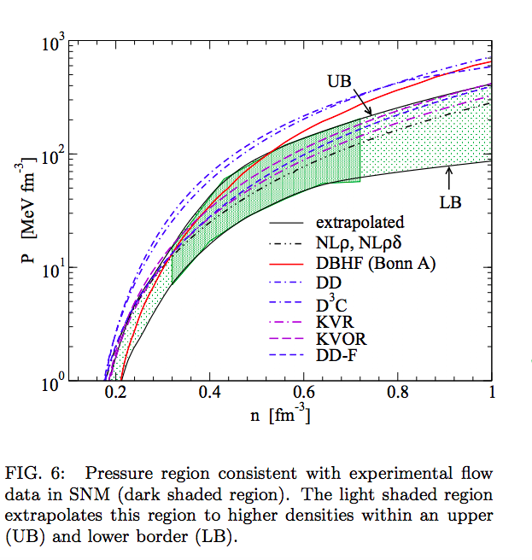
Flow Constraint
Klaehn et al. PhysRev C74 (2006)
P. Danielewicz, R. Lacey and W.G. Lynch, Science 298, 1592 (2002)

Slide 6
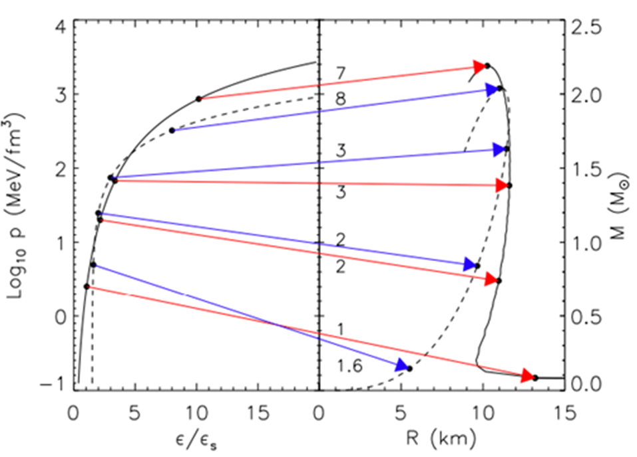
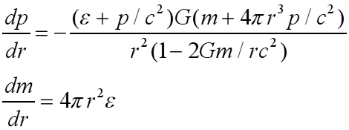

Compact Star Sequences
(M-R ⇔ EoS)
Lattimer,
Annu. Rev. Nucl. Part. Sci. 62, 485 (2012)
arXiv: 1305.3510
TOV Equations
Equation of State (EoS)

Slide 7
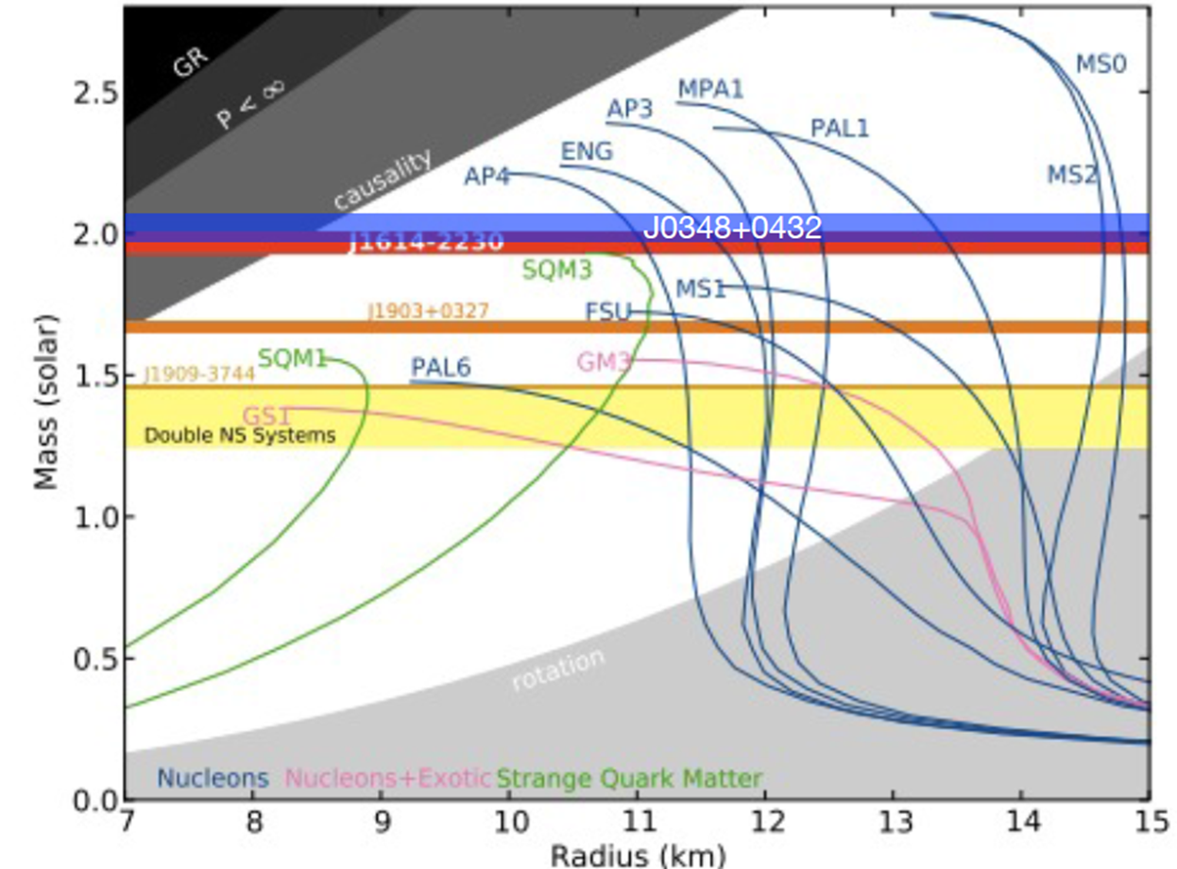
Massive Neutron Stars
PSR J0740+6620: M=2.17(+0.11, -0.10) Msun, at 68.3% credibility

Slide 8
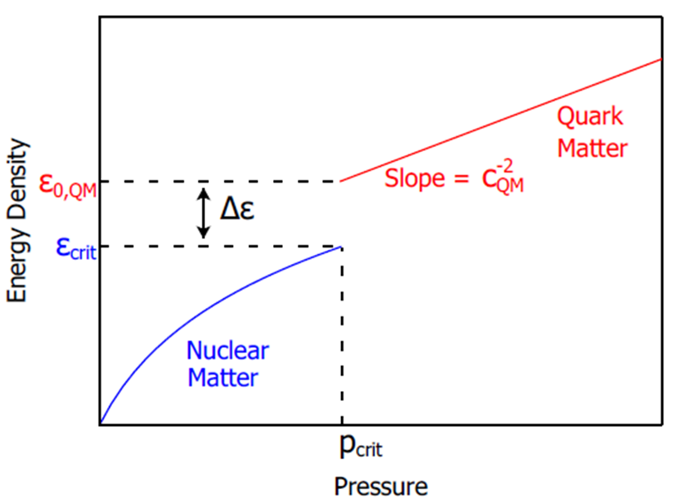
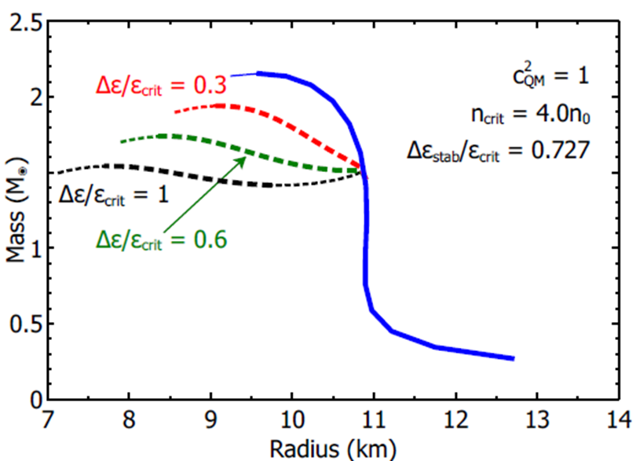
Compact Star Mass Twins and the AHP scheme
First order PT can lead to a stable branch of hybrid stars with quark matter cores which, depending on the size of the “latent heat” (jump in energy density), can even be disconnected from the hadronic one by an unstable branch → “third family of CS”.
Measuring two disconnected populations of compact stars in the M-R diagram would represent the detection of a first order phase transition in compact star matter and thus the indirect proof for the existence of a critical endpoint (CEP) in the QCD phase diagram!
Alford, Han, Prakash,
Phys. Rev. D 88, 083013 (2013)
arxiv:1302.4732

Slide 9
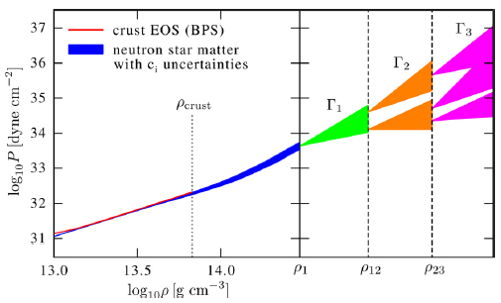

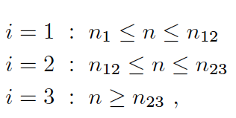

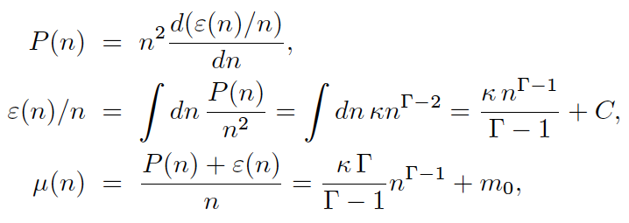
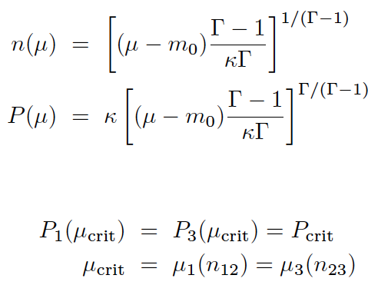

Piecewise polytrope EoS
Hebeler et al., ApJ 773, 11 (2013)
Here, 1st order PT in region 2:
Maxwell construction:
Seidov criterion for instability:

Slide 10
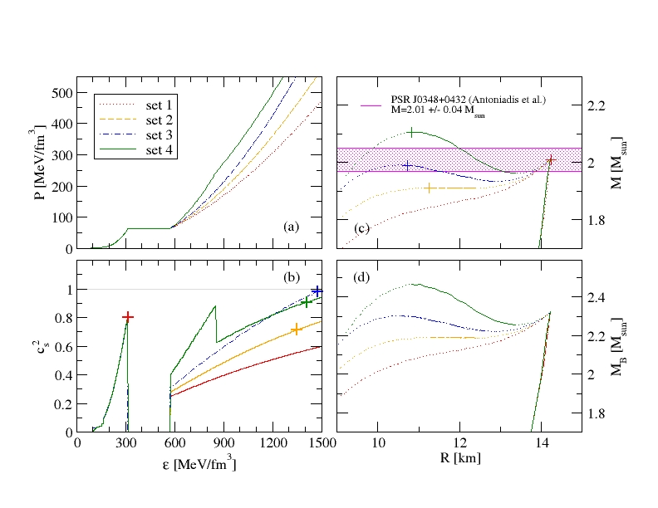
Compact Star Twins
Alvarez-Castillo, Blaschke (2017)
High mass twins from multi-polytrope equations of state
arXiv: 1703.02681v2, Phys. Rev. C 96, 045809 (2017)

Slide 11
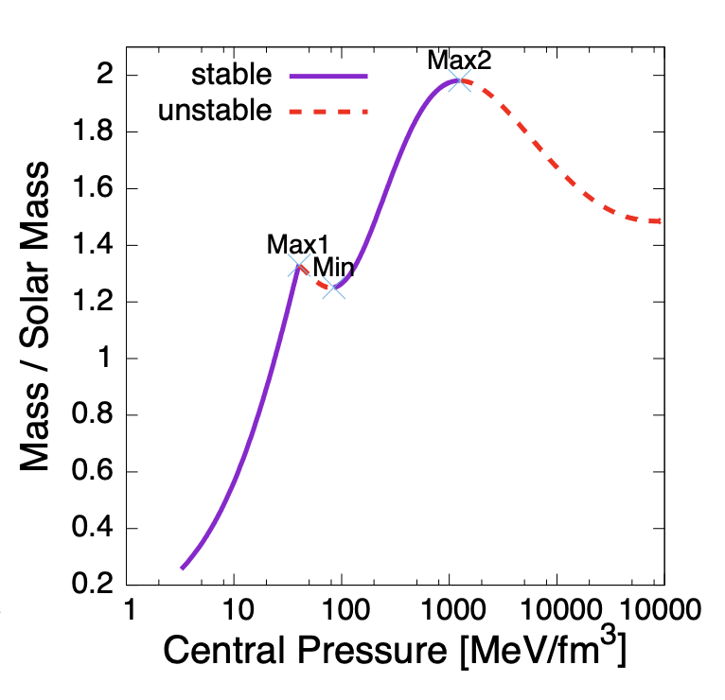
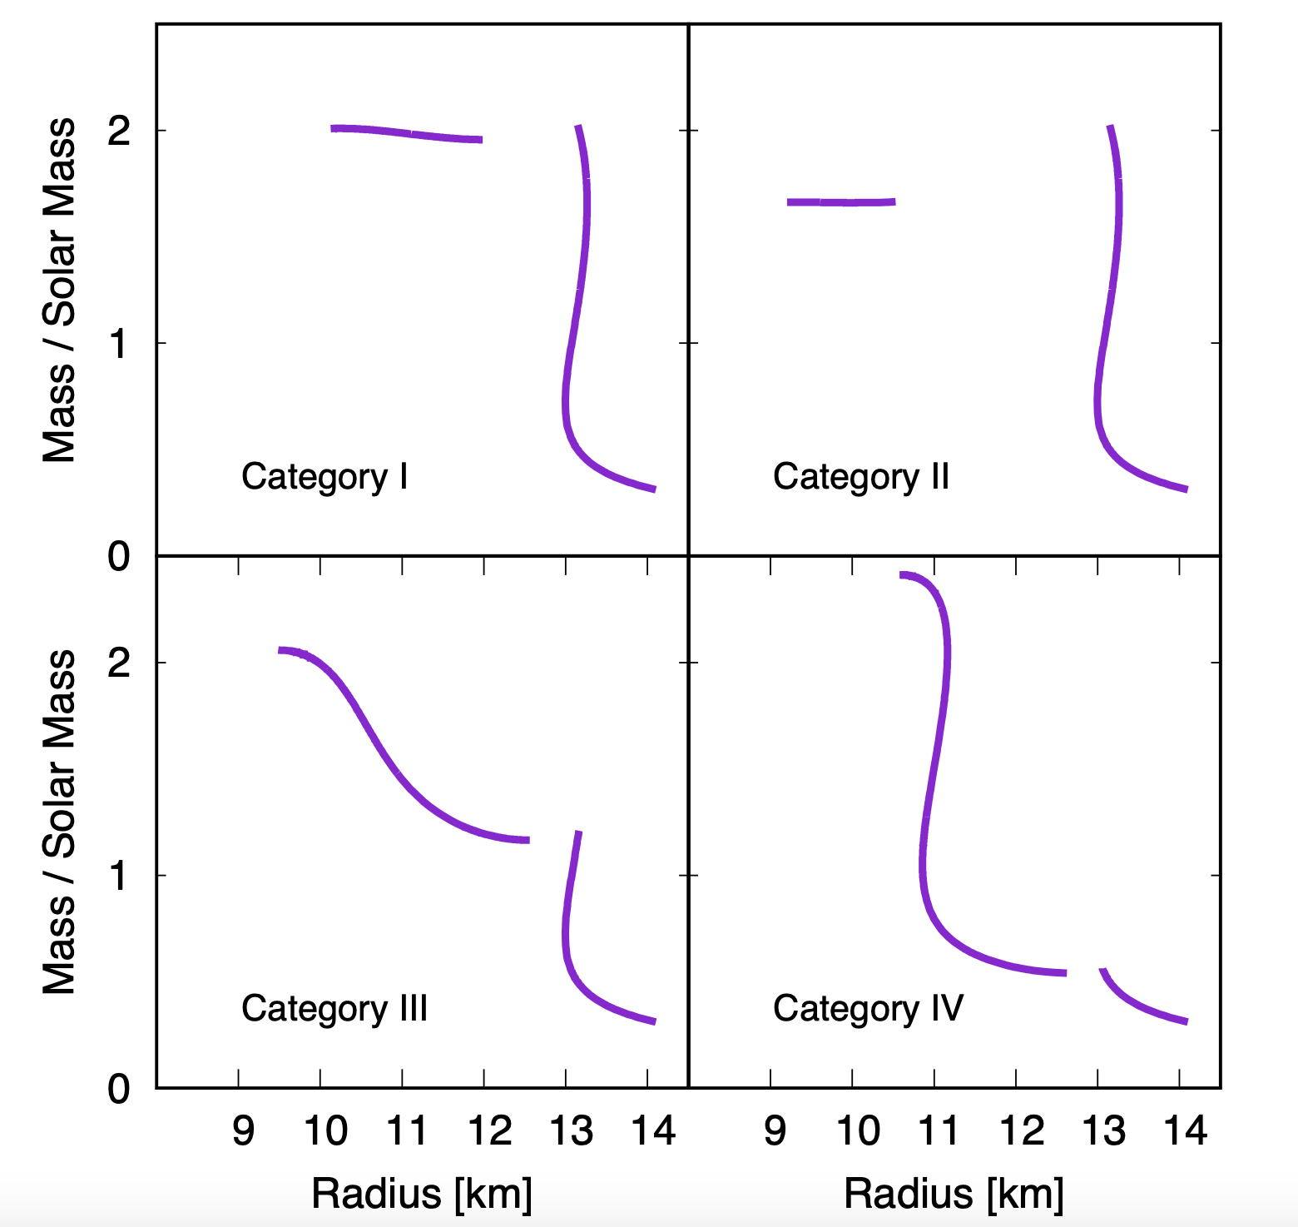
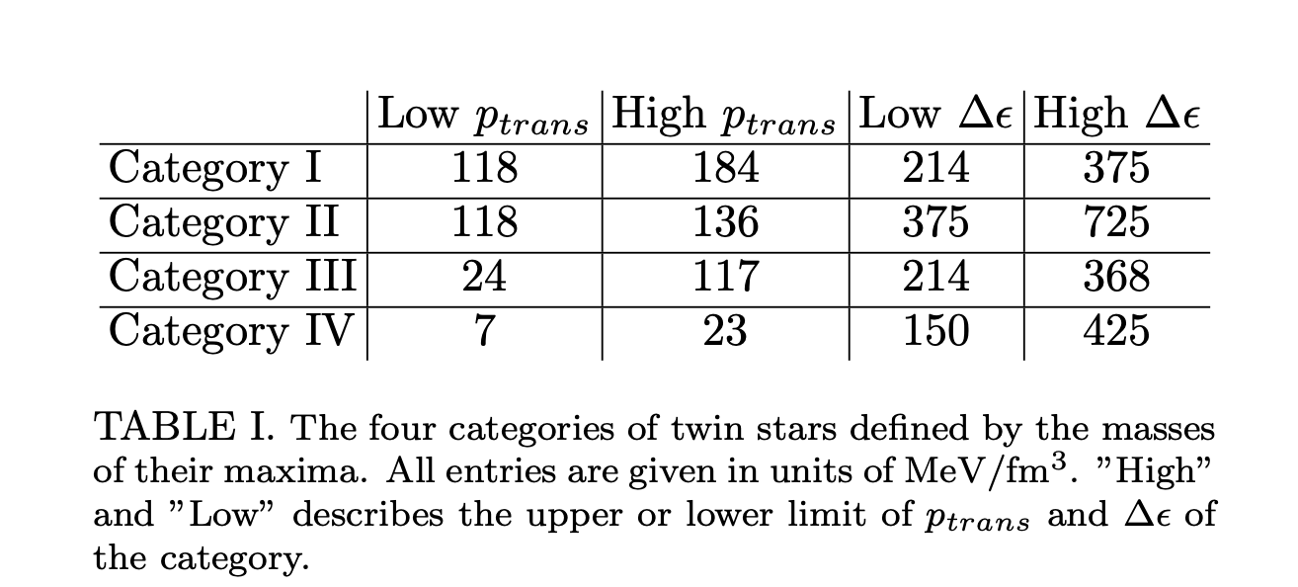
Classification
Christian, J., Zacchi, A. & Schaffner-Bielich, J.
Eur. Phys. J. A 54, 28 (2018).

Slide 12
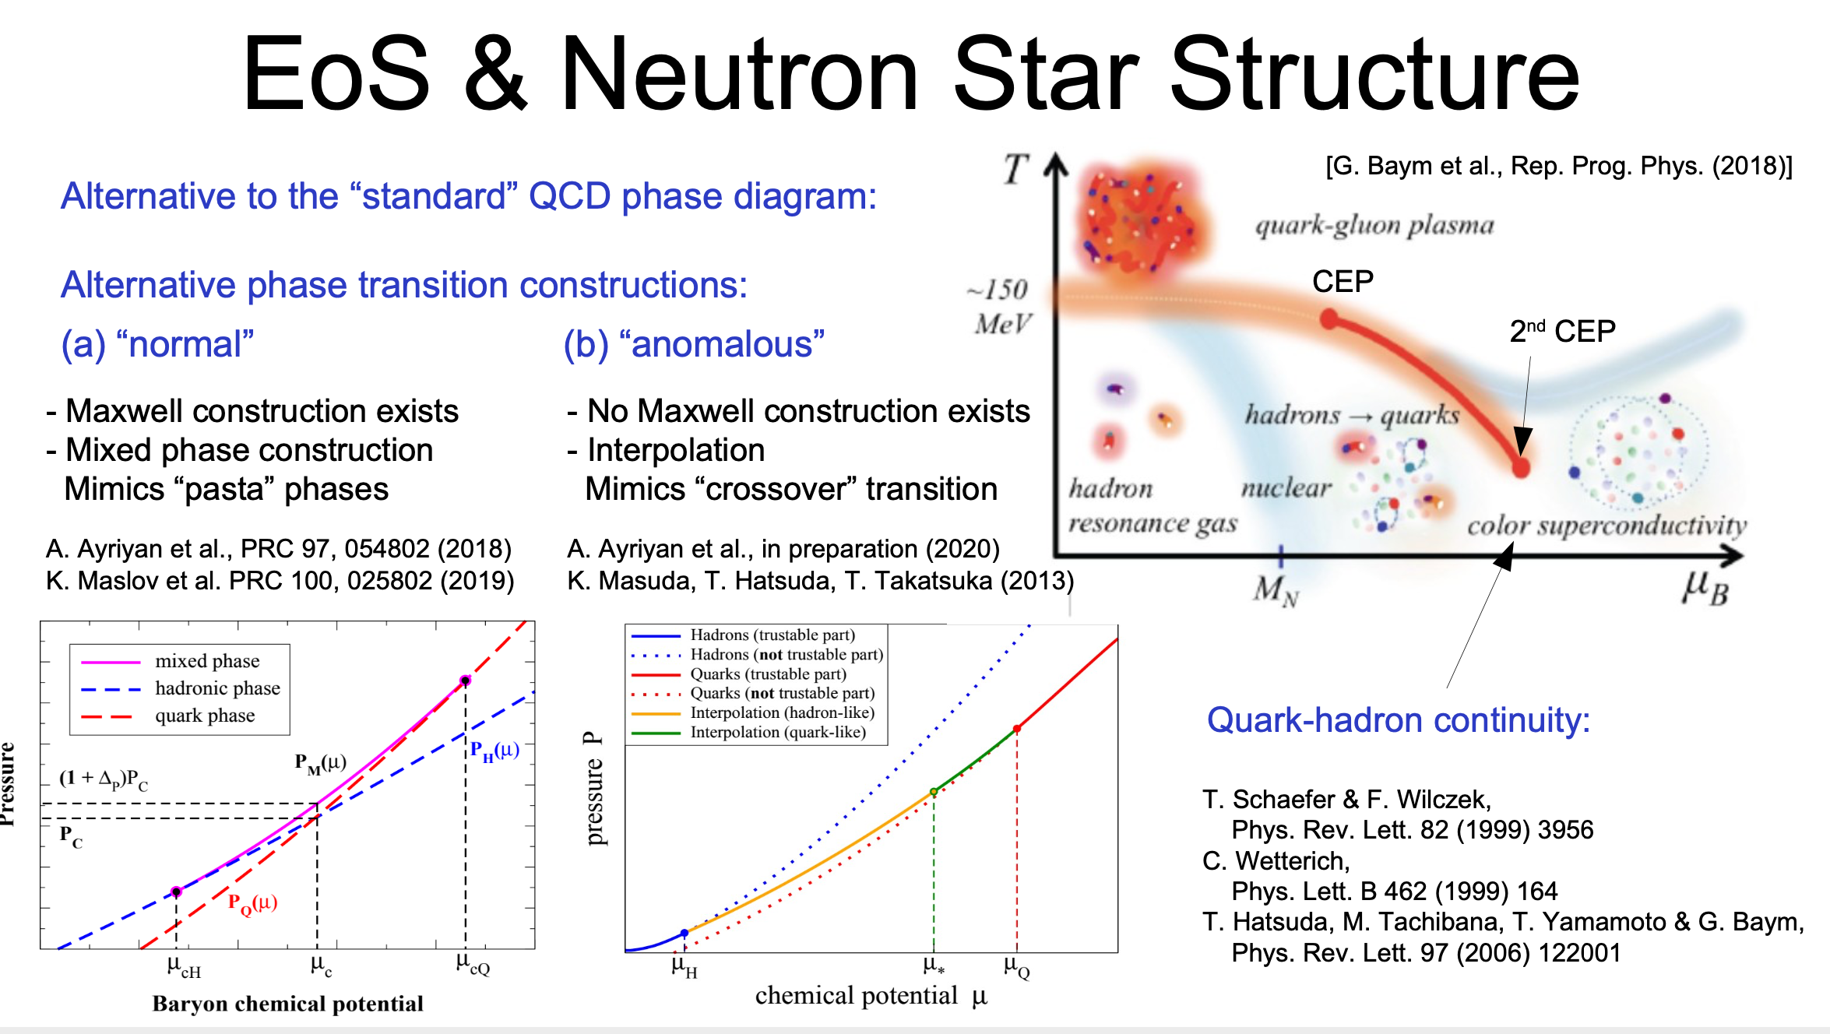

Slide 13
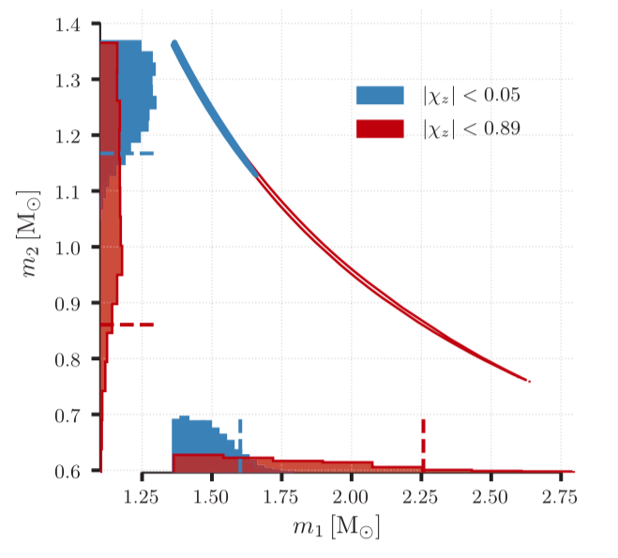
Implications from GW170817
GW170817: Observation of Gravitational Waves from a Binary Neutron Star Inspiral
B. P. Abbott et al. arXiv:1712.00451

Slide 14
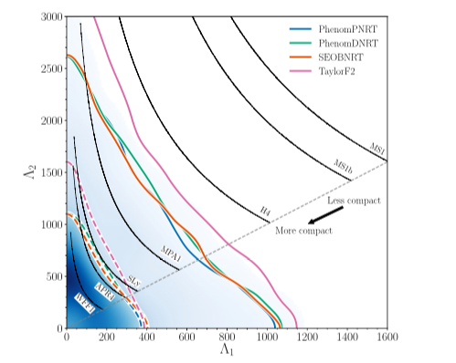
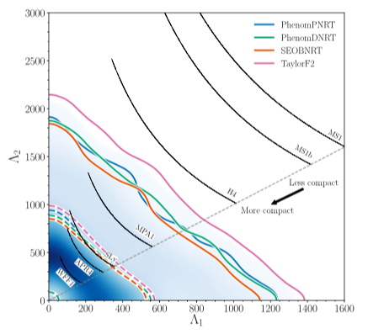
Implications from GW170817
Properties of the Binary Star Merger GW170817
B. P. Abbott et al., Phys. Rev. X 9, 011001 (2019)

Slide 15
Implications from GW170817
Vasileios Paschalidis, Kent Yagi, David Alvarez-Castillo,
David B. Blaschke, Armen Sedrakian
Phys. Rev. D 97, 084038 (2018), arXiv:1712.00451

Slide 16
Implications from GW170817
Vasileios Paschalidis, Kent Yagi, David Alvarez-Castillo,
David B. Blaschke, Armen Sedrakian
Phys. Rev. D 97, 084038 (2018), arXiv:1712.00451

Slide 17
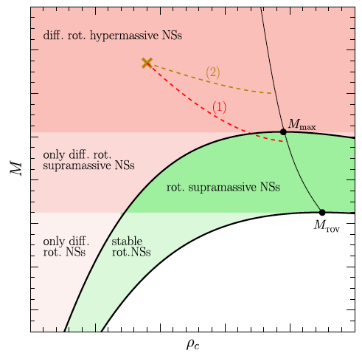
Upper limit on the Maximum mass of static compact stars?
17
Rezzolla et al., ApJ Lett 852 (2018) L25

Slide 18
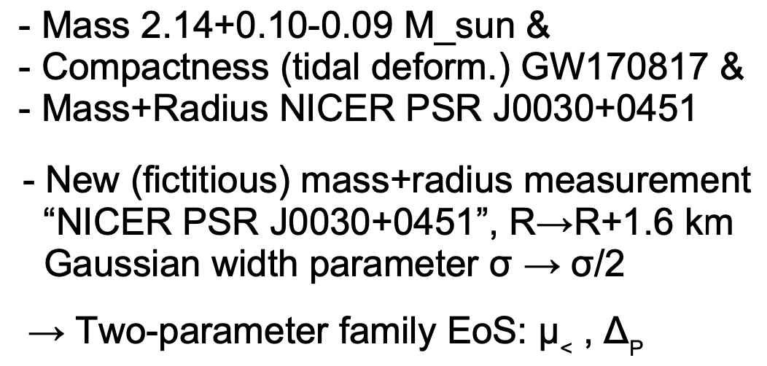
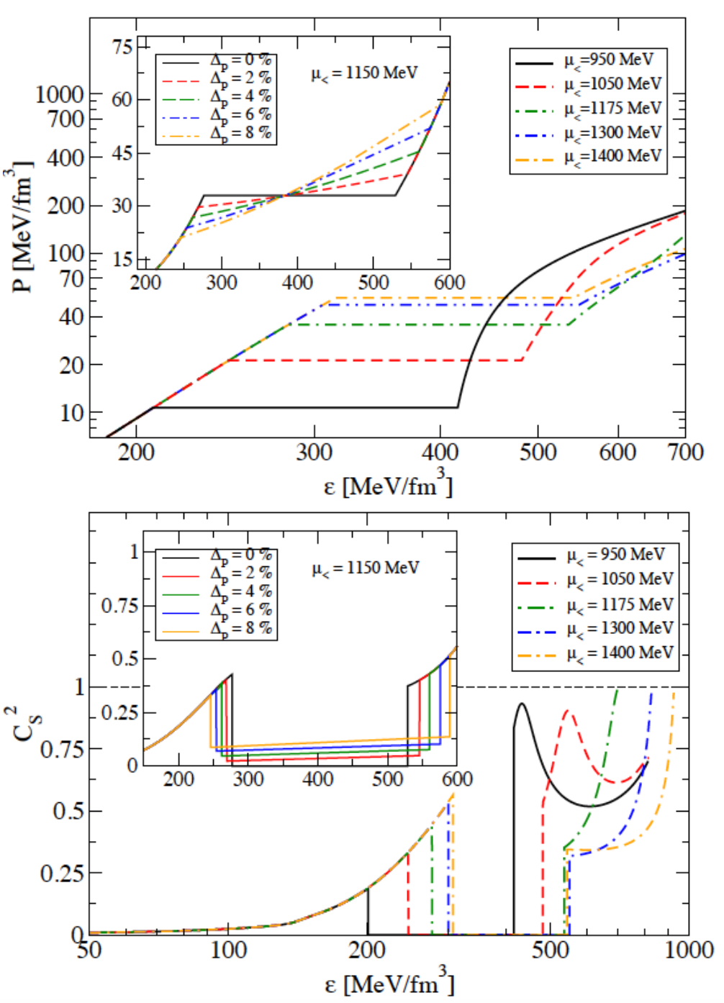
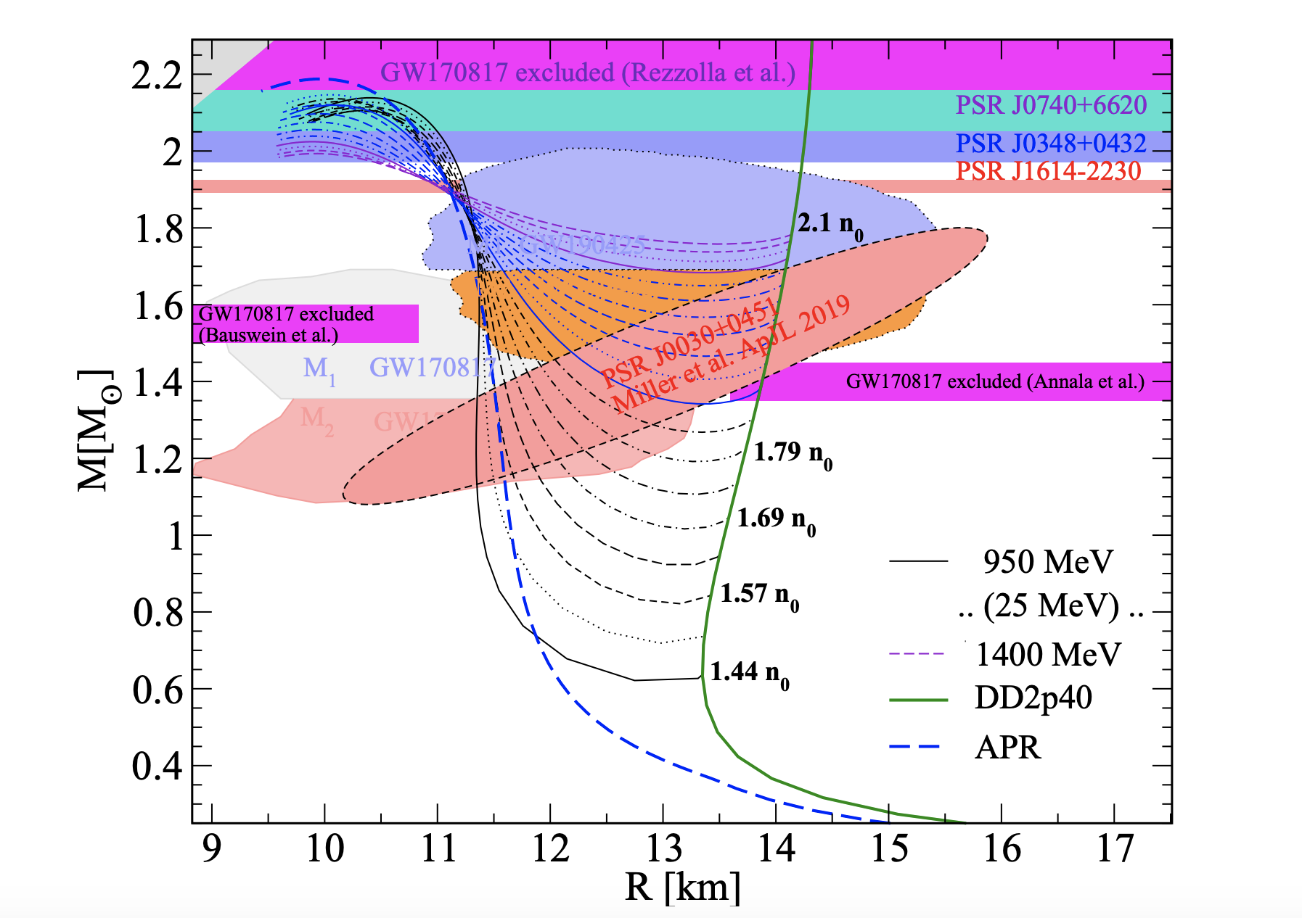
Was GW170817 a canonical neutron star merger?

Slide 19
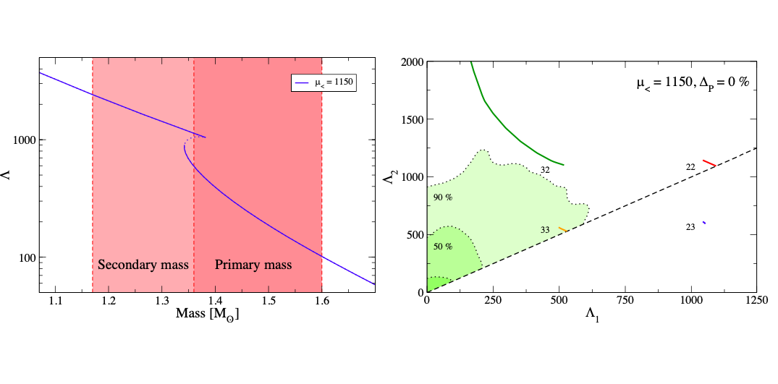
Was GW170817 a canonical neutron star merger?
A. Ayriyan, D.Alvarez-Castillo, D. Blaschke and H. Grigorian,
Universe 6, 81 (2020)
D. Alvarez-Castillo, D. Blaschke, G. Grunfeld, V. Pagura
Phys. Rev. D 99, 063010 (2019) - arXiv: 1805.04105

Slide 20
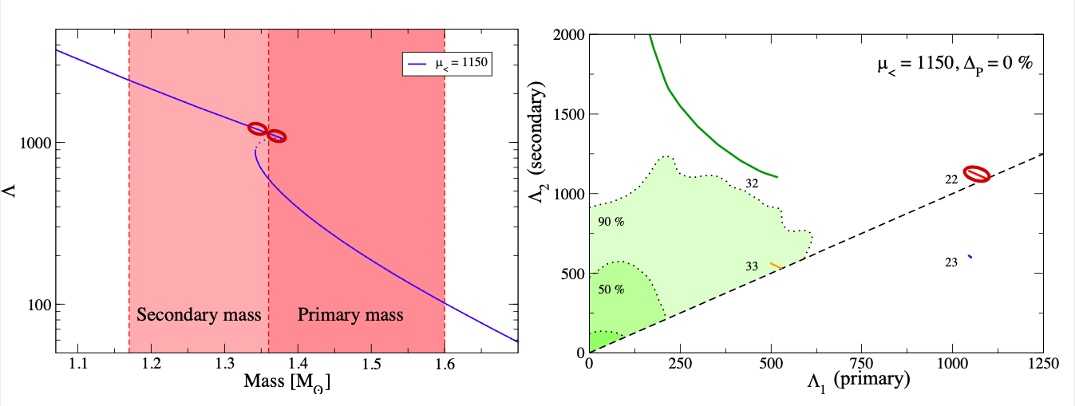
Was GW170817 a canonical neutron star merger?
A. Ayriyan, D.Alvarez-Castillo, D. Blaschke and H. Grigorian,
Universe 6, 81 (2020)
D. Alvarez-Castillo, D. Blaschke, G. Grunfeld, V. Pagura
Phys. Rev. D 99, 063010 (2019) - arXiv: 1805.04105

Slide 21
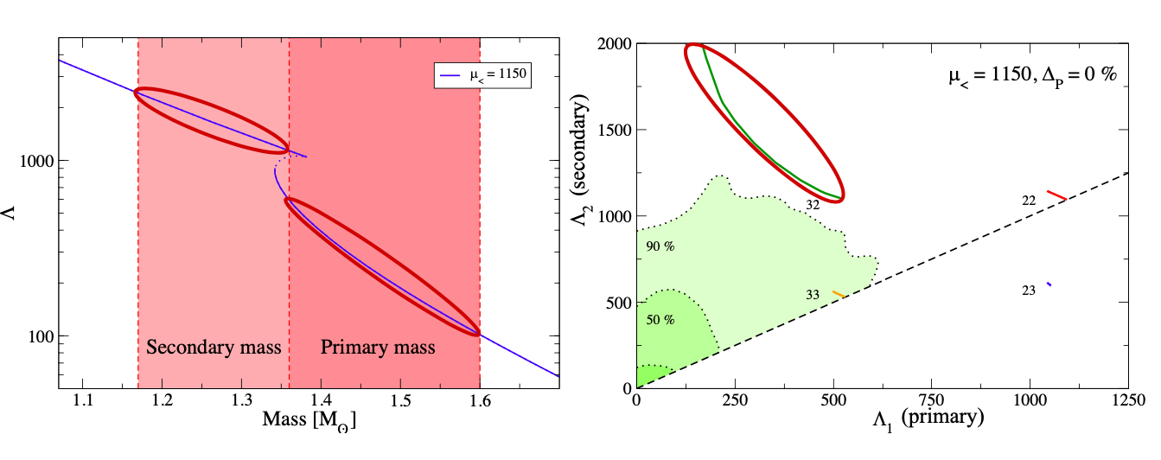
Was GW170817 a canonical neutron star merger?
A. Ayriyan, D.Alvarez-Castillo, D. Blaschke and H. Grigorian,
Universe 6, 81 (2020)
D. Alvarez-Castillo, D. Blaschke, G. Grunfeld, V. Pagura
Phys. Rev. D 99, 063010 (2019) - arXiv: 1805.04105

Slide 22
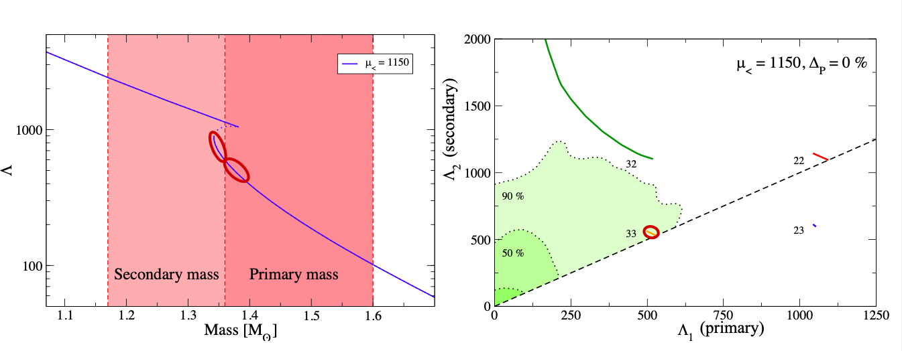
Was GW170817 a canonical neutron star merger?
A. Ayriyan, D.Alvarez-Castillo, D. Blaschke and H. Grigorian,
Universe 6, 81 (2020)
D. Alvarez-Castillo, D. Blaschke, G. Grunfeld, V. Pagura
Phys. Rev. D 99, 063010 (2019) - arXiv: 1805.04105

Slide 23
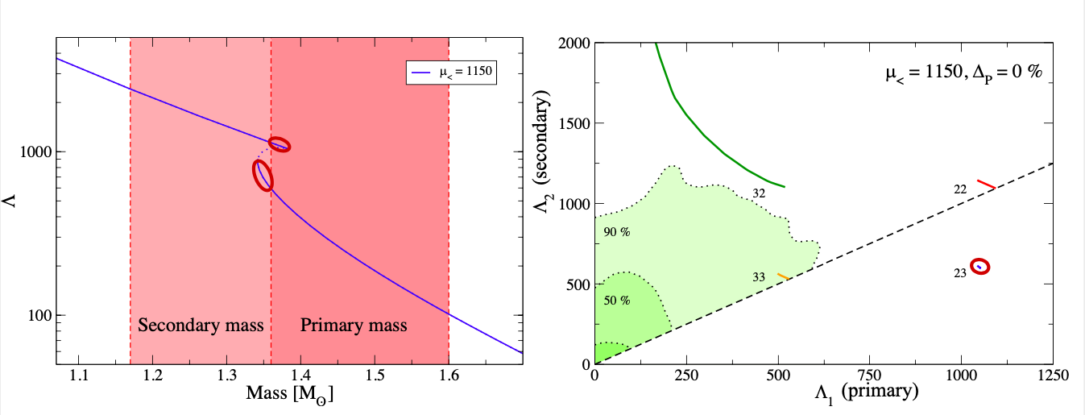
Was GW170817 a canonical neutron star merger?
A. Ayriyan, D.Alvarez-Castillo, D. Blaschke and H. Grigorian,
Universe 6, 81 (2020)
D. Alvarez-Castillo, D. Blaschke, G. Grunfeld, V. Pagura
Phys. Rev. D 99, 063010 (2019) - arXiv: 1805.04105

Slide 24
High vs Low Mass Twins

Slide 25
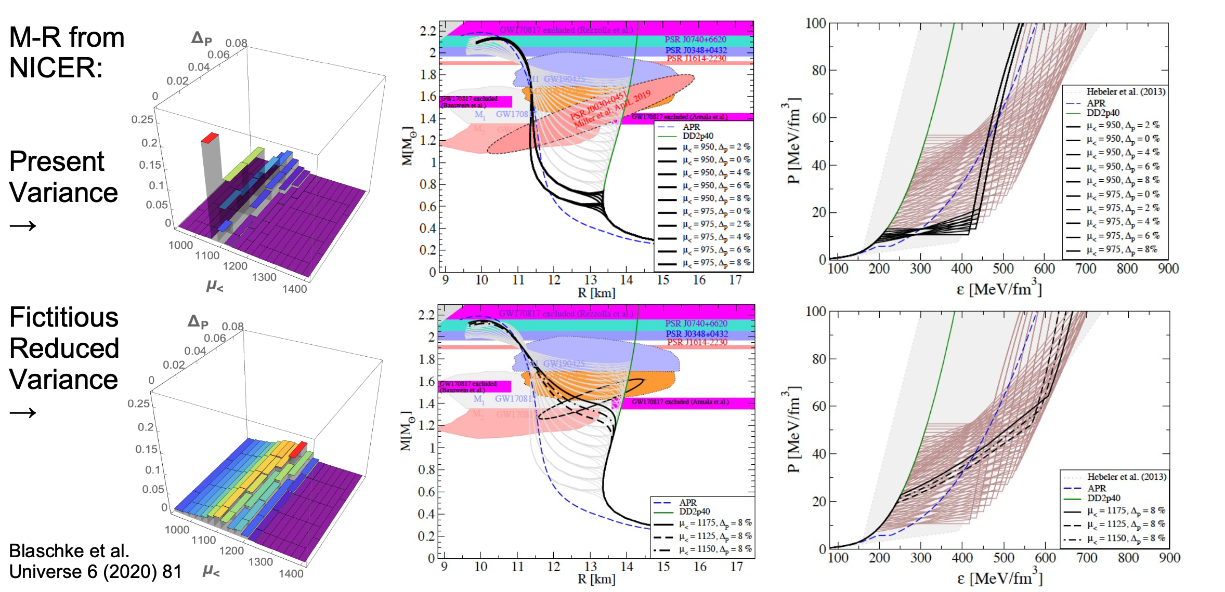
Bayesian inference for hybrid EoS Models

Slide 26
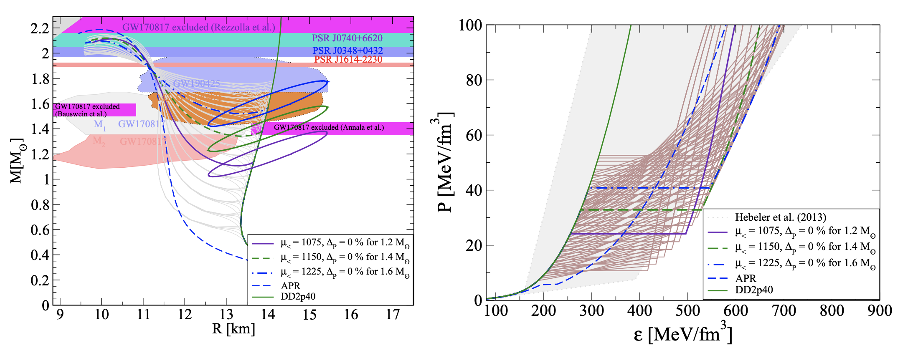
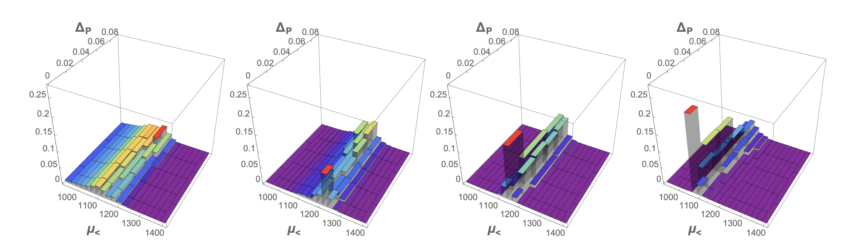
Fictitious Measurements

Slide 27
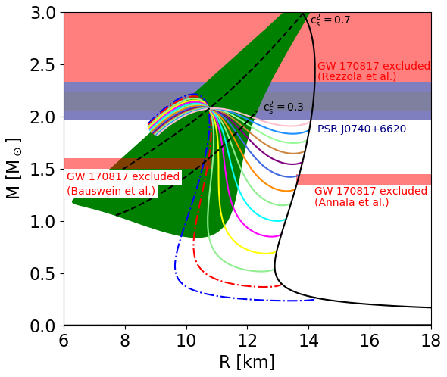
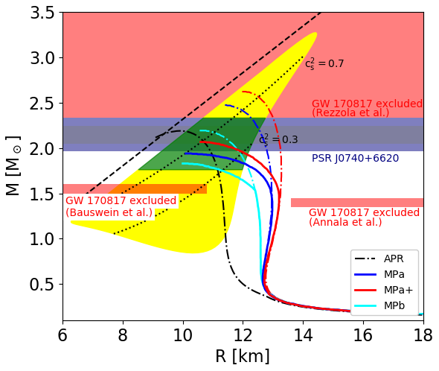
Hybrid star mass–radius diagram
Only hybrid star radius R_{2.0} can be less than 12 km!
Mateusz Cierniak, David Blaschke, arXiv:2009.12353
Yamamoto, Y., Togashi, H., Tamagawa, T., Furumoto, T., Yasutake, N., & Rijken, T. A. - Physical Review C, 96(6) (2017)

Slide 28
Conclusions
NICER radius measurement of massive PSR J0740+6620 of less than 12 km supports the existence of a quark matter core in neutron stars
Radius measurements of about 1.2 solar mass compact stars can probe the stiffness of nuclear matter around 1 to 2 times saturation density therefore probing the low mass twins hypothesis.
Bayesian analysis analysis favors low mass twins over high mass twins.
Detection of signals from dynamical scenarios like star transitional evolution from second to third family may serve as a smoking gun for mass twins.
The non-existence of compact star twins does not rule out the possibility of a CEP in the QCD phase diagram.
Gracias

Slide 29
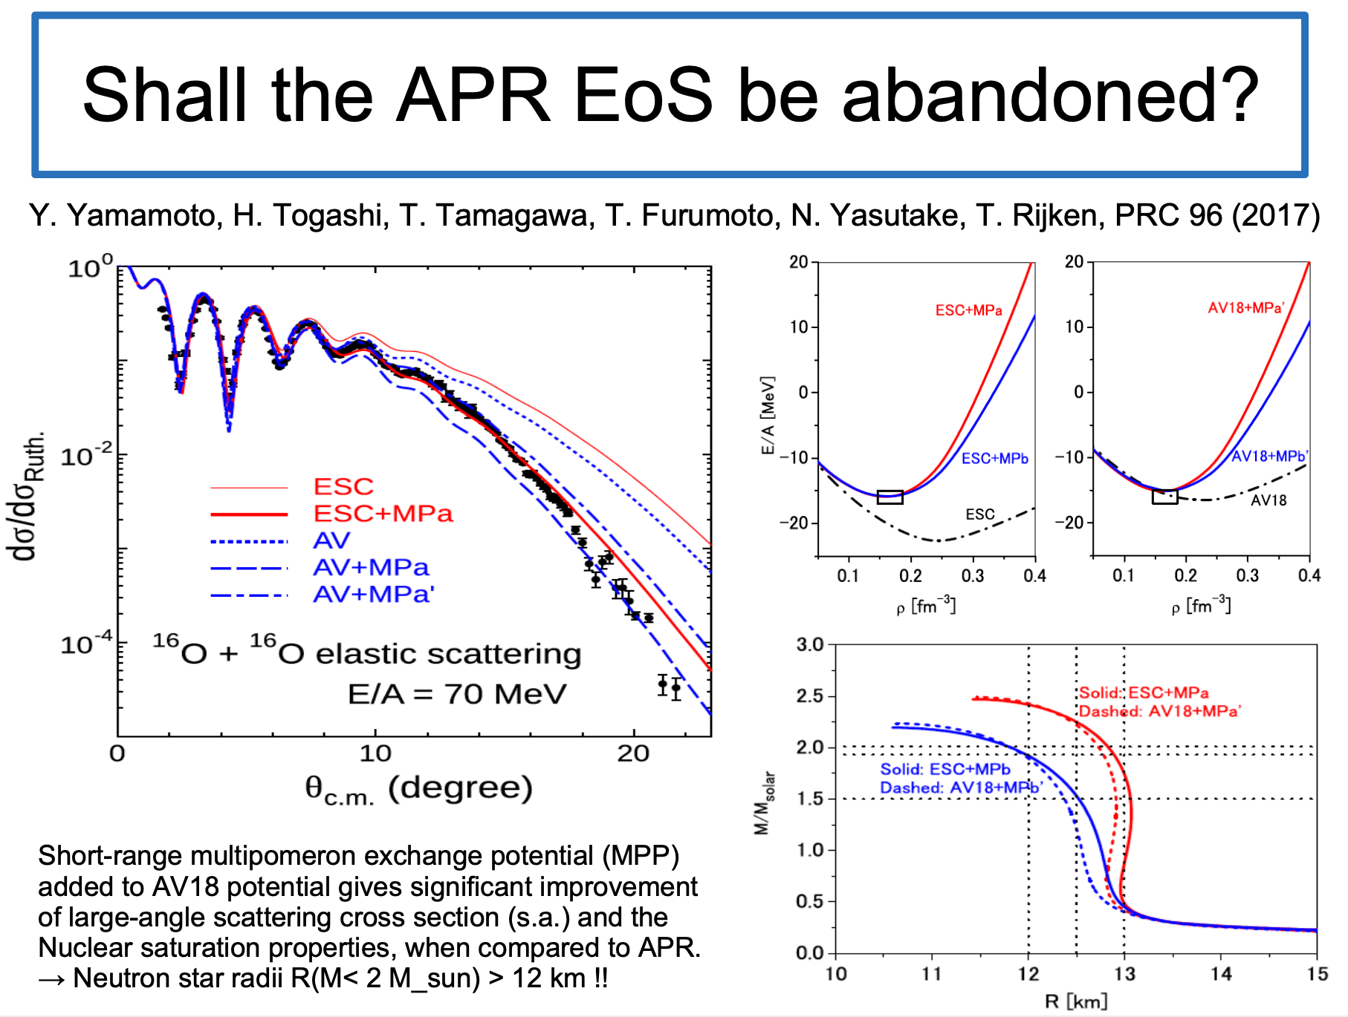

Slide 30
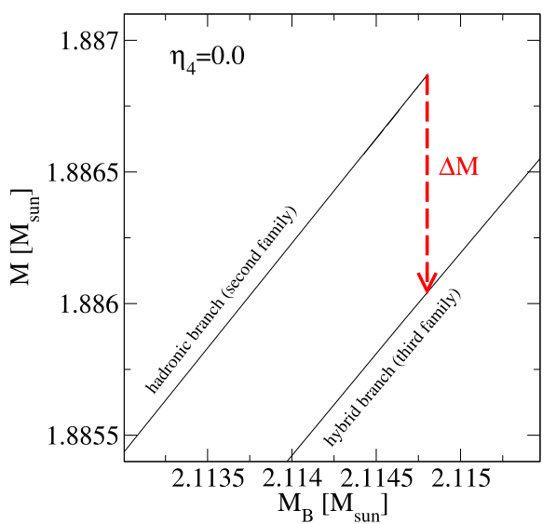
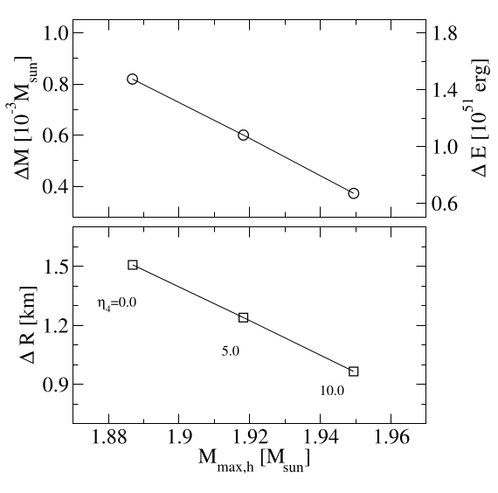
Energy bursts from deconfinement
Alvarez-Castillo, Bejger, Blaschke, Haensel, Zdunik (2015), arXiv:1401.5380

Slide 31
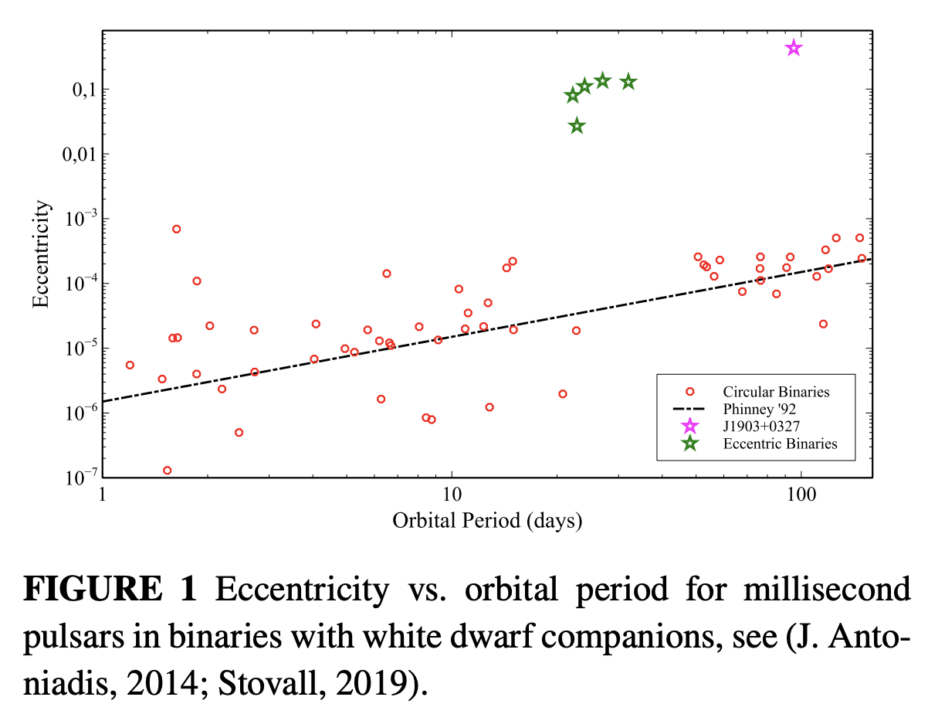
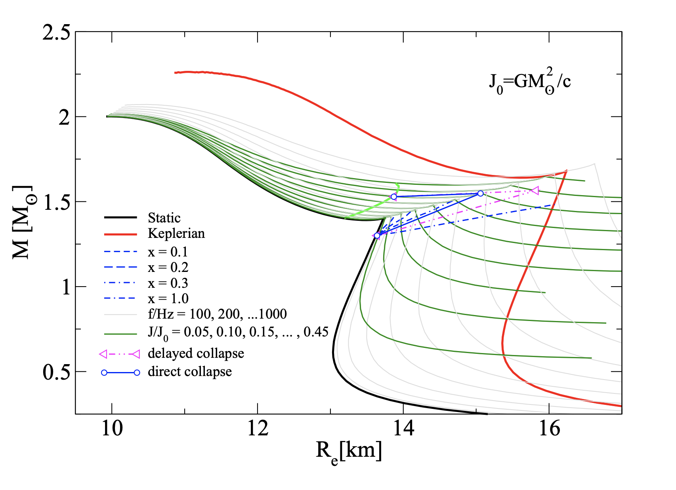
Accretion-induced collapse to third family compact stars as trigger for eccentric orbits of millisecond pulsars in binaries
David Edwin Alvarez-Castillo, John Antoniadis, Alexander Ayriyan, David Blaschke,
Victor Danchev, Hovik Grigorian, Noshad Khosravi Largani, Fridolin Weber.
Astron. Nachr. 2019;340:878-884. Eprint: arXiv: 1912.08782

